Slide 1
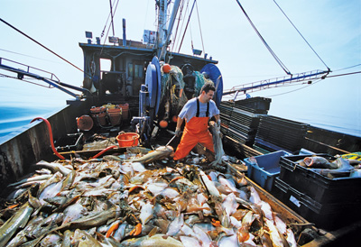
Scoring Rules for Fisheries Rules Violations
Fred S. Roberts
DIMACS and CCICADA
Rutgers University

Slide 2
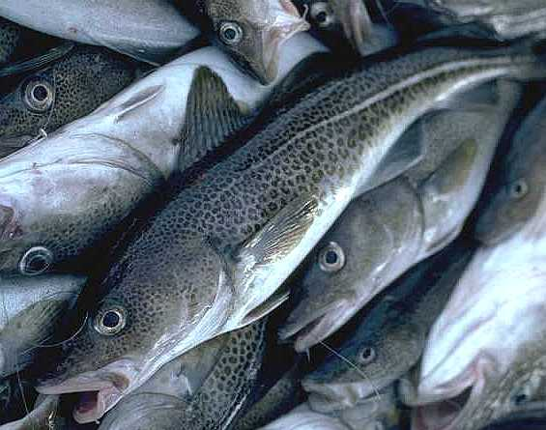
Fisheries Rules
The United States sets rules for fishing with the goal of maintaining healthy fish populations.
Rules depend on specific species and include
  Allowable locations to fish
  Allowable seasons to fish
  Catch quotas
Violations of the rules
leads to fines – sometimes quite large
Endangered Atlantic Cod

Slide 3

Enforcement of Fisheries Rules
Many agencies are involved in enforcing the fisheries rules and regulations.
One of those agencies is the US Coast Guard.
Through the Laboratory for Port Security at Rutgers and the CCICADA Center, we have been working with the Coast Guard to define and enhance scoring rules to lead to better enforcement of fisheries rules.

Slide 4


Enforcement of Fisheries Rules
This work has gotten me to some interesting places.

Slide 5
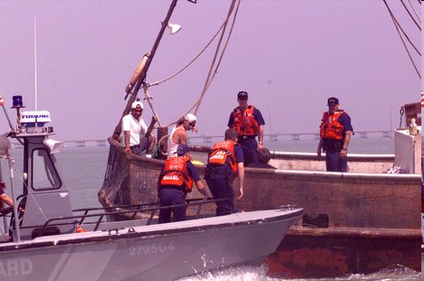
Fisheries Law Enforcement
The US Coast Guard uses a scoring system called OPTIDE to determine which commercial fishing vessels to board to look for violations.
They asked us if their success rate in finding violations by boarding could be improved by use of sophisticated methods of data analysis?
August 2012 5

Slide 6
Fisheries Law Enforcement
Examples of Scoring Rule Components
Points for current or past negative intelligence reports
Points depending upon date last boarded
Points based on information about the type of boat
Points for having found violations in past boardings – depending upon type of violations
Board if total score (number of points)
exceeds a threshold

Slide 7
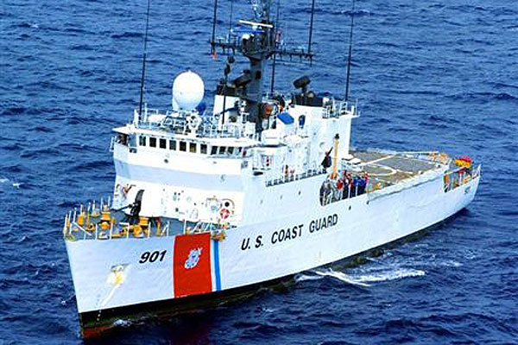
Many Goals of Fisheries Law Enforcement
While our project is concerned with increasing success rates from boarding, there are many other goals of fisheries law enforcement:
  Balanced deterrent
  Balanced policing
  Balanced maintenance of safe operations

Slide 8
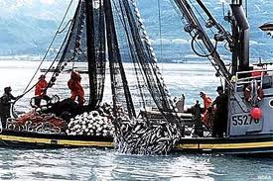
Many Goals of Fisheries Law Enforcement
The project started with the following definition of the goal: Find a decision rule for deciding whether or not to board that leads to as large a percentage of times as possible in which boarding leads to finding a violation.

Slide 9
Many Goals of Fisheries Law Enforcement
Complication: There are different types of violations:
  Fisheries violations
  Safety violations
  It’s hard to compare seriousness of a fishery violation vs. a safety violation
Complication: Some violations are more serious than others
  Categories of violations (e.g., simply severe or not severe)
  Ranking of violations (from least to most severe)

Slide 10
Many Goals of Fisheries Law Enforcement
This leads to need for metrics for scoring violations and a change of goal to maximize scores obtained when boarding.
Let V be the violation score obtained from a boarding.
So far, we have been letting V = 0 or 1, depending on whether or not a violation is found.
Alternatives:
  V = number of violations found
  V = weighted sum Σ w_{i}x_{i} where x_{i} =1 if the i^{th} violation is found and 0 otherwise, and w_{i} is some weighting factor

Slide 11
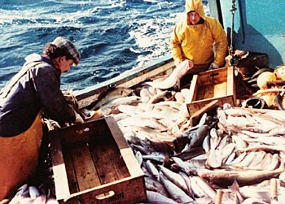
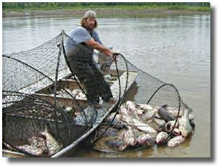
Project Challenges
Complex Domain
  Fishery regulations, quotas, migration patterns, weather, regional variations, close-to-shore/offshore, etc.
  Complex human behavior influenced by economic, environmental and human factors
  Game-theoretic aspects: deterrent, adversarial behavior
Notes:
New bullet that emphasizes visualization of large graphs

Slide 12
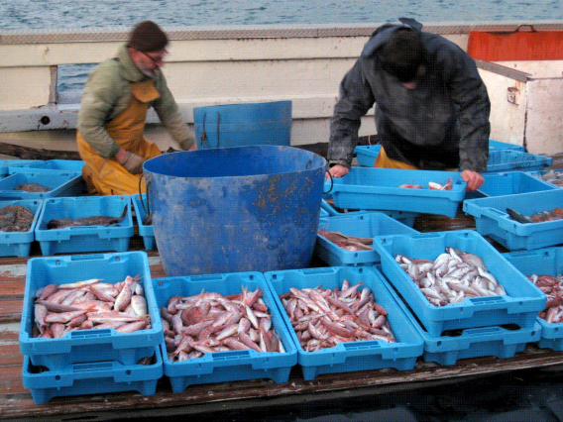
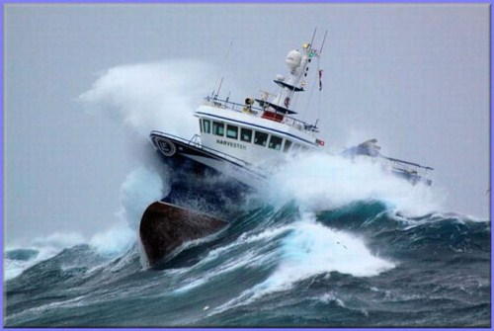
A Variety of Relevant Features
In addition to working with Coast Guard features, we are looking at introducing other features, such as:
  Weather
  Seasonality
  Fish migration
  Key fish species
  Home port
  Detailed vessel history
Economic data (e.g., fish prices)
Socioeconomic factors (such as type of family boat vs. large commercial fishing boat, or attitudes toward law enforcement)

Slide 13
Looking at Data
Data is Challenging
Sample Challenge: Fish Price
Premise: When fish price is high, there will be more violations
Fish price data available from NOAA
(National Oceanic & Atmospheric Admin)
Challenges we have encountered:
  Data comes in text form
  Data doesn't have a standard format.
  The names, the order of fish types and presentation of price are irregular, change from one text file to another.

Slide 14
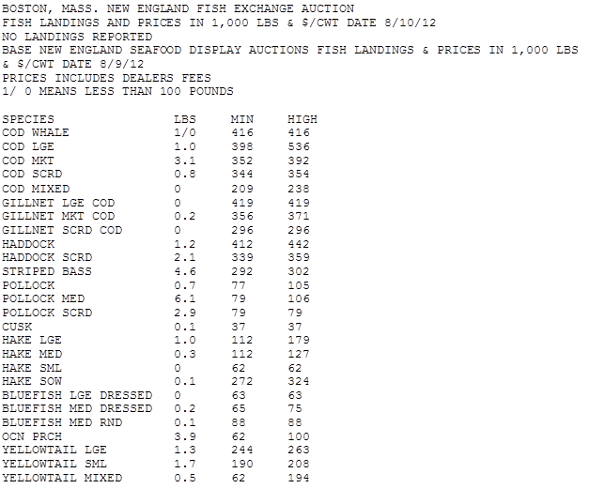
Sample NOAA Fish Price Data

Slide 15
Automatically Learning
Violation Prediction Rules
Approach due to Hans Chalupsky
USC Information Sciences Institute

Slide 16

Machine Learning
Looking at machine learning methods to see if other features, or combination of present features and new ones, can lead to decision rules that obtain higher success rate from boardings
Looking at simple situations to test different decision rules, e.g., simplified situations where we have to choose one of two boats to board or one of N boats to board
Looking at ways to determine “optimal boarding rule” given data
August 2012 16

Slide 17
Goal
Build a predictive model that given a ship’s current features and history predicts the likelihood of a violation
  Outperform current Coast Guard rule’s predictive power
  Demonstrate model’s applicability to increase Coast Guard’s boarding efficiency

Slide 18
Our Basic Approach
Deploy automated ‘classification engine’ that mimics humans’ decisions, given the input information (called ‘features’)
  Example: If I see [A, B, D] then choose X₁, else if I see [C, D, J] then choose X₂, etc.
  Our tasks:
    1. Modeling the features (converting data into computer-readable format)
    2. Modeling the ‘output’ choices: what the system should tell the user
    3. Giving the computer a set of existing examples so it can learn its rules automatically
    4. Measuring how well the learned rules
    work

Slide 19
Classifier-based Violation Prediction
Learned automated decision tree classifier to try to improve “board”/“don’t-board” decisions
  Predict probability of any violation found based on history
    Currently no differentiation between safety and fishery
  We only use 6 features at the moment:
    Some of the current Coast Guard features
    Number of prior boardings
    Boarding quarter
    Last boarding had violation

Slide 20
Evaluation
Method 1:
  Use classifier to classify boardings and measure accuracy
  Problem: very unbalanced data, always saying DONT-BOARD wins
Method 2 (better): Need to make some boardings
  Make resource decisions using classifier input
  Given a “bucket” of N potential boarding targets, decide which one to board using one of the following strategies:
    Strategy 1: pick randomly from the bucket
    Strategy 2: use partial current Coast Guard score to pick
    Strategy 3: use learned rules (pick boat whose classification rule gives highest probability for a violation)
  Run this many times and measure how often
  we “win”

Slide 21
Boarding Efficiency Results
Results from averaging 10-fold cross validation
80%/20% training/test data splits
Combination of Rules and Current Rule
Rules
Efficiency
Current Rule
Random
Bucket Size

Slide 22
Next Steps
Connect additional data
  Fish prices, weather, “quota reset days”, etc.
Improve prediction models
  Better individualized violation behavior models
  Link additional data sources to improve prediction

Slide 23
Regression Methods
Thanks to Minge Xie
Rutgers, CCICADA

Slide 24
Regression Models
Looking at regression models to derive alternative weights for different features
Developing decision rules based on derived weights
Testing those decision rules on rest of the data

Slide 25
The Problem
Data Available
  Whether violations found on ships boarded
  Features that the ‘decision to board’ is based on
Objective
  Help improve inspection efficiency by suggesting a new decision rule that would help identify potential candidates for boarding
    A simulation study based on the boarding data is performed to demonstrate the effectiveness of the proposed new rule.

Slide 26
Existing Approach
Underlying assumption:
  A violation is related to an underlying score S which is a weighted sum of some predictor variables
Yes, if S ≥ d
Boarding: B = where d = threshold No, if S < d

Slide 27
Statistical Latent Model
The same assumption that violation is related to an underlying score S, plus a potential error term, leads us directly to a statistical model: a logistic regression model.
This LR model directly studies the probability of having a violation
Yes, if S ≥ d
Violation: V =
No, if S < d

Slide 28
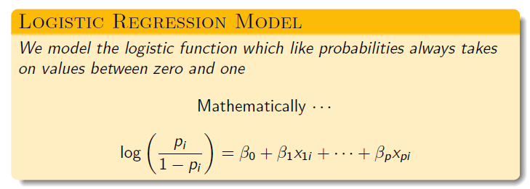
Logistic Regression Model
We use the data set available to us to determine (estimate) the coefficients. This in turn helps us pick a set of new weights that will be used to create a new decision rule

Slide 29
New Decision Rule
New score is a weighted sum of the same set of predictor variables, but with a new set of weights determined by our data analysis using the logistic regression model.
Then,
Yes, if S_{new} ≥ d_{new}
Boarding: = where d_{new} = threshold No, if S_{new} < d_{new}

Slide 30
New Decision Rule
The new decision rule we have derived uses the same features as the current Coast Guard rule, but just gives different scores to the features.
These scores are derived by our regression methods.
Remark: The set of points listed for the new decision rule is just an example. There is still room to improve and fine tune.

Slide 31
A Simulation Study
We randomly split the boarding data set available to us into two subsets:
  70% used for training
  30% used for validating
Fit a LR model to the 70% data; Then, based on the data analysis results, we come up with a set of new weights and a new decision rule.
We apply the new rule to the remaining 30% of data and see how effective we are.

Slide 32
Result : The New Rule Works Better than Coast Guard OPTIDE
Efficiency
New rule
OPTIDE
Random
Result with a selected threshold; results with
other thresholds are similar.

Slide 33
Result : Contd.
Current CG Rule
Logistic
No Boarding
Boarding : No Violation
Boarding : Violation
Note: Logistic has much higher success rate, but leads
to fewer boardings and finds fewer total violations

Slide 34
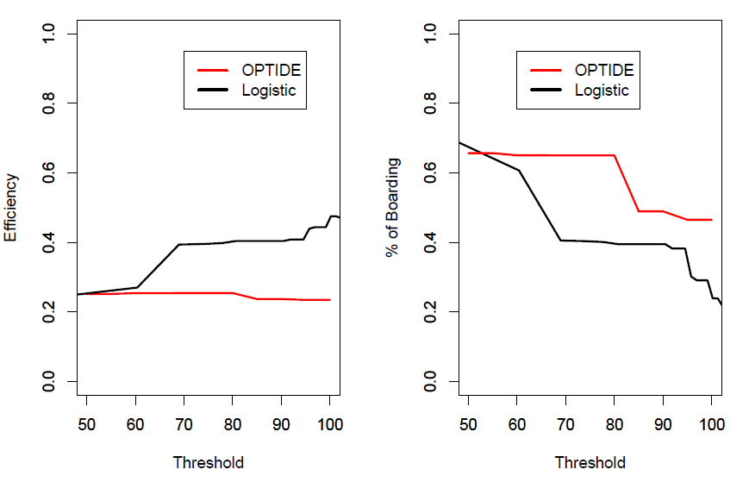
Result : Threshold vs. Efficiency & Percentage of Boarding
On left the plot shows the efficiency increasing as we increase threshold. On right percentage of boarding against threshold (score) is plotted.

Slide 35
Result: Threshold vs. Efficiency & Percentage of Boarding
*Current CG rule efficiency does not go up with higher point score, while Logistic was designed to do so.
*For Logistic, fewer boardings means higher efficiency, which raises the question of whether the decision rule should also take into account number of boardings or just efficiency

Slide 36
Beyond the Predictive Model
Thanks to Robert DeMarco
CCICADA Center

Slide 37
Beyond the Predictive Model
The optimal strategy is not necessarily to board the boat
with the highest predicted probability of being in
violation. Here are three reasons why:
A desire to check on every boat in the fishery at least once a year
Consideration of the time it will take to board
Search/wait and improve?

Slide 38
Beyond the Predictive Model
The optimal strategy is not necessarily to board the boat
with the highest predicted probability of being in
violation. Here are three reasons why:
A desire to check on every boat in the fishery at least once a year
Consideration of the time it will take to board
Search/wait and improve?

Slide 39
Checking all Boats
In order to check all boats at least once a year, at times the Coast Guard must choose to board a boat predicted to have a small chance of being in violation.
When is a good time to perform such boardings?
Are there more general concerns about the number of prior boardings? For example, consider:
 | Probability of Violation | Boardings in Past Year
Boat A | 13% | 2
Boat B | 15% | 6

Slide 40
Proposed Model
Input boarding strategy (e.g. Board Boat A or Boat B)
Run simulation
Output number of violations found and the boarding distribution
Can be used to develop a strategy which best balances the tradeoff between maximizing the number of violations found and boarding distribution concerns.
To best develop the model, one needs data on observed boats in a fishery at different times.

Slide 41
Beyond the Predictive Model
The optimal strategy is not necessarily to board the boat
with the highest predicted probability of being in
violation. Here are three reasons why:
A desire to check on every boat in the fishery at least once a year
Consideration of the time it will take to board
Search/wait and improve?

Slide 42
Alternative Efficiency Measures
Consider the following hypothetical:
If we measure efficiency as violations per boarding (VPB), then the efficiency of boarding Boat A is .12 VPB, and the efficiency of boarding Boat B is .15 VPB. Prefer Boat B.
If we measure efficiency as violations per hour (VPH), then efficiency of boarding Boat A is .12/4=.03 VPH, & efficiency of boarding Boat B is .15/6=.025 VPH. Prefer Boat A.
It should be noted that the best we may be able to do is predict approximate boarding time; there is no way to know it for certain. This further complicates decision-making.
 | Probability of Violation | Predicted Time Boarding will Take
Boat A | 12% | 4 hours
Boat B | 15% | 6 hours

Slide 43
Beyond the Predictive Model
The optimal strategy is not necessarily to board the boat
with the highest predicted probability of being in
violation. Here are three reasons why:
A desire to check on every boat in the fishery at least once a year
Consideration of the time it will take to board
Search/wait and improve?

Slide 44
Will “Better” Ships Appear?
Let us consider a hypothetical:
Of course in the real world there is no way to KNOW Boat B will appear in an hour (although it’s conceivable we know where Boat B is, but it is an hour away). The best we might be able to do is predict the probability a Boat like Boat B will appear.
Back to the hypothetical: If we simply want to maximize the probability of finding a violation, and only have time to board one boat a day, and if waiting one hour is acceptable, then it would be best to bypass boat
A and board boat B in an hour.
 | Probability of Violation | Time Until we can Board
Boat A | 10% | 0
Boat B | 15% | 1 hour

Slide 45
Will “Better” Ships Appear? (2)
Let us continue to consider the hypothetical:
Let us consider violations per hour (VPH) as the criterion when deciding which boat to board.
1 hour to board. Boat A: .1/1=.1 VPH. Boat B: .15/2 =
. 075 VPH. Prefer Boat A.
4 hours to board. Boat A: .1/4=.025 VPH. Boat B: .15/5=.03 VPH. Prefer Boat B.
At times the best strategy may be to search or wait for “better” ships, meaning ships our model judges more likely to be in violation.
 | Probability of Violation | Time Until it Appears
Boat A | 10% | 0
Boat B | 15% | 1 hour

Slide 46
Comments on Going Beyond the Predictive Model
There are challenging questions to be answered in order to determine how to best use a predictive model.
To answer these questions we need data on the following, which may be missing or “noisy” or subject to large range of uncertainty
Data on boarding times, and an understanding of the uncertainty in predicting boarding time
Data on all observed boats (Boat ID, time, location)
(Preferably) Assessment of the uncertainty of the location of a boat today as well as an assessment of the uncertainty of the future movement of a boat once its current location has been determined.
(Alternatively) Data or projections on the number of boats that might be observed relative to different amounts of patrol time.

Slide 47
Other Directions
Look at different kinds of strategies
  Random vs. deterministic
    Weighted sum approaches are deterministic
    But maybe a randomization rule, e.g., 30% of time use Goal 1, 40% of time Goal 2, 30% of time Goal 3
  E.g., changing number of boats used in searching for violations depending upon factors such as weather, season, economic factors, etc.

Slide 48
Other Directions
Examine pattern of violation in the set of vessels that were boarded more than once within a very short amount of time (e.g., three days)
Connect additional data such as fish prices, weather, “quota reset days,” and others
Improve prediction models by using better individualized violation behavior models & additional data sources to improve prediction
Updated data set to include additional features, including:
  Fishery/fisheries for which each vessel is permitted
  Location of boarding
  Amount of time per boarding

Slide 49
Making Use of Analogies from Ecology
Modified from a paper by F.S. Roberts and H. Marcus-Roberts (1976)

Slide 50

Efficiency of Energy Use in Obtaining Food
Body of literature: Animals are very efficient users of energy in obtaining food.
Animals may evolve so as to be efficient in use of energy in foraging
Animals may develop feeding preferences that maximize their caloric intake per unit time.
Variety of models to capture these ideas might be relevant to the Coast Guard’s problem

Slide 51
Efficiency of Energy Use in Obtaining Food
One model: Predators seek to optimize amount of energy obtained per unit of energy expended.
If E_{O} is energy “output” and E_{I} is energy “input”, they may seek to maximize
E_{O}/E_{I}
This is sometimes called the energetic efficiency.
This model omits the role of time.
It may take too much time to be efficient in this sense.

Slide 52
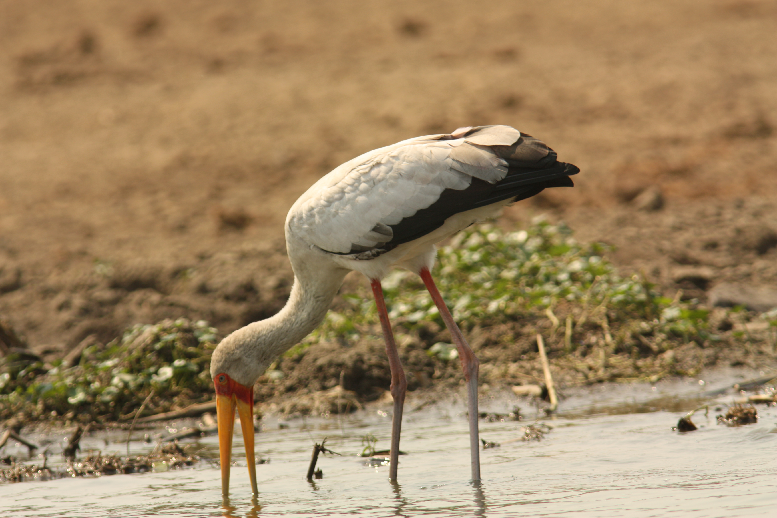
Efficiency of Energy Use in Obtaining Food
Alternative model: Let T = time to obtain E_{O}. Maximize
(E_{O}-E_{I})/T
This is the time-energy efficiency.

Slide 53

Efficiency of Energy Use in Obtaining Food
If eat a small food item, E_{I} might be small and so energetic efficiency might be high. But this omits consideration of energy requirements E_{R}.
E_{R} is total amount of energy E_{O} required over a period of time.
Thus, we might look to maximize the relative energetic efficiency:
(E_{O}/E_{R})
____________________
E_{I}

Slide 54
Efficiency of Energy Use in Obtaining Food
Or we might look to maximize the relative time-energy efficiency:
(E_{O}-E_{I})/E_{R}
_______________________________
T
Here, E_{R} has a different meaning than before: It is the amount of net energy E_{O}-E_{I} required over a period of time.

Slide 55
Efficiency of Energy Use in Obtaining Food
In the Coast Guard problem:
  E_{O} is some violation score obtained from boarding
  E_{I} is some measure of time spent boarding or searching for a vessel to board
  E_{R} might not make sense in the Coast Guard setting. However, it is conceivable that it could mean some sort of minimum score of violations found that is acceptable over the course of a period of time like a day.

Slide 56
Efficiency of Energy Use in Obtaining Food
As an aside that might not be relevant to the Coast Guard problem: How is E_{R} calculated for animals?
This depends on the metabolic rate MR, rate of heat production per unit time.
Energy requirement (for resting) during a given length of time T corresponds to MR x T
MR in turn is a function of body weight.
A well-known result derives the formula
MR = αW^{2/3}
This in turn follows from the “allometric law”

Slide 57
Efficiency of Energy Use in Obtaining Food
Allometric Law
Allometry is study of comparative growth rates of different biological quantities.
Example: growth rates of head and of hands
Much biological data suggests that relative growth rates of different biological quantities are proportional.
Thus
(1/y)(dy/dt) = ϒ(1/x)(dx/dt)
dy/dx = ϒ(y/x)
y = e^{k}x^{ϒ}
y = Kx^{ϒ}
The latter equation is the allometric law.

Slide 58
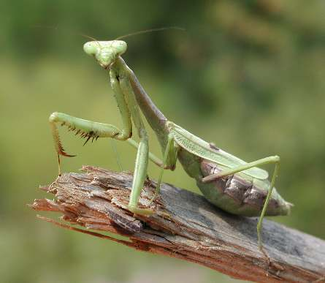
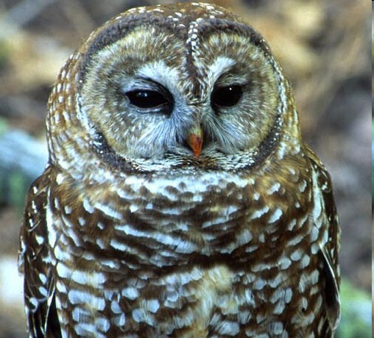
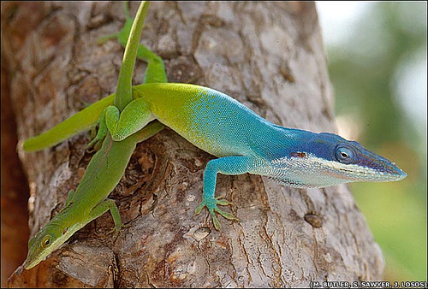
Pure Pursuers & Pure Searchers
Assume that we have a solitary predator (no competing species). (Only one Coast Guard boat.)
Two types: pure pursuers and pure searchers.
Pure pursuers expend little or no energy in moving about in search of food; they wait until food is sighted and then pursue their prey.
Examples: anolis lizards, kingfishers, many frogs, certain preying mantises, ambush bugs, certain predatory cats, certain owls.

Slide 59
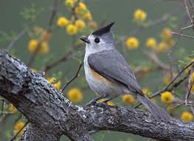

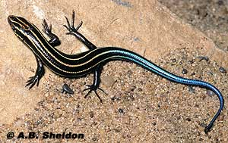
Pure Pursuers & Pure Searchers
Pure searchers: Spend a great deal of time and energy searching for food, but when food is sighted, very little time on pursuit.
Examples: warblers, kinglets, titmice, some lizards, many skinks

Slide 60
Pure Pursuers
Suppose a pure pursuer has in front of it an array of food items of different kinds.
i = body size of a food item, r = distance away from the pursuer.
Thus, food items can be described by pairs (i,r)
E(i) = energy obtained by eating a food item of size i
EP(r) = energy expended in pursuit and capture of a food item at distance r. (We assume the same amount of energy in pursuit and capture independent of size i)
E_{R} = energy requirements (say in a day)

Slide 61
Pure Pursuers
Maximizing energetic efficiency means maximizing
E(i)/EP(r)
Maximizing time-energy efficiency means maximizing
[E(i)-EP(r)]/T
Maximizing the relative energetic efficiency means maximizing
[E(i)/E_{R}]/EP(r)
Maximizing the relative time-energy efficiency means maximizing
{[E(i)-EP(r)]/E_{R}}/T

Slide 62
Pure Pursuers
In the Coast Guard problem:
  i could be the equivalent of the Optide score or some other score.
  E(i) could be some expected violation score V(i) based on violations found, e.g.,: violation = yes or no; number of violations, weighted sum of violations where weighting is by severity, etc.
  Challenge: how to calculate E(i)
  EP(r) could simply be time to move a distance r and T could be EP(r) + time required to board (which we assume is independent of i, though can change that).
  E_{R} could mean some sort of minimum score of violations found that is acceptable over
  the course of a period of time like a day.

Slide 63
Pure Pursuers
We assume a pure pursuer chooses one remaining food item (i,r) at a time and calculates relative energy output
[E(i)/E_{R}]
Summing outputs and summing energy expended over items chosen gives a variant of the knapsack problem of Operations Research
We want to choose a set S of the food items so as to solve the following problem:
Maximize Σ_{S}[E(i)/E_{R}]/Σ_{S}EP(r)
Subject to Σ_{S}E(i) ≥ E_{R}
It is well known, for example, that a greedy algorithm for solving this problem sometimes gives an optimal solution and sometimes doesn’t.

Slide 64
Pure Pursuers
We want to choose a set S of the food items so as to solve the following problem:
Maximize Σ_{S}[E(i)/E_{R}]/Σ_{S}EP(r)
Subject to Σ_{S}E(i) ≥ E_{R}
The greedy algorithm says to always pick as the next food item one that maximizes [E(i)/E_{R}]/EP(r) until just equally reaching or exceeding E_{R} with Σ_{S}E(i)
To implement this procedure in practice, a predator might establish a threshold and only eat items (i,r) if [E(i)/E_{R}]/EP(r) exceeds the threshold.
Some ecologists argue that predators are “programmed” to use this procedure.
They also argue that hunger functions to
change the threshold.

Slide 65
Pure Pursuers
The greedy algorithm says to always pick as the next food item one that maximizes [E(i)/E_{R}]/EP(r) until just equally reaching or exceeding E_{R} with Σ_{S}E(i)
This does not necessarily reach the optimal solution.
E(i) and EP(r) calculated using some ecological formulas derived from allometric laws.
Food item (i,r) | E(i) | EP(r) | [E(i)/E_{R}]/EP(r) if E_{R} = 760
(12,2) | 750 | .132 | 7.6
(11,3) | 250 | .066 | 5.1
(10,4) | 10 | .013 | 1.0

Slide 66
Pure Pursuers
The greedy algorithm says to always pick as the next food item one that maximizes [E(i)/E_{R}]/EP(r) until just equally reaching or exceeding E_{R} with Σ_{S}E(i)
This does not necessarily reach the optimal solution.
Greedy: Choose item (12,2) and then item (11,3).
A better choice is (12,2) and (10,4)
Food item (i,r) | E(i) | EP(r) | [E(i)/E_{R}]/EP(r) if E_{R} = 760
(12,2) | 750 | .132 | 7.6
(11,3) | 250 | .066 | 5.1
(10,4) | 10 | .013 | 1.0

Slide 67
Pure Pursuers
Choose item (12,2) and then item (11,3)
Σ_{S}[E(i)/E_{R}]/Σ_{S}EP(r) = [750/760+250/760]/[.132+.066] = 6.6
A better choice is (12,2) and (10,4)
Σ_{S}[E(i)/E_{R}]/Σ_{S}EP(r) = [750/760+10/760]/[.132+.013] = 6.9
Food item (i,r) | E(i) | EP(r) | [E(i)/E_{R}]/EP(r) if E_{R} = 760
(12,2) | 750 | .132 | 7.6
(11,3) | 250 | .066 | 5.1
(10,4) | 10 | .013 | 1.0

Slide 68
Pure Searchers
Now consider a pure searcher, a predator that expends energy looking for food items.
When a pure searcher comes upon a food item, it has to make a choice:
  Expend time and energy eating the food
  Or: continue the search because there may be more valuable food items ahead: “Will better ships appear?”
To make this decision, the pure searcher must know something about the distribution of food items it might encounter
It needs to develop an decision rule to help it choose whether to eat or search.

Slide 69
Pure Searchers
Consider the simplest case where there are two types of food sources, types u and v.
Let E(i) be energy obtained from eating a food of type i – as before.
While EP is now irrelevant, the energy spent capturing a food of type i, EC(i), is relevant.
Also relevant is energy spent searching, ES.
Consider two kinds of strategies: patient and impatient.
Patient Strategy: Wait for the “best” type of food
Impatient Strategy: Wait for awhile for the best type of food

Slide 70
Pure Searchers
Patient Strategy
The energetic efficiency E_{O}/E_{I} from eating a food of type i is given by
F(i) = E(i)/(EC(i)+ES)
It could be that ES is proportional to the time spent searching, TS, so ES = λTS.
In the Coast Guard application:
  i is something like the Optide Score
  E(i) is the expected score based on violations found
  We assume that u > v iff E(u) > E(v)
  EC(i) is time spent boarding and will usually be independent of i.

Slide 71
Pure Searchers
Patient Strategy
Suppose E(u) > E(v)
If the predator begins searching and the first food found is u -- then good strategy to eat that food. (For the Coast Guard, inspect that vessel.)
If first food found is v, the predator has to decide whether to wait for a food of type u.
Suppose the predator keeps finding foods of type v.
Then ES increases and so the energetic efficiency
F(i) = E(i)/(EC(i)+ES)
decreases.

Slide 72
Pure Searchers
Patient Strategy
So, if the predator ever eats food of type v, it is better to eat the food when it is first found.
How to decide whether to eat a food of type v when first found or wait until a food of type u is found?
Calculate expected energetic efficiency of the two strategies:
  Strategy (1): always eat first food found (includes always eat a food of type v when encountered)
  Strategy (2): always pass up a food of type v to wait for the first food of type u.

Slide 73
Pure Searchers
Patient Strategy
Calculate expected energetic efficiency of strategies (1) and (2)
Assume the food types are uniformly distributed in the region of search – so average time between encounters is a constant τ.
Assume that the probability of finding a type i food next is P(i) and that these probabilities are independent of previous food type found.
So P(u) + P(v) = 1.

Slide 74
Pure Searchers
Patient Strategy
The probability of first finding a type u food on the k^{th} encounter is P(v)^{k-l}P(u).
Expected number of encounters before finding a type u food is
P(u)ΣkP(v)^{k-1}
= P(u)/[1-P(v)]²
=1/P(u)
Thus expected TS = τ/P(u), expected ES = λτ/P(u)

Slide 75
Pure Searchers
Patient Strategy
Expected energetic efficiency of eating food of type i when that food is found on first encounter is
K_{i} = E(i)/(EC(i)+τ)
Expected energetic efficiency of strategy (1) is
S₁ = P(v)K_{v} + P(u)K_{u}
= P(v)[E(v)/(EC(v)+τ)] + P(u)[E(u)/(EC(u)+τ)]
Expected energetic efficiency of strategy (2) is
S₂ = E(u)/[EC(u)+λτ/P(u)]
The patient pure searcher adopts strategy (1) or strategy (2) as S₁ or S₂ is larger.

Slide 76
Pure Searchers
Impatient Strategy
A predator who has adopted strategy (2), i.e., wait until food type u is encountered, might get hungrier and hungrier.
At some point, the predator might decide to take the next food item encountered, regardless of type.
Suppose the predator adopts Strategy (3): waiting w-1 encounters for a type u food and then eating any type of food encountered at the w^{th} encounter if no food of type u had been encountered up until then.

Slide 77
Pure Searchers
Impatient Strategy
With strategy (3), if the next food item encountered is v, the energetic efficiency is
A = E(v)/[EC(v)+λτw]
If it is u, the energetic efficiency is
B = E(u)/[EC(u)+λτw]
Thus, with strategy (3), expected energetic efficiency is
S₃ = P(v)A + P(u)B
= P(v){E(v)/[EC(v)+λτw]} + P(u){E(u)/[EC(u)+λτw]}
In strategy (1), which is to eat first food encountered, the energetic efficiency was S₁.
We compare S₁ to S₃ to determine whether
strategy (1) or strategy (3) is better.

Slide 78
Pure Searchers
Patient Strategy/Impatient Strategy
So far, only two food types.
Also, we disregarded daily energy requirements R.
If more than two food types, might define Δ = a subset of food types.
Then compare:
  Strategy (1): Always eat first food encountered
  Strategy (2): Wait until a food of one of the types in Δ is encountered.
  Strategy (3): Wait up to w-1 steps with strategy (2) and then adopt strategy (1)
How to choose Δ is one challenge.

Slide 79
Pure Searchers
Patient Strategy/Impatient Strategy
In the ecological problem, the energy requirements R enter into the discussion of which of these strategies is better since it is the versions of objective function like relative energetic efficiency
(E_{O}/E_{R})
____________________
E_{I}
that may be most relevant.

Slide 80
Ecological Analogy: Comments
How do we calculate E(i)?
Which of the four measures of efficiency are most appropriate to investigate?
Should the Coast Guard adopt a pure pursuer or pure searcher model, or some hybrid?
If the pure pursuer model, how bring in uncertainty about distribution of food items?
If the pure searcher model, when is the patient strategy best and when is the impatient strategy best?
If it is the patient strategy, which variation of that strategy is best?
There is much more to do.

Slide 81
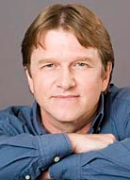


Special Thanks to:
Hans Chalupsky
USC
Bobby DeMarco
Rutgers
Minge Xie
Rutgers

Slide 82
Additional Acknowledgements
LCDR Ryan Hamil, US Coast Guard
Lt. Ryan Kowalske, US Coast Guard
Ed Hovy, Carnegie-Mellon
Paul Kantor, Rutgers
Alisa Matlin, Rutgers
Priyam Mitra, Rutgers
Birnur Ozbas, Rutgers
Andrew Philpot, USC
William Strawderman, Rutgers
James Wojtowicz, Rutgers

