Slide 1

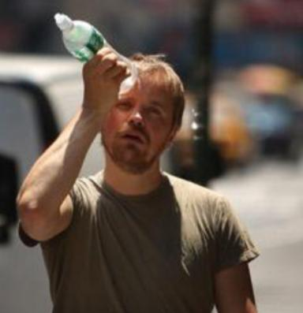
Urban Influences on Temperature
in New Jersey
Dr. David A. Robinson
Professor, Department of Geography
& New Jersey State Climatologist
Rutgers University
DIMACS/CCICADA Workshop on Urban Planning for Climate Events
September 23, 2013

Slide 2
Outline
Urban climate
Urban heat island
Anatomy of the NJ/NY Metro heat island
  Geography
  Diurnal
  Seasonal
  Synoptic
  Heat waves
  Over time
What lies ahead

Slide 3
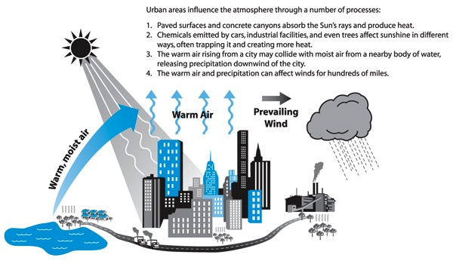
Urban Climate
http://www.ucar.edu/communications/staffnotes/0603/cities.shtml

Slide 4
Outline
Urban climate
Urban heat island
Anatomy of the NJ/NY Metro heat island
  Geography
  Diurnal
  Seasonal
  Synoptic
  Heat waves
  Over time
What lies ahead

Slide 5
Urban Heat Islands
Urban heat island refers to the increased local temperatures that result from urbanization.
Occurs due to modifications to the energy balance that result when natural surfaces are paved and built upon or when human activities release heat into the environment.
Several variables influence the magnitude of the heat island: population density, radiation, changes in heat storage, sensible and latent heat transfer.

Slide 6
Increased particulates associated with urban activity absorbs and scatters incoming solar radiation. May also reduce transfer of thermal radiation away from the urban environment.
Buildings, often a part of urbanized areas, impact the radiation balance by albedo and energy transfer.
Conduction and convection affect the energy balance to form urban heat island.
The release of heat from buildings plays a major role in urban heat islands.

Slide 7
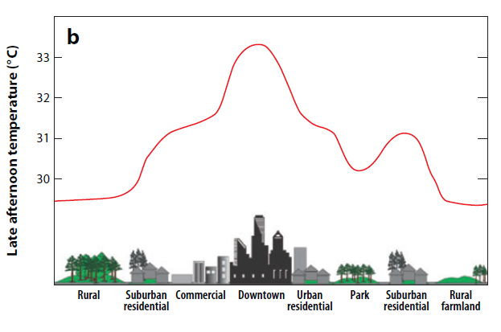
Late afternoon air temperature profile
across the urban environment and beyond

Slide 8
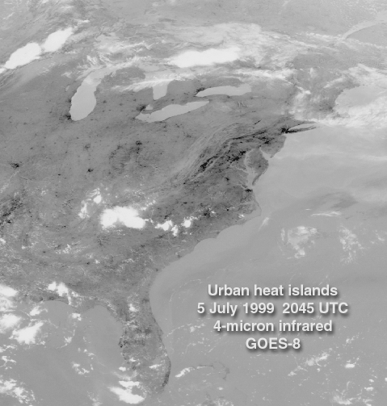

Slide 9
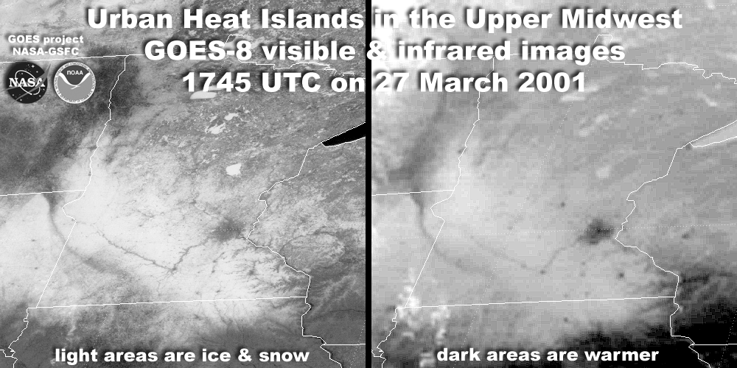

Slide 10
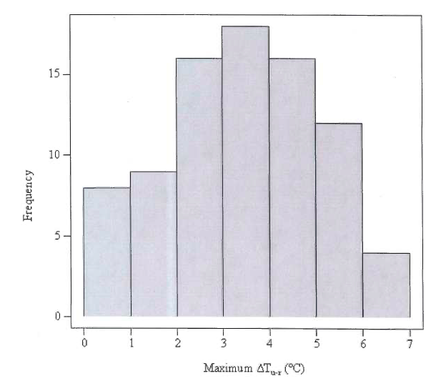
Frequency of maximum urban heat island intensity
at Newark for 80 summertime events
Thuman, C.C., 2008. Summertime urban heat island in Newark, NJ and its relationship with urban particulate matter.
Rutgers master’s thesis

Slide 11
Outline
Urban climate
Urban heat island
Anatomy of the NJ/NY Metro heat island
  Geography
  Diurnal
  Seasonal
  Synoptic
  Heat waves
  Over time
What lies ahead

Slide 12
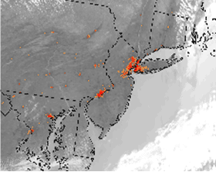
Mid Atlantic from space: enhanced infrared (thermal) image

Slide 13
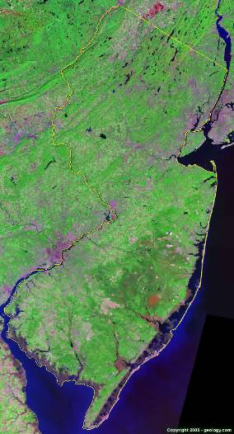
New Jersey from space:
visible composite image

Slide 14

New Jersey: enhanced infrared (thermal) image
Paterson
Newark
Elizabeth
Trenton
Camden

Slide 15
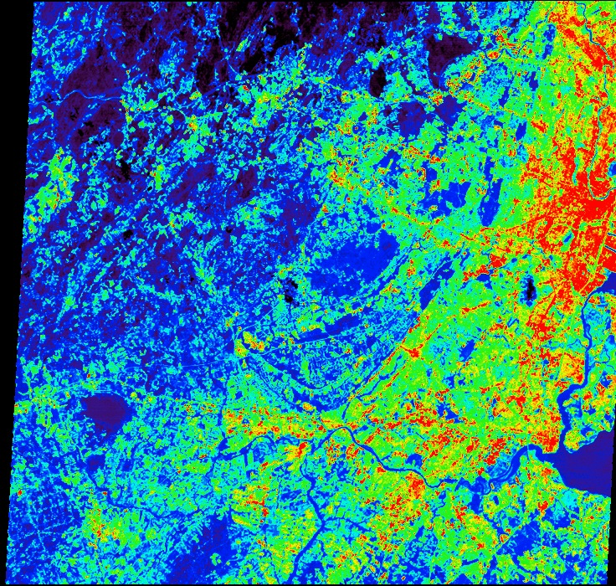
Paterson
Newark
Elizabeth
ASTER TIR image of NJ centered on the Watchung Mountains, ASTER Band 12 (9.075 um) was acquired July 3, 2001. Daytime image.
Colors: Cold to warm to hot (blue to green to red).
Center for Remote Sensing & Spatial Analysis, Rutgers University

Slide 16
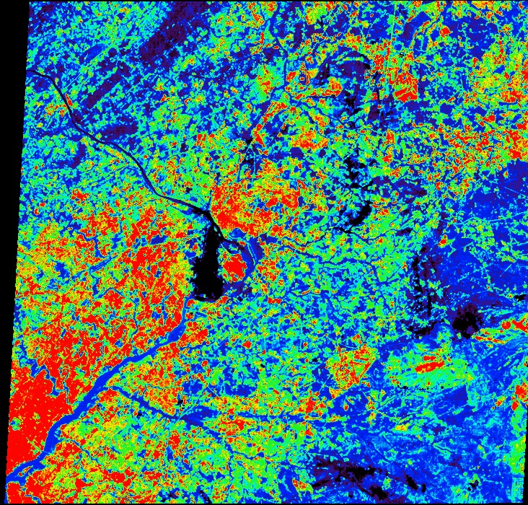
Trenton
cloud
cloud
ASTER TIR image of NJ centered on Trenton, ASTER Band 12 (9.075 um) was
acquired July 3, 2001. Daytime image.
Colors: Cold to warm to hot (blue to green to red).
Camden
Center for Remote Sensing & Spatial Analysis, Rutgers University

Slide 17
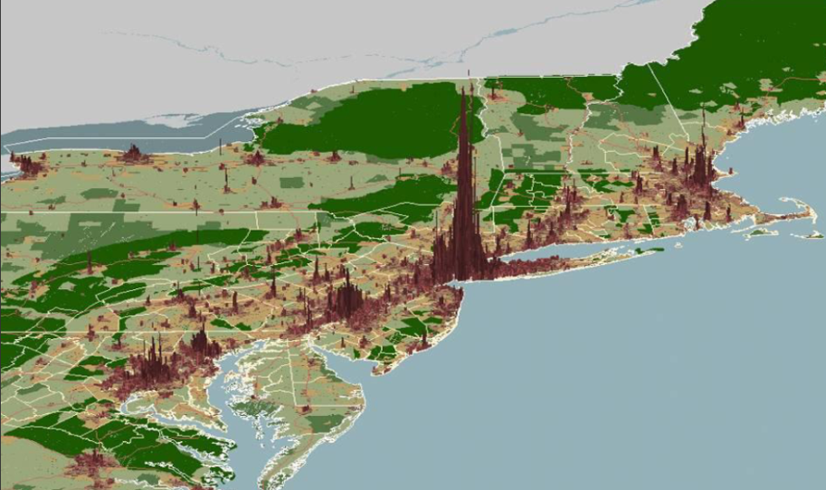
Human Population Density in the Mid Atlantic

Slide 18
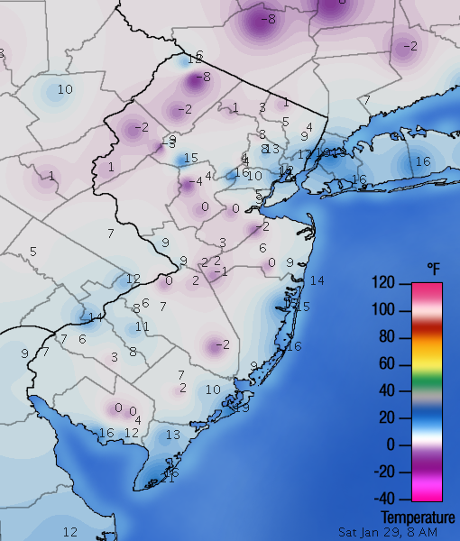
Temperatures (deg F):
8AM EST,
January 29, 2005
NJ Weather and Climate Network (njwxnet.org)

Slide 19
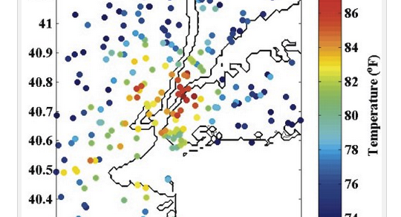
Metro NJ/NY temperatures at 1:15 AM: June 9, 2011
http://philiporton.com/2011/08/01/forecasting-coastal-urban-microclimates/

Slide 20
Outline
Urban climate
Urban heat island
Anatomy of the NJ/NY Metro heat island
  Geography
  Diurnal
  Seasonal
  Synoptic
  Heat waves
  Over time
What lies ahead

Slide 21
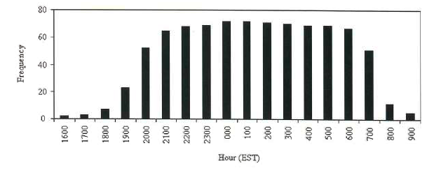
Hourly frequency of heat island events:
Newark: June 10 – September 10, 2007
Thuman, C.C., 2008. Summertime urban heat island in Newark, NJ and its relationship with urban particulate matter.
Rutgers master’s thesis

Slide 22
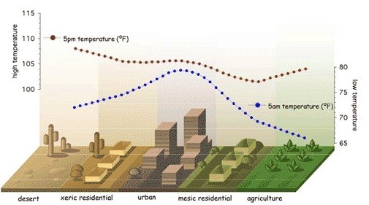
Dawn and Late Afternoon Temperature Profiles

Slide 23
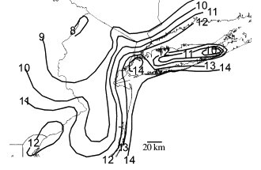
Mean temperature (deg C) at midnight:
September – November 1998
Gedzelman et al., 2003. Mesoscale aspects of the urban heat island around New York City. Theoretical and Applied Climatology

Slide 24
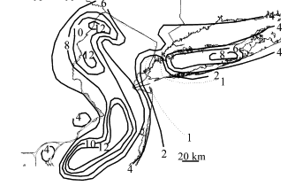
Two hour temperature change (deg C):
6 – 8 AM EST October 25, 1998
Gedzelman et al., 2003. Mesoscale aspects of the urban heat island around New York City. Theoretical and Applied Climatology

Slide 25
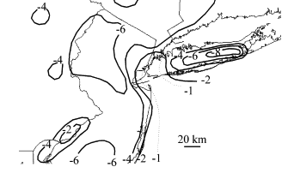
Three hour temperature change (deg C):
3 – 6 PM EST December 9, 1998
Gedzelman et al., 2003. Mesoscale aspects of the urban heat island around New York City. Theoretical and Applied Climatology

Slide 26
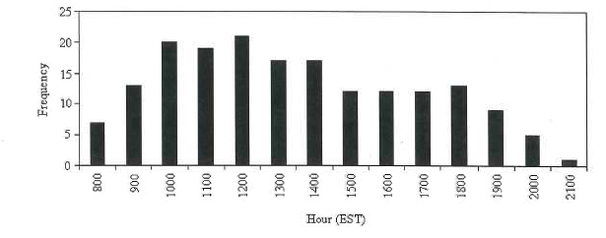
Negative Heat Island in Newark:
June 10 – September 10, 2007
Thuman, C.C., 2008. Summertime urban heat island in Newark, NJ and its relationship with urban particulate matter.
Rutgers master’s thesis

Slide 27
Outline
Urban climate
Urban heat island
Anatomy of the NJ/NY Metro heat island
  Geography
  Diurnal
  Seasonal
  Synoptic
  Heat waves
  Over time
What lies ahead

Slide 28
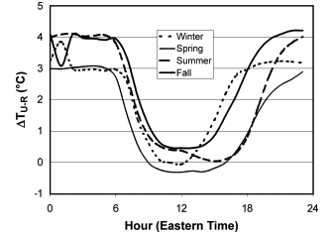
Seasonal urban – rural temperature difference
Fall
Summer
Winter
Spring
Gedzelman et al., 2003. Mesoscale aspects of the urban heat island around New York City. Theoretical and Applied Climatology

Slide 29
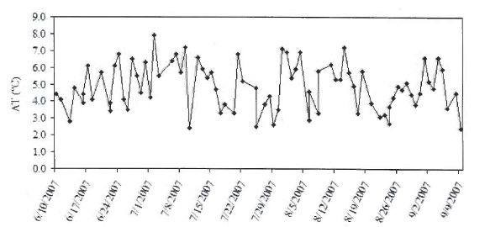
Maximum urban – rural temperature difference:
June 10 – September 10, 2007
Thuman, C.C., 2008. Summertime urban heat island in Newark, NJ and its relationship with urban particulate matter.
Rutgers master’s thesis

Slide 30
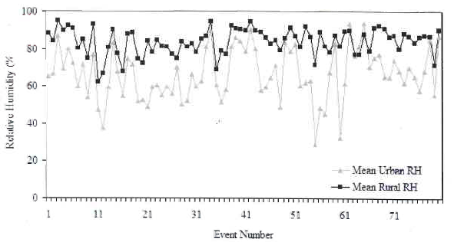
Urban &rural humidity during
80 summer heat island events
Thuman, C.C., 2008. Summertime urban heat island in Newark, NJ and its relationship with urban particulate matter.
Rutgers master’s thesis

Slide 31
Outline
Urban climate
Urban heat island
Anatomy of the NJ/NY Metro heat island
  Geography
  Diurnal
  Seasonal
  Synoptic
  Heat waves
  Over time
What lies ahead

Slide 32
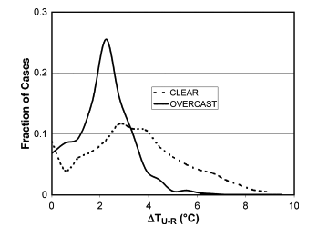
Fraction of cases with urban – rural temperature
differences at given values for clear & overcast conditions
Gedzelman et al., 2003. Mesoscale aspects of the urban heat island around New York City. Theoretical and Applied Climatology

Slide 33
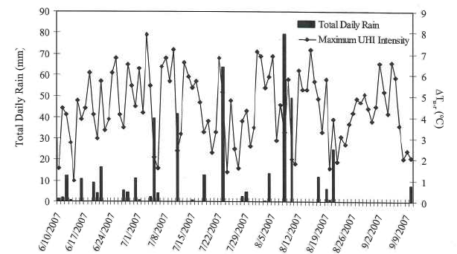
Daily rainfall and urban heat island intensity:
June 10 – September 10, 2007
Thuman, C.C., 2008. Summertime urban heat island in Newark, NJ and its relationship with urban particulate matter.
Rutgers master’s thesis

Slide 34
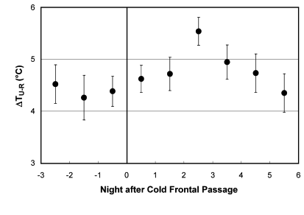
Average urban – rural temperature difference
for each night following a cold front passage
Gedzelman et al., 2003. Mesoscale aspects of the urban heat island around New York City. Theoretical and Applied Climatology

Slide 35
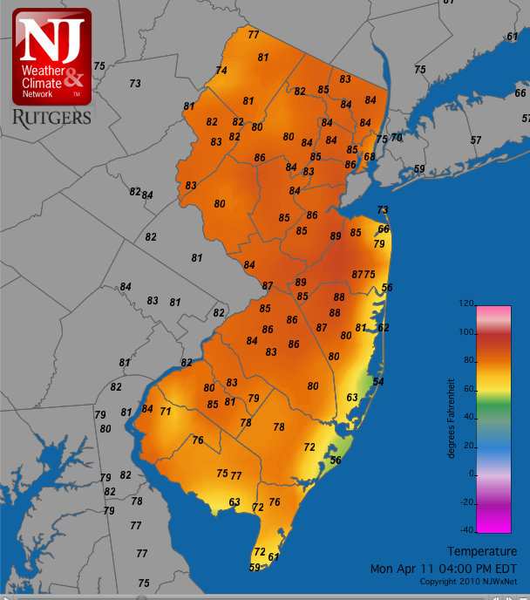
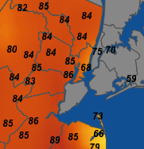
Temperatures:
4PM EDT,
April 11, 2011
NJ Weather and Climate Network (njwxnet.org)

Slide 36
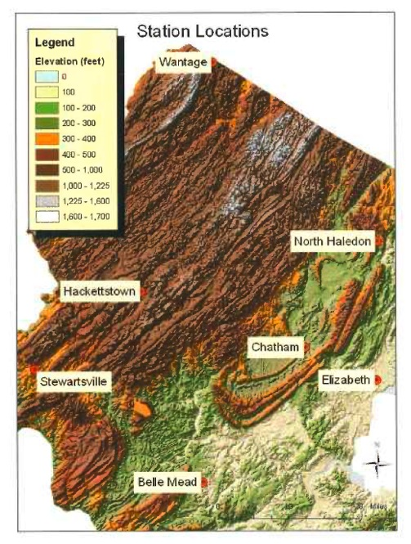
Holzer, M.A., 2004. Synoptic and diurnal characteristics of the northern NJ heat island, Rutgers master’s thesis

Slide 37
Winter SSC’s at All Stations
Holzer, M.A., 2004. Synoptic and diurnal characteristics of the northern NJ heat island, Rutgers master’s thesis
Notes:
*Quick cooling at hour 12 under dry conditions may be artificial induced warming at Elizabeth
*Wantage cools after hour 10 under dry moderate conditions, and after hour 13 under dry polar conditions – may be because of daytime orographic produced cloud cover

Slide 38
Dry Moderate SSC in All Seasons at Belle Mead and Chatham
Inversion at Belle Mead breaks between hours 7 and 9 in all seasons
Timing of evening cool down is dependent on the time of sunset
During the overnight hours Chatham is warmer than Belle Mead
Holzer, M.A., 2004. Synoptic and diurnal characteristics of the northern NJ heat island, Rutgers master’s thesis
Notes:
Urban influence see in Chatham, not in Belle Mead

Slide 39
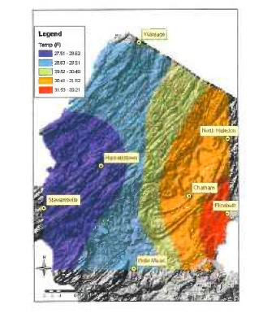
Winter 4 AM: Dry Moderate
Holzer, M.A., 2004. Synoptic and diurnal characteristics of the northern NJ heat island, Rutgers master’s thesis

Slide 40
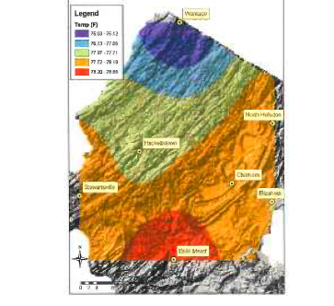
Summer noon: Dry Moderate
Holzer, M.A., 2004. Synoptic and diurnal characteristics of the northern NJ heat island, Rutgers master’s thesis

Slide 41
Outline
Urban climate
Urban heat island
Anatomy of the NJ/NY Metro heat island
  Geography
  Diurnal
  Seasonal
  Synoptic
  Heat waves
  Over time
What lies ahead

Slide 42
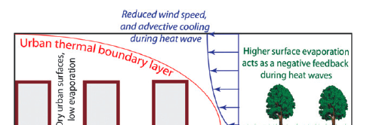
Synergistic interaction mechanisms between the
urban heat island and heat waves
Li and Bou-Seid, 2013. Synergistic interactions between urban heat islands and heat waves: the impact in cities is larger than
The sum of its parts. Journal of Applied Meteorology and Climatology

Slide 43
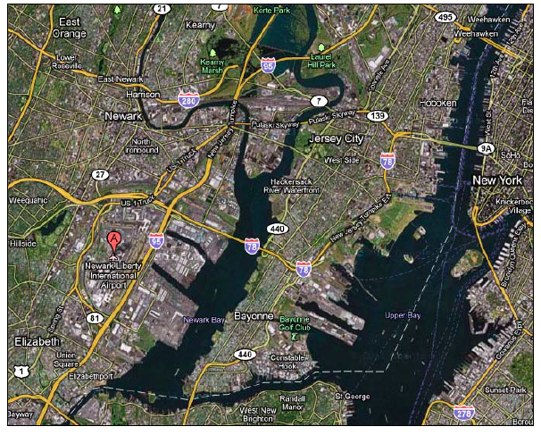
Newark, NJ and vicinity
Google maps

Slide 44
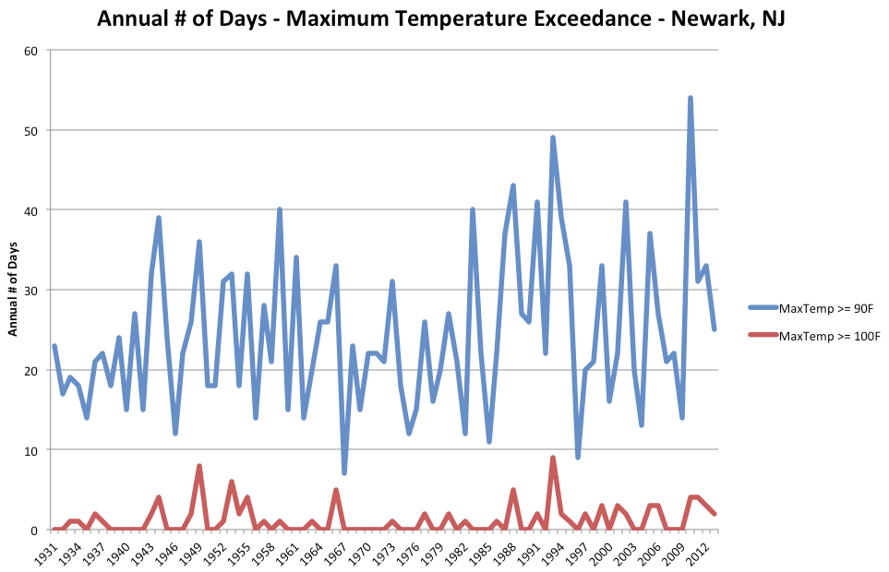
Office of the NJ State Climatologist

Slide 45
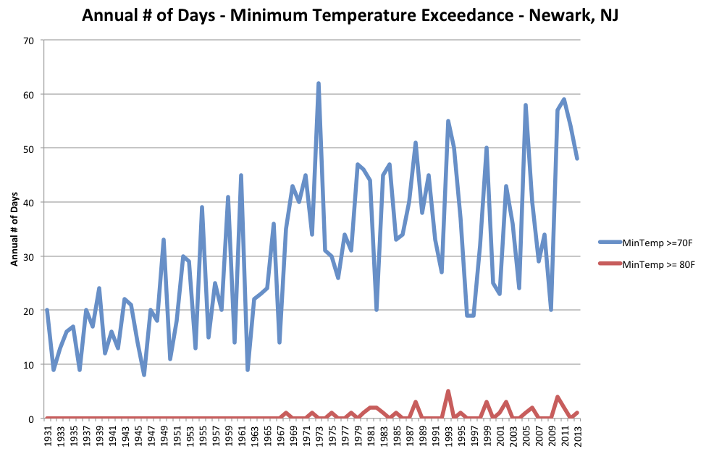
Office of the NJ State Climatologist

Slide 46
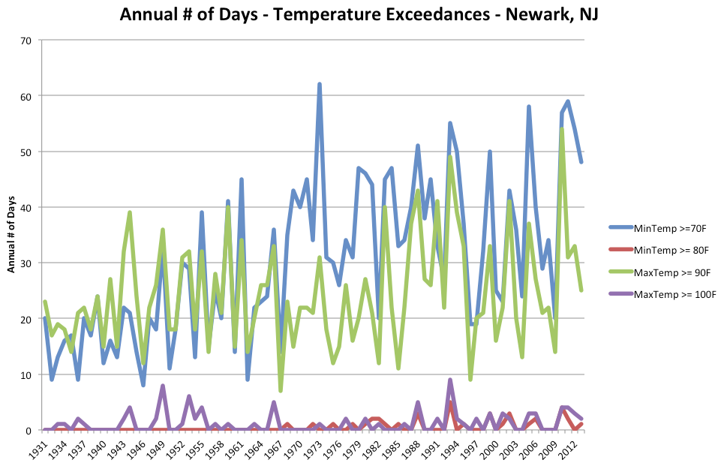
Office of the NJ State Climatologist

Slide 47
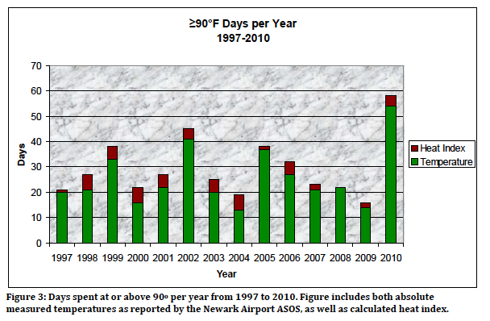
Office of the NJ State Climatologist

Slide 48
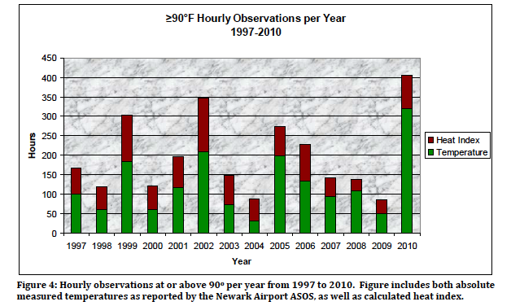
Office of the NJ State Climatologist

Slide 49
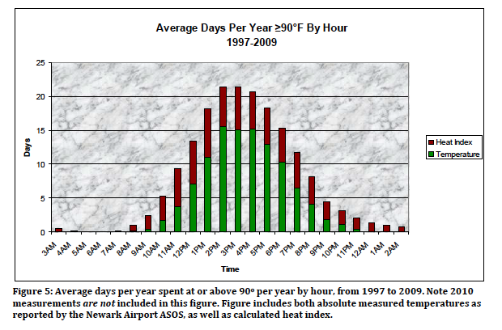
Office of the NJ State Climatologist

Slide 50
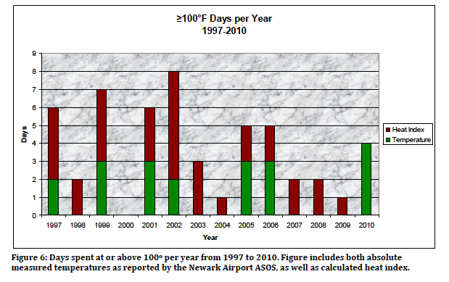
Office of the NJ State Climatologist

Slide 51
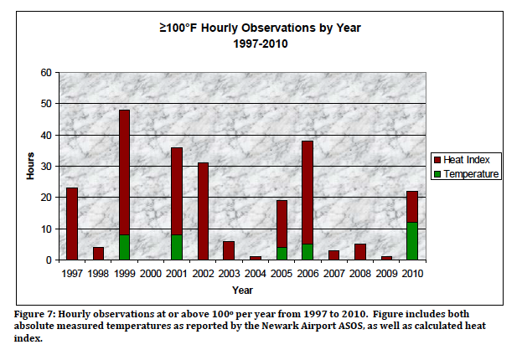
Office of the NJ State Climatologist

Slide 52
Outline
Urban climate
Urban heat island
Anatomy of the NJ/NY Metro heat island
  Geography
  Diurnal
  Seasonal
  Synoptic
  Heat waves
  Over time
What lies ahead

Slide 53
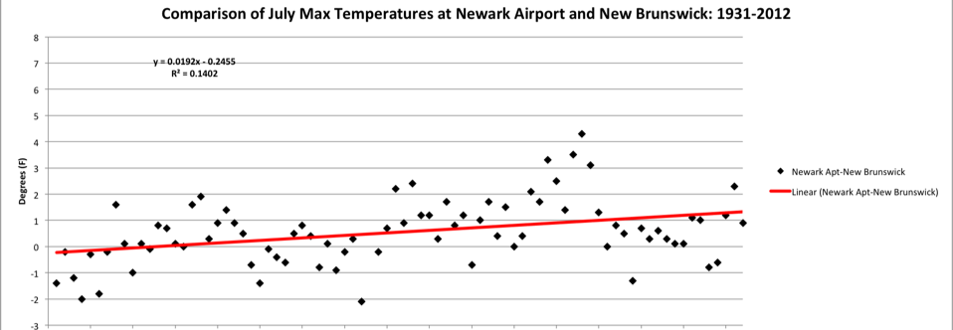
1931
2012

Slide 54
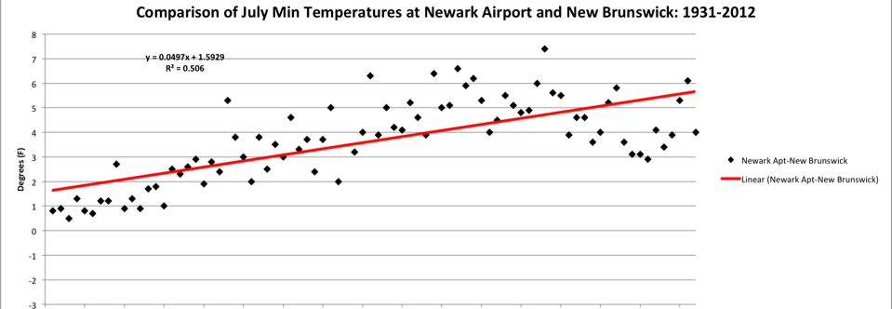
1931
2012

Slide 55
Outline
Urban climate
Urban heat island
Anatomy of the NJ/NY Metro heat island
  Geography
  Diurnal
  Seasonal
  Synoptic
  Heat waves
  Over time
What lies ahead

Slide 56
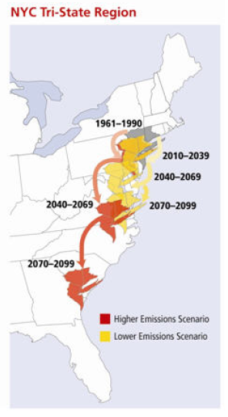
Changes in heat index
The heat index combines the effects of temperature and humidity to estimate human comfort.
Results are from simulations with three global climate models with two emissions scenarios, representing the low and high ends of the IPCC range.
Under the high emissions scenario, Tri-State summers at the end of the 21st century are projected to be similar to those in Savannah, Georgia today.

Slide 57
Projected warming
Days over 90F
Days over 100F
days per year over 90ºF
days per year over 100ºF
Union of Concerned Scientists, NE Climate Impacts Report, 2006

Slide 58
New Jersey's future climate
Rising temperatures
Steady or increasing precipitation
Increasing variability and extremes
    - storms, flood, drought, heat…….
Rising sea level

Slide 59
Wrapping things up:
Anatomy of the NJ/NY Metro heat island
  Geography
  Diurnal
  Seasonal
  Synoptic
  Heat waves
  Over time
What lies ahead
Thanks: Dave Robinson
      david.robinson@rutgers.edu

