Slide 1
Urban Planning for Climate Events, Sept. 23-24, 2013. Rutgers University Pre-Sandy Modeling of Storm Surge Impacts on the NYC Metro Region’s Transportation Infrastructure: Validation by Sandy, and post-Sandy Resilience Issues Tue 9/25, 10:40-11:20 AM (35+5 minutes) Klaus H. Jacob Lamont-Doherty Earth Observatory & School of International and Public Affairs, Columbia University jacob@ldeo.columbia.edu

Slide 2
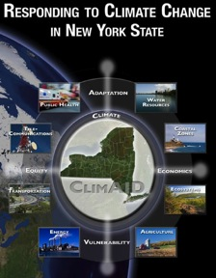
Topics:
Pre-Sandy Forecasts
Sandy Impacts
Post Sandy Issues
Long-term Issues
ClimAID, Chapter 9:
Transportation.
Jacob et al. 2011
SIRR
June 11, 2013

Slide 3
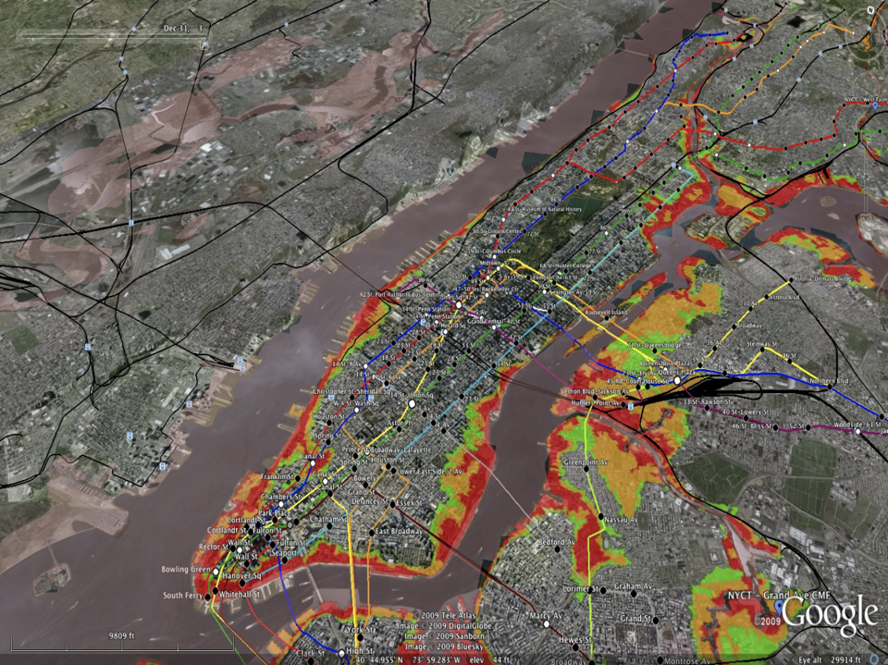
Red 100-y flood in 2000 (surge of ~ 8ft).
Yel 100-y flood in 2040s, with +2ft SLR
Grn 100-y flood in 2080s, with +4ft SLR
S1
S2
S3
ClimAID, Chapter 9:
Transportation.
Jacob et al. 2011

Slide 4
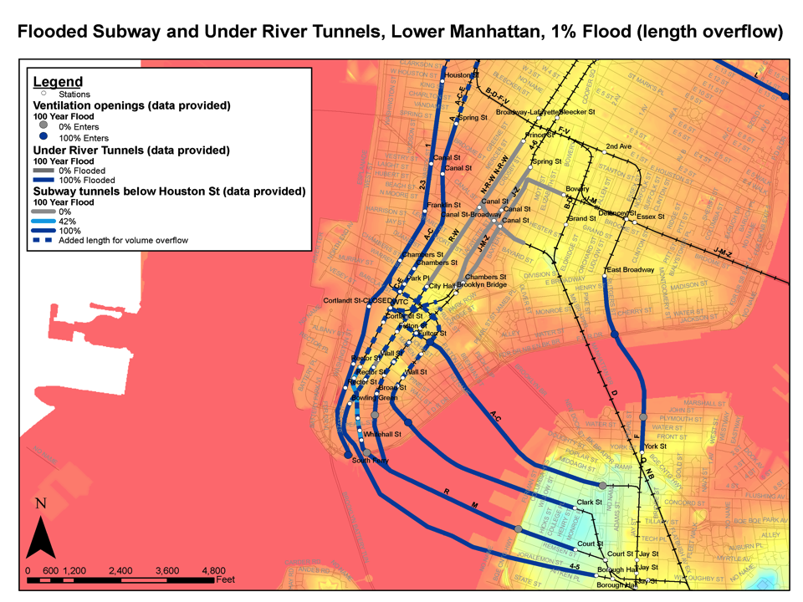
ClimAID, Chapter 9:
Transportation.
Jacob et al. 2011

Slide 5
ClimAID, Chapter 9:
Transportation.
Jacob et al. 2011

Slide 6
ClimAID Study: Chapter 9 – Transportation. (Jacob et al. December 2011)
What is the expected direct damage from the
100yr flood to the transportation infrastructure ?
How long will it take for the various components
of infrastructure to have their services restored ?
What will be potential economic losses from
the transportation outages and extended
restoration times ?
~ $ 10 Billion
~3 weeks (at ~ $ 4B/day =>)
~ $ 60 Billion (+ Losses to Building Stock)

Slide 7
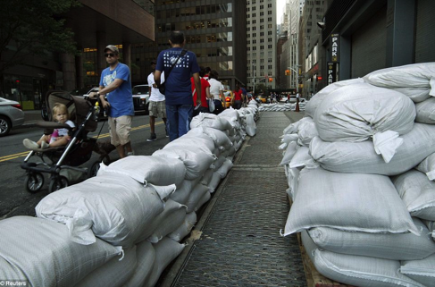
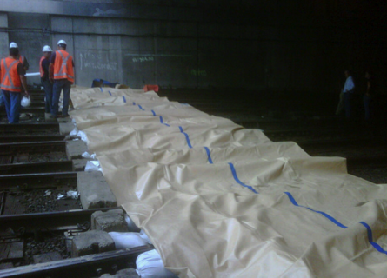
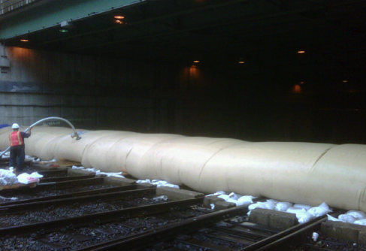
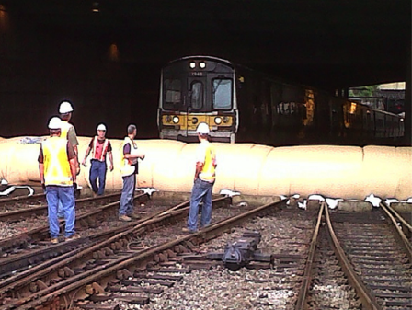
Preparations for Irene, Downtown Manhattan Subway Grates & Penn Station MTA LIRR yard
Notes:
7

Slide 8
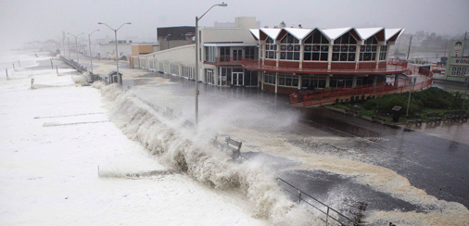
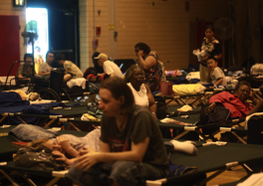
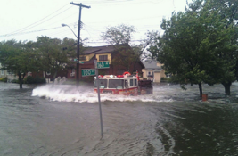
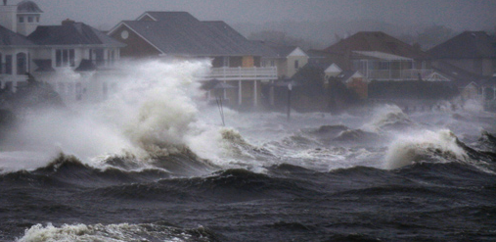
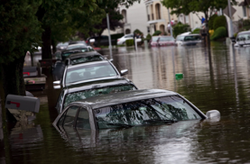
Notes:
8

Slide 9
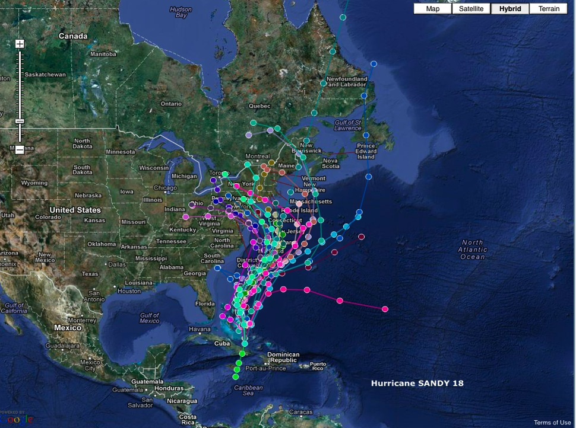
Notes:
9

Slide 10
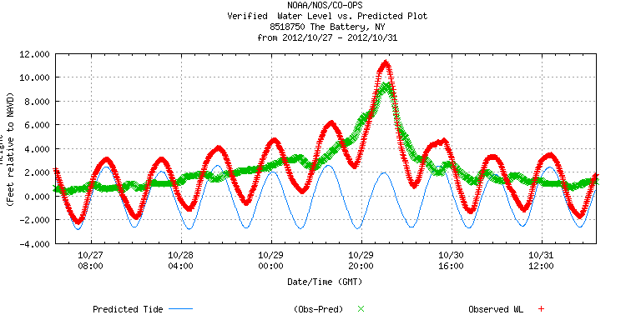
SANDY Oct 29, 2012
11.3 ft
11.0 ft
0.2%/yr BFE
2.5ft
8.9 ft
1%/yr BFE

Slide 11
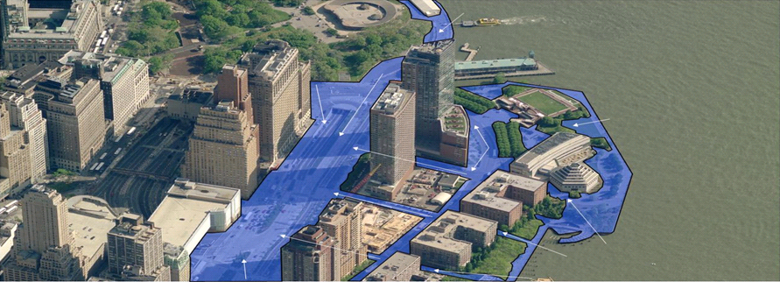
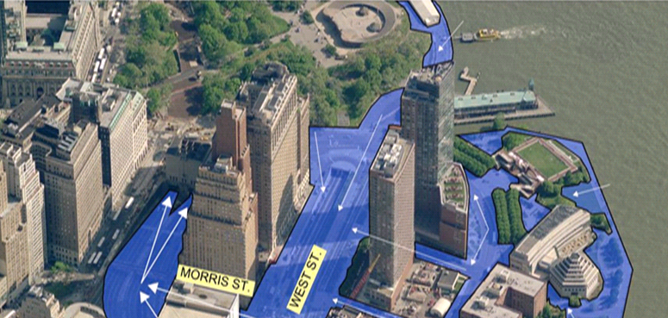
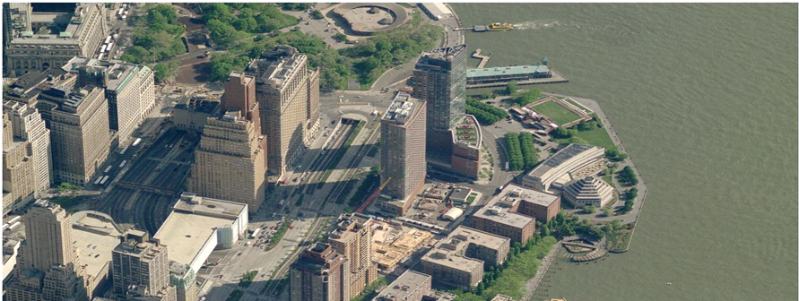
SANDY FLOOD PATH – FLOODING OF THE BBT

Slide 12
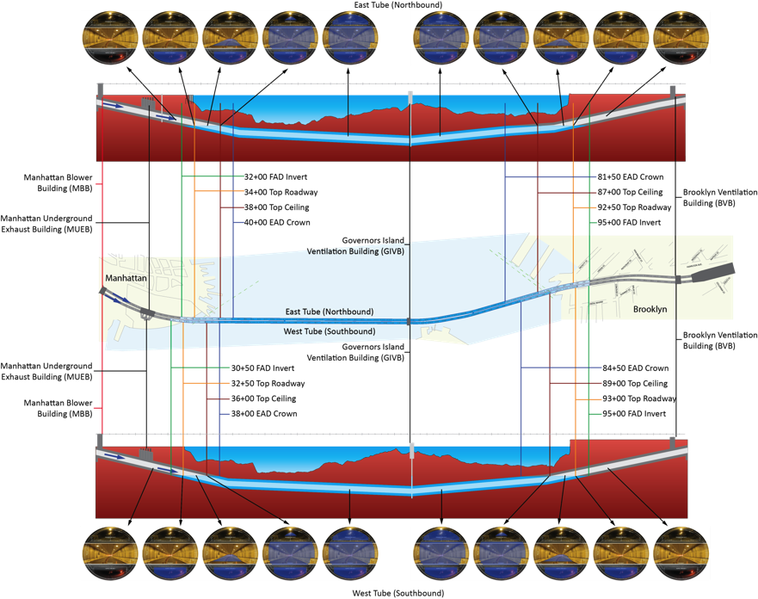
Notes:
Approx. 6,300-ft of the East Tube and 6,450-feet of the West Tube flooded.
Air ducts above the roadway ceiling and below the tunnel roadway were flooded
Sublevels in the MBB and the GIVB were flooded.
Flood water into Sublevel S2 in the BVB and on the MUEB floors
The storm surge at the Battery was measured at approximately 13 Feet and caused severe flooding of lower Manhattan, including at the BBT. Important to note is that waters came up the vertical shaft of the BBT Governors Island ventilation building knocking out elevators and lots of electrical equipment , and in sublevels flooded sections of the underground section of the plazas in Manhattan. Damage extends from the Manhattan plaza all the way to Brooklyn. The same for QMT from Borden Avenue in Queens, to the Manhattan Vent building
As a result of the flooding both tubes were completely filled with sea water and were impassable soon after the tunnels were closed to traffic beginning Monday October 29, 2012 at 8:30 pm until limited re-opening at the QMT for buses only on November 6 at 6 am, and all traffic, except trucks, on November 9 at 6 am. Remaining restrictions on trucks and contraflow traffic were eased on November 16 and 26 respectively. The BBT was closed from 2pm October 29 and limited 4 hour opening to buses on November 12 at 6 am, all traffic on November 19, and today, December 10, 2 way traffic
The storm surge at the Newtown Creek was measured at approximately 14 feet and resulted in widespread flooding of the Long Island City areas of Queens, including the QMT. Seawater flooding due to the storm surge was found present at roadway level of both tunnel measuring approximately 2,590 feet at the North Tube and 2,450 feet at the South Tube
Flooding waters inundated both the Exhaust and Fresh air intake ducts. These ducts are each located above and below the roadway level
Following the storm, the QMT remained closed to traffic, while 60 million (BBT) and 12 million (QMT) of gallons of sea water were actively pumped out.
Tunnel Pumping Systems, controls and infrastructure were severely damaged beyond repair and or salvageable reuse, including the complete failure of dewater pumps, motors, power supplies and virtually all pump control systems.

Slide 13
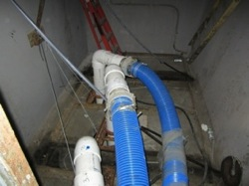
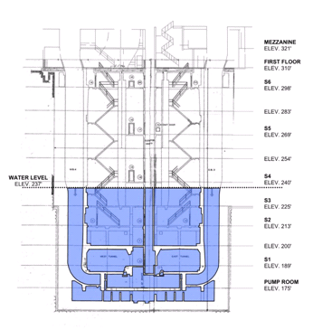
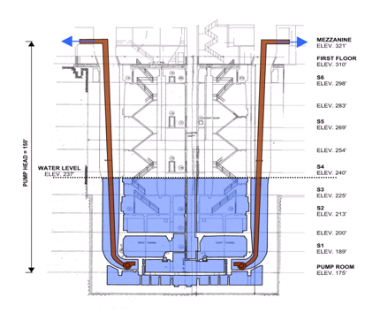
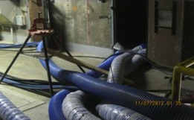
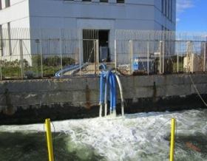
DEWATERING FROM GIVB FRESH AIR SHAFTS
Maximum dewatering achieved from GIVB fresh air shaft way.
Dewatering operations at GIVB, Manhattan Plaza, and BVB Pump Room were supplemented by the ACOE/USCG.

Slide 14
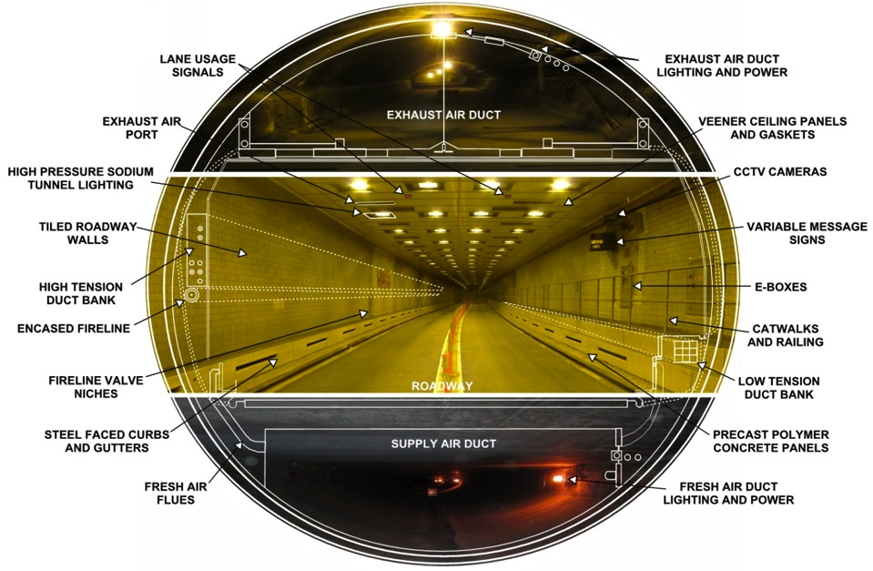
TUNNEL ELEMENTS & SYSTEMS – ALL AFFECTED BY SANDY

Slide 15
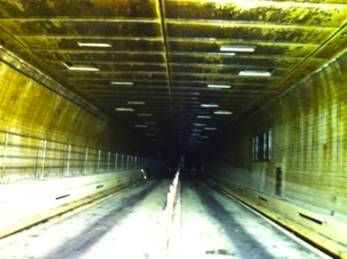
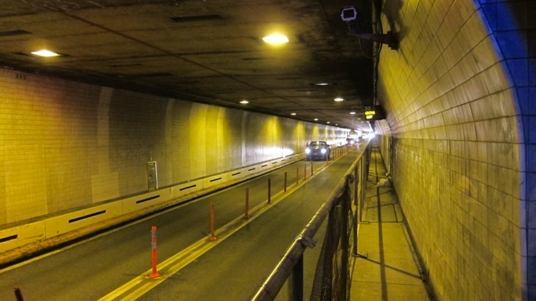
BBT & QMT VENEER CEILING PANEL REMOVAL
Removed over 12,000 veneer suspended ceiling panels at the BBT that were compromised by contaminated saltwater. Oil and salt have totally destroyed the thin aluminum sandwich panel veneer system.
Removed over 2600 veneer ceiling panels at the QMT
BBT WITH CEILING PANEL REMOVAL

Slide 16
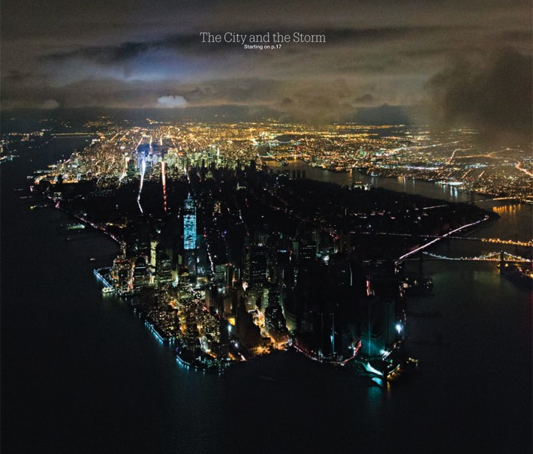

Slide 17
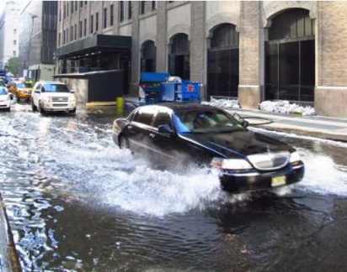
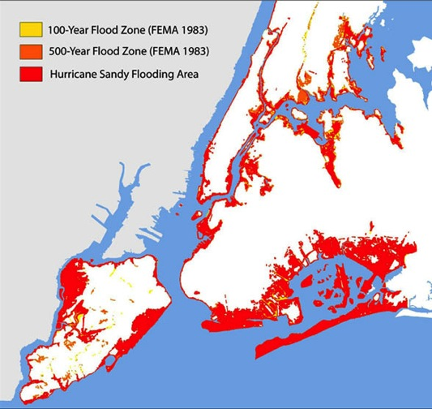
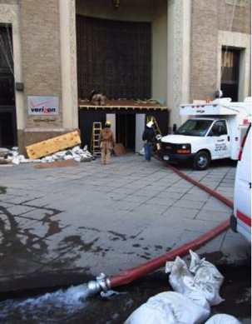
Verizon Central Offices, 140 West Street, Manhattan

Slide 18
SIRR
June 11, 2013
3 Basic Modes of Adaptation:
• Protection
• Accommodation
• Strategic Retreat

Slide 19
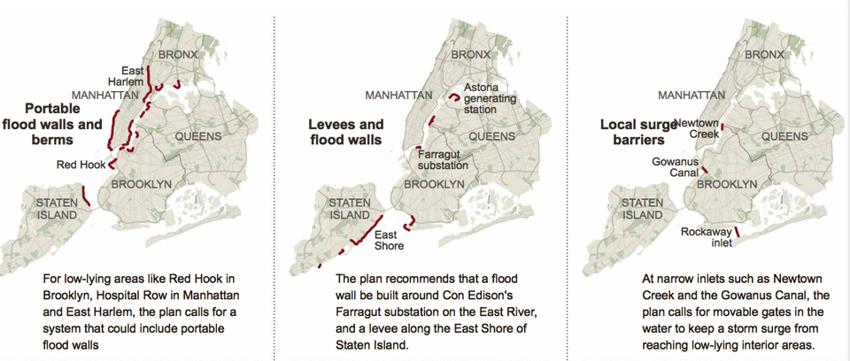
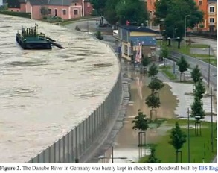
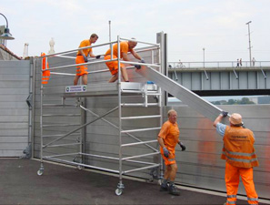
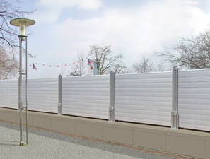

Slide 20
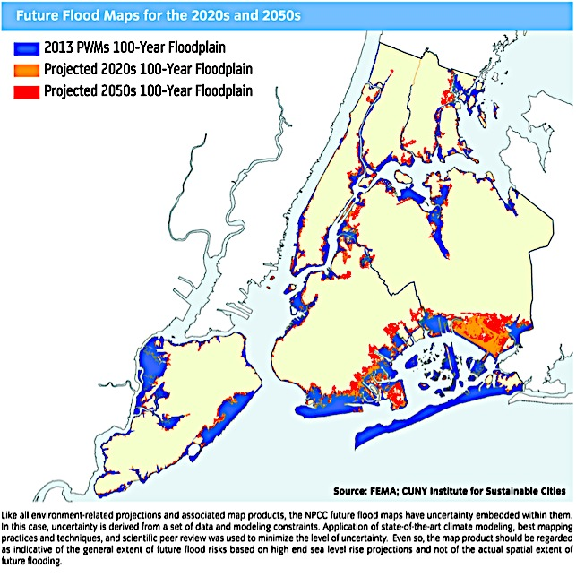
NPCC2: June 11, 2013

Slide 21
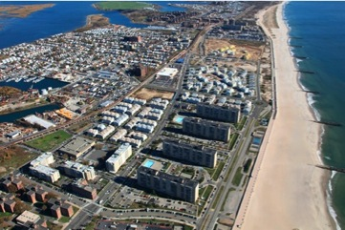
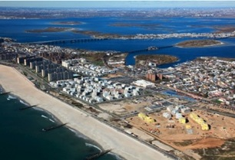
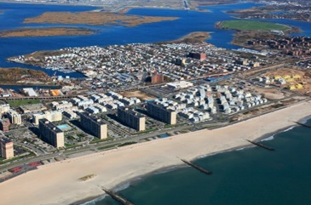
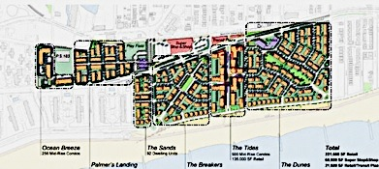

Slide 22
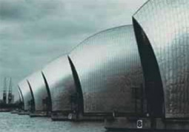
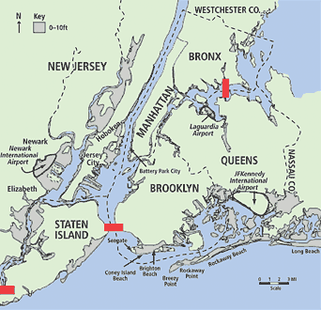
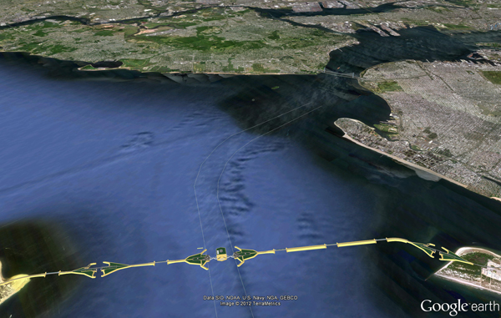
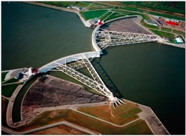
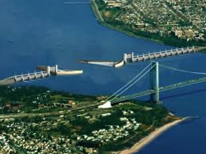
Proposed: 2 - 4 New York Barriers
Barriers Probably Unsustainable. Why?
London’s Thames Barriers
Rotterdam
Flood Barriers
Proposed
NY Barriers
Notes:
22

Slide 23
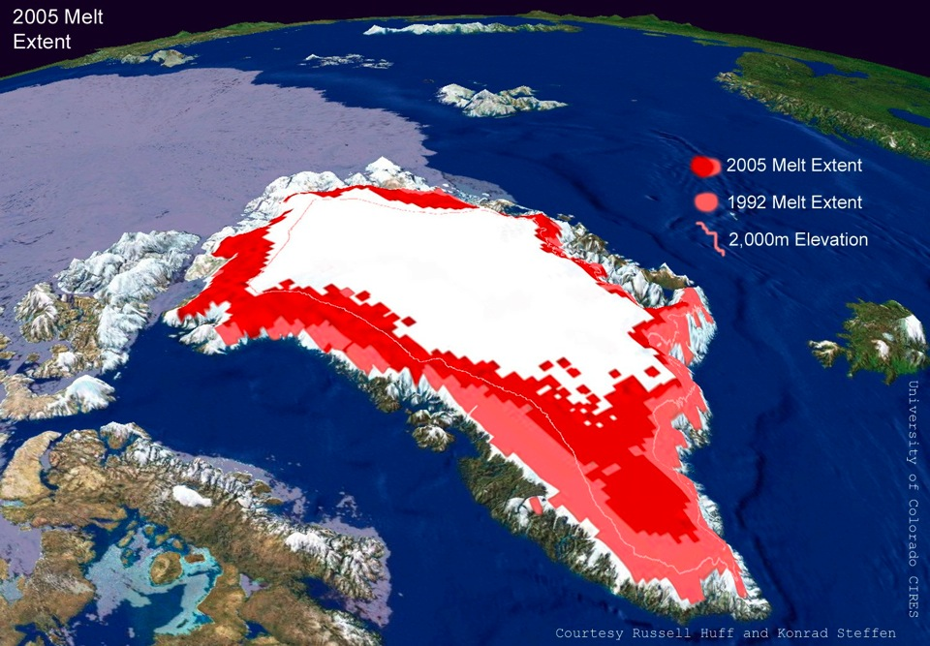
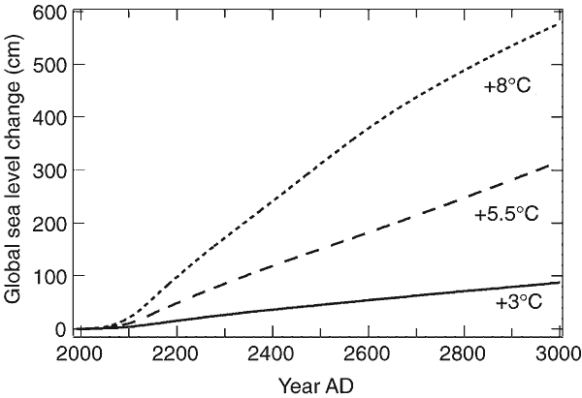
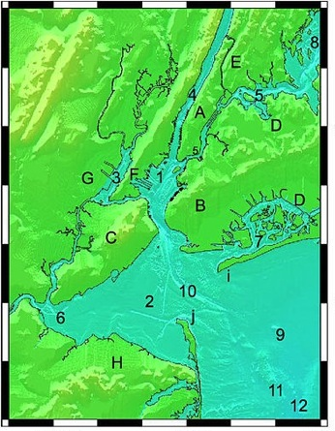
Contribution to SLR from Greenland Ice Sheet
As a function of average temperature increase
15
12
9
6
3 ft
? Total SLR

Slide 24
Recent and future climatic extremes:
consequences for the Netherlands

Slide 25
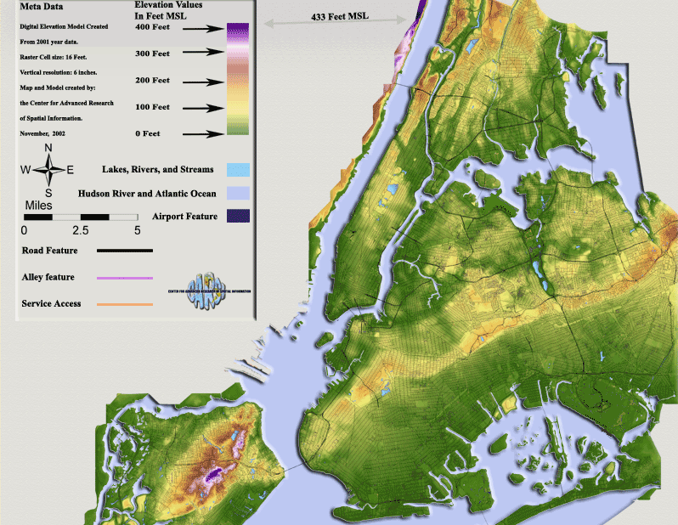
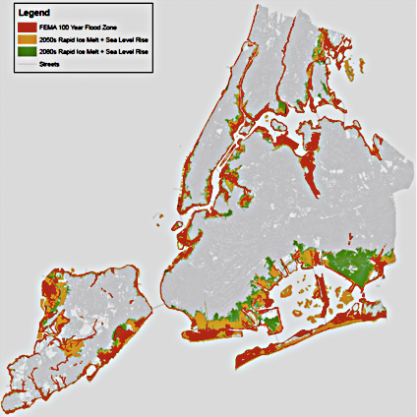
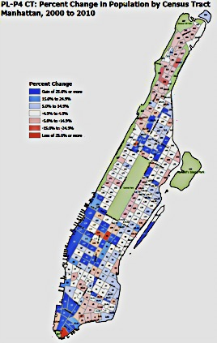
Rockaways

Slide 26
Thinking Outside the Box:
More NYC “High-Lines” ?

Slide 27
The good Message is
(from MMC Study, see below):
For every $1 invested in
Disaster Loss Mitigation & Prevention
there is, on Average, a Return of
~$4 Saved in NOT Incurred Losses.
National Institute of Building Science
Multi-hazard Mitigation Council
(NIBS/MMC) Study “Mitigation Saves”:
http://www.nibs.org/MMC/MitigationSavingsReport/natural_hazard_mitigation_saves.htm

Slide 28
Some final thoughts on Sustainable Resilience:
Sustainable design minimizes liabilities for future generations => Intergenerational equity and justice.
Design for “Higher Ground”: avoid putting new assets into current and future flood planes near sea level.
Sustainable design => adaptive designs (=> floats).
Design for sustained functionality during system life time and respective sea levels: adaptive transport elevations, pathways and accessibility, mass transit, utilities (water, sewer, electric, gas, telecommunication).
Think and design long term, then design short term solutions (to assist transformation to long-term conditions).

Slide 29
No
Thank You !
Timing makes a Difference.

