Slide 1

NIST SGIP PRIORITY ACTION PLAN REVIEW:
Accelerating Standards for the Smart Grid
David Wollman
NIST

Slide 2
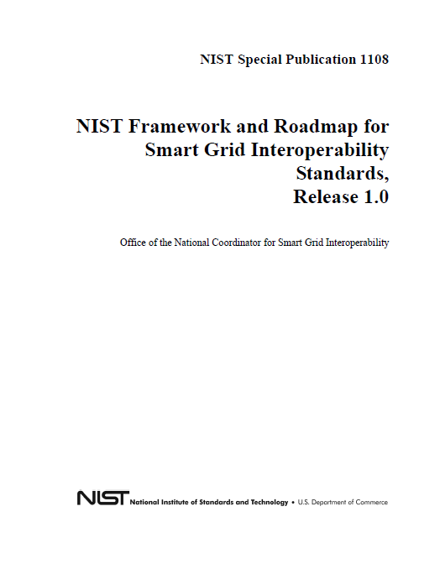
NIST Framework and Roadmap 1.0
Published January 2010
  Extensive public input and
  review
  Completed in Less than 1 year
Smart Grid Vision & Reference Model
Identified 75 existing standards
16 Priority Action Plan Projects
are filling key gaps
Companion Cyber Security Strategy
Smart Grid Domains
http://www.nist.gov/smartgrid/
Notes:
2

Slide 3
NIST SGIP PRIORITY ACTION PLANS
Created to address gaps in Smart Grid standards
# | Priority Action Plan | # | Priority Action Plan
0 | Meter Upgradeability Standard | 9 | Standard DR and DER Signals
1 | Role of IP in the Smart Grid | 10 | Standard Energy Usage Information
2 | Wireless Communication for the Smart Grid | 11 | Common Object Models for Electric Transportation
3 | Common Price Communication Model | 12 | IEC 61850 Objects/DNP3 Mapping
4 | Common Scheduling Mechanism | 13 | Time Synchronization, IEC 61850 Objects/ IEEE C37.118 Harmonization
5 | Standard Meter Data Profiles | 14 | Transmission and Distribution Power Systems Model Mapping
6 | Common Semantic Model for Meter Data tables | 15 | Harmonize Power Line Carrier Standards for Appliance Communications in the Home
7 | Electric Storage Interconnection Guidelines | 16 | Wind Plant Communications
8 | CIM for Distribution Grid Management | 17 | Facility Smart Grid Information Standard
Notes:
NEED TO FOCUS ON A FEW PAPs that may be of interest to regulators or have regulatory policy implications AND DEMONSTRATE PROGRESS. This may require an additional or different slide. Potential candidate PAPs to discuss include:
PAP 0 – Meter Upgradeability Standard
PAP 3 - Common Price Communication Model
PAP 9 - Standard DR and DER Signals
PAP 10 - Standard Energy Usage Information
PAP 11 - Interoperability Standards to Support Plug-in Electric Vehicles
PAP 16 - Wind Plant Communications

Slide 4
Standards Being Addressed by PAPs
Priority Action Plan | Standard(s) or Guideline(s)
PAP 1 - Role of IP in the Smart Grid | Informational IETF RFC
PAP 2 - Wireless Communications for the Smart Grid | IEEE 802.x, 3GPP,3GPP2, ATIS, TIA
PAP 3 - Common Price Communication Model | OASIS EMIX, ZigBee SEP 2, NAESB
PAP 4 - Common Scheduling Mechanism | OASIS WS-Calendar
PAP 5 - Standard Meter Data Profiles | AEIC V2.0 Guidelines
PAP 6 - Common Semantic Model for Meter Data Tables | ANSI C12.19-2008, MultiSpeak V4, IEC 61968-9
PAP 7 - Electric Storage Interconnection Guidelines | IEEE 1547.4, IEEE 1547.7, IEEE 1547.8, IEC 61850-7-420, ZigBee SEP 2
PAP 8 - CIM for Distribution Grid Management | IEC 61850-7-420, IEC 61968-3-9, IEC 61968-13,14, MultiSpeak V4, IEEE 1547
PAP 9 - Standard DR and DER Signals | NAESB WEQ015, OASIS EMIX, OpenADR, ZigBee SEP 2
PAP 10 - Standard Energy Usage Information | NAESB Energy Usage Information, OpenADE, ZigBee SEP 2, IEC 61968-9, ASHRAE SPC 201P
PAP 11 - Common Object Models for Electric Transportation | ZigBee SEP 2, SAE J1772, SAE J2836/1-3 , SAE J2847/1-3, ISO/IEC 15118-1,3, SAE J2931, IEEE P2030-2, IEC 62196
PAP 12 - IEC 61850 Objects/DNP3 Mapping | IEC 61850-80-5, Mapping DNP to IEC 61850, DNP3 (IEEE 1815)
PAP 13 - Time Synchronization, IEC 61850 Objects/IEEE C37.118 Harmonization | IEC 61850-90-5, IEEE C37.118, IEEE C37.238, Mapping IEEE C37.118 to IEC 61850, IEC 61968-9
PAP 14 - Transmission and Distribution Power Systems Model Mapping | IEC 61968-3, MultiSpeak V4
PAP 15 - Harmonize Power Line Carrier Standards for Appliance Communications in the Home | DNP3 (IEEE 1815), HomePlug AV, HomePlug C&C, IEEE P1901 and P1901.2, ISO/IEC 12139-1, G.9960 (G.hn/PHY), G.9961 (G.hn/DLL), G.9972 (G.cx), G.hnem, ISO/IEC 14908-3, ISO/IEC 14543, EN 50065-1
PAP 16 - Wind Plant Communications | IEC 61400-25
PAP 17 - Facility Smart Grid Information Standard | ASHRAE SPC 201P

Slide 5
PAP to Gridwise Architecture Council Stack
Shared meaning | Resource Ident | Time-Sync & Sequence | Security & Privacy | Log & Audit | Xaction & State Mgmt | System Preservation | Perform,Reliable,Scale | Discover & Config | System Evolution | Physical Connection
Economic/Regulatory
0
1
2
7
10
17
Business Objectives
0
0
0
1
1
1
1
7. Business Procedures
2
2
2
2
3
3
3
4
4
6. Business Context
5
3
4
5
6
7
8
9
10
11
12
13
14
16
6
7
7
7
7
4. Semantic Understanding
8
8
8
8
0
9
9
9
10
10
3. Syntactic Interoperability
11
11
11
11
12
12
12
2. Network Interoperability
13
13
13
13
1
2
15
14
14
14
14
1. Basic Connectivity
15
15
15
15
16
16
16
16
17
Legend
  =: PAP Number
n

Slide 6
SGIP Open Process for Smart Grid Standards
SGIP Encourages Regulatory & Stakeholder Participation in SGIP Working Groups
Stakeholder Selection of SGIP Governing Board Facilitates Input to the Board
SDO procedures generally provide opportunities for input
  Open SDO process facilitates FERC adoption of standards
  Many Standards now available to regulators without charge
SGIP Governing Board
Identifies Need for New or Harmonized Standard
Charters Priority Action Plan Working Group (PAP)
SGIP PAP Working Group
Initiates Coordination with Standards Organization
Defines Use Cases & Specifies Requirements for New Standards
Standard Setting Organization/Standard Developing Organization
Develops and/or Harmonizes Standard(s) under SSO/SDO Procedures
Reviews Draft Standard with SGIP PAP & Publishes Standard
SGIP
Working Groups Review & Recommend New Standard
Governing Board Confirms Recommendation & Lists Standard
NIST
Updates NIST SG Interoperability Framework including voluntary
industry standards and information for Regulators
FERC and/or State Commissions
May Initiate Proceedings to Consider Adoption of Standards

Slide 7
September 2010 PAP Timeline Status
Milestone:
PAP Initiation
Milestone:
SSO Identified
Milestone:
Requirements Handoff
Milestone:
Standards Handback
Milestone:
GB/SGIP
Decision
Milestone:
Close PAP
Develop List of
Deliverables and Tasks
With Assignments
Form Initial Team
Analysis
That Standard
Meets PAP
Requirements
Post to
Catalog
PAP Charter
Develop Requirements
SSO Development
GB Decision
Close PAP
PAP 6
PAP 8
PAP 14
PAP 16
PAP 17
PAP 13
PAP 15
PAP 2
PAP 7
PAP 10
PAP 12
PAP 11
PAP 0
PAP 4
PAP 5
PAP 3
PAP 9
PAP 1
September 2010 Activities - PMO Monthly Report

Slide 8

PAP 00: Meter Upgradeability Standard
Objective
  Develop requirements for meter upgradeability
Impact
  Allow meters to interoperate and comply with the yet-to-be-established national standards
  Ensure meters evolve and grow as Smart Grid standards evolve
Outcome
  NEMA upgradeability standard SG-AMI 1-2009
Status
  Standard completed September 2009
Leadership and Participating Organizations
  Tom Nelson (NIST) & Aaron Snyder (EnerNex)
  NEMA
Completed Date
  Q3, 2009

Slide 9
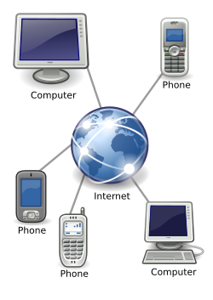
PAP 01: Role of IP in the Smart Grid
Objective
  Review the communications networks and domains identified in the Smart Grid conceptual model and determine whether they are discussed in fine enough granularity to discuss the application of the Internet protocol suite
Impact
  Well-defined networking profiles can be tested for consistency and interoperability and ensure systems integration across the Smart Grid.
  Consistent and testable protocol profiles ensure that the combination of technologies can meet not only today’s requirements but meet future application needs as well
Outcome
  Identifies key Internet protocols for use in the Smart Grid
Status
  Submitting final comments to IETF
Leadership and Participating Organizations
  David Su & Nada Golmie (NIST), Vishant Shah (EnerNex),
  Joe Hughes, EPRI
  IETF, ATIS , IEEE, TIA, UCAuig Open Grid, NEMA
Projected Completion Date
  Q4, 2010
Notes:
`

Slide 10

PAP 02: Wireless Communications for the Smart Grid
Objective
  Review existing documentation and ongoing work to assess the capabilities and weaknesses of wireless technologies operating in both licensed and unlicensed bands and to develop guidelines on their use for different Smart Grid application requirements
Impact
  Provides objective information on the appropriateness of using different wireless technologies with knowledge of their varying capabilities and weaknesses in all plausible conditions of operation
Outcome
  A set of guidelines for the use of wireless communications in the Smart Grid. This will assist local decisions surrounding the use and application of emerging wireless technology
Status
  Draft of Wireless Communications Guideline NISTIR completed and in review by PAP team to ensure requirements have been met
Leadership and Participating Organizations
  David Su & Nada Golmie (NIST) & Joe Hughes, EPRI
  IEEE, ISA SP100, IEEE 802, IETF, TIA, ATIS, UTC
Projected Completion Date
  Q1, 2011

Slide 11

PAP 03: Common Price Communication Model
Objective
  Define a common price model to exchange energy characteristics, availability, and schedules to support free and effective exchange of information in any market
Impact
  A common specification for price communication is a precursor to new market developments, to demand response, to distributed energy resources, to understanding meter information, and to every other hand-off between domains
Outcome
  OASIS EMIX TC has published a draft UML model and EAP file
Status
  Initial Draft of EMIX completed.
  Final Draft expected in late November, 2010.
Leadership and Participating Organizations
  David Holmberg (NIST) & Aaron Snyder (EnerNex)
  OASIS, NAESB
Projected Completion Date
  Q4, 2011

Slide 12
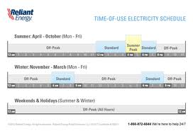
PAP 04: Common Schedule
Communication Mechanism
Objective
  Survey the existing specifications for calendaring and develop a standard for how schedule and event information is passed between and within services
Impact
  A common standard for transmitting calendaring information will enable the coordination necessary to improve energy efficiency and overall performance
  Coordinated scheduling will enable aggregation for both consumption and curtailment resources.
  With information in consistent formats, building and facility agents can make decisions about energy production, sale, purchase, and use that fit the goals and requirements of their home, business, or industrial facility
Outcome
  WS-Calendar undergoing 60 day public review
Status
  Final Draft complete and out for public comment.
  PAP team reviewing to ensure requirements have
  been met. Expected completion date November 26.
Leadership and Participating Organizations
  Dave Holmberg (NIST) & Bill Cox (EnerNex)
  OASIS, CALCONNECT, ISO, SIIA, NAESB
Projected Completion Date
  Q1, 2011

Slide 13
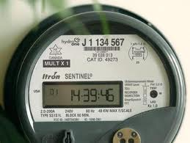
PAP 05: Standard Meter Data Profiles
Objective
  Compared to ANSI C12.19’s extensive set of end device data tables, develop a smaller set of data Tables that meets the needs of most utilities and simplify the meter procurement process
Impact
  This work allows several clients to access to meter data locally and these may be on the same order of complexity as the meter itself. Such potential clients might range from thermostats to building automation systems
Outcome
  Requirements to simplify meter data tables complete. Review process currently underway
Status
  Final Draft complete. PAP team identified minor issues for guidelines against submitted requirements, which are being addressed by AEIC.
Leadership and Participating Organizations
  Tom Nelson (NIST) & Aaron Snyder (EnerNex)
  AEIC, ANSI, IEC, IEEE, NEMA, MultiSpeak, UCAIug
Projected Completion Date
  Q4, 2010

Slide 14
PAP 06: Common Semantic Model for Meter Data Tables
Objective
  Translate the ANSI C12.19 meter data model to and from a common form allowing the semantics of this and other models/standards to be harmonized
Impact
  Utilities will focus on products and services that provide benefit to the organization and to the customer
  Sharing resources represented by metering greatly enhances the operation of the energy generation and delivery operations as well as opening up new ways to serve customers.
  Enables enterprise level sharing and supports a variety of new applications
Outcome
  UML model of ANSI C12.19-2008
  Comparison of UML models of
  ANSI C12.19-2008 IEC 61968-9
Status
  Developing requirements
Leadership and Participating Organizations
  Tom Nelson (NIST) & Aaron Snyder (EnerNex)
  AEIC, ANSI, IEC, IEEE, MultiSpeak, NEMA, UCAIug
Projected Completion Date
  Q1, 2011

Slide 15

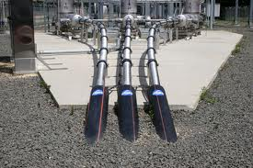
PAP 07: Energy Storage
Interconnection Guidelines
Objective
  Develop a series of coordinated and consistent electrical interconnection standards, communication standards, and implementation guidelines for energy storage devices (ES), power-electronics-connected distributed energy resources (DER), hybrid generation-storage systems (ES-DER), and the ES-DER aspects of plug-in electric vehicles (PEV)
Impact
  Will allow for increased penetration of intermittent renewable energy resources and will improve overall electrical power system performance
  Broad set of stakeholders must agree on the electrical interconnection standards
Outcome
  Increased penetration of intermittent renewable energy resources
Status
  PAP WG has provided requirements to IEEE
  and IEC and are awaiting Standards from them
Leadership and Participating Organizations
  Al Hefner (NIST) & Frances Cleveland (EnerNex)
  IEEE 1547 series, IEC TC57, UL 1741
Projected Completion Date
  Q4, 2011

Slide 16
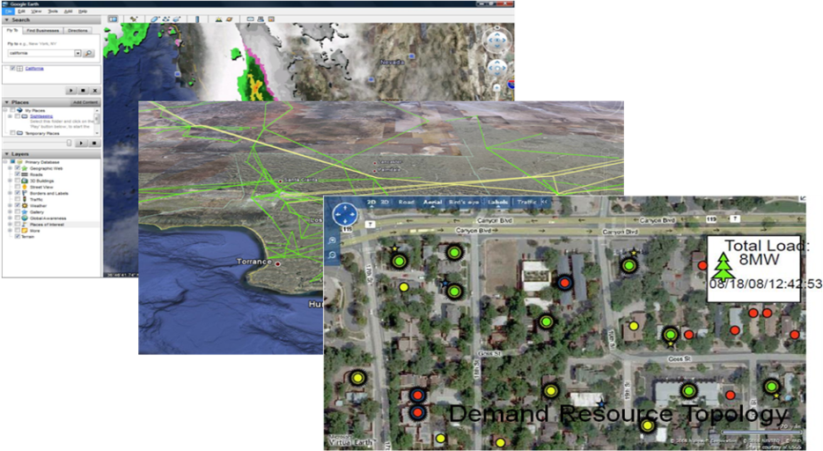
PAP 08: CIM/61850 for Distribution Grid Management
Objective
  Develop Standards to enable Advanced Distribution Automation (ADA) applications. These Standards will allow competitive procurement of advanced equipment to reduce capital costs, and facilitate new life cycle maintenance and management functions
Impact
  New standards will allow competitive procurement of advanced equipment to reduce capital costs, and facilitate new life cycle maintenance and management functions
  Better interaction between monitored and controlled devices
Outcome
  Improved Transmission & Distribution models and messaging in areas outside of the “wires” modeling, which is covered by PAP14
Status
  PAP WG is working to finalize Use Cases and r
  equirements, and deliver them to SSO
Leadership and Participating Organizations
  Jerry FitzPatrick (NIST) & John Simmins (EPRI)
  IEC
Projected Completion Date
  Q4, 2011

Slide 17
PAP 09: Standard DR and DER Signals
Objective
  Develop or adopt standard for Demand Response (DR) and Distributed Energy Resources (DER) signals to ensure that support load control, supply control, and environmental signals are supported
Impact
  Improved responsiveness of the entire power generation and delivery system to intermittency
  Easier implementation of new Smart Grid applications
Outcome
  A new framework and common terminology for price communication, grid safety or integrity signals, DER support, and other signals and/or an extensibility mechanisms
Status
  PAP WG has delivered requirements to OASIS and is awaiting draft Standard for review
Leadership and Participating Organizations
  David Holmberg (NIST) & Bill Cox (EnerNex)
  OASIS, IEC, NAESB, ZigBee
Projected Completion Date
  Q4, 2011

Slide 18
PAP 10: Standard Energy Usage Information
Objective
  To set up a standardized information model of energy usage to allow customers and other authorized entities to access such information easily and rapidly, in order to make decisions based on that information
Impact
  Easier access to monthly usage information, including near-real-time information as smart meters and other devices are deployed
  The standards will enable innovation by third-party service and software providers in providing novel ways to help consumers and operations manage their energy usage
Outcome
  Standardized information model which facilitates access to information
Status
  NAESB formal comment period complete. Now in executive committee. Next step is NAESB member ratification, then PAP team will review for requirements one final time.
Leadership and Participating Organizations
  David Wollman (NIST) & Marty Burns (EnerNex)
  NAESB, Zigbee, EIS Alliance, UCAIug
Projected Completion Date
  Q1, 2011

Slide 19
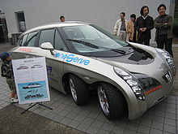
PAP 11: Common Object Models for Electric Transportation
Objective
  Ensure that the grid can support information exchange involved in charging massive numbers of electric cars, including price, DR events, energy characteristics for dynamic pricing across markets, etc.
Impact
  Standards will optimize information exchange concerning all aspects of charging capabilities and vendor innovation, allowing for more creative engineering and automobile amenities
Outcome
  Requirements to transport synchrophasor data complete. Review process currently underway
Status
  Final reviews from cyber security and architecture
  teams underway. Will go to Governing Board soon
  to vote on adding to the SGIP Catalog of Standards.
Leadership and Participating Organizations
  Eric Simmon (NIST) &
  Jerry Melcher (EnerNex)
  IEEE, IEC
Projected Completion Date
  Q4, 2010

Slide 20

PAP 12: Mapping IEEE 1815 (DNP3) to
IEC 61850 Objects
Objective
  Develop a means to enable transport of select Smart Grid data and related services over legacy DNP3 networks
Impact
  Bridging the power delivery communication standards from current standards to more feature rich standards which will accelerate the implementation of the Smart Grid. Expected benefits include reduced capital and lifecycle costs, improved reliability and the enablement of new applications
Outputs
  Provide a method to map between DNP3 data objects and IEC 61850 information objects
  Define a proposed migration path forward from current DNP only systems to hybrid implementations and ultimately to IEC 61850 only systems.
Status
  Standards requirements have been transmitted to the SSOs
Leadership and Participating Organizations
  Jerry FitzPatrick (NIST) & Ron Farquharson (EnerNex)
  IEEE, UCAIug, IEC TC57
Projected Completion Date
  Q3, 2011

Slide 21
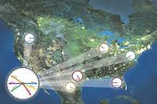
PAP 13: Time Synchronization
Objective
  Accelerate the integration of standards that can impact phasor measurement and applications depending on PMU and PDC based data and information
Impact
  Removing overlaps between the standards will allow development of interoperable equipment and systems
  A standards-based approach that addresses the requirements from all applications will facilitate implementation of new Smart Grid applications
Outcome
  Requirements to transport synchrophasor data complete.
  Review process currently underway
Status
  PAP WG met with IEEE WG to finalize the requirements
  and next steps
Leadership and Participating Organizations
  Jerry FitzPatrick (NIST) & Ron Farquharson (EnerNex)
  IEEE, UCAIug, IEC TC57
Projected Completion Date
  Q3, 2011

Slide 22
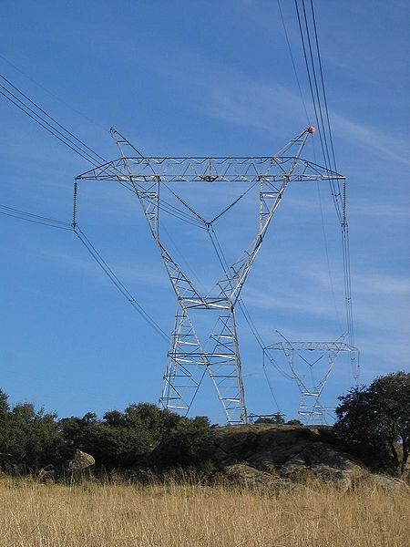
PAP 14: Transmission and Distribution
Power Systems Model Mapping
Objective
  Develop strategies to expand and integrate MultiSpeak, IEC 61850, IEC 61968, IEC 61970, IEEE PC37.237 (Time Tagging), IEEE PC37.239 (COMFEDE) and the future IEEE Common Settings file format for Smart Grid Applications
Impact
  Modeling of the electric power system, multifunctional IEDs, and definition of standard methods
Outputs
  A report and updated models for use by the standards setting organizations
Status
  Determining and assessing key use cases. Scoping to transmission ONLY and using cross-PAP process with PAP 8 to manage distribution system interfaces.
Leadership and Participating Organizations
  Jerry Fitzpatrick (NIST) & Joe Hughes (EPRI)
  IEEE, IEC, MultiSpeak
Projected Completion Date
  Q1, 2011

Slide 23
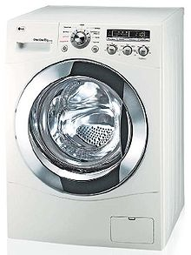
PAP 15: PLC standards for appliance integration
Objective
  Develop and aggregate key requirements
    Appliance SG PLC
    Interoperability
    Coexistence
Impact
  Enables appliance and appliance centered industries to use PLC for Smart Grid without stranding investment
  Enables appliance customers to expect longevity from their appliance PLC connections across relevant Smart Grid markets
Outputs
  Harmonized Broad Band Coexistence standards, P1901, G.9972,
  standards available from IEEE, ITU-T
  Harmonized Narrow Band Coexistence standards, P1901, G.9972,
  standards available from IEEE, ITU-T
Status
  Appliance centered PLC requirements transitioned to SSOs
    Significant progress in broadband coexistence harmonization
    Appliance-specific requirements sources due this month,
    aggregated in November
    Joint SSO team forming between IEEE-SA & ITU-T to harmonize
Leadership
  David Su NIST, Stefano Galli Panasonic, Bradley Singletary EnerNex,
  IEEE-SA, ITU-T, CEA, AHAM, UCAIug / OpenSG
Projected Completion Date
  Q1, 2011

Slide 24
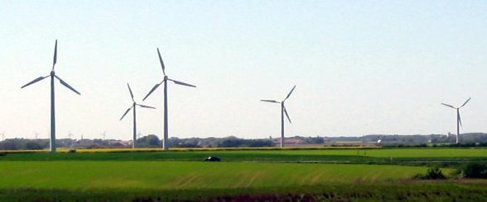
PAP 16: Wind Plant Communications
Objective
  Develop changes required to IEC 61400-25 to make this international standard apply to the US wind farm community
Impact
  By implementing a standard model for reporting data, all systems can use the same data structure no matter which ISO or other entity needs to receive and understand the data.
Outputs
  Additional elements in IEC 61400-25 to accommodate US requirements and a “best practices” guide to implementation
Status
  Preparing to submit requirements to IEC
Leadership and Participating Organizations
  Al Hefner (NIST) & Bill Moncrief (EnerNex)
  IEC, NERC
Projected Completion Date
  Q4, 2011

Slide 25

PAP 17: Facility Smart Grid Information Standard
Objective
  Enable communication of critical information originating from the customer operated “facility” which deals with the representation and dynamics of loads including prediction, measurement and shedding to the Smart Grid
Impact
  This action will enable energy consuming devices and control systems in the customer premises to manage electrical loads and generation sources in response to communication with the Smart Grid
Outputs
  A draft standard for ASHRAE consideration
Status
  Developing requirements.
Leadership and Participating Organizations
  Steve Bushby (NIST) & Aaron Snyder (EnerNex)
  ASHRAE
Projected Completion Date
  Q3, 2011

Slide 26
QUESTIONS?
David Wollman, david.wollman@nist.gov +1-301-975-2433
NIST, Smart Grid Team, Leader, Electrical Metrology Groups

