Slide 1


UNCLASSIFIED
Optimization and Control Theory for Smart (Power) Grids
Misha Chertkov
LANL/LDRD DR, FY10-FY12
http:/cnls.lanl.gov/~chertkov/SmarterGrids/
Slide 1
UNCLASSIFIED
Slide 1
LA-UR-08-
Notes:
1

Slide 2
Optimization & Control Theory for Smart Grids
Outline:
Smart Grid Research at LANL
Control of Electric Vehicle Charging
Control of Reactive Flow over Distribution Grid
Describing and Evaluating Distance to Failure in
Transmission Grid

Slide 3
Optimization & Control Theory for Smart Grids

Slide 4
Optimization & Control Theory for Smart Grids

Slide 5
Optimization & Control Theory for Smart Grids
Publications so far (first year of the project):
12. P. Sulc, K. S. Turitsyn, S. Backhaus, and M. Chertkov , Optimization of Reactive Power by Distributed Photovoltaic Generators, submitted to Proceedings of the IEEE, special issue on Smart Grid, arXiv:1008.0878
11. F. Pan, R. Bent, A. Berscheid, and D. Izrealevitz , Locating PHEV Exchange Stations in V2G, accepted IEEE SmartGridComm 2010
10. K. S. Turitsyn, N. Sinitsyn, S. Backhaus, and M. Chertkov, Robust Broadcast-Communication Control of Electric Vehicle Charging, arXiv:1006.0165, accepted IEEE SmartGridComm 2010
9. K. S. Turitsyn, P. Sulc, S. Backhaus, and M. Chertkov , Local Control of Reactive Power by Distributed Photovoltaic Generators, arXiv:1006.0160, accepted IEEE SmartGridComm 2010
8. M. Chertkov, F. Pan and M. Stepanov , Distance to Failure in Power Grids, LA-UR 10-02934
7. K. S. Turitsyn , Statistics of voltage drop in radial distribution circuits: a dynamic programming approach, arXiv:1006.0158, accepted to IEEE SIBIRCON 2010
6. J. Johnson and M. Chertkov , A Majorization-Minimization Approach to Design of Power Transmission Networks, arXiv:1004.2285, accepted 49th IEEE Conference on Decision and Control
5. K. Turitsyn, P. Sulc, S. Backhaus and M. Chertkov, Distributed control of reactive power flow in a radial distribution circuit with high photovoltaic penetration, arxiv:0912.3281 , selected for super-session at IEEE PES General Meeting 2010
4. R. Bent, A. Berscheid, and G. L. Toole, Transmission Network Expansion Planning with Simulation Optimization, Proceedings of the Twenty-Fourth AAAI Conference on Artificial Intelligence (AAAI 2010), July 2010, Atlanta, Georgia.
3. L. Toole, M. Fair, A. Berscheid, and R. Bent , Electric Power Transmission Network Design for Wind Generation in the Western United States: Algorithms, Methodology and Analysis, Proceedings of the 2010 IEEE Power Engineering Society Transmission and Distribution Conference and Exposition (IEEE TD 2010), April 2010, New Orleans, Louisiana. Message Passing for Integrating and Assessing Renewable Generation in a Redundant Power Grid
2. L. Zdeborova, S. Backhaus and M. Chertkov ,, presented at HICSS-43, Jan. 2010, arXiv:0909.2358
1. L. Zdeborova, A. Decelle and M. Chertkov , Message Passing for Optimization and Control of Power Grid: Toy Model of Distribution with Ancillary Lines, arXiv:0904.0477, Phys. Rev. E 80 , 046112 (2009)
More info is available at http://cnls.lanl.gov/~chertkov/SmarterGrids

Slide 6
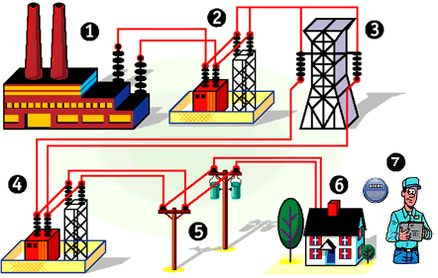
Optimization & Control Theory for Smart Grids:
Control
This part of our control research focuses on the distribution system
Designed to handle peak loads with some margin
Deliver real power from the substation to the loads (one way)
Ensure voltage regulation by control of reactive power (centralized utility control)
We will be asking the grid to do things it was not designed to do

Slide 7
Optimization & Control Theory for Smart Grids:
Control
Need control with new technology
  Electric vehicle charging is a significant new load
  Type 2 charging rates ~ 7-10 kW
  Uncontrolled charging—peak load during evening hours
  Coincident with the existing peak on many residential
  distribution circuits
  Could easily double the peak load resulting in circuit
  overloads
  Need a robust and fair way to control EV charging
High-penetration distributed photovoltaic generation
  Rapidly fluctuating real power flows during partly cloudy days
  Large voltage swings and loss of regulation and power quality
  Existing utility-scale equipment is too slow to compensate
  Latent reactive power capability of the PV inverters can leveraged
  Need a fast, distributed algorithm to dispatch PV inverter
  reactive power
K. Turitsyn
N. Sinitsyn
S. Backhaus
M. Chertkov
P. Sulc
K. Turitsyn
S. Backhaus
M. Chertkov

Slide 8
Optimization & Control Theory for Smart Grids:
Control (of electric vehicle charging)
Robust Broadcast-Communication Control of Electric Vehicle Charging
Distribution circuits with a high penetration of uncontrolled EV charging may…
  experience large EV charging load in the evening…. Resulting in….
  a coincidence with existing peak loads…..Causing…
  potential circuit overloads, breaker operation, equipment damage…..
We seek to control circuit loading by spreading out EV charging via regulation of the rate of random charging start times because…
  it only requires one-way broadcast communication (less expensive), and
  only requires periodic updating of the connection rate, and
  customers treated equally.
Control of circuit loading also allows….
  maximum utilization of existing utility assets, but
  analysis and engineering judgment are required to determine loading limits.
Questions we will try to (at least partially) answer:
  Is broadcast communication sufficient to control EV charging?
  How does the control performance depend on communication rate?
  How many EVs can be integrated into a circuit?

Slide 9
Optimization & Control Theory for Smart Grids:
Control (of electric vehicle charging)
Capacity constraint
Single branch circuit
EVs randomly distributed
May need to consider clustering in multi-branch circuits
Power flow modeled as capacity
No voltage effects
Circuit capacity
Load
N=EV charging capacity
Existing load curve
Additional EV load
4 pm
8 pm
12 am
4 am
8 am
12 pm

Slide 10

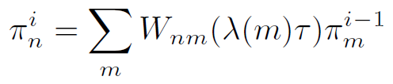
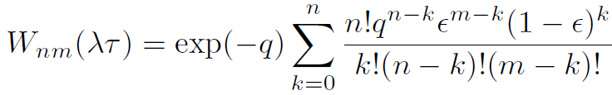

Optimization & Control Theory for Smart Grids:
Control (of electric vehicle charging)
n(t)
λ(t_{i}→t_{i}+τ)
n
nμ(t)
λ(t→t+τ)
Uncontrolled—exit when fully charged
t_{i-1} t_{i} t_{i+1}
Controlled via broadcast
Determine λ(t_{i}→t_{i+1})=F[n(t_{i})] such that E(n) -> N, but π_{n>N} is minimized.
Maximum circuit utilization with small chance of an overload
Poisson processes in each interval τ
Evolution of π_{n} from t_{i-1} to t_{i}
Probability of an overload
Control function λ(n) to cap P_{N}

Slide 11
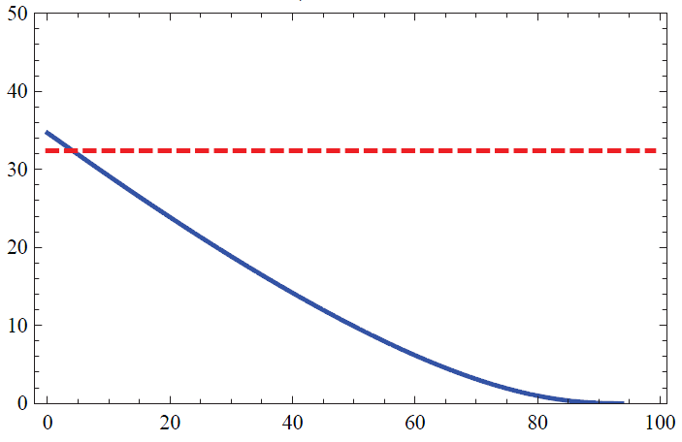
Optimization & Control Theory for Smart Grids:
Control (of electric vehicle charging)
P_{N}=10⁻¹⁰ μτ=10⁻³
1 overload/10 years
n(t)
τ=15 seconds for 1/μ~4 hours
λ(t→t+τ)
λ(n)
t_{i-1} t_{i} t_{i+1}
In steady state:
n
Shape in this region is important
N=100

Slide 12
Approach to Steady State—Speed of Control
no communications … slow
with communications … much faster
Slide 12

Slide 13
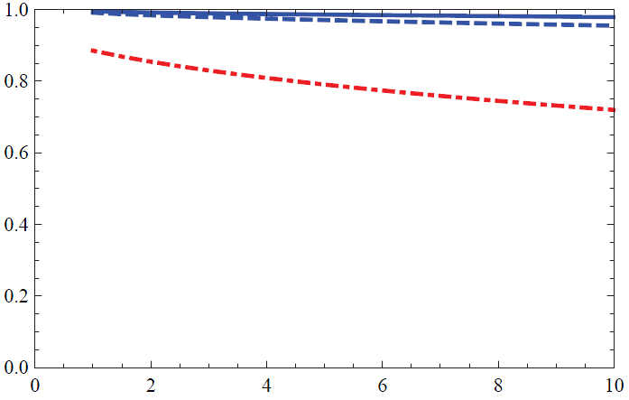
Optimization & Control Theory for Smart Grids:
Control (of electric vehicle charging)
A little bit of communication goes a long way
More loads allows for slower communications –smaller fluctuations
μτ=10⁻³ [15 sec]
μτ=10⁻² [2.5 min]
N=1000
μτ=\infty
N=100
[no communication
n/N
… slow ]
with communications
… much faster
-log₁₀P_{N}

Slide 14
Optimization & Control Theory for Smart Grids
Control (of electric vehicle charging)
Conclusions:
In distribution circuits with a high penetration of EVs where uncontrolled charging will lead to coincident peaks and overloads, excellent EV load management can be achieved by:
  Randomization of EV charging start times
  Control of rate of EV connections by one-way broadcast communication.
Quality of control depends on the communication rate, but
  Modest communication rates can achieve high circuit utilization
  Control gets better as the number of EV increases (for a fixed communication rate)
  Speed of control (convergence) improves significantly
How many EVs can be integrated into a circuit?
  Requires engineering judgment to balance cost versus performance, but….
  Greater than 90% of excess circuit capacity can be utilized with modest communication requirements.

Slide 15
Optimization & Control Theory for Smart Grids:
Control (of reactive power)
Objectives:
Distribution circuits with a high penetration of PV generation may
  experience rapid changes in cloud cover. Inducing…
  rapid variations in PV generation. Causing…
  reversals of real power flow and potentially large voltage variations
We seek to control the voltage variations by controlling PV-inverter reactive power generation because
  it does not affect the PV owners ability to generate, and
  we can make a significant impact with modest oversizing of inverters
Control of reactive power also allows for reducing distribution circuit losses, but
  voltage regulation and loss reduction are fundamentally competing objectives, and
  analysis and engineering judgment are required to find the appropriate balance
Questions we try to (at least partially) answer:
  Should control be centralized or distributed (i.e. local)?
  What variables should we use as control inputs?
  How to turn those variables into effective control?
  Does the control equitably divide the reactive generation duty?

Slide 16
Optimization & Control Theory for Smart Grids:
Control (of reactive power)
Power flow. Losses & Voltage
0
j -1
j
j +1
n
Competing objectives
Minimize losses → Q_{j}=0
Voltage regulation → Q_{j}=-(r_{j}/x_{j})P_{j}
Rapid reversal of real power flow can cause undesirably large voltage changes
Rapid PV variability cannot be handled by current electro-mechanical systems
Use PV inverters to generate or absorb reactive power to restore voltage regulation
In addition… optimize power flows for minimum dissipation
1.05
Fundamental problem:
import vs export
1.0
Voltage (p.u.)
0.95
Substation
End of line

Slide 17
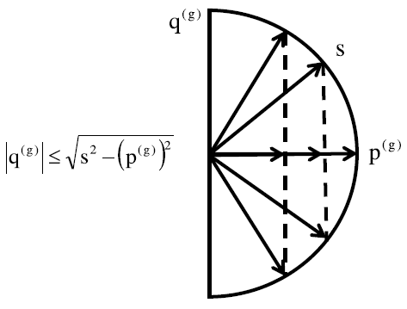
Optimization & Control Theory for Smart Grids:
Control (of reactive power)
Parameters available & limits for control
0
j -1
j
j +1
n
Not available to affect control —but available
(via advanced metering)
for control input
Not available to affect control — but available (via inverter PCC) for control input
Available—minimal impact on customer, extra inverter duty

Slide 18

Optimization & Control Theory for Smart Grids:
Control (of reactive power)
Schemes of Control
Base line (do nothing)
Unity power factor
Proportional Control
(EPRI white paper)
voltage control heuristics
composite control
Hybrid (composite at V=1 built in proportional)
1.0
Voltage p.u.
0.95
1.05

Slide 19
Optimization & Control Theory for Smart Grids:
Control (of reactive power)
Prototypical distribution circuit:
case study
V₀=7.2 kV line-to-neutral
n=250 nodes
Distance between nodes = 200 meters
Line impedance = 0.33 + i 0.38 Ω/km
50% of nodes are PV-enabled with 2 kW maximum generation
Inverter capacity s=2.2 kVA – 10% excess capacity
Import—Heavy cloud cover
p^{c} = uniformly distributed 0-2.5 kW
q^{c} = uniformly distributed 0.2p^{c}-0.3p^{c}
p^{g} = 0 kW
Average import per node = 1.25 kW
Export—Full sun
p^{c} = uniformly distributed 0-1.0 kW
q^{c} = uniformly distributed 0.2p^{c}-0.3p^{c}
p^{g} = 2.0 kW
Average export per node = 0.5 kW
Measures of control performance
δV—maximum voltage deviation in transition from export to import
Average of import and export circuit dissipation relative to “Do Nothing-Base Case”

Slide 20
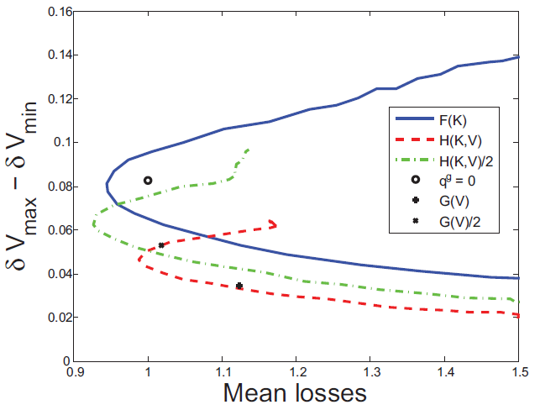
Optimization & Control Theory for Smart Grids:
Control (of reactive power)
Performance of different control schemes
Hybrid scheme
Leverage nodes that already have V_{j}~1.0 p.u. for loss minimization
Provides voltage regulation and loss reduction
K allows for trade between loss and voltage regulation
Scaling factor provides related trades
F(K)
q^{g}=q^{c}
δV
q^{g}=0
H/2
K=1.5
K=1
H(K)
K=0

Slide 21
Optimization & Control Theory for Smart Grids:
Control (of reactive power)
Conclusions:
In high PV penetration distribution circuits where difficult transient conditions will occur, adequate voltage regulation and reduction in circuit dissipation can be achieved by:
  Local control of PV-inverter reactive generation (as opposed to centralized control)
  Moderately oversized PV-inverter capacity (s~1.1 p^{g,max})
Using voltage as the only input variable to the control may lead to increased average circuit dissipation
  Other inputs should be considered such as p^{c}, q^{c}, and p^{g}.
  Blending of schemes that focus on voltage regulation or loss reduction into a hybrid control shows improved performance and allows for simple tuning of the control to different conditions.
Equitable division of reactive generation duty and adequate voltage regulation will be difficult to ensure simultaneously.
  Cap reactive generation capability by enforcing artificial limit given by s~1.1 p^{g,max}

Slide 22
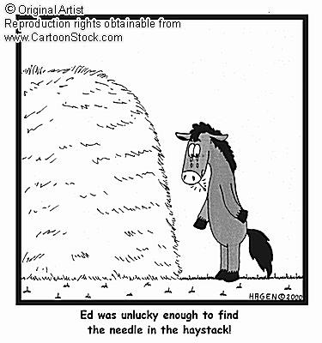
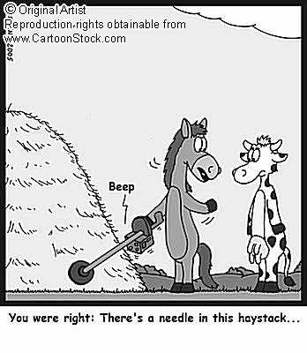
Optimization & Control Theory for Smart Grids:
Stability (distance to failure)
Distance to Failure in Power Grids [Chertkov,Pan,Stepanov]
Normally the grid is SATisfiable
Sometimes failures happen
How to estimate probability of a failure?
How to predict and prevent a failure?
Phase space of possibilities is huge
(finding the needle in the haystack)
Example: The power grid of Guam

Slide 23
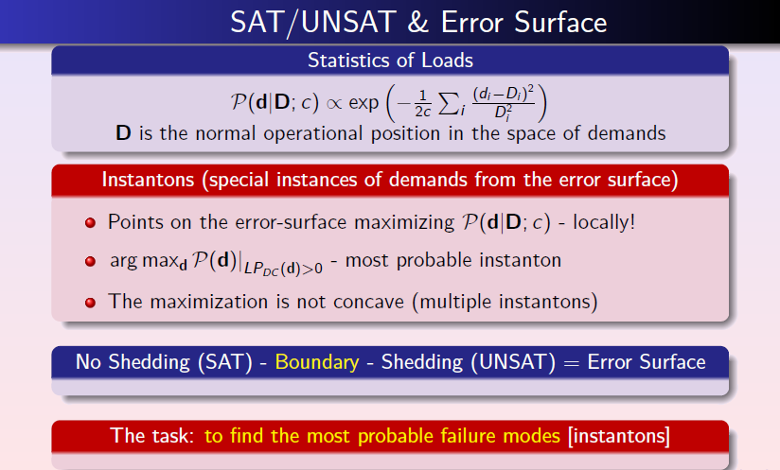
Optimization & Control Theory for Smart Grids
Stability (distance to failure)

Slide 24
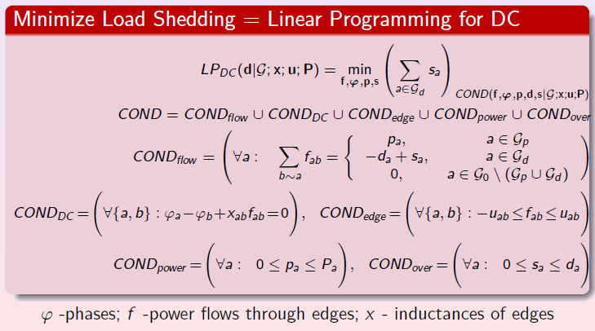
Optimization & Control Theory for Smart Grids
Stability (distance to failure)
no load shedding ⬄

Slide 25
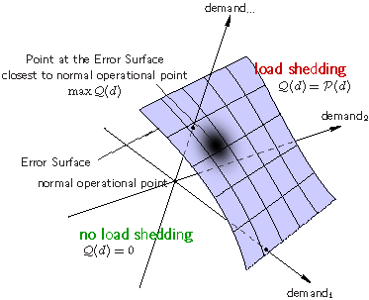
Optimization & Control Theory for Smart Grids:
Stability
Technique to tackle the problem is borrowed from our (LANL) previous
Physics & Error-Correction studies: Instanton Search Algorithm
For any configuration of demand, construct a function Q(d)=0 if no load shedding is required and Q(d)=P(d) [postulated configuration probability] when shedding is unavoidable
Generate a simplex (N+1) of UNSAT points
Use Amoeba-Simplex [Numerical Recipes] to maximize Q(d)
Repeat multiple times (sampling the space of instantons)

Slide 26
Optimization & Control Theory for Smart Grids:
Stability (distance to failure)
Example of Guam:
Data is taken from LANL/ D-division (infrastructure) data-base for a typical day
The instantons (ranked according to their prob. of occurrence) are sparse (localized on nodes connected to highly stressed lines)
The analysis reveals weak points of the grid: unserved nodes, stressed links and generators. Normally, there exists only a handful of the weak points calling for attention.
other examples were also tested

Slide 27
Optimization & Control Theory for Smart Grids
Stability (distance to failure)
Example of IEEE RTS 96:
Instantons are localized but not sparse
Hot spots are not necessarily neighbors, may be far from each other (on the graph)
Weaker demand may also be bad (``paradox”/triangular example)

Slide 28
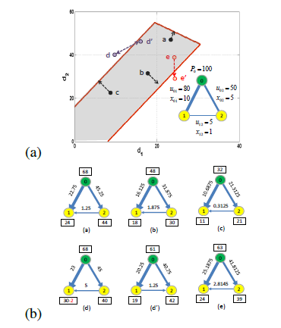
Optimization & Control Theory for Smart Grids
Stability (distance to failure)
Triangular Example [illustrating the ``paradox”]:
lowering demand may be troublesome [SAT -> UNSAT]
develops when a cycle contains a weak link
similar observation was made in other contexts before, e.g. by S. Oren and co-authors
the problem is typical in real examples
consider ``fixing” it with extra storage [Scott’s idea]

Slide 29
Optimization & Control Theory for Smart Grids:
Stability (distance to failure)
Conclusions and Path Forward
Formulated Load Shedding (SAT/UNSAT) condition as a Linear Programming task based on DC power flow approximation
Analyzed power-grid failure using Error-Surfaces and an instanton description
Instanton-amoeba algorithm was adapted and tested on examples. Good to test, identify (and eventually resolve) hidden problems.
Incorporate other, more realistic measures of network stability, i.e. voltage stability (via AC power flow), voltage collapse and transient stability
Accelerate the instanton-search by utilizing LP-structure of the model. Apply to larger scale problems [e.g. ERCOT driven by renewables]
Reach beyond our first step to explore cutting-edge topics, e.g. fluctuations in renewables, interdiction, optimal switching, cascading events, and avoidance of extreme outages

Slide 30
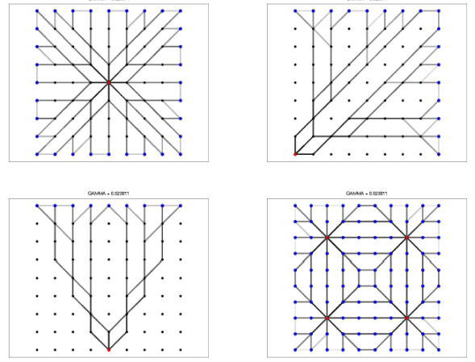
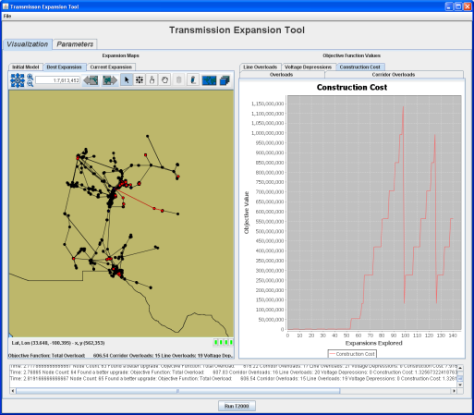
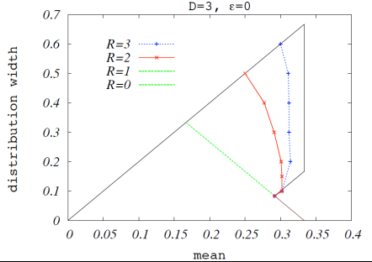
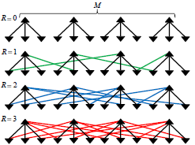
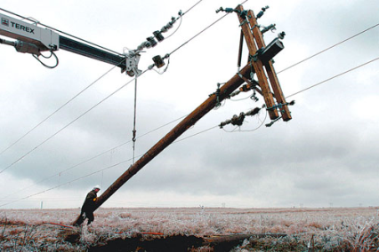

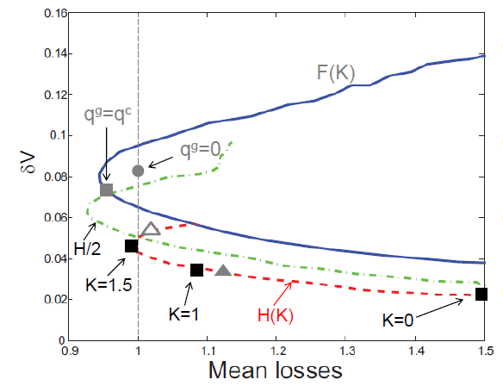
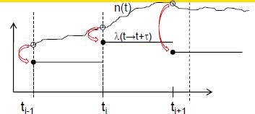
LANL LDRD DR (FY09-11): Optimization & Control Theory for Smart Grids
grid planning
grid control
grid stability
http://cnls.lanl.gov/~chertkov/SmarterGrids/

