Slide 1
Identifying social network and mobile technology use and its correlation with household evacuation behavior in Hurricane Sandy
Introduction Background Approach Results Next Steps
Justin Yates, Tom Ferris, Erick Moreno
Department of Industrial and Systems Engineering
Texas A&M University
jtyates@tamu.edu
David Matarrita
Department of Parks, Recreation and Tourism Sci.
Texas A&M University
Student Researchers
Mahmoud El-Sherif (ISE, Graduate)
Jae Ho Lee (RPTS, Graduate)
Monica Tellam (RPTS, Undergraduate)
This project is funded by the National Science Foundation

Slide 2
Introduction
Introduction Background Approach Results Next Steps
Quick Background
Research Approach
Preliminary Results
Next Steps

Slide 3
Quick Background
Introduction Background Approach Results Next Steps
Existing literature in evacuee behavior
Lindell, Sorensen, Eisenman, etc.
Existing literature in social network analysis
Wasserman and Faust, Scott, etc.
Emerging literature:
Butts (social network structure)
Sutton (communication via social networks)

Slide 4
Quick Background
Introduction Background Approach Results Next Steps
Observations:
Key considerations when planning evacuation:
Perceived safety (past exerpiences)
Delivery of information (face-to-face, radio/tv, etc.)
Perceived storm severity (cat 1, cat 2, cat 3)
Hypothesis:
Social media and mobile technology are changing the ways in which individuals obtain, deliver and perceive information when planning an evacuation.

Slide 5
Research Approach
Introduction Background Approach Results Next Steps
Questions of Focus
What percentage of households use mobile technology during an evacuation?
How frequently are mobile devices and social networks used and what content is being viewed/posted?
To what extent is information being used dynamically during evacuation?

Slide 6
Research Approach
Introduction Background Approach Results Next Steps
Mail Survey
1,100 random households in Monmouth, NJ
Mandatory evacuation order
Diverse demographics
Comparatively less storm damage
Tailored Design Method (Dillman)
3 waves (postcard → survey)
Cash incentive in 1st wave

Slide 7
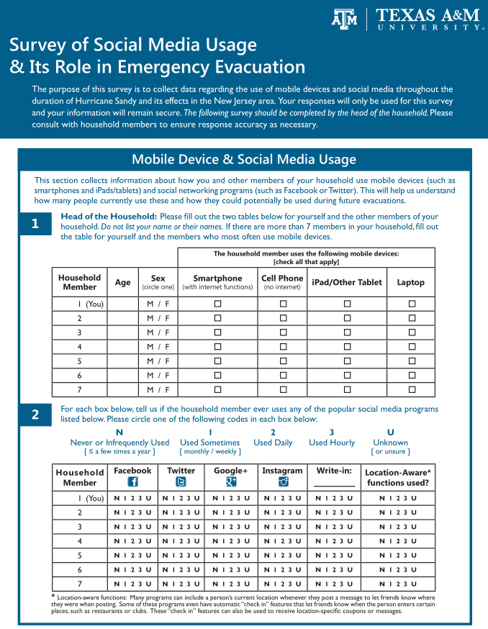
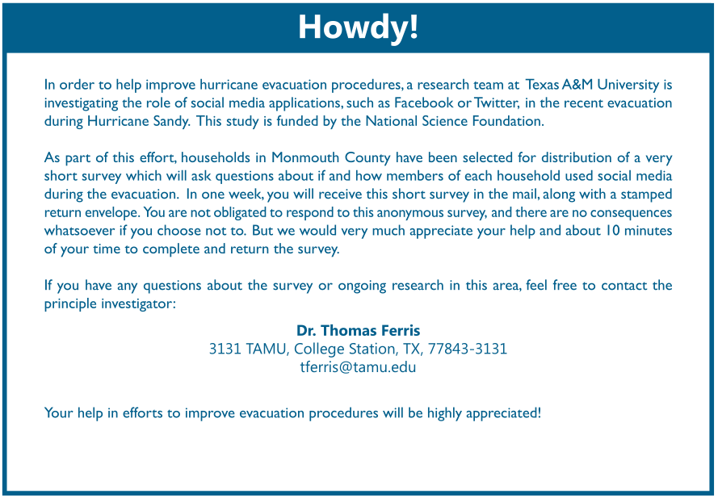
Research Approach
Introduction Background Approach Results Next Steps

Slide 8
Preliminary Results
Introduction Background Approach Results Next Steps
Initial Mailing: 4/26/2013
Survey administration still in-process
As of 3 June 2013:
124 responses (11.3% response rate)
1st wave results only
Does not include undeliverable addresses

Slide 9
Preliminary Results
Introduction Background Approach Results Next Steps

Slide 10
Preliminary Results
Introduction Background Approach Results Next Steps
individuals were allowed to indicate ownership of multiple devices
Smartphone indicates internet-capable device
Cell Phone indicates no internet capability

Slide 11
Preliminary Results
Introduction Background Approach Results Next Steps
Facebook and Google+ were the two most frequently used Online social media sites
Younger generation most frequent
Older generation still social media savvy

Slide 12
Preliminary Results
Introduction Background Approach Results Next Steps
Communication with Immediate Family

Slide 13
Preliminary Results
Introduction Background Approach Results Next Steps

Slide 14
Preliminary Results
Introduction Background Approach Results Next Steps

Slide 15
Preliminary Results
Introduction Background Approach Results Next Steps

Slide 16
Next Steps
Introduction Background Approach Results Next Steps
Finish Execution of Tailored Design Method
Convert Survey Results to Electronic Format
Mine and Assess Data
Test Hypotheses
Disseminate Results

Slide 17
Thank You
Introduction Background Approach Results Next Steps
Questions?
Justin Yates – ISE Department
jtyates@tamu.edu
ETB 4079

