Slide 1
RAPID Collection of Water Level, Scour, and Structural Damage Data Due to Extreme Storm Surge
Thomas O. Herrington, Jon K. Miller
Omar Lopez, Katlin Walling, Anthony Eble

Slide 2
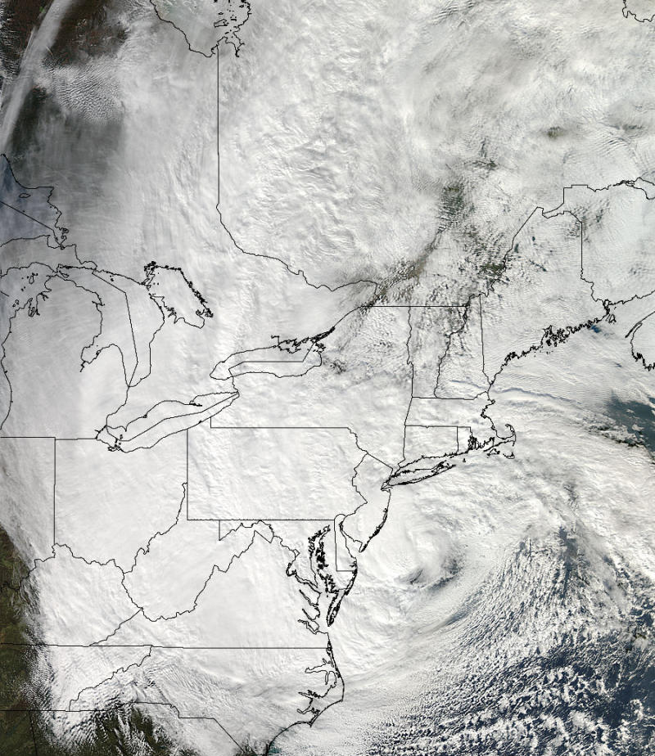
Superstorm Sandy
Highest water level recorded at the Battery
Largest wave measured off NJ coast (44025)
Lowest cp for landfalling NE hurricane
H>12’ over 1.4x10⁶ mi² (Area 1/2 Continental US)

Slide 3
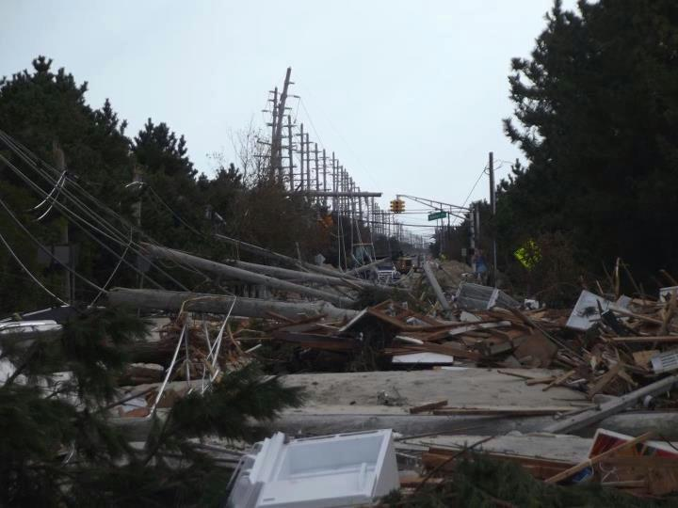

Slide 4
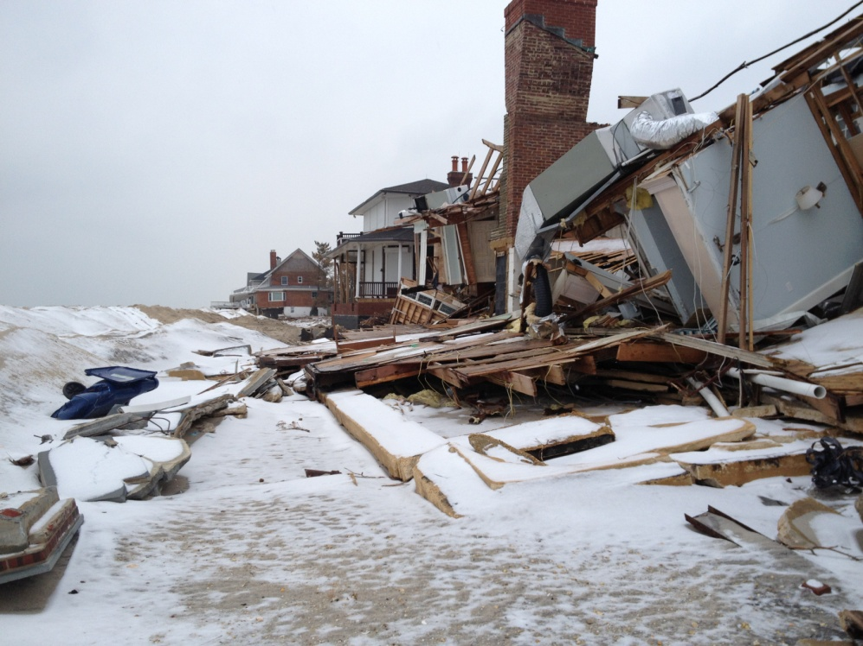
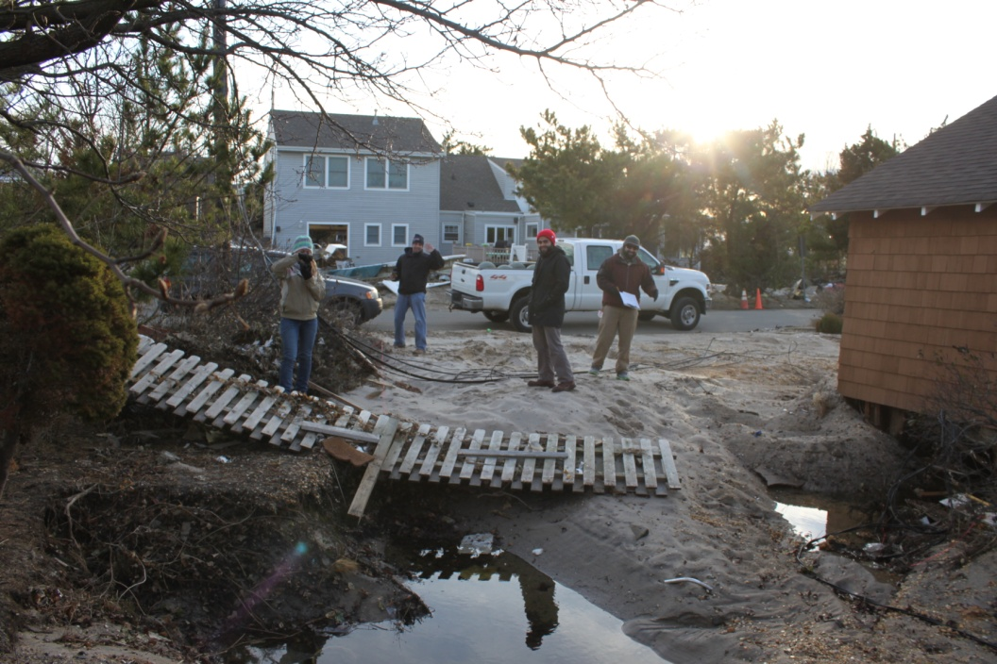
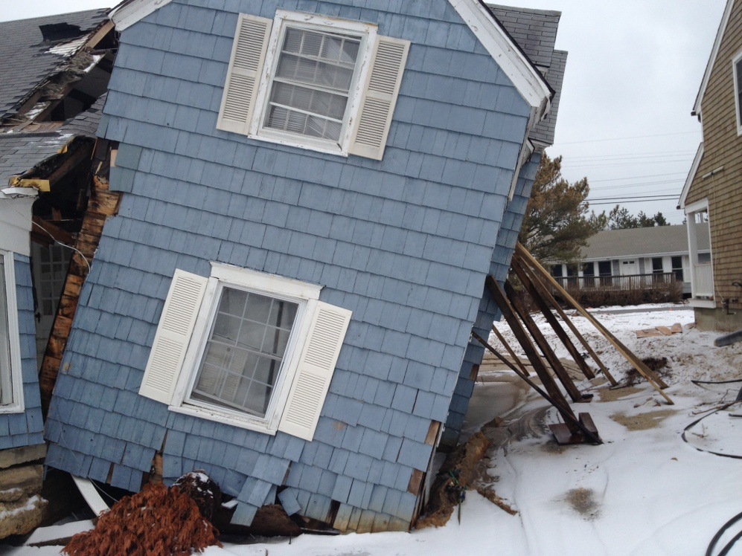
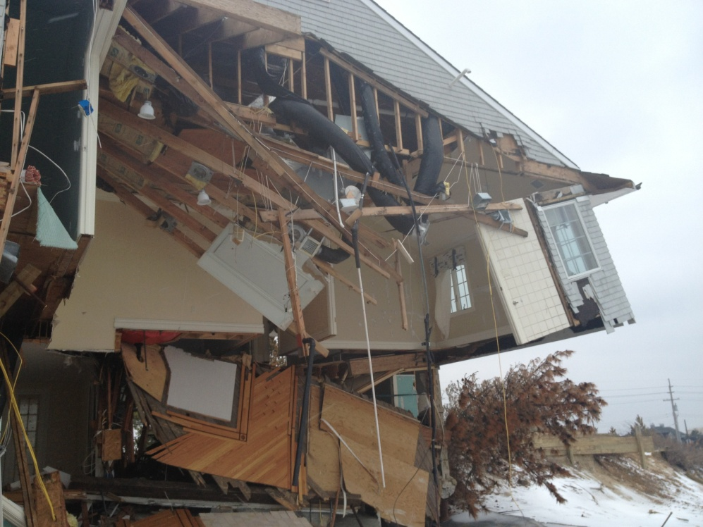
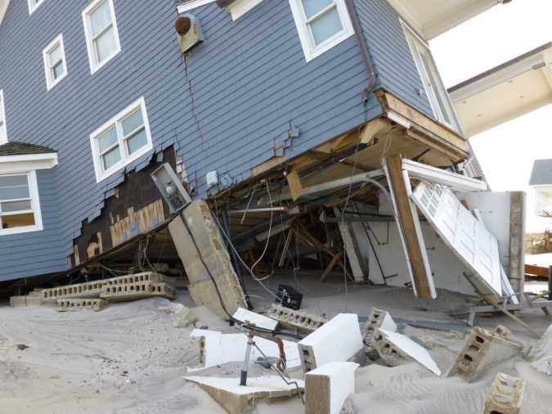
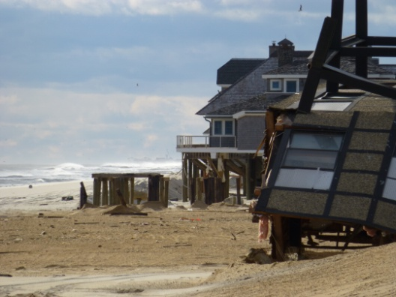

Slide 5
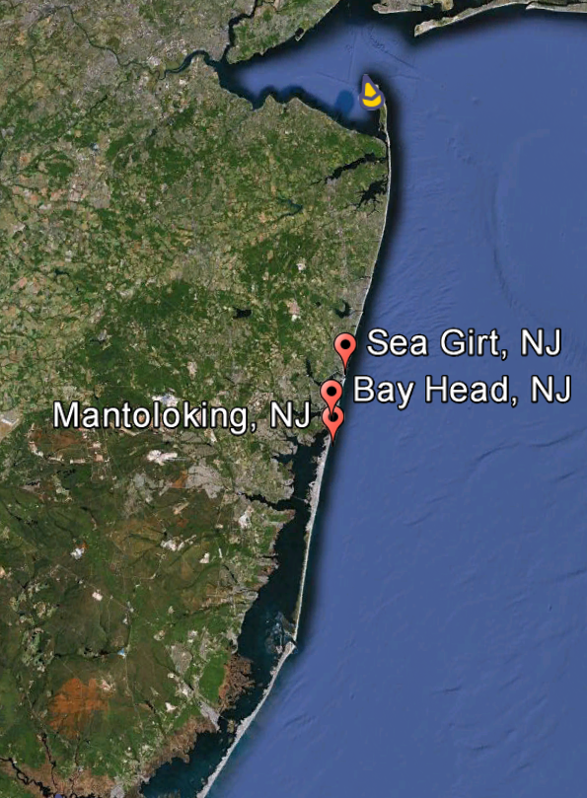
Community Profiles
Sea Girt
Wide beach/dune
High elevation
Bay Head
Stable beach/dune with groin field
Seawall protecting 75%
Mantoloking
Vulnerable
No structures

Slide 6
Field Equipment
Initial Pass
Damage Assessment Form
Handheld GPS
GPS Enabled Camera
Measuring Tape
Second Pass
Above +
RTK GPS

Slide 7
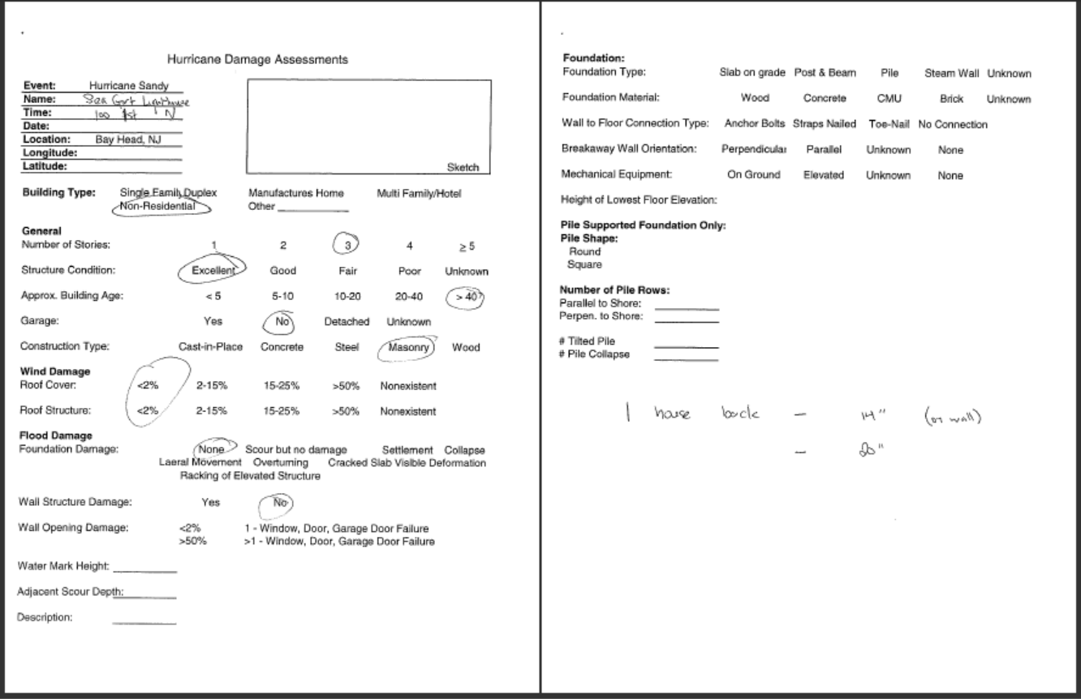
Damage Assessment Form
Modified from Freidland et al. (2008)

Slide 8
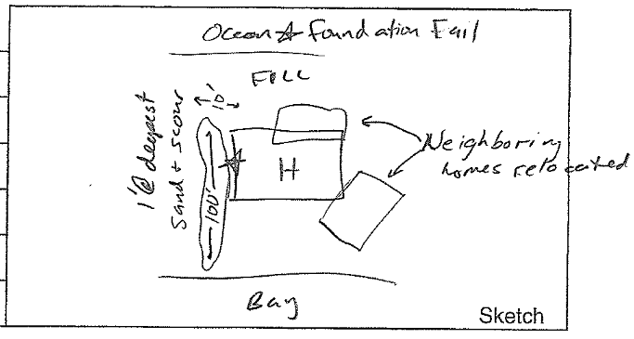
Sample Sketch

Slide 9
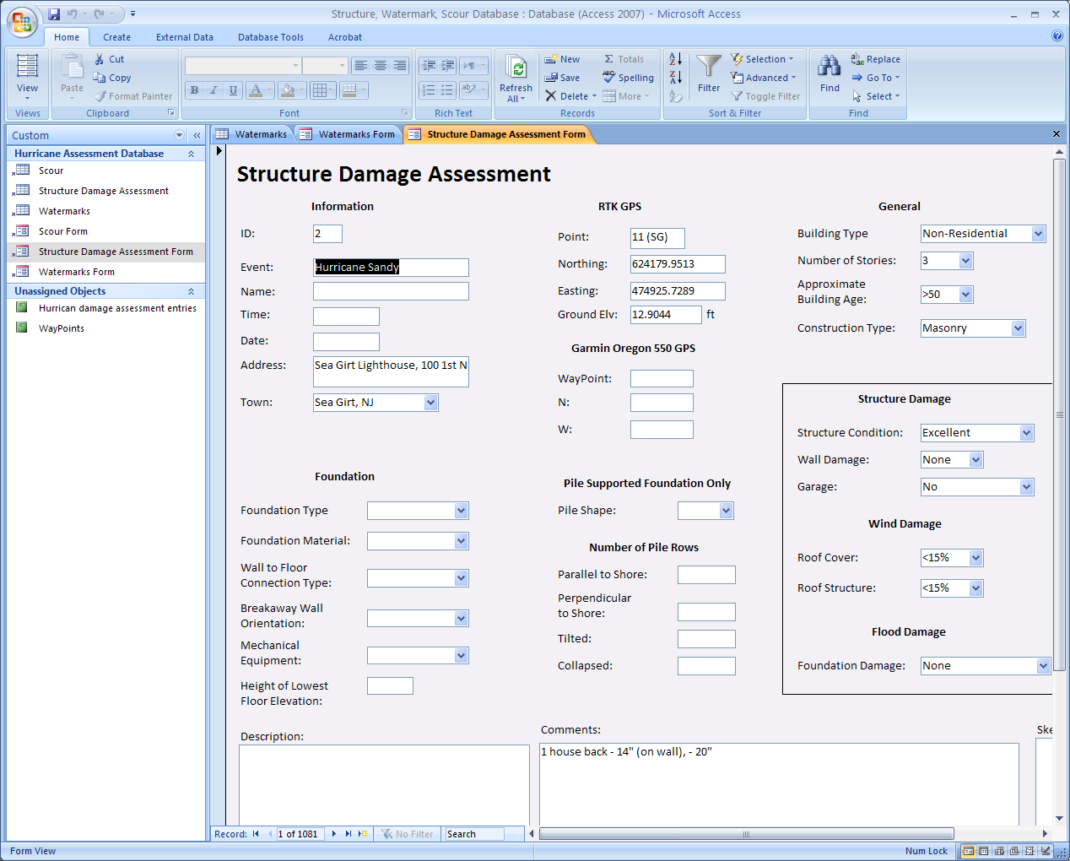
Microsoft Access Electronic Form (Structures)

Slide 10
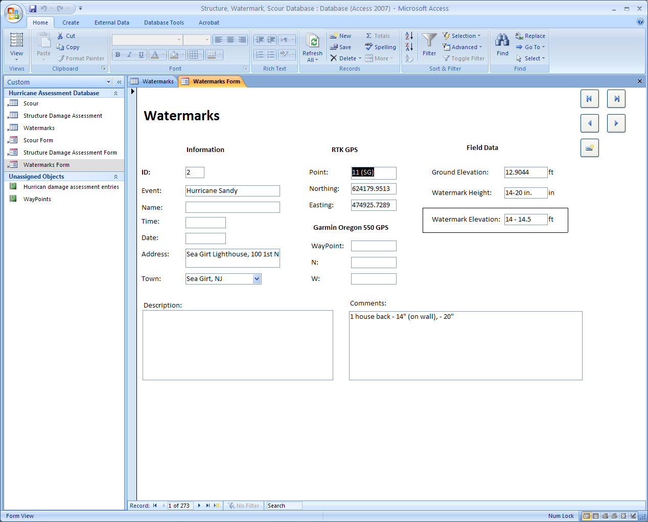
Microsoft Access Electronic Form (Watermarks)

Slide 11
GIS Data Presentation

Slide 12
In Total…
Over 500 Structural Evaluations
Over 150 Watermarks
Over one dozen scour depressions

Slide 13
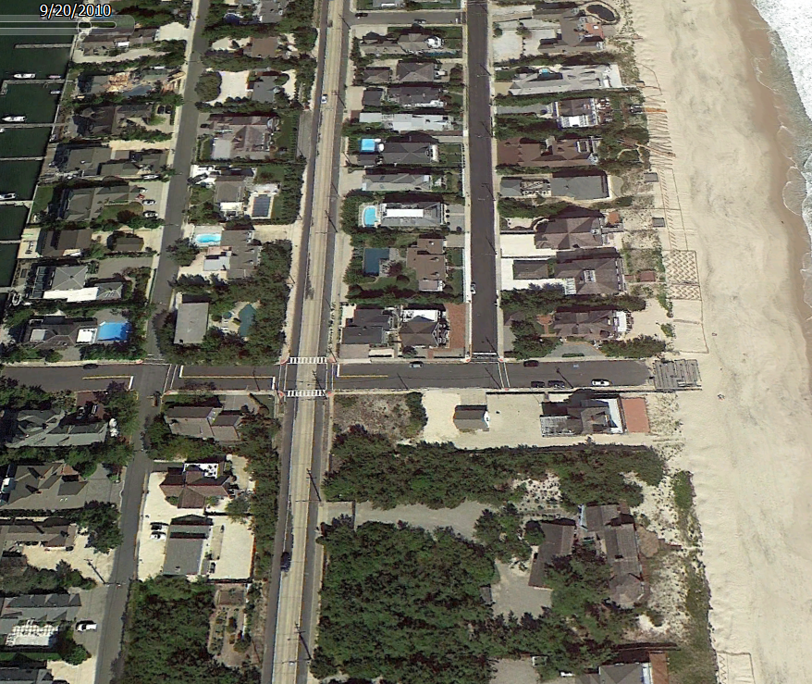
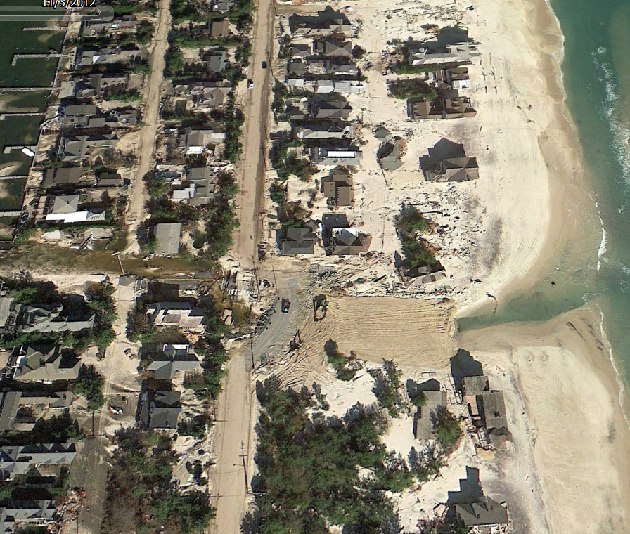
Details make the difference..

Slide 14
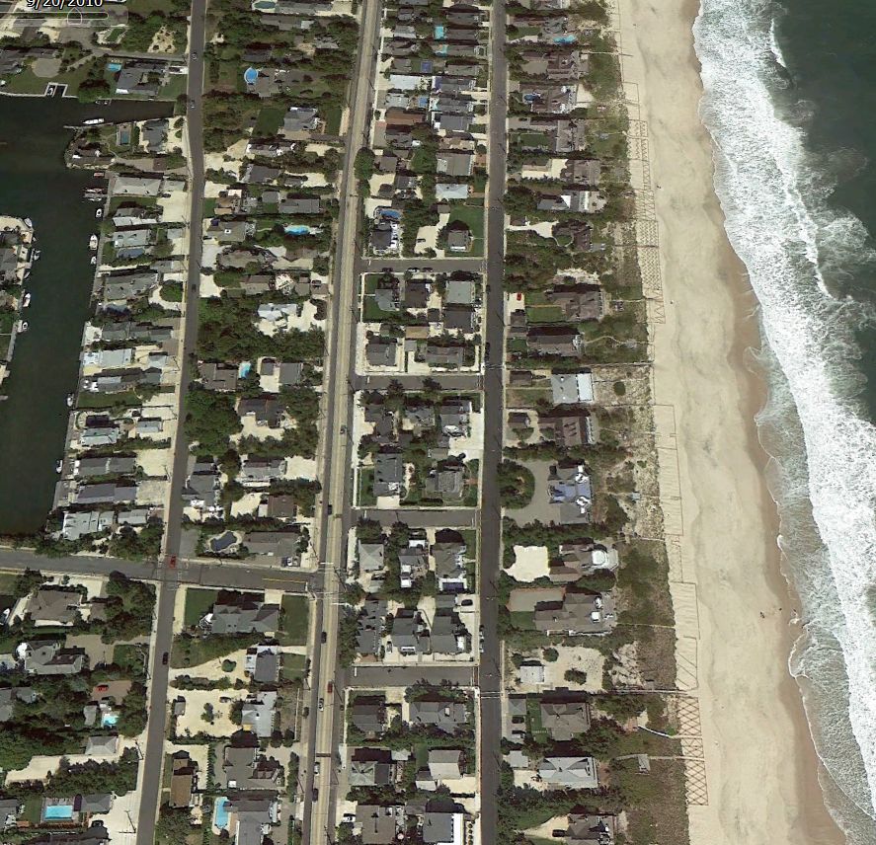
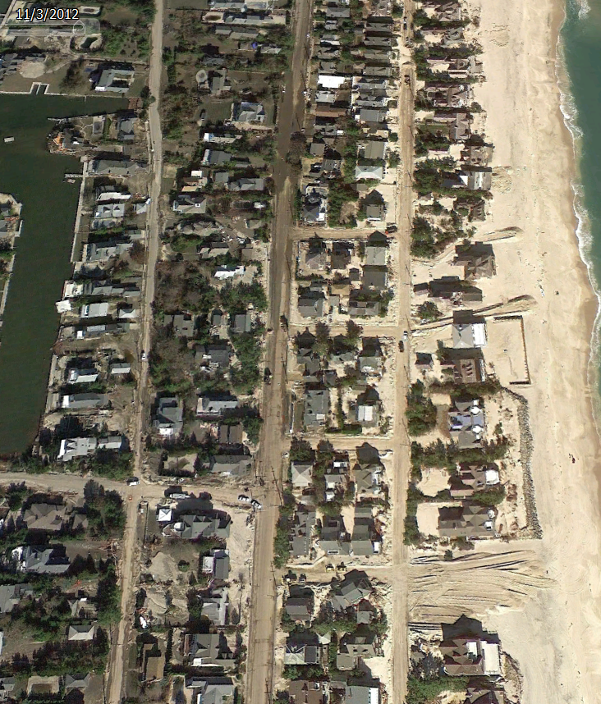
Details make the difference…

Slide 15
Questions?
For more info, contact:
Jon K. Miller (jmiller@stevens.edu)
Thomas Herrington (therring@stevens.edu)
The work discussed herein was supported by the
National Science Foundation through award #1318169

