Slide 1
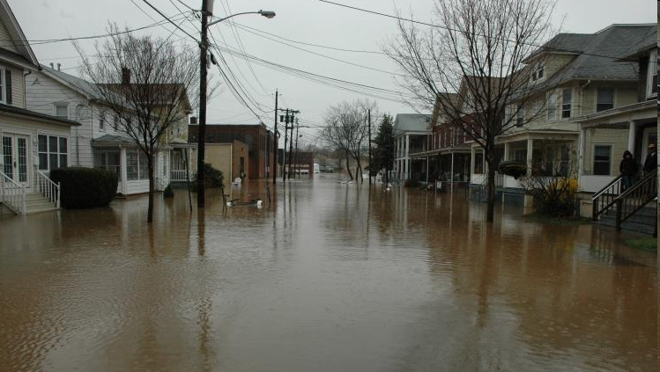
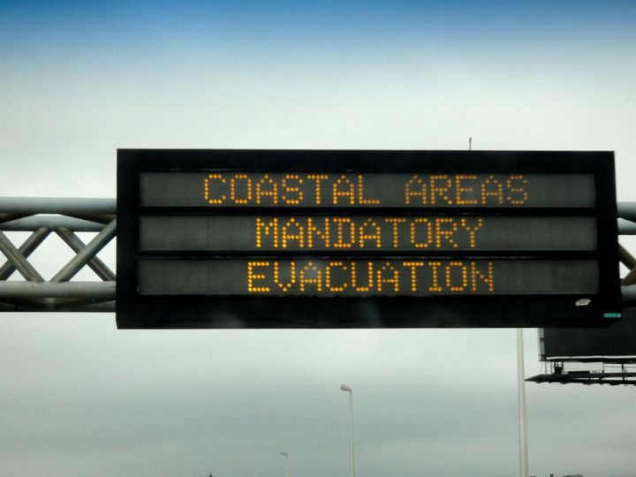
Data Science and Emergency Preparedness at CCICADA
Fred Roberts
Director, CCICADA

Slide 2
DHS CVADA Center
CCICADA = Command, Control & Interoperability Center for Advanced Data Analysis
One of two coordinated “halves” of the Center for Visual and Data Analytics, founded by DHS as a university center of excellence in 2009.
CCICADA is based at Rutgers
CCICADA emphasizes data analysis.
The other half of the CVADA Center is based at Purdue and emphasizes visual analytics.
2

Slide 3
CCICADA Partners
Alcatel-Lucent Bell Labs
AT&T Labs - Research
City College of NY
Howard University
Princeton University
Rensselaer Polytechnic Inst.
Texas Southern University
University of Massachusetts, Lowell
University of Medicine & Dentistry of NJ
Applied Communications Sciences
Carnegie-Mellon Univ.
Geosemble Technologies
Morgan State University
Regal Decision Systems
Rutgers University (Lead)
Tuskegee University
University of Illinois, Urbana Champaign
University of Southern California

Slide 4
Why CCICADA?
Virtually all of the activities in the homeland security enterprise require the ability to reach conclusions from massive flows of data.
This is especially true in emergency preparedness.
Here: Examples of CCICADA
projects involving data science and
emergency preparedness
4

Slide 5
Example 1. Project with FEMA Region II: Flood Mitigation on the Raritan River in NJ
Developed data-driven methods to determine which flood mitigation projects to invest in
Buyouts
Better flood warning systems
“Green infrastructure” (cisterns & rain barrels)
Pervious concrete
Etc.
Raritan River flood
Bound Brook, NJ
August 2011

Slide 6
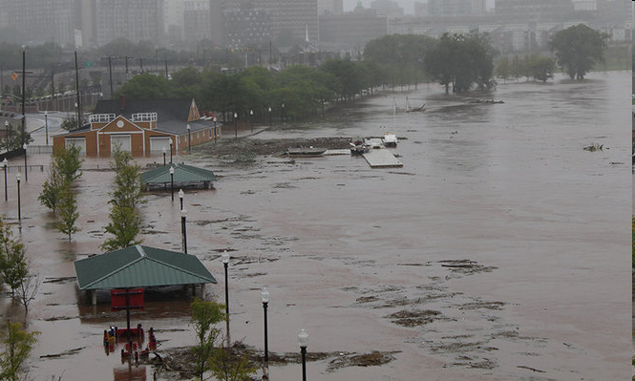
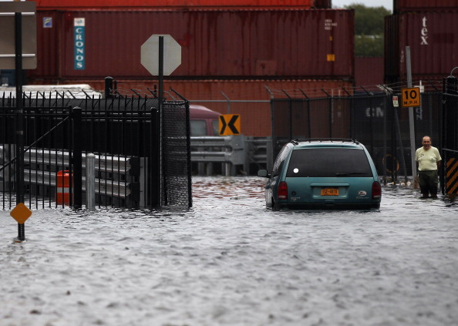
Flood Mitigation on the Raritan River
New tools for Data-driven Decision Support
Data driven. Assemble data about:
Precipitation (duration, amount)
Antecedent conditions (soil moisture content, ground cover, seasonality)
River guage levels
Flood maps
Property damage data – FEMA payouts

Slide 7
Flood Mitigation on the Raritan River
Developed general model for flood mitigation investment decision making
Component 1: Hydrological model to measure impact on peak flow of different mitigation strategies (catch basins, cisterns, “green infrastructure,” flood buyouts, better flood warning systems)
Component 2: Nonlinear, threshold-based regression model to relate peak flow and aggregrate flow over flood level to property damage (insurance claims)
Combined 2 components to calculate savings due to different flood mitigation strategies
Conclusion: linking of meteorology, hydrology, non-linear econometric modeling provides powerful tool for flood mitigation decision making
7

Slide 8
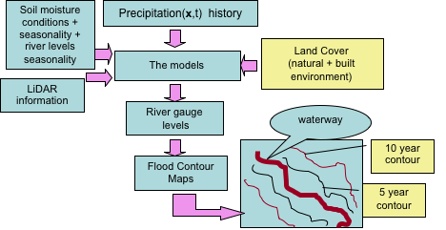
Flood Mitigation on the Raritan River
Project Participants: Blake Cignarella, Carlos Correa, Quizhong Guo, Paul Kantor, Fred Roberts, David Robinson – all Rutgers
8

Slide 9
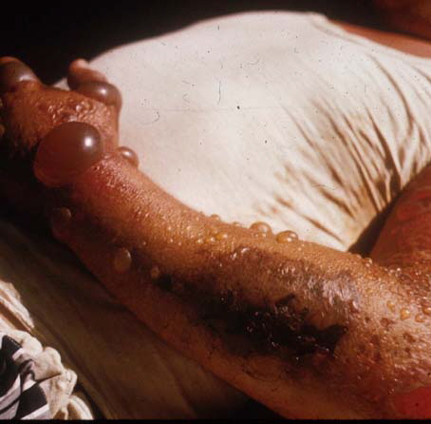
Example 2: Hippocrates Health Emergency Situational Awareness System
NJ’s response to anthrax scare of 2001 developed into Hippocrates, a web-based situational awareness
tool developed by NJ Dept. of
Health and Senior Services
Utilized by federal and state
agency partners.
9

Slide 10
Hippocrates Health Emergency Situational Awareness System
Applicability of Hippocrates to first responders limited due to difficulties of using it in the field.
NJ DHSS asked CCICADA to develop smart phone applications to enhance usability of Hippocrates by first responders.
10

Slide 11
Hippocrates Health Emergency Situational Awareness System
Apps developed for iPhone and Android
Certified software tester
Worked with first responders
Prototype delivered to NJ DHSS
They take over development
Project Participants:
UMDNJ: Panos Georgopolous, Sastry Isukapalli, Paul Lioy
Rutgers: Muthu Muthukrishnan, Christie Nelson, Bill Pottenger, Fred Roberts, Yves Sukhu
11

Slide 12
Example 3: Social Media and Emergency Response
People are everywhere; observe environments
Interconnected and reporting, they are an intelligent distributed ‘sensor’ network
We can track information flow on the non-private part of the network to determine what’s going on.
Catastrophes: Situation monitoring and response planning
Anomaly Detection: Recognizing problems before they occur
Challenge: Can we find out when
events occur and how they develop
by watching the twitter stream?

Slide 13
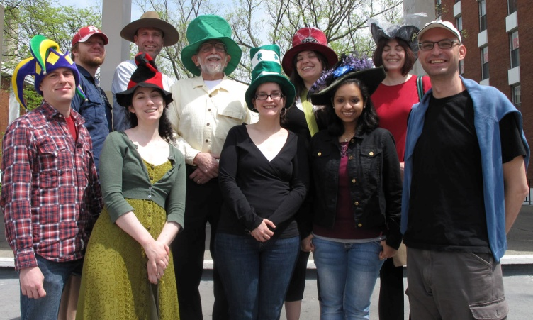
Social Media and Emergency Response
How do people use social media in emergency situation?
Funded by DHS First Responder Group
Collaboration among Rutgers, RPI, USC/ISI
Campus experiments at Rutgers (“Hat Chase”), data from real emergency near RPI
Collaboration with NJ OHSP and CUPSA (Assn of Campus Police of NJ)
Project Participants
UIUC: Dan Roth
USC: Ed Hovy
RPI: Cindy Hui, Al Wallace
Rutgers: Paul Kantor, Mor Namman, Bill Pottenger, Rannie Teodoro

Slide 14
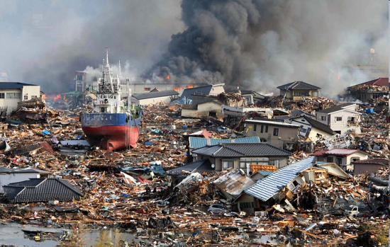
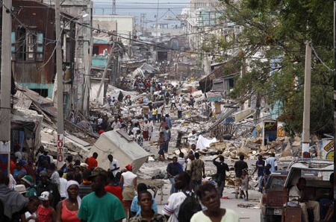
Social Media and Emergency Response
Our work in these projects has found:
Great diversity of communication
Interesting characteristics of network spread
People coordinate in different ways
People follow typical sequences when communicating in emergency situations
Understanding typical sequence allows crisis responders and others to identify “relapses,” pick out anomalies, etc.
New work using over 1 billion tweets from twitter, and communications during Japanese earthquake and tsunami and Haitian earthquake.
Looking for algorithmic approaches to processing large amounts of social media data
14

Slide 15
Trustworthiness in Disaster Situations
Data during emergencies is often inconsistent or conflicting
Could be due to noise or malicious intent
Developing computational tools to address problem of trustworthiness in such contexts
Need find appropriate degree of “trust” in claims made.
Need precise definitions of and metrics for factors contributing to trust: accuracy, completeness, bias
Project Participants
UIUC: Dan Roth
USC: Ed Hovy
RPI: Cindy Hui, Al Wallace
Rutgers: Paul Kantor, Mor Namman, Bill Pottenger, Rannie Teodoro

Slide 16
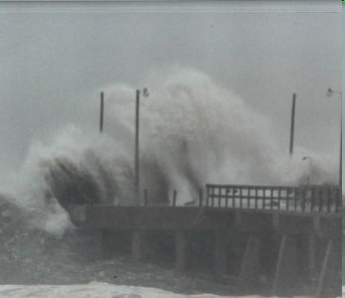
Example 4: Port Resilience
Ports might be shut down by terrorist attacks, natural disasters like hurricanes or ice storms, strikes or other domestic disputes, etc.
Project themes:
How do we design port operations to minimize vulnerability to shut down?
How do we reschedule port operations in case of a shutdown?
16
Notes:
16

Slide 17
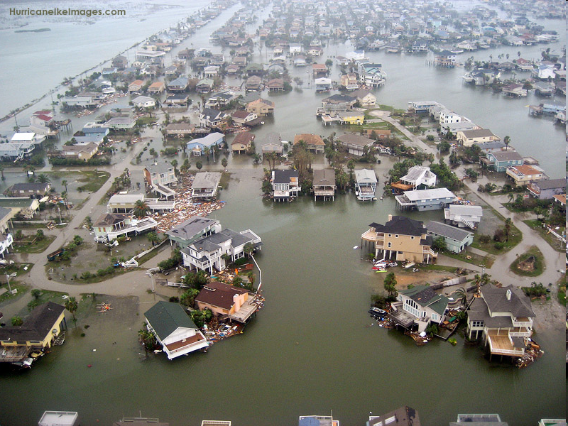
Reopening a Port After Shutdown
Shutting down ports is not unusual – e.g., hurricanes
Scheduling and prioritizing in reopening the port is often done very informally
Improving on existing decision support tools for port reopening could allow us to take many more considerations into effect
Can modern algorithmic methods based in data science help here?
17
Notes:
17

Slide 18
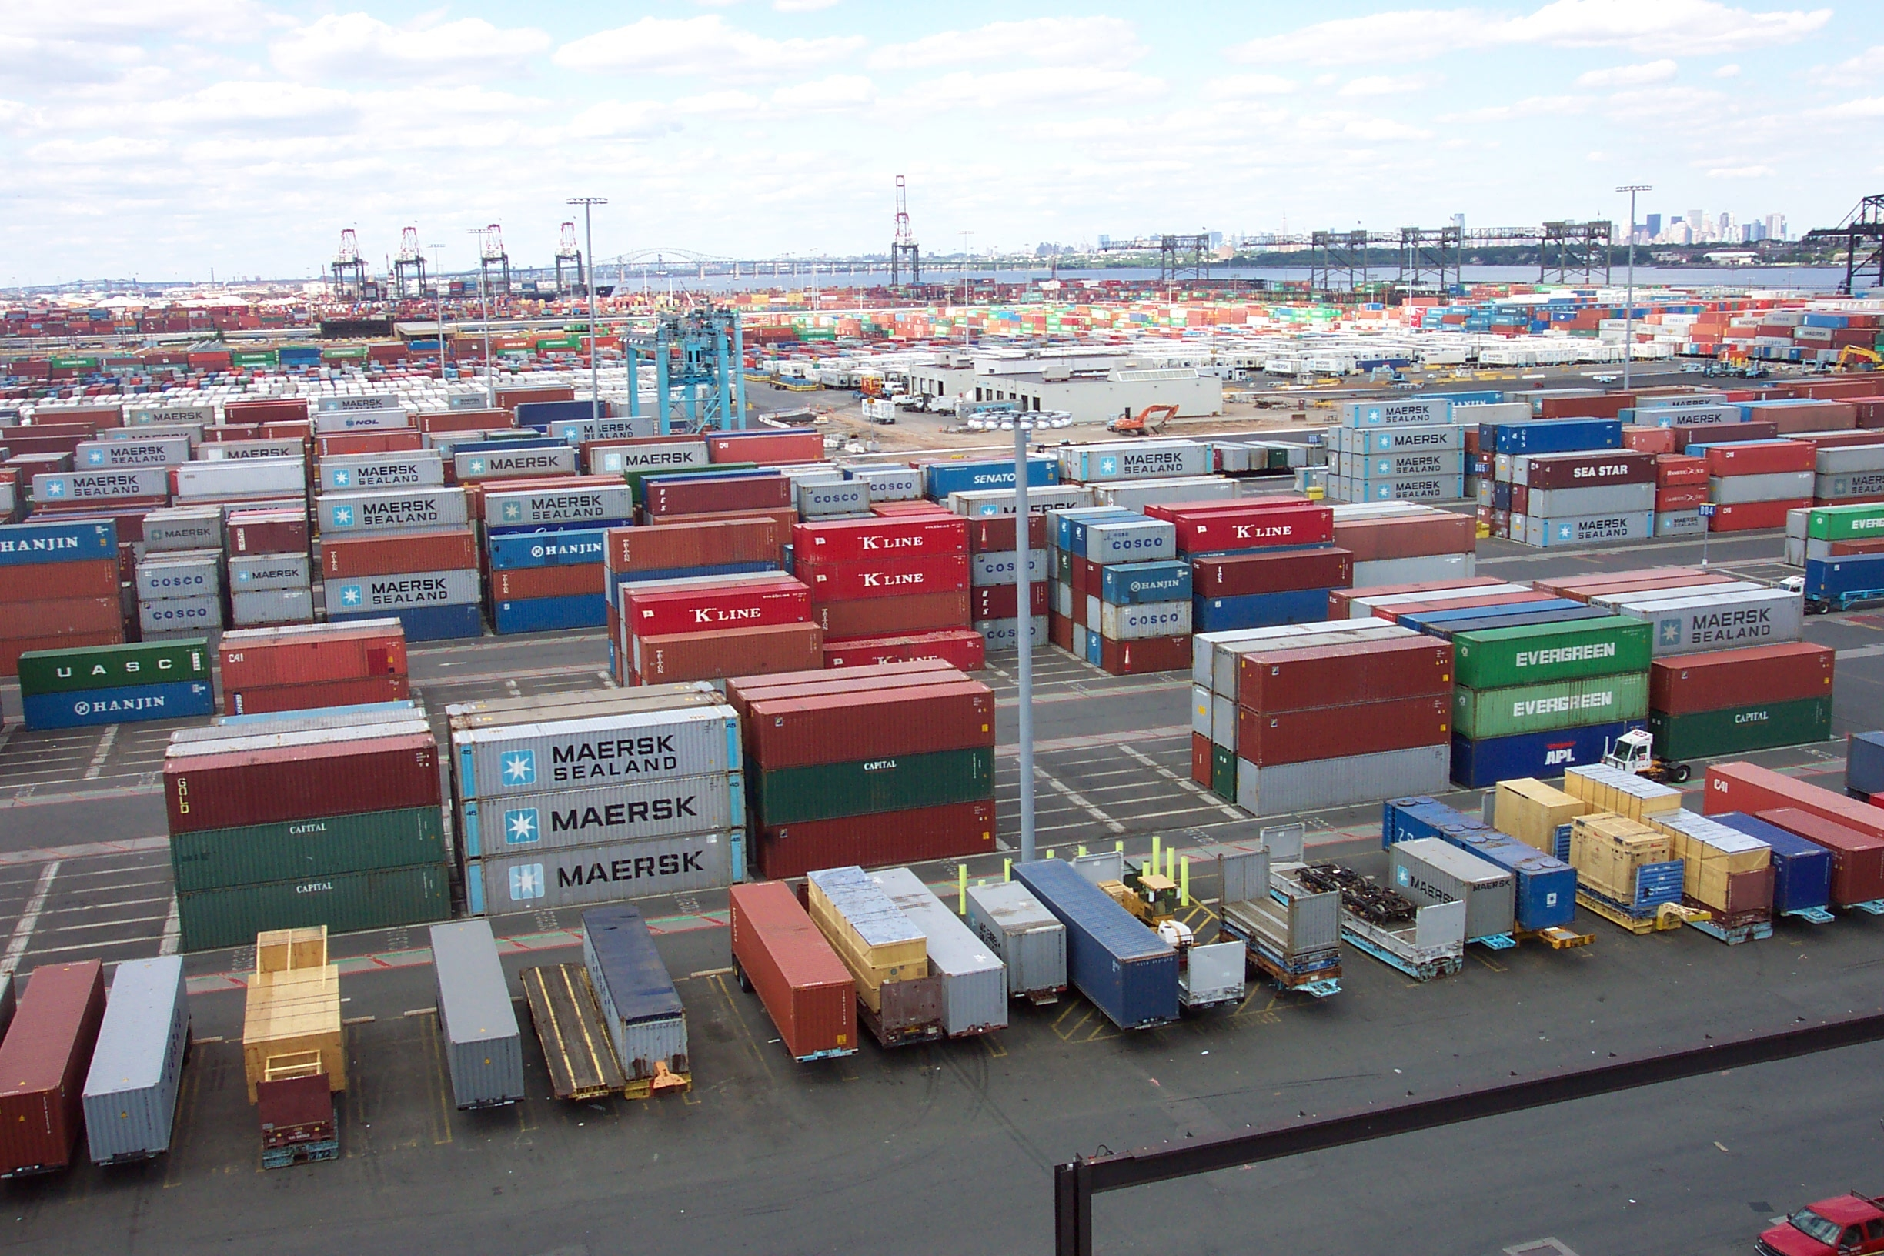
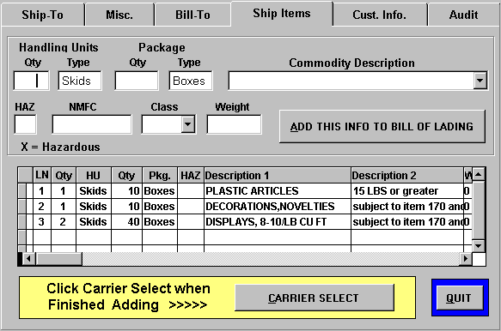
Manifest Data
Part of the solution to the port reopening problem: Detailed information about incoming cargo:
What is it?
What is its final destination?
What is the economic impact of delayed delivery?
A key is to use container manifest data to estimate economic impact of various disaster scenarios & understand our port reopening requirements
18
Notes:
18

Slide 19
Visualization Tools Applied to Manifest Data
Visualizing data can give us insight into interconnections, patterns, and what is “normal” or “abnormal.”
Visualization is part of another effort, but similar methods can help with the port reopening problem
Our visual analysis methods are based on tools originally developed at AT&T for detection of anomalies in telephone calling patterns – e.g., quick detection that someone has stolen your AT&T calling card.
The visualizations are interactive so you can “zoom” in on areas of interest, get different ways to present the data, etc.
19
Notes:
19

Slide 20
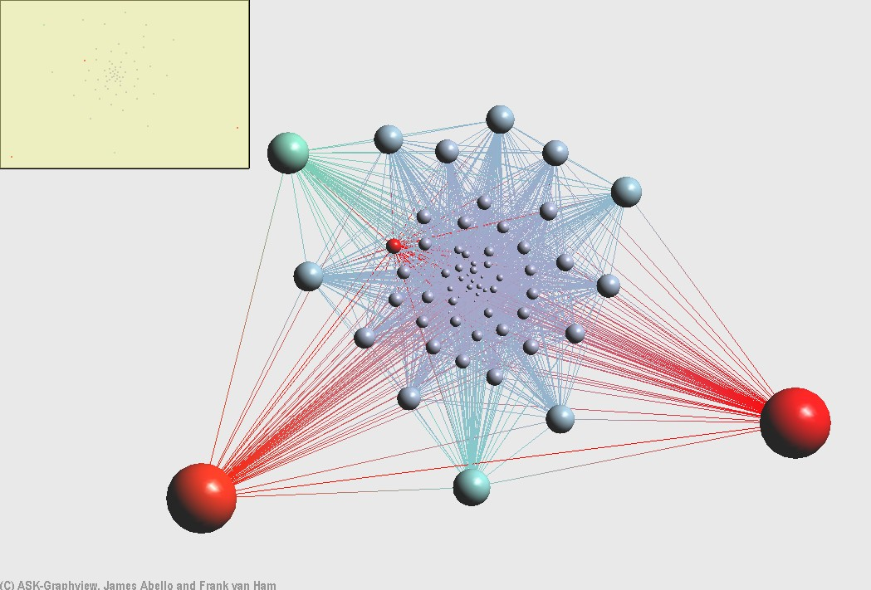
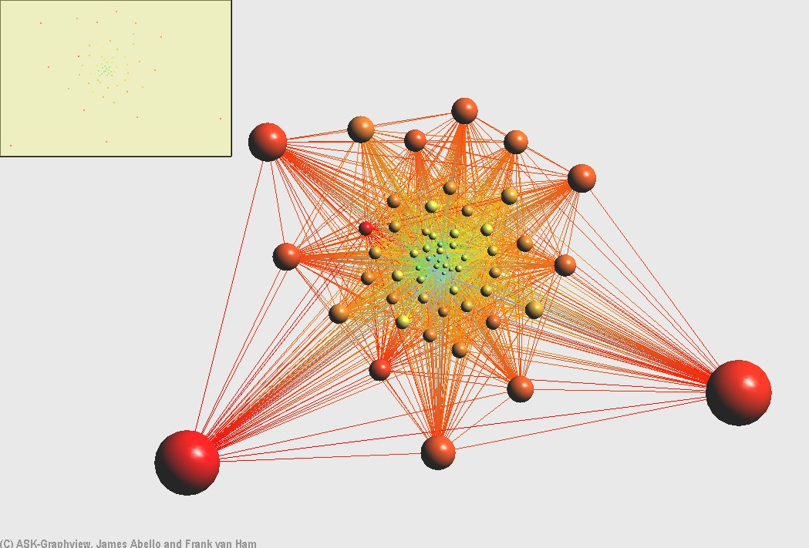
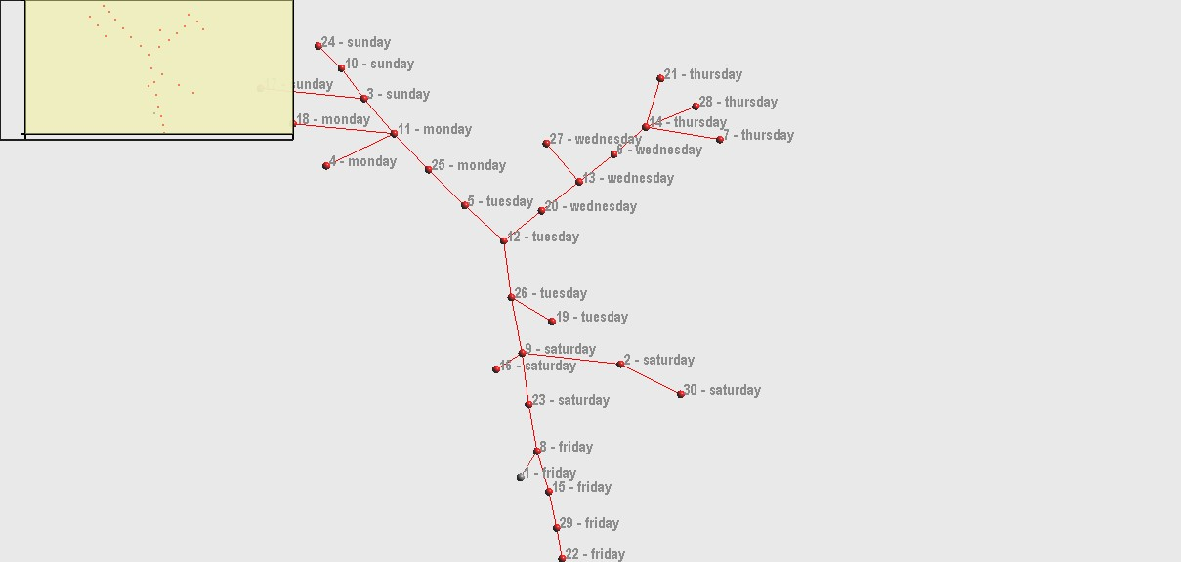
Visualization Tools Applied to Manifest Data
20
Notes:
20

Slide 21
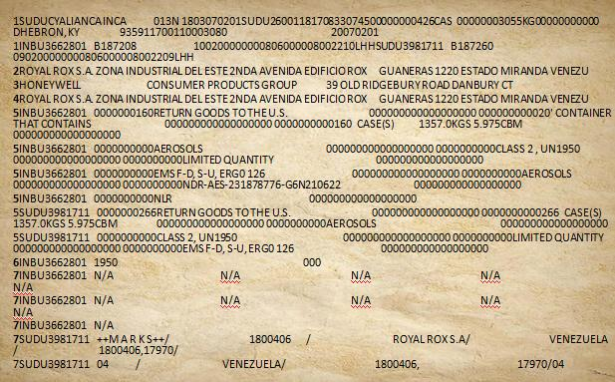
Manifest Data
Aside: Use of manifest data to do risk scoring of containers
We obtained from CBP one year’s data consisting of manifests for all cargo shipments to all US ports from container ships – every Wed.
Goal: Identify mislabeled or anomalous shipments through scrutiny of manifest data
Goal: compare effect of Japanese tsunami
21
21

Slide 22
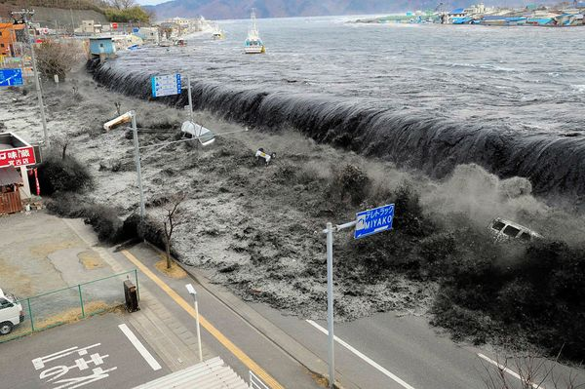
Manifest Data
Test of our risk scoring methods: looked at manifest data from before and after the Japanese tsunami. Expected to find differences.
Credit: National Geographic News
22

Slide 23
Manifest Data
We used statistical analysis tools (Poisson regression) to detect patterns or time trends of important variables.
Found that pattern of frequency data based on “domestic port of unlading” is statistically different before and after the tsunami.
But the pattern based on distribution of carrier is not
Conclusion: Don’t depend on just one variable to uncover anomalies.
23

Slide 24
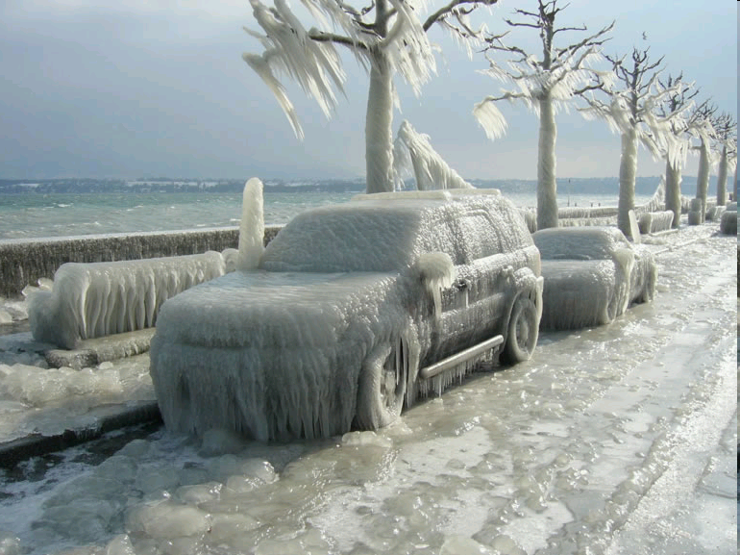
Resilience Modeling
If a port is damaged or closed, immediate problem of rerouting some or all incoming vessel traffic – if the reopening will be delayed for awhile.
Also: problem of prioritizing the reopening of the port – and deciding whether and how to reorder ships’ arrivals/unloading
These problems can be subtle.
Ice storm shuts down port
Maybe priority is unload salt to de-ice. It wasn’t a priority before.
24
Notes:
24

Slide 25
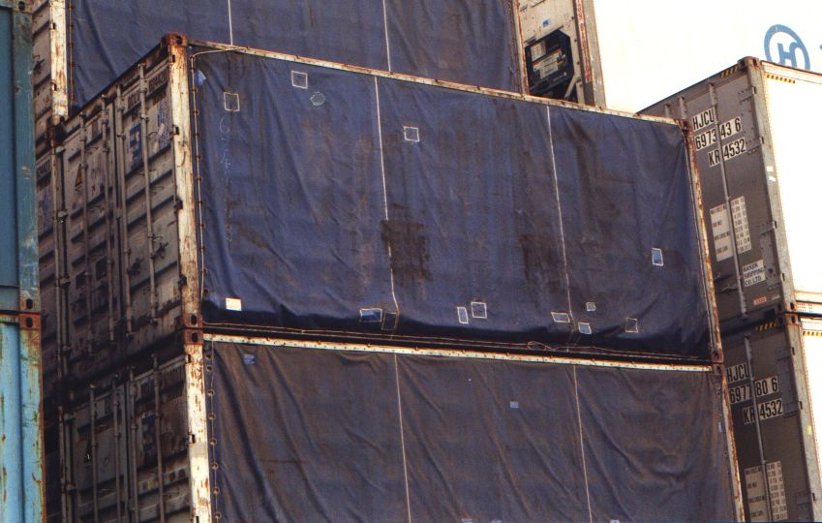
Resilience Modeling
Problem: Reschedule unloading of queued vessels.
Done by consult with shippers and their priorities
Also consult with key government agencies to target priority goods or shipments
Take into account potential spoilage of cargo
Take into account acute shortage of key items: food, fuel, medicine, etc.
Thus: Many variables to take into account and juggle
25
Notes:
25

Slide 26
Resilience Modeling
There are some subtleties:
The manifest data is unclear. In the case of water, 150 could mean 150 bottles of water or 150 cases of bottles of water.
The manifest data is unclear: Descriptions like “household goods” are too vague to be helpful
Different goods have different priorities. For example, not having enough food, fuel or medicine is much more critical than not having enough bottles of water.
26
Notes:
26

Slide 27
Resilience Modeling: Formulation
Desired amounts of each good
Priorities for each good
Port capacity: number of ships per timeslot
Desired arrival time for each good
Penalties for late arrival of a good
Unloading time per ship.
Delay time before unloading can begin – per ship
Storage time for unloaded goods
We made simplifying assumptions for each of these and formulated an optimization problem precisely.
Our methods show that sometimes a “greedy algorithm” can solve this problem.
Other times, the problem is NP-complete, i.e., “computationally intractable”
Project Participants: James Abello, Tsvetan Asamov, Endre
Boros, Mikey Chen, Paul Kantor, Neil Parikh, Fred Roberts,
Emre Yamangil – all Rutgers
27
Notes:
27

Slide 28
Example 5: Evacuation Modeling
One of effects of climate change is increasing number of extreme heat events.
Of great concern to CDC modeling group.
Our work has emphasized evacuations during extreme heat events.
Work is relevant to floods, hurricanes, etc.
Modeling challenges:
Where to locate the evacuation centers?
Whom to send where?
Goals include minimizing travel time, keeping facilities to their maximum capacity; sending people to facilities that can deal with their special needs
28

Slide 29
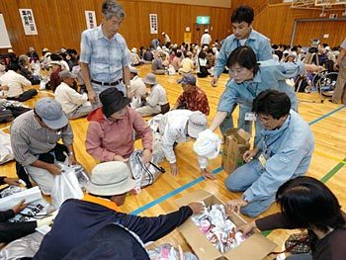
Optimal Locations for Shelters in Extreme Heat Events
Work based in Newark NJ
Data includes locations of potential shelters, travel distance from each city block to potential shelters, and population size and demographic distribution on each city block.
Determined “at risk” age groups and their likely levels of healthcare needed to avoid serious problems
29

Slide 30
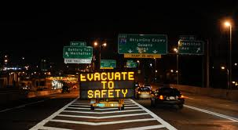
Optimal Locations for Shelters in Extreme Heat Events
Computed optimal routing plans for at-risk population to minimize adverse health outcomes and travel time
Used techniques of probabilistic mixed integer programming and aspects of location theory constrained by shelter capacity (based on predictions of duration, onset time, and severity of heat events)
Project participants: Endre Boros, Melike Gursoy, Nina Fefferman – all Rutgers
30

Slide 31
Example 6: Economics and Security
A joint project of 3 DHS COEs: CCICADA, CREATE, NTSCOE called the Urban Commerce and Security Study (UCASS)
The challenge: Understand the interface between security and commerce; what are the economic impacts of security initiatives.
Problem initiated around the WTC site in Lower Manhattan.
31

Slide 32
UCASS
Ultimate Project Goal: Develop a decision support tool that planners and decision makers can use to make choices about security initiatives/countermeasures
Usable to compare security measures or packages (“portfolios”) of security measures as to risk and economic consequences
Seek insights into when security acts as a barrier to economic activity and when it enhances such activity
Notes:
Looks like duplicate of 48

Slide 33
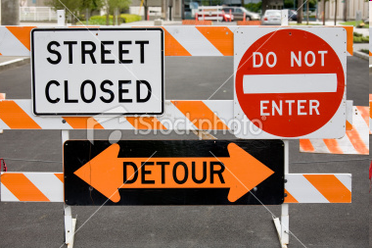
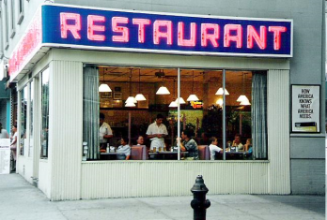
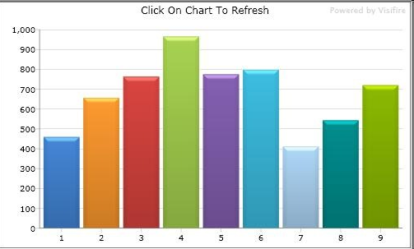
UCASS Research Methodology
Developed Modeling/Simulation Tools:
ARENA and OMNet++
Input: scenario and a security countermeasure
Input: information about probabilities of different movements/behaviors
If a pedestrian passes a restaurant, what is probability she will go inside?
If a car finds a street blocked, what is probability it will make a right turn and seek a parallel street?
Output: Changes in level of economic
activity (after an hour, day, year)
Combine with CREATE economic
models to estimate spillover effects/
regional economic impact
33

Slide 34
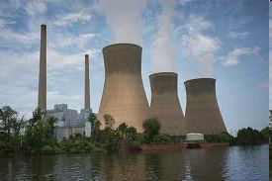
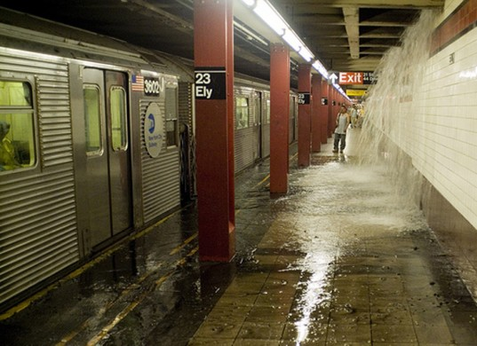
Other Applications
Worked with partners such as NJ OHSP to explore applications of the methodology.
NYC OEM suggested applying methods to recovery from disasters: which facility to reopen first?
Project participants:
San Jose State: Brian Jenkins
USC: Misak Avetisyan, Sam Chatterjee, Steve Hora, Adam Rose, Heather Rosoff
Rutgers: Selim Bora, Renee Graphia, Cindy Hui, Paul Kantor, Chistie Nelson, Bill Pottenger, Fred Roberts, Andrew Rodriguez, Jim Wojtowicz
34

