Slide 1
Properties of symmetric primes with implications for primality testing for extremely large numbers Brad Clardy Xalgos DIMACS Workshop on Mathematics of Post –Quantum Cryptography January 12, 2015

Slide 2
Why a new primality test matters
There are many primality tests in use, both probabilistic and deterministic. The type of test used depends on the nature of the application. If 100% certainty is required, such as in publishing a new record prime, then a deterministic test is necessary, but it comes at a cost. Deterministic tests are much slower and become increasingly more impractical the larger the number. Probabilistic tests are much quicker but run the risk of returning “false positives” that are, in fact, strong pseudo primes or Carmichael numbers. This can be minimized by repeated application of a probabilistic tests and then testing some small primes as factors.
Large primes are at the heart of public many encryption methods. Conventional wisdom is that the size of primes in use and the methods of determining primality are adequate for most purposes, but that may soon change. Quantum computing is on the horizon and with it comes the prospect that all current encryption schemes based on “large primes”, will not be large enough. It is possible that private and secure communications encrypted using current methodologies, which may have been intercepted in transit and stored, could be almost instantly cracked with the advent of a viable quantum computer.
While quantum technology may also provide some new tools for facilitating secure communication, they aren't here yet. This creates a gap of vulnerability in the time between now and the introduction of quantum computing. Even without the super computers of the future it has become clear that a lot of data is not as secure as was once thought. Stories of hacked systems, cracked credit card information and identity theft are daily news items. While increasing the length of the primes used by a few bits may yield a little more security, this will clearly not be adequate for what is coming. Either entirely new approaches or much, much larger primes will be necessary.
Utilizing much larger primes presents its own set of problems. Deterministic tests become impractical, and probabilistic tests still have the same problems; they are just bigger. The “Primality Test for Extremely Large Numbers” developed has the advantage that it is parallelizable, only requires a cheap test like the Fermat test, and it can be demonstrated that the method eliminates 95% of all potential Carmichaels – without resorting to factoring. The use of primes from this type of test may be capable of protecting privileged communications now from prying eyes in the near future.
The primality test is envisioned as a tool that can be incorporated in existing prime based encryption protocols. It might be utilized in some new yet to be proposed encryption standard. While the test might find its primary application in extending the life of systems like RSA public key encryption, it is possible that other encryption schemes based on unpublished math related to this test may be possible, particularly in the area of on-the-fly rather than static encryption methods.

Slide 3
1915 - 2015
Über das Goldbachsche Gesetz und die Anzahl der Primzahlpaare (V. Brun, 1915)
La série 1/5+1/7+1/11+1/13+1/17+1/19+1/29+1/31+1/41+1/43+1/59+1/61+..., où les dénominateurs sont nombres premiers jumeaux est convergente ou finie
(V. Brun, 1919)
Some Problems of ‘Partitio Numerorum.' III. On the Expression of a Number as a Sum of Primes (G. H. Hardy and J. E. Littlewood, 1923)
Généralisation du théorème de Brun (B. Segal, 1930)
Enumeration to 10¹⁴ of the Twin Primes and Brun's Constant (T. Nicely, 1996)
Counting twin primes and Brun's constant new computation (P. Sebah, 2002)

Slide 4
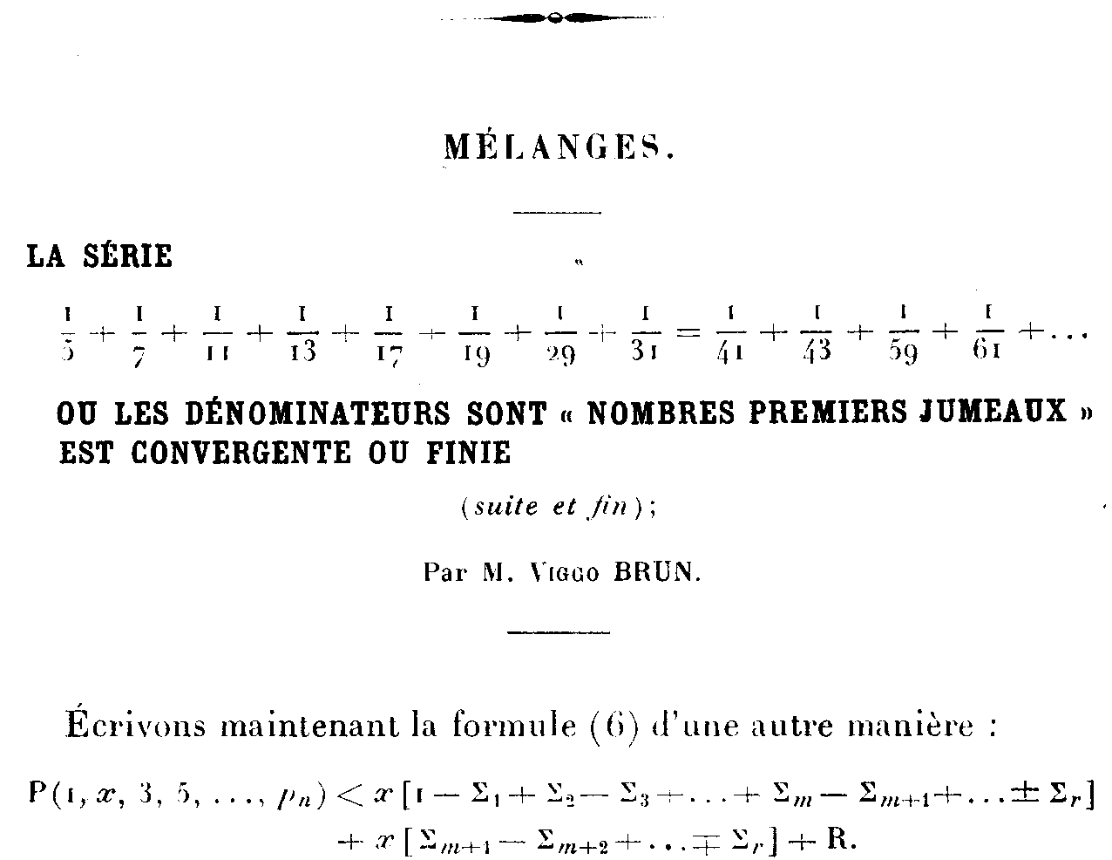

Slide 5
Some other properties
Starting with (5,7) all other twins
1: never cross a power of two
2: are symmetric within a power of two interval or a recursively halved subdivision
3: can be written simply as (6*n-1,6*n+1)

Slide 6
Symmetric Primes and OEIS A199824*

Slide 7
OEIS entry for A199824
A199824 Primes in successive intervals (2^i +1 .. 2^(i+1) -1) i=1,2,3,... such that there are no
prime symmetric XOR couples in either the original interval or any recursively
halved interval that contains them.
67, 167, 587, 719, 751, 769, 1129, 1163, 1531, 1913, 2099, 2153, 2543, 2819, 3049, 3079, 3709,
3967, 4691, 4861, 4909, 5147, 5347, 5749, 5813, 5939, 6121, 6151, 6397, 6473, 6563, 6709, 6883,
6899, 6911, 7247, 7393, 7451, 7703, 7829, 7919, 8093, 8171, 8447, 8707, 8807, 8963, 9157, 9161,
9209 (list; graph; refs; listen; history; text; internal format)

Slide 8
Extending those properties
1: only separation distances d of the form
d = 2, 6, 10, 14… 4*n + 2 are permissible
2: the number of pairs of primes separated by distance d that bracket a
power of two, appears to be finite
d = 2 [ 3 ]
d = 6 [OEIS A220951: 5, 7, 11, 13, 31, 61, 251, 4093 ] (next>2^750740)
d = 10 [OEIS A220746: 3, 7, 13, 31, 61, 127, 1021, 1048573,
23945242826029513411849172299223580994042798784118781]
3: not crossing a power of two and symmetry seem to be necessary
conditions for convergence of reciprocal sums in a maximal set of primes

Slide 9
Extending those properties
d=2 6*n +/- 1
d=6 4*n +/- 3
d=10 24*n +/- 5
d=14 24*n +/- 7
d=18 16*n +/- 9
4: where i(d)=Int log2(d) represents the power of two in which d occurs and d the separation distance,
if 0==d mod 3, pairs are 2^(i(d))*n +/- d/2
else 3*2^(i(d))*n +/- d/2

Slide 12
Symmetric/all Primes
*/all Primes

Slide 15
Ratio of Fractional Contributions */symmetric by Power of Two Interval 1 at 2^n where n=e^(4.77*10^9)?

Slide 16
Carmichael* / Carmichael by Power of Two Interval

Slide 18
Twin Primes Below 2000 x axis is number of prime connections y axis is number of composite connections

Slide 20
A near deterministic primality test algorithm for extremely large numbers
x is a number previously determined to be a probable prime
determine “n” -- the power of two interval in which x occurs, the integer portion of log2(x)
generate “xor” numbers to create the symmetric couples associated with x in its interval
2, 6, 14, 30…2^n-2
xor these numbers with the number being tested and then test that number to see if it is composite
the return of any xor paired number as a probable prime ends the test as “indeterminate”
the successful return of all paired numbers as composite ends the test as “extremely probable prime”

