Slide 1
Sorting, Searching, and Simulation in the MapReduce Framework
Michael T. Goodrich
Dept. of Computer Science

Slide 2
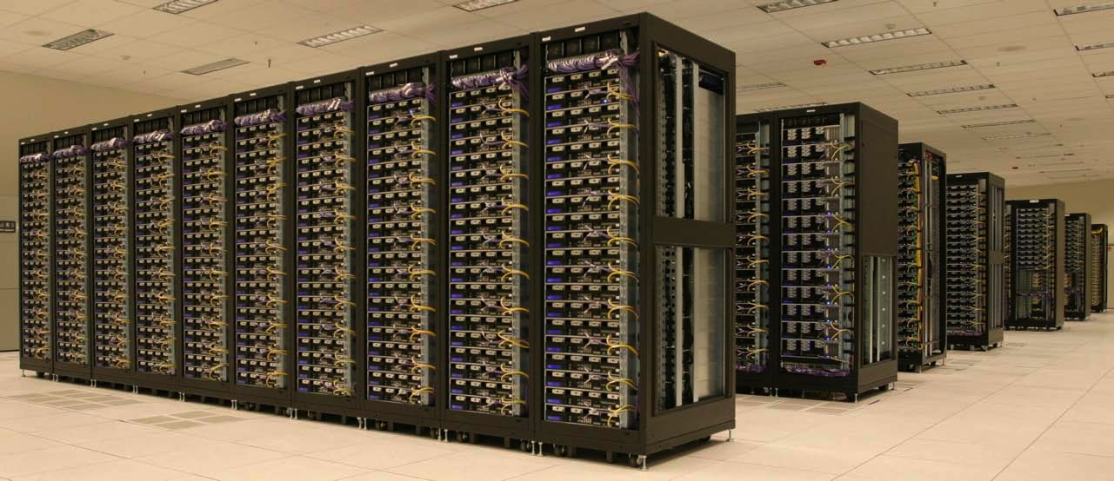
MapReduce
A framework for designing computations for large clusters of computers.
Decouples location from data and computation
Image from taken from Yahoo! Hadoop Presentation: Part 2, OSCON 2007.

Slide 3
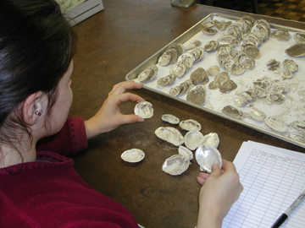
Map-Shuffle-Reduce
Map:
(k,v) -> [(k₁,v₁),(k₂,v₂),…]
must depend only on this one pair, (k,v)
Shuffle:
For each key k used in the first coordinate of a pair, collect all pairs with k as first coordinate
[(k,v₁),(k,v₂),…]
Reduce:
For each list, [(k,v₁),(k,v₂),…]:
Perform a sequential computation to produce a set of pairs, [(k’₁,v’₁),(k’₂,v’₂),…]
Pairs from this reduce step can be output or used in another map-shuffle-reduce cycle.
Image from http://www.wvculture.org/shpo/es/graphics/6-sorting%20shell.jpg

Slide 4
A Simple Example
Count number of occurrences of each word in a large document or corpus
Map: (word,null) -> (word,1)
Shuffle: groups occurrences of each word
Reduce: count number of 1’s in each list
This has one round of computation, but can take a long time (e.g., 7% of all English words are “the”).
Image from http://peterpappas.blogs.com/copy_paste/2009/01/build-literacy-skills-with-wordle.html

Slide 5
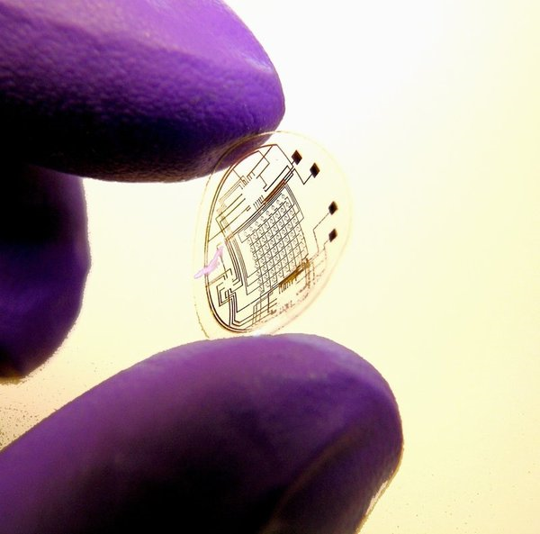
Evaluating MapReduce Algorithms
If map/reduce time is dominated by a buffer-size, B, parallelism is increased.
So time is dominated by number of rounds and message complexity
Eliminates false efficiency of the trivial one-round algorithm
similar approaches were used by
[Feldman et al., 08], who choose B=polylog(n)
[Karloff et al., 10], who choose B=n^{1-ε}
We choose B=n^{1/k}, for a given integer parameter, k>0, to allow for a spectrum of possible buffer sizes, e.g., k=2, 3, or 4 would be natural for real-world problem instances

Slide 6
Our Results
Label a set of inputs from 1..N in O(k) rounds
Simulate any bulk-synchronous parallel (BSP) algorithm with constant overhead
extends constant-overhead EREW PRAM simulation of [Karloff et al., 10]
Simulate any CRCW PRAM algorithm with an overhead of O(k) per PRAM step
Applications: sorting, 2-d/3-d convex hulls, fixed-d linear programming in O(k) rounds
Perform multisearching of a tree of size n with n searches

Slide 7
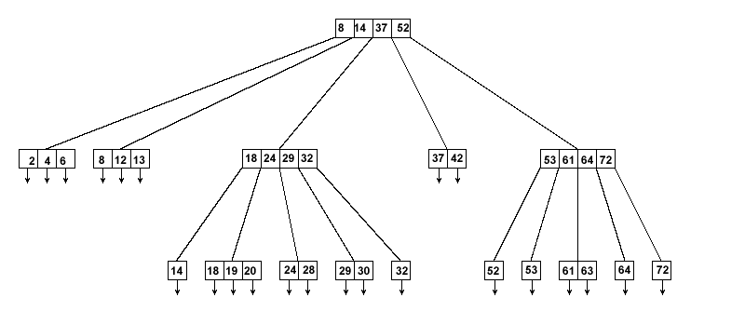
Invisible B-Trees
Define a B-tree labeling, (L,i), where L is a level and i is an index.
Each node knows its parent-node label and its children labels
Perform a top-down or bottom-up computation in such a tree, automatically ignoring missing nodes.
Image from http://svn.apache.org/repos/asf/xml/xindice/trunk/src/documentation/resources/images/

Slide 8
Invisible B-Trees
Allows for tree-based computations that utilize only the necessary nodes.
1,1
2,1
2,2
2,3
3,1
3,2
3,3
3,4
3,5
3,6
3,7
3,8
3,9
4,2
4,6
4,8
4,9
4,14
4,20
4,27
4,1
4,3
4,5
4,7
4,13
4,15
4,19
4,21
4,25
4,26
4,4

Slide 9
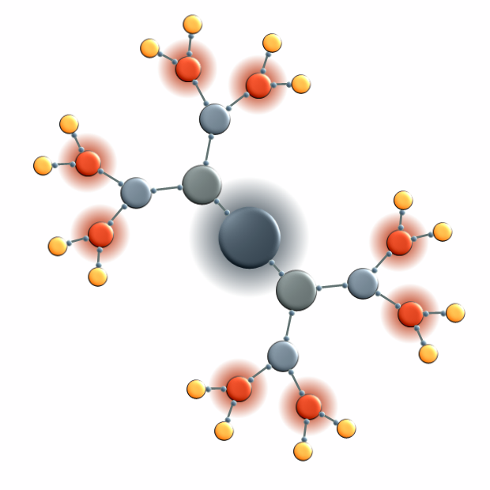
Index-Labeling the Input
B-ary distribute-and-combine:
Assign each pair a random value from 1 to N³
Apply invisible B-tree technique to perform a bottom-up sum (with each tuple worth 1)
Perform a top-down prefix sum computation
Now the pairs are numbered 1 to N.
Takes O(log_{B} N) = O(k) rounds.
Image from http://www.nevron.com/gallery/FullGalleries/diagram/symmetrical/images/binaryTree.png

Slide 10
BSP Simulation
Each super-step involves sending/receiving B messages.
To simulate:
Create a tuple for each memory cell and processor
Map each message to the destination processor label, P.
Reduce by performing one step of processor P, outputting the messages for next round.
Theorem: Given a BSP algorithm A that runs in T super-steps with a total memory size N using P < N processors, we can simulate A using T rounds and message complexity O(TM) in the memory-bound MapReduce framework with reducer buffer size bounded by B = N/P and total memory size M.
Some implications…

Slide 11
MapReduce Sorting
Given the optimal BSP algorithm of [Goodrich, 99], we can sort N values in the MapReduce framework in O(k) rounds and O(kN) message complexity.
Image from http://www.hatfulofhollow.com/posts/code/visualisingsorting/

Slide 12
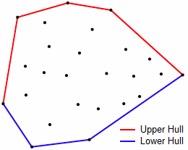
MapReduce Convex Hulls
Given BSP algorithms of [Goodrich, 97], we can do 2-d and 3- convex hulls in O(k) rounds, w.h.p., with message complexity O(kN).
Image from http://www.algorithmist.com/index.php/Monotone_Chain_Convex_Hull

Slide 13
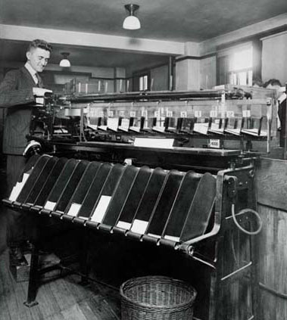
CRCW PRAM Simulation
Create tuples for memory cells and processors.
For each memory access, use an invisible B-tree to map read/write requests to the memory cells and back to the processors.
Allows us to simulate even the most powerful version of the CRCW PRAM, where writes are combined according to an associative function
Theorem: Given an algorithm A in the CRCW PRAM model, with write conflicts resolved according to a commutative semigroup function, f, such that A runs in T steps using P processors and N memory cells, we can simulate A in the memory-bound MapReduce framework in O(kT) rounds and O(kT(N + P)) message complexity, where k=O(log_{B} P).
Image from http://sky.geocities.jp/enokiec/enokiepisode/KeypunchSorting.jpg

Slide 14
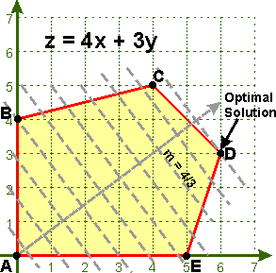
Fixed-d Linear Programming
[Alon and Meggido, 94] give a constant-time CRCW PRAM algorithm for fixed-d linear programming w.h.p.
This gives us a MapReduce algorithm running in time O(k) w.h.p.
Image from http://people.richland.edu/james/lecture/m116/systems/linear.html

Slide 15
Multisearching
Given: a binary tree T of size n and a set Q of n queries to perform on T.
Q={q₁,q₂,…,q_{n}}
[Goodrich 97] gives a BSP solution, but it would require O(n log2 n) message complexity to simulate it in the MapReduce framework.
T:

Slide 16
Pipelined Multisearching
Break Q into k random groups of size n/k each.
Sample from Q₁ to get an estimate of the query distribution.
Build the circuit of [Goodrich 97] for Q1.
Pipeline all the queries through this circuit.
Total time O(k).
Message complexity: O(kn)

Slide 17
Conclusion and Open Problems
We have given a general way of analyzing MapReduce algorithms and some techniques:
the invisible B-tree
index labeling
BSP simulation
CRCW simulation
multi-searching
Other problems:
Sparse graph problems?
B-tree
Image from http://travelhouseuk.files.wordpress.com/2009/08/invisible-man.jpg

