Slide 1
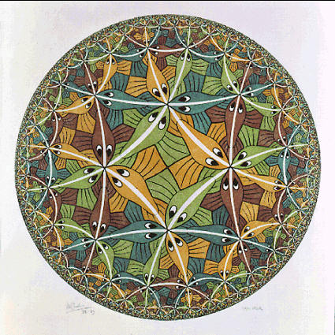

Locally Limited but Globally Unbounded:
Dealing with Resources in an Explicitly Parallel World
John Kubiatowicz
UC Berkeley
kubitron@cs.berkeley.edu

Slide 2
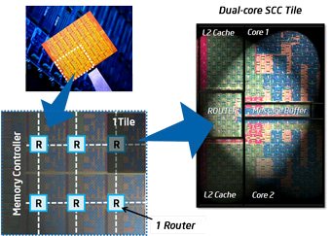
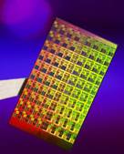
ManyCore Chips: The future is here
Intel 80-core multicore chip (Feb 2007)
  80 simple cores
  Two FP-engines / core
  Mesh-like network
  100 million transistors
  65nm feature size
Intel Single-Chip Cloud
Computer (August 2010)
  24 “tiles” – two cores/tile
  24-router mesh network
  4 DDR3 memory controllers
  Hardware support for message-passing
“ManyCore” refers to many processors/chip
  64? 128? Hard to say exact boundary
How to program these?
  Use 2 CPUs for video/audio
  Use 1 for word processor, 1 for browser
  76 for virus checking???
Parallelism must be exploited at all levels

Slide 3
A Lingering Problem: Imbalance
In today’s parallel world, we have a “globally unbounded” set of resources to interact with however:
As we increase number of components (processors, caches, network connections, cloud components…)
  We increase potential for Imbalance
  We increase potential for Denial of Service
  We increase potential for locality-induced Limits
  We increase potential to waste energy on unnecessary operations
  We increase potential for Privacy Leakage
Examples:
  Not enough local memory bandwidth
  Not enough networking bandwidth
  One element overuses memory, causing another component to fail to meet its realtime requirements
  Fast connection to local storage or cache, but slow connection to remote storage or cache
  Every component that stores information can leak it

Slide 4
But such problems are not new…
Every systems project (hardware, software) talks about imbalances of some sort
  And, they fix them
  And, the imbalances return
  And, they fix them again
Imbalances are unavoidable
  Universe of systems is a huge connected graph
    Choke-points in access to outside world
    Rent’s rule: # Connections ∝ (Nodes)^{p} with p < 1.0
  Surface over which remote resources can be accessed is smaller than volume enclosed –
    External resources may be unbounded but overloading of communication to them is easy (“Locally Limited”)
    Denial of service – other elements in local volume can overload remote access by a single element.
  Changing usage models ⇒ underprovisioned resources
  More elements ⇒ more things that can be out of balance

Slide 5
Hypothesis: it is time to introduce explicit tracking of (all? many?) resources into systems design
The Advent of ManyCore gives us a (good) excuse to reevaluate the structure of systems software

Slide 6

What might we want? RAPPidS
Responsiveness: Meets real-time guarantees
  Good user experience with UI expected
  Illusion of Rapid I/O while still providing guarantees
  Real-Time applications (speech, music, video) will be assumed
Agility: Can deal with rapidly changing environment
  Programs not completely assembled until runtime
  User may request complex mix of services at moment’s notice
  Resources change rapidly (bandwidth, power, etc)
Power-Efficiency: Efficient power-performance tradeoffs
  Application-Specific parallel scheduling on Bare Metal partitions
  Explicitly parallel, power-aware OS service architecture
Persistence: User experience persists across device failures
  Fully integrated with persistent storage infrastructures
  Customizations not be lost on “reboot”
Security and Correctness: Must be hard to compromise
  Untrusted and/or buggy components handled gracefully
  Combination of verification and isolation at many levels
  Privacy, Integrity, Authenticity of information asserted

Slide 7
The Problem with Current OSs
What is wrong with current Operating Systems?
  They (often?) do not allow expression of application requirements
    Minimal Frame Rate, Minimal Memory Bandwidth, Minimal QoS from system Services, Real Time Constraints, …
    No clean interfaces for reflecting these requirements
  They (often?) do not provide guarantees that applications can use
    They do not provide performance isolation
    Resources can be removed or decreased without permission
    Maximum response time to events cannot be characterized
  They (often?) do not provide fully custom scheduling
    In a parallel programming environment, ideal scheduling can depend crucially on the programming model
  They (often?) do not provide sufficient Security or Correctness
    Monolithic Kernels get compromised all the time
    Applications cannot express domains of trust within themselves without using a heavyweight process model
The advent of ManyCore both:
  Exacerbates the above with a greater number of shared resources
  Provides an opportunity to change the fundamental model

Slide 8
Explicitly Managed Resources

Slide 9
A First Step: Two Level Scheduling
Resource Allocation
And
Distribution
Monolithic
CPU and Resource
Scheduling
Two-Level Scheduling
Application Specific
Scheduling
Split monolithic scheduling into two pieces:
  Course-Grained Resource Allocation and Distribution
    Chunks of resources (CPUs, Memory Bandwidth, QoS to Services) distributed to application (system) components
    Option to simply turn off unused resources (Important for Power)
  Fine-Grained Application-Specific Scheduling
    Applications are allowed to utilize their resources in any way they see fit
    Other components of the system cannot interfere with their use of resources

Slide 10
Important Idea: Spatial Partitioning
Spatial Partition: group of processors within hardware boundary
  Boundaries are “hard”, communication between partitions controlled
  Anything goes within partition
Key Idea: Performance and Security Isolation
Each Partition receives a vector of resources
  Some number of dedicated processors
  Some set of dedicated resources (exclusive access)
    Complete access to certain hardware devices
    Dedicated raw storage partition
  Some guaranteed fraction of other resources (QoS guarantee):
    Memory bandwidth, Network bandwidth, Energy
    fractional services from other partitions

Slide 11
Performance w/ Spatial Partitioning
RAMP Gold: FPGA-Based Emulator
  64 single-issue
  in-order cores
  Private L1 Inst and
  Data Caches
  Shared L2 Cache
    Up to 8 slices using
    page coloring
  Memory bandwidth partitionable into
  3.4 GB/s units
Spatial partitioning shows the potential to do quite well
  However it is important to pick the right points.
(7.15)

Slide 12
Space-Time Partitioning
Space
Time
Space
Spatial Partitioning Varies over Time
  Partitioning adapts to needs of the system
  Some partitions persist, others change with time
  Further, Partititions can be Time Multiplexed
    Services (i.e. file system), device drivers, hard realtime partitions
    Some user-level schedulers will time-multiplex threads within a partition
Controlled Multiplexing, not uncontrolled virtualization
  Multiplexing at coarser grain (100ms?)
  Schedule planned several slices in advance
  Resources gang-scheduled, use of affinity or hardware partitioning
  to avoid cross-partition interference

Slide 13
Defining the Partitioned Environment
Our new abstraction: Cell
  A user-level software component, with guaranteed resources
  Is it a process? Is it a Virtual Private Machine? Neither, Both
  Different from Typical Virtual Machine Environment which duplicates many Systems components in each VM
Properties of a Cell
  Has full control over resources it owns (“Bare Metal”)
  Contains at least one address space (memory protection domain), but could contain more than one
  Contains a set of secured channel endpoints to other Cells
  Contains a security context which may protect and decrypt information
  Interacts with trusted layers of OS (e.g. the “NanoVisor”) via a heavily Paravirtualized Interface
    E.g. Manipulate address mappings without knowing format of page tables
When mapped to the hardware, a cell gets:
  Gang-schedule hardware thread resources (“Harts”)
  Guaranteed fractions of other physical resources
    Physical Pages (DRAM), Cache partitions, memory bandwidth, power
  Guaranteed fractions of system services

Slide 14
Resource Composition
Secure
Channel
Device
Drivers
Secure
Channel
Real-Time
Cells
(Audio,
Video)
Secure
Channel
Secure
Channel
Secure
Channel
Parallel
Library
Core Application
File
Service
Component-based model of computation
  Applications consist of interacting components
  Produces composable: Performance, Interfaces, Security
CoResident Cells ⇒ fast inter-domain communication
  Could use hardware acceleration for fast secure messaging
  Applications could be split into mutually distrusting partitions w/ controlled communication (echoes of μKernels)
Fast Parallel Computation within Cells
  Protection of computing resources not required within partition
    High walls between partitions ⇒ anything goes within partition
    Shared Memory/Message Passing/whatever within partition

Slide 15
It’s all about the communication
We are interested in communication for many reasons:
  Communication crosses resource and security boundaries
  Efficiency of communication impacts (de)composability
Shared components complicate resource isolation:
  Need distributed mechanism for tracking and accounting of resources
    E.g.: How guarantee that each partition gets guaranteed fraction of service?
How does presence of a message impact Cell activation?
  Not at all (regular activation) or immediate change (interrupt-like)
Communication defines Security Model
  Mandatory Access Control Tagging (levels of information confidentiality)
  Ring-based security (enforce call-gate structure with channels)
Application A
Secure
Channel
Shared File Service
Secure
Channel
Application B

Slide 16
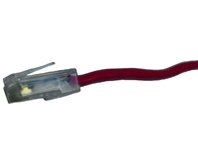

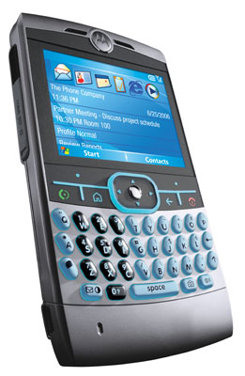


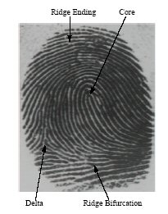

Tessellation: The Exploded OS
Normal Components split into pieces
  Device drivers (Security/Reliability)
  Network Services (Performance)
    TCP/IP stack
    Firewall
    Virus Checking
    Intrusion Detection
  Persistent Storage (Performance, Security, Reliability)
  Monitoring services
    Performance counters
    Introspection
  Identity/Environment services (Security)
    Biometric, GPS,
    Possession Tracking
Applications Given
Larger Partitions
  Freedom to use resources arbitrarily
Large Compute-Bound
Application
Firewall
Virus
Intrusion
Monitor
And
Adapt
Real-Time
Application
Video &
Window
Drivers
Persistent
Storage &
File System
Identity
HCI/
Voice
Rec
Device
Drivers

Slide 17

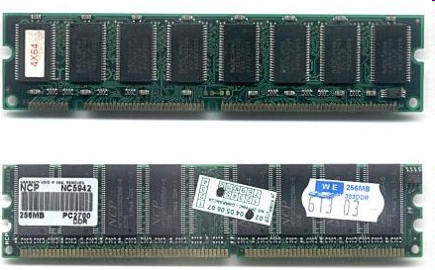
Tessellation in Server Environment
QoS
Guarantees
Large Compute-Bound
Application
Network
QoS
Large Compute-Bound
Application
Network
QoS
QoS
Guarantees
Large Compute-Bound
Application
Network
QoS
Large Compute-Bound
Application
Network
QoS
Monitor
And
Adapt
Monitor
And
Adapt
Cloud Storage
BW QoS
Monitor
And
Adapt
Large I/O-Bound
Application
Other
Devices
Monitor
And
Adapt
Large I/O-Bound
Application
Other
Devices
Large I/O-Bound
Application
Other
Devices
Large I/O-Bound
Application
Other
Devices
Persistent Storage &
Parallel File System
Disk
I/O
Drivers
Persistent Storage &
Parallel File System
Disk
I/O
Drivers
Persistent Storage &
Parallel File System
Disk
I/O
Drivers
Persistent Storage &
Parallel File System
Disk
I/O
Drivers
QoS
Guarantees
QoS
Guarantees

Slide 18
Tessellation’s
Resource Management Architecture

Slide 19
Another Look: Two-Level Scheduling
First Level: Global partitioning of resources
  Goals: Power Budget, Overall Responsiveness/QoS, Security
    Adjust resources to meet system level goals
  Partitioning of CPUs, Memory, Interrupts, Devices, other resources
  Constant for sufficient period of time to:
    Amortize cost of global decision making
    Allow time for partition-level scheduling to be effective
  Hard boundaries ⇒ interference-free use of resources for quanta
    Allows AutoTuning of code to work well in partition
Second Level: Application-Specific Scheduling
  Goals: Performance, Real-time Behavior, Responsiveness, Predictability
    Fine-grained, rapid switching
  CPU scheduling tuned to specific applications
  Resources distributed in application-specific fashion
  External events (I/O, active messages, etc) deferrable as appropriate

Slide 20
Space-Time Resource Graph
Resource
Group
Cell 3
Resources:
4 Proc, 50% time
1GB network BW
25% File Server
Cell 2
Cell 3
Lightweight
Protection Domains
Space-Time Resource Graph (STRG)
  the explicit instantiation of resource assignments and relationships
Leaves of graph hold Cells
  All resources have a Space/Time component
    E.g. X Processors/fraction of time, or Y Bytes/Sec
  Resources cannot be taken away except via explicit APIs
  Resources include fractions of OS services
Interior Nodes
  Resource Groups can hold resources to be shared by children
  “Pre-Allocated” resources can be shared as excess until needed
  Some Similarity to Resource Containers

Slide 21
Implementing the Space-Time Graph
Partition Policy Service (allocation)
  Allocates Resources to Cells based
  on Global policies
  Produces only implementable space-time resource graphs
  May deny resources to a cell that requests them (admission control)
Mapping Layer (distribution)
  Makes no decisions
  Time-Slices at a course granularity (when time-slicing necessary)
  performs bin-packing like operation to implement space-time graph
  In limit of many processors, no time multiplexing of processors, merely distributing of resources
Partition Mechanism Layer
  Implements hardware partitions and secure channels
  Device Dependent: Makes use of more or less hardware support for QoS and Partitions
Partition Policy Layer
(Resource Allocator)
Reflects Global Goals
Space-Time Resource Graph
Mapping Layer (Resource Distributer)
Space
Time
Space
Partition Mechanism Layer
ParaVirtualized Hardware
To Support Partitions

Slide 22
Guaranteed Resources within Cells
What might we want to guarantee?
  Examples:
    Guarantees of BW (say data committed to Cloud Storage)
    Guarantees of Requests/Unit time (DB service)
    Guarantees of Latency to Response (Deadline scheduling)
    Guarantees of total energy available to Cell
  What level of guarantee?
    Hard Guarantee? (Hard to do)
    Soft Guarantee? (Better than existing systems)
      With high confidence (specified), Maximum deviation, etc.
What does it mean to have guaranteed resources?
  A Service Level Agreement (SLA)?
  Something else?
Impedance-mismatch problem
  The SLA guarantees properties that programmer/user wants
  The resources required to satisfy SLA are not things that programmer/user really understands

Slide 23
How to Adhere to SLAs for Services?
First question: what is 100%?
  Available network BW depends on communication pattern
    e.g. transpose pattern vs nearest neighbor in mesh topology
  Available DB bandwidth depends on number of processors and I/O devices assigned to service.
  Available disk BW depends on ratio of seek/sequential
  Need static models or training period to discover how service properties vary with resources
  Most of today’s systems have no idea what resources they have and/or how they are using them
Second question: How to enforce SLA?
  Need way to restrict users of service to prevent DOS
    e.g. Consumer X receives designated fraction of service because we prevent consumers Y and Z from overusing service
  May need to grow resources quickly if cannot meet SLA
    This provides challenge because it may take resources away from others
Third question: How to compose SLAs?

Slide 24
Resource Allocation Architecture
Cell Creation
and Resizing
Requests
From Users
Major
Change
Request
Cell #1
Cell #2
Cell #3
Admission
Control
Resource Allocation
And Adaptation
Mechanism
Global Policies /
User Policies and
Preferences
ACK/NACK
ACK/NACK
Minor
Changes
Space-Time Resource Graph
(STRG)
All system resources
Policy Service
Online
Performance
Monitoring,
Model Building,
and Prediction
Offline Models
and Behavioral
Parameters
Cell group with fraction of resources
Cell
Performance
Reports
Cell
Cell
Cell
(Current Resources)
User/System
Partition
Mapping and
Multiplexing
Layer
Partition #1
Partition #2
Partition #3
STRG Validator
Resource Planner
Partition
Multiplexing
Tessellation
Kernel
(Trusted)
Partition
Mechanism
Layer
Partition
Implementation
QoS
Enforcement
Channel
Authenticator
Network
Bandwidth
Cache/
Local Store
Physical
Memory
Cores
Disks
NICs
Performance
Counters
Partitionable Hardware Resources

Slide 25
Policies “User” might want to express
Need progress X on measurement Y
  i.e. need 5 frames/second (where frame rate measured by application)
When Battery below 20%, slow usage of everything but application Z
  i.e. below 20%, only voice calls work normally
When in location X, give higher priority to Y over Z
  i.e. when in car, higher priority to GPS than web browser
Tradeoffs between types of apps:
  Video quality more important than email poll rate
  Should always be able to make 911 calls
  Whatever happens, I want my battery to last until midnight
Profile managers for new Android phones very interesting
  Allow user-visible properties (ringtones, screen brightness, volume, even whole apps) to be set based on situations
  Possible situational information:
    GPS location, battery power, docked/not docked, time, user profile selection, …

Slide 26
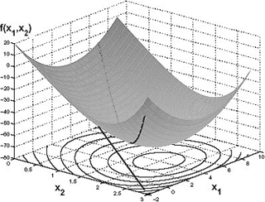
Modeling and Adaptation Policies
Adaptation
  Convex optimization
    Relative importance of different Cells expressed via scaling functions (“Urgency”)
  Walk through Configuration space
    Meet minimum QoS properties first, enhancement with excess resources
User-Level Policies
  Declarative language for describing application preferences and adaptive desires
Modeling of Applications
  Static Profiling: may be useful with Cell guarantees
  Multi-variable model building
    Get performance as function of resources
    Or – tangent plane of performance as function of resources

Slide 27
Scheduling inside a cell
Cell Scheduler can rely on:
  Coarse-grained time quanta allows efficient fine-grained use of resources
  Gang-Scheduling of processors within a cell
  No unexpected removal of resources
  Full Control over arrival of events
    Can disable events, poll for events, etc.
Pure environment of a Cell ⇒ Autotuning will return same performance at runtime as during training phase
Application-specific scheduling for performance
  Lithe Scheduler Framework (for constructing schedulers)
    Will be able to handle preemptive scheduling/cross-address-space scheduling
  Systematic mechanism for building composable schedulers
    Parallel libraries with different parallelism models can be easily composed
  Of course: preconstructed thread schedulers/models (Cilk, pthreads…) as libraries for application programmers
Application-specific scheduling for Real-Time
  Label Cell with Time-Based Labels. Examples:
    Run every 1s for 100ms synchronized to ± 5ms of a global time base
    Pin a cell to 100% of some set of processors
  Then, maintain own deadline scheduler

Slide 28
Consequences

Slide 29
Discussion
How to divide application into Cells?
  Cells probably best for coarser-grained components
    Fine-grained switching between Cells antithetical to stable resource guarantees
  Division between Application components and shared OS services natural (obvious?)
    Both for security reasons and for functional reasons
  Division between types of scheduling
    Real-time (both deadline-driven and rate-based), pre-scheduled
    GUI components (responsiveness most important)
    High-throughput (As many resources as can get)
    Stream-based (Parallelism through decomposition into pipeline stages)
What granularity of Application component is best for Policy Service?
  Fewer Cells in system leads to simpler optimization problem
Language-support for Cell model?
  Task-based, not thread based
  Cells produced by annotating Software Frameworks with QoS needs?
  Cells produced automatically by just-in-time optimization?
    i.e. Selective Just In Time Specialization or SEJITS

Slide 30
Some Objections/Philosophy
Isn’t the Cell model a “Death by 1000 Knobs?”
  Adds 1000s of knobs (timing and quantity of resource distribution to Cells)
  Same problem as Exokernel
    Would anyone actually write their own app-specific libOS?
Ans: Parallel programming hard enough without unpredictability
  Parallel projects of 1990s generated whole PhDs tuning parallel apps
Ans: Real-time is very hard with unpredictable resources
Ans: Advancement in mechanisms helps policy (Knob) problem
  By removing unpredictable multiplexing of resources, gain predictability of behavior
    Mechanisms to provide a clean Cell model not fully available in today’s OSes
    Different policy/mechanism separation from today’s systems
  Task model associates resources with particular tasks
  Benefit of Cell model must outweigh disadvantages
    Clear “graceful degradation” to more standard use of resources
Ans: Resources are central to many modern systems
  E.g. battery life, Video BW, etc.

Slide 31
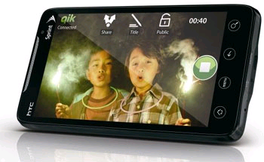
Applications in 2020
Massive Cluster
Massive Cluster
Clusters
Clusters
Gigabit Ethernet
Gigabit Ethernet

Slide 32
What we might like from Hardware
A good parallel computing platform (Obviously!)
  Good synchronization, communication (Shared memory within Cells would be nice)
  Vector, GPU, SIMD (Can exploit data parallel modes of computation)
  Measurement: performance counters
Partitioning Support
  Caches: Give exclusive chunks of cache to partitions
  High-performance barrier mechanisms partitioned properly
  System Bandwidth
  Power (Ability to put partitions to sleep, wake them up quickly)
QoS Enforcement Mechanisms
  Ability to give restricted fractions of bandwidth (memory, on-chip network)
  Ability to hand out/limit to energy budget
  Message Interface: Tracking of message rates with source-suppression for QoS
  Examples: Globally Synchronized Frames (ISCA 2008, Lee and Asanovic)
Fast messaging support (for channels and possible intra-cell)
  Virtualized endpoints (direct to destination Cell when mapped, into memory FIFO when not)
  User-level construction and disposition of messages
  DMA, user-level notification mechanisms
  Trusted Computing Platform (automatic decryption/encryption of channel data)

Slide 33
Conclusion
Explicit Management of resources
  Two-level scheduling
    Global Distribution of resources
    Application-Specific scheduling of resources
  Space-Time Partitioning: grouping processors & resources
  behind hardware boundary
Cells: Basic Unit of Resource and Security
  User-Level Software Component with Guaranteed Resources
  Secure Channels to other Cells
Tessellation OS
  Exploded OS: spatially partitioned, interacting services
  Exploit Hardware partitioning mechanisms when available
  Policy Service and explicit Resource Management
For more Info: http://tessellation.cs.berkeley.edu

Slide 34
Tessellation Implementation Status
First version of Tessellation
  ~7000 lines of code in NanoVisor layer
  Supports basic partitioning
    Cores and caches (via page coloring)
    Fast inter-partition channels (via ring buffers in shared memory, soon cross-network channels)
    Use of Memory Bandwidth Partitioning (RAMP)
  Network Driver and TCP/IP stack running in partition
    Devices and Services available across network
  Hard Thread interface to Lithe – a framework for constructing user-level schedulers
  Initial version of Policy Service to come on line soon
Currently Two ports
  32-core Nehalem system
  64-core RAMP emulation of a manycore processor (SPARC)
    Will allow experimentation with new hardware resources
    Examples:
      QoS Controlled Memory/Network BW
      Cache Partitioning
      Fast Inter-Partition Channels with security tagging

