Slide 1
Managing Constraints for improved data quality Fei Chiang, Renee J. Miller University of Toronto
Feb 4, 2011
DIMACS Workshop on Data Quality Metrics

Slide 2
Resolving Data Inconsistencies
Human error
Integration across multiple sources
Weak enforcement of constraints
Schema, data evolution
Why?
Incomplete fields
Duplicates
Wrong values
Discover new constraints
Repair the data
Repair the existing constraints

Slide 3
Integrity Constraints
Integrity constraints are the primary means for preserving data integrity
Functional dependencies (FDs)
Old world assumption that only the data changes, and schema and constraints remain fixed
Previous techniques focus on data repairs
Modern applications: need to discover and maintain schema & constraints
Form of constraints needed may be different from old world

Slide 4
Overview
Constraint discovery [VLDB08]
No prior rules given
Discover conditional functional dependencies (CFDs)
Constraint Maintenance [ICDE11]
Unified model for constraint & data repair
How to decide whether to repair the data or the constraints?

Slide 5
New World Constraints
Airline | Status | Miles | Seating | Boarding
One World | Bronze | 1x | Standard | Standard
Meridan | Silver | 1x | Elite | Standard
Skyway | Silver | 2x | Preferred | Standard
Skyway | Gold | 2x | Elite | First
One world | Gold | 3x | Preferred | Priority
Skyway | Gold | 2x | Preferred | Priority
One World | Silver | 2x | Preferred | Priority
Functional Dependency (FD)
[Airline, Status] → [Miles]
Conditional FD (CFD)
[Maher97,Bohannon⁺07]
[Status=‘Gold’,Seating] → [Boarding]
[Status,Seating] → [Boarding]
[Boarding = ‘Priority’] → [Seating = ‘Preferred’]
Rules may not hold over entire table
Data cleaning tutorial [Fan,Geerts 08]
Both FDs and CFDs are important for understanding & managing data
Discovery of CFDs

Slide 6
Algorithmic Framework: Attribute Partitions [HKPT98]
Contract | Type | Region
tid | A | B | C
1 | Voice | Unlim | World
2 | Voice | Unlim | World
3 | Voice | CorpVoice | World
4 | Data | WkEnd | Canada
5 | Voice | CorpVoice | World
6 | Data | WkEnd | Canada
7 | Phone | iPhone | N/A
8 | Phone | iPhone | N/A
9 | Data | iPhone | N/A
10 | Data | WkEnd | Canada
11 | Phone | iPhone | N/A
12 | Voice | WkEnd | Canada
ΠA = {(1,2,3,5,12), (4,6,9,10), (7,8,11)}
ΠAB = {(1,2),(3,5),(4,6,10),(7,8,11),(9),(12)}
ΠABC= {(1,2),(3,5),(4,6,10),(7,8,11),(9),(12)}
Voice
Data
Phone
(Voice,Unlim)
(Voice,CorpVoice)
Π_{X} refines Π_{XY} if every class in Π_{X} is a subset of some class in Π_{XY}
X → Y is an FD iff Π_{X} refines Π_{XY}
Here AB → C
CFDs: is there a condition defining a subset of classes in Π_{X} refines Π_{XY}?

Slide 7
Generating Candidate CFDs
tid | A | B | C | D
1 | Voice | Unlim | World | 123
2 | Voice | Unlim | World | 124
3 | Voice | CorpVoice | World | rim66
4 | Data | WkEnd | Canada | 157
5 | Voice | CorpVoice | World | rim77
6 | Data | WkEnd | Canada | 678
7 | Phone | iPhone | N/A | Walkin
8 | Phone | iPhone | N/A | 678
9 | Data | iPhone | N/A | 555
10 | Data | WkEnd | Canada | 123
11 | Phone | iPhone | N/A | Walkin
12 | Voice | WkEnd | Canada | 444
A
B
C
D
AB
AC
AD
BC
BD
CD
ABC
ABD
ACD
BCD
ABCD
B → A
ΠB = {(1,2), (3,5), (4,6,10,12), (7,8,9,11)}
ΠAB = {(1,2),(3,5),(4,6,10),(7,8,11),(9),(12)}
[B = ‘Unlim’] → [A = ‘Voice’]
[B= ‘CorpVoice’] → [A = ‘Voice’]
[B= ‘WkEnd’] → [A = ‘Data’] NO
[B= ‘iPhone’] → [A = ‘Phone’] NO

Slide 8
Generating Candidate Rules
tid | A | B | C
1 | Voice | Unlim | World
2 | Voice | Unlim | World
3 | Voice | CorpVoice | World
4 | Data | WkEnd | Canada
5 | Voice | CorpVoice | World
6 | Data | WkEnd | Canada
7 | Phone | iPhone | N/A
8 | Phone | iPhone | N/A
9 | Data | iPhone | N/A
10 | Data | WkEnd | Canada
11 | Phone | iPhone | N/A
12 | Voice | WkEnd | Canada
A
B
C
D
AB
AC
AD
BC
BD
CD
ABC
ABD
ACD
BCD
AC → B ?
ΠAC = {(1,2,3,5), (4,6,10),(7,8,11),(9),(12)}
ΠABC= {(1,2),(3,5),(4,6,10),(7,8,11),(9),(12)}
ABCD
[C = ‘Canada’] A → B
[C = ‘N/A’] A → B

Slide 9
Conditioning on Multiple Attributes
A | B | C | D
level | Candidate A = condition attr
1 | D → C
2 | AD → C BD → C DA → C DB → C
3 | DAB→ C, ABD → C BAD→ C, BDA → C ABD→ C, ADB → C
A
B
C
D
AB
AC
AD
BC
BD
CD
ABC
ABD
ACD
BCD
ABCD

Slide 10
Controlling the Search
Limit support of conditioned rules
Support threshold θ that all rules must satisfy
Permit approximation [HKPT98]
Allow a rule to have α exceptions
Simply count – doesn’t measure whether an exception is “unexpected”

Slide 11
Rule Quality
tid | A | B | C | D
1 | Voice | Unlim | World | 123
2 | Voice | Unlim | N.Am. | 124
3 | Voice | CorpVoice | Canada | rim66
4 | Data | WkEnd | Canada | 157
5 | Voice | CorpVoice | World | rim77
6 | Data | WkEnd | Canada | 678
7 | Phone | iPhone | N/A | Walkin
8 | Phone | iPhone | N/A | 678
9 | Data | iPhone | N/A | 555
10 | Data | WkEnd | Canada | 123
11 | Phone | iPhone | Canada | Walkin
12 | Voice | WkEnd | Canada | 444
R1: [B= ‘iPhone’] → [A = ‘Phone’]
R2: [B= ‘WkEnd’] → [A = ‘Data’]
Both have one exception
use Conviction to compare
Conviction: for a rule X → Y
measure how much X and ~Y
deviate from independence
P(X)P(~Y)/P(X,~Y)
Conviction(R1) = 3
Conviction(R2) = 2.6

Slide 12
Interest Measures
Support : Maximal number of tuples that satisfy the CFD
-test : Deviation of support (X→A) from (support(X) * support(A))
Confidence: Likelihood that A occurs given X under condition C
Interest
Measures how much X and A deviate from independence under C
Symmetric measure
Conviction [BMUT97]
Measures how much X and ~A deviate from independence under C
Similar to interest, but directional

Slide 13
Qualitative Evaluation (Precision)
Conviction gave best precision for rules

Slide 14
Examples
[ED = 'Masters', FAM] → [SAL]
For Masters educated, family type determines salary range
[ED = 'Children'] → [SAL = ’less than 50K']
School aged children should make less than $50K
[BODY = 'hatchback', CYL] → [PRICE]
For hatchbacks, num cylinders determines price
[MR = 'single', PROP = ’no’] → [LIFE = 'minimal']
Single persons not owning property have minimal life insurance

Slide 15
Overview
Constraint discovery [VLDB08]
No prior rules given
Discover Conditional functional dependencies (CFDs)
Constraint Maintenance [ICDE11]
Unified model for constraint & data repair
How to decide whether to repair the data or the constraints?
In this case, constraints are FDs.

Slide 16
Motivation
Constraints may be inconsistent with data
Option 1: Repair data
Bohannon et al. [SIGMOD05], Cong et al. [VLDB07], Kolahi et al. [ICDT09]
For FD: X → Y, find minimal cost changes to the Y values, that make data consistent
Assumes constraints are correct
Option 2: Repair constraints
Discover new constraints from data
Find minimal modifications to existing constraints

Slide 17
Data and Constraint Repair
District | Region | Municipal | AC | Street | City | Prov | PCode
Brook | Granville | Glendale | 412 | Roslin | Toronto | ON | M4N 1Y3
Brook | Granville | Glendale | 412 | Roslin | Toronto | OH | M4N 1Y3
Brook | Granville | Guildwood | 553 | Sidney | Belleville | ON | K8P 3Y9
Brook | Granville | Guildwood | 553 | Sidney | Belleville | ON | K8P 1J7
Fife | Parkhill | Moore | 725 | Poth | Dundee | ON | NOB 2E0
Fife | Parkhill | Moore | 725 | Roseville | Dundee | ON | NOB 2E0
Fife | Parkhill | Napa | 228 | Roslin | Toronto | ON | M4N 1Y3
Repair the data or the constraints?
How to find the repairs?
F1: [District, Region] → [AC]
F2: [PCode] → [City, Prov]

Slide 18
Highlights
Minimum Description Length (MDL) based model that quantifies the consistency of the data
Find a model M w.r.t. F that can represent as much of the data as possible. Want M to be small.
Description Length: DL = L(M) + L(I|M)
L(M): length of model M;
L(I|M): length of data instance I given M
Data repair: update X or Y values
Given violation t1: [X1Y1], t2: [X1Y2]
Either change Y value to be same(Y2 →Y1), or change X to be different (t2.X1 → t2.X2)
Constraint repair: F: X→Y, find an attribute A to add to X

Slide 19
A Unified Repair Model
Municipal
F1: [District, Region] → [AC]
1) Consider the cost of data repairs
∧
District | Region | Municipal | AC
Brook | Granville | Glendale | 412
Brook | Granville | Glendale | 412
Brook | Granville | Glendale | 412
Brook | Granville | Guildwood | 553
Brook | Granville | Guildwood | 553
Brook | Granville | Guildwood | 553
Brook | Granville | Moore | 725
Brook | Granville | Moore | 725
Brook | Granville | Moore | 725
L(M) | L(I|M) | DL
0 | 27 | 27
District | Region | AC
Brook | Granville | 412
Brook | Granville | 412
Brook | Granville | 412
Brook | Granville | 553
Brook | Granville | 553
Brook | Granville | 553
Brook | Granville | 725
Brook | Granville | 725
Brook | Granville | 725
M
Brook, Granville, 412
3+12 | 0 | 15
Unchanged cell cost 1; Repaired cell cost 2
412
2) Consider the cost of constraint repairs
412
L(M) | L(I|M) | DL
0 | 36 | 36
M
L(M) | L(I|M) | DL
0 | 36 | 36
12 | 0 | 12
412
Brook, Granville, Guildwood, 553
412
Brook, Granville, Glendale, 412
412
412
Brook, Granville, Moore, 725
3) Apply lower cost repair

Slide 20
Data Repairs
Cost of a data repair
If domain has natural distance metric (btw 0-1)
Cost of repair is 1 + distance (original value, new value)
Otherwise, cost is 2 (assumes maximal distance)
Tuple patterns
Core pattern: is a tuple pattern with support greater than a threshold
Deviant pattern: has support lower than threshold and is similar to at least one core pattern

Slide 21
Data Repair Overview
For each inconsistent FD F
Initialize M = set of core patterns
For each deviant d
Find p in M closest to d
Compute data repair cost (d, p)
Update DL
FDs are evaluated in order of degree of attribute overlap and the number of inconsistent tuples
Impact of a data repair on dependent FDs is considered in updating DL

Slide 22
Variance of Information
Clustering evaluation measure
Considers homogeneity and completeness
Assume a ground truth clustering C_F, and new clustering C_A
Homogeneity: c_a only contain elements from c_f
Completeness: c_a contains all elements from c_f
Conditional entropy: measures the likelihood of homogeneity and completeness of each cluster
VI = 0 is best

Slide 23
Constraint Repair
For each inconsistent FD F: X → Y
Want to find an attribute A (not in XY):
Variance of Information wrt XY minimal
Minimize VI(XY, A)
District | Region | Municipal | AC | Street
Brook | Granville | Glendale | 412 | Roslin
Brook | Granville | Glendale | 412 | Roslin
Brook | Granville | Guildwood | 553 | Sidney
Brook | Granville | Guildwood | 553 | Sidney
Fife | Parkhill | Moore | 725 | Poth
Fife | Parkhill | Moore | 725 | Roseville
Fife | Parkhill | Napa | 228 | Roslin
C_F: [(1,2)(3,4)] [(5,6) (7)]
C_m = [(1,2) (3,4) (5,6) (7)]
C_s = [(1,2,7) (3,4) (5) (6)]
VI(DRA, M) = 0
< VI(DRA, S)

Slide 24
Experimental Evaluation
Qualitative tests
Scalability tests
Case Study with Cora bibliographic data
Comparative evaluation with Bohannon et al. [SIGMOD05]

Slide 25
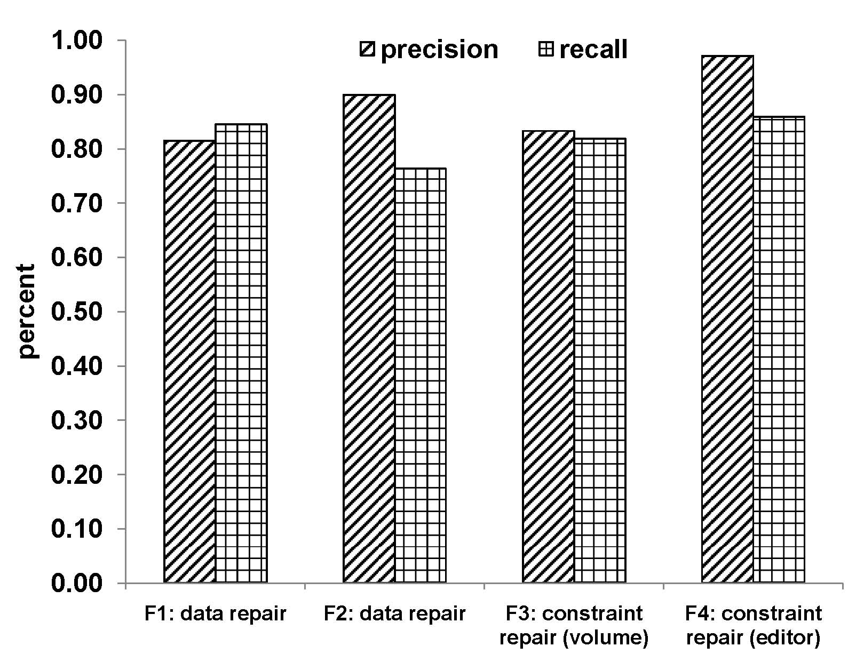
Qualitative Evaluation
Cora bibliographic data
F1: [venue, year] → location
F2: [title, venue] → author
F3: [venue, location]→ editor
F4: venue → publisher
Repair | Precision | Recall
Data | 81-90% | 76-84%
Constraint | 83-97% | 82-86%

Slide 26
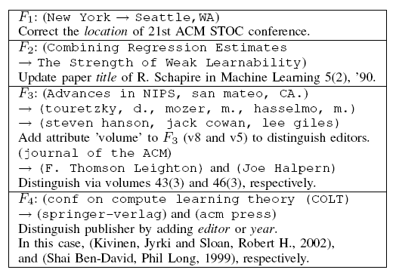
Example Repairs

Slide 27
Conclusion
Improved management of constraints will help to improve data quality.
CFDs are useful in data cleaning [Fan, Geerts ‘08 tutorial]
CFDs may not be given by a designer – identifying an appropriate set is important.
A unified model that considers data and constraint repair on an equal footing.

Slide 28
Questions

