Slide 1

DIMACS/CINJ Workshop on Electronic Medical Records - Challenges & Opportunities:
Patient Privacy, Security & Confidentiality Issues
Bradley Malin, Ph.D.
Assistant Prof. of Biomedical Informatics, School of Medicine
Assistant Prof. of Computer Science, School of Engineering
Director, Health Information Privacy Laboratory
Vanderbilt University

Slide 2
Disclaimer
Privacy, Security , & Confidentiality are overloaded words
Various regulations in healthcare and health research
  Health Insurance Portability & Accountability Act (HIPAA)
  NIH Data Sharing Policy
  NIH Genome Wide Association Study Data Sharing Policy
  State-specific laws and regulations

Slide 3
Privacy is Everywhere
Collection
It’s impractical to always control who gets, accesses, and uses data “about” us
  But we are moving in this direction
Legally, data collectors are required to maintain privacy
Care &
Operations
Dissemination

Slide 4
Privacy is Everywhere
Collection
It’s impractical to always control who gets, accesses, and uses data “about” us
  But we are moving in this direction
Legally, data collectors are required to maintain privacy
Care &
Operations
Dissemination

Slide 5
What’s Going On?
Primary Care
Secondary Uses
Beyond Local Applications

Slide 6
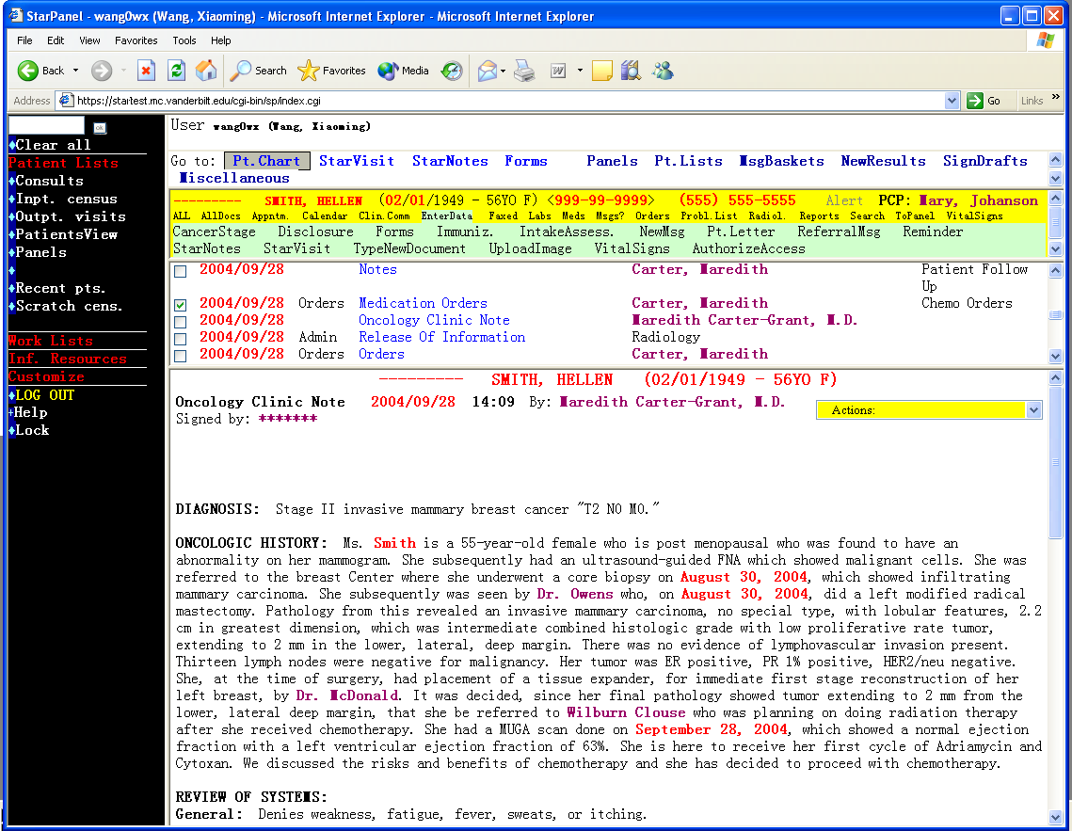

Electronic Medical Records – Hooray!
An Example: at Vanderbilt, we began with StarChart back in the ’90s
  Longitudinal electronic patient charts!
  Receives information from over 50 sources!
  Fully replicated geograpically & logically (runs on over 60 servers)!
We have StarPanel
  Online environment for anytime / anywhere access to patient charts!
Increasingly distributed across organizations with overlapping patients and user bases different user bases
Various Commercial Systems: Epic, Cerner, GE, ICA, …

Slide 7


Snooped
Snooped
Snooped
Snooped

Slide 8
Bring on the Regulation
1990s: National Research Council warned
  Health IT must prevent intrusions via policy + technology
State & Federal regulations followed suit
  e.g., HIPAA Security Rule (2003)
  Common policy requirements:
    Access control
    Track & audit employees access to patient records
    Store logs for ≥ 6 years

Slide 9
HIPAA Security Rule
Administratrive Safeguards
Physical Safeguards
Technical Safeguards
  Audit controls: Implement systems to record and audit access to protected health information within information systems

Slide 10
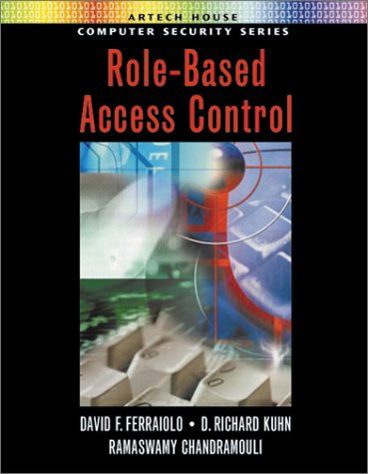
Access Control?
“We have *-Based Access Control.”
“We have a mathematically rigorous access policy logic!”
“We can specify temporal policies!”
“We can control your access at a fine-grained level!”
“Isn’t that enough?”

Slide 11
So…
… what are the policies?
… who defines the policies?
… how do you vet the policies?
Many people have multiple, special, or “fuzzy” roles
Policies are difficult to define & implement in complex environments
  multiple departments
  information systems
CONCERN: Lack of record availability can cause patient harm

Slide 12
Why is Auditing So Difficult?
The Good
28 of 28 surveyed EMR systems had auditing capability (Rehm & Craft)
The Bad
10 of 28 systems alerted administrators of potential violations
The Ugly
Proposed violations are rudimentary at best
  Often based on predefined policies
  Lack of information required for detecting strange behavior or rule violations

Slide 13
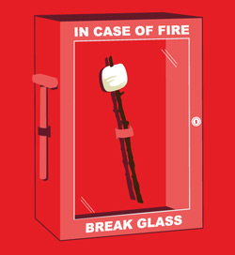
If You Let Them, They Will Come
Central Norway Health Region enabled “actualization” (2006)
Reach beyond your access level if you provide documentation
53,650 of 99,352 patients actualized
5,310 of 12,258 users invoked actualization
Over 295,000 actualizations in one month
Role | Users | Invoked Actualization in Past Month
Nurse | 5633 | 36%
Doctor | 2927 | 52%
Health Secretary | 1876 | 52%
Physiotherapist | 382 | 56%
Psychologist | 194 | 58%
L. Røstad and N. Øystein. Access control and integration of health care systems: an experience report and future challenges. Proceedings of the 2nd International Conference on Availability, Reliability and Security (ARES). 2007: 871-878,

Slide 14
Experience-Based Access Management
(EBAM)
Let’s use the logs to our advantage!
Joint work with
  Carl Gunter @ UIUC
  David Liebovitz @ Northwestern
*C. Gunter, D. Liebovitz, and B. Malin. Proceedings of USENIX HealthSec’10. 2010.

Slide 15
HORNET: Healthcare Organizational Research Toolkit
(http://code.google.com/p/hornet/)
HORNET Core
Plugins
Network API
Graph, Node, Edge, Network Statistics
File Network Builder
Database Network Builder
Task API
Parallel & Distributed Computation
Noise Filtering
Network Abstraction
File API
Association Rule Mining
Social Network Analysis
CSV
…
Database API
Network Visualization
Oracle, MySQL, Etc.
…

Slide 16
What’s Going On?
Primary Care
Secondary Uses
Beyond Local Applications

Slide 17
Privacy is Everywhere
Collection
It’s impractical to always control who gets, accesses, and uses data “about” us
  But we are moving in this direction
Legally, data collectors are required to maintain privacy
Care &
Operations
Dissemination

Slide 18
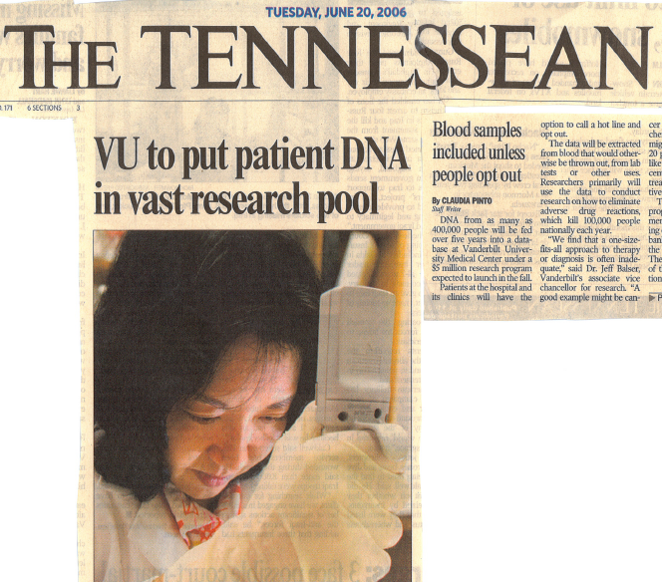

Slide 19
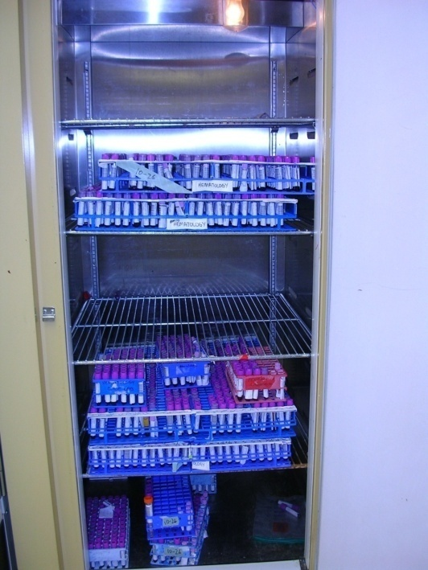
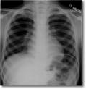
Information Integration
Electronic Medical Record System
80M entries on >1.5M patients
Discarded blood
- 50K per year
Clinical
Notes
CPOE
Orders
(Drug)
ICD9,
CPT
Clinical
Messaging
Test Results
Updated Weekly
Extract DNA
Clinical
Resource

Slide 20
Research Support &
Data Collection
cases
Genotyping, genotype-phenotype relations
controls
cases
Data analysis
Sample retrieval
controls
Investigator query

Slide 21
Holy Moly! How Did You…
Initially an institutionally funded project
Office for Human Research Protections designation as Non-Human Subjects Research under 45 CFR 46 (“HIPAA Common Rule”)*
  Samples & data not linked to identity
  Conducted with IRB & ethics oversight
*D. Roden, et al. Development of a large-scale de-identified DNA biobank to enable personalized medicine. Clin Pharmacol Ther. 2008; 84(3): 362-369.

Slide 22
Speaking of HIPAA
(the elephant in the room)
“Covered entity” cannot use or disclose protected health information (PHI)
  data “explicitly” linked to a particular individual, or
  could reasonably be expected to allow individual identification
The Privacy Rule Affords for several data sharing policies
  Limited Data Sets
  De-identified Data
    Safe Harbor
    Expert Determination

Slide 23
HIPAA Limited Dataset
Requires Contract: Receiver assures it will not
  use or disclose the information for purposes other than research
  will not identify or contact the individuals who are the subjects
Data owner must remove a set of enumerated attributes
  Patient’s Names / Initials
  #’s: Phone, Social Security, Medical Record
  Web: Email, URL, IP addresses
  Biometric identifiers: finger, voice prints
But, owner can include
  Dates of birth, death, service
  Geographic Info: Town, Zip code, County

Slide 24
“Scrubbing” Medical Records
Replaced SSN and phone #
MR# is removed
Rules*
Regular Expressions
Dictionaries
Exclusions
↓ ↓ ↓ ↓ ↓
Machine Learning (e.g., Conditional Random Fields**)
*D. Gupta, et al. Evaluation of a deidentification (De-Id) software engine to share pathology reports and clinical documents for research. Am J Clin Pathol. 2004; 121(2): 176-186.
**J. Aberdeen, et al. Rapidly retargetable approaches to de-identification in medical records. Journal of the American Medical Informatics Association. 2007; 14(5):564-73
Substituted names
Shifted Dates
24

Slide 25
A Scrubbing Chronology
(incomplete)
Clinical Vocabs (Morrisson et al)
HL7-basis (Friedlin et al)
Conditional Random Fields [HIDE] (Gardner & Xiong)
Dictionaries, Lookups, Regex (Neamatullah et al)
Support Vector Machines + Grammar (Uzuner et al)
2009
NLP – Conditional Random Fields (Wellner et al)
Decision Trees / Stumps (Szarvas et al)
2008
AMIA Workshop on Natural Language Processing Challenges for Clinical Records (Uzuner, Szolovits, Kohane)
Regular Expression - Comparison to Humans (Dorr et al)
Rules + Patterns + Census (Beckwith et al)
Concept Match – Doublets (Berman)
Support Vector Machines - (Sibanda, Uzuner)
2007
2006
2004
Rules + Dictionary (Gupta et al)
2003
Concept Matching (Berman)
2002
Trained Semantic Templates for Name ID (Taira et al)
Name Pair – Search / Replace (Thomas et al)
2000
NLP / Semantic Lexicon (Ruch et al)
1996
Scrub - Blackboard Architecture (Sweeney)

Slide 26
“Scrubbed” Medical Record
Replaced SSN and phone #
MR# is removed
Unknown residual re-identification potential (e.g. “the mayor’s wife”)
Substituted names
Shifted Dates
26

Slide 27
@Vanderbilt: Technology + Policy
Databank access restricted to Vanderbilt employees
Must sign use agreement that prohibits “re-identification”
Operations Advisory Board and Institutional Review Board approval needed for each project
All data access logged and audited per project

Slide 28
What’s Going On?
Primary Care
Secondary Uses
Beyond Local Applications

Slide 29
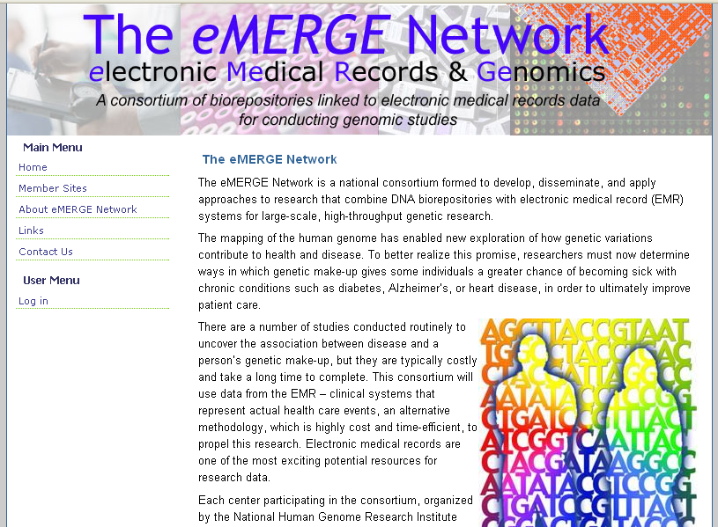
Consortium members (http://www.gwas.net)
  Group Health of Puget Sound (UW)
  Marshfield Clinic
  Mayo Clinic
  Northwestern University
  Vanderbilt University
Funding condition: contribute de-identified genomic and EMR-derived phenotype data to database of genotype and phenotype (dbGAP) at NCBI, NIH

Slide 30
Data Sharing Policies
Feb ‘03: National Institutes of Health Data Sharing Policy
  “data should be made as widely & freely available as possible”
  researchers who receive >= $500,000 must develop a data sharing plan or describe why data sharing is not possible
  Derived data must be shared in a manner that is devoid of “identifiable information”
Aug ‘06: NIH Supported Genome-Wide Association Studies Policy
  Researchers who received >= $0 for GWAS

Slide 31
Case Study – “Quasi-identifier”
Re-identification of William Weld
Name
Address
Date registered
Party affiliation
Date last voted
Ethnicity
Visit date
Diagnosis
Procedure
Medication
Total charge
Zip Code
Birthdate
Gender
Hospital Discharge Data
Voter List
L. Sweeney. Journal of Law, Medicine, and Ethics. 1997.

Slide 32
5-Digit Zip Code
+ Birthdate
+ Gender
63-87% of US estimated to be unique
P. Golle. Revisiting the uniqueness of U.S. population. Proceedings of ACM WPES. 2006: 77-80.
L. Sweeney. Uniqueness of simple demographics in the U.S. population. Working paper LIDAP-4, Laboratory for International Data Privacy, Carnegie Mellon University. 2000.

Slide 33
Various Studies in Uniqueness
It doesn’t take many [insert your favorite feature] to make you unique
  Demographic features (Sweeney 1997; Golle 2006; El Emam 2008)
  SNPs (Lin, Owen, & Altman 2004; Homer et al. 2008)
  Structure of a pedigree (Malin 2006)
  Location visits (Malin & Sweeney 2004)
  Diagnosis codes (Loukides et al. 2010)
  Search Queries (Barbaro & Zeller 2006)
  Movie Reviews (Narayanan & Shmatikov 2008)

Slide 34
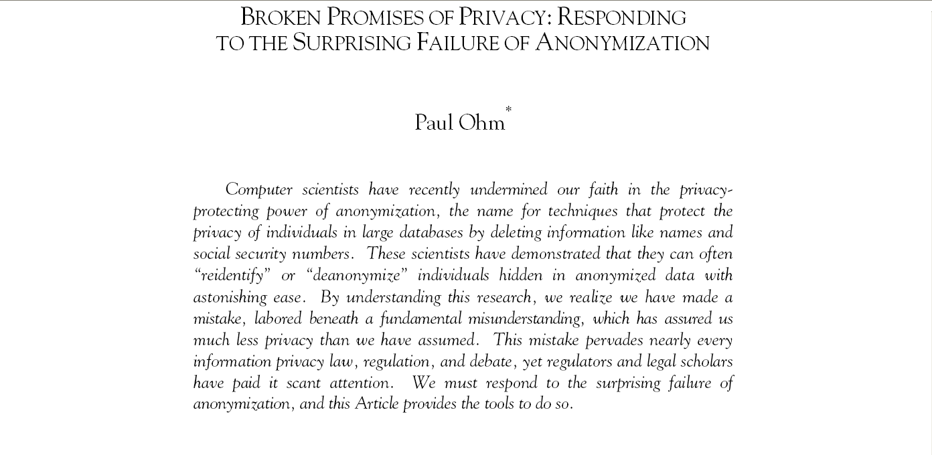
Which Leads us to
P. Ohm. Broken promises: Responding to the surprising failure of anonymization. UCLA Law Review. 2010; 57: 1701-1777.

Slide 35
But…
There’s a Really Big But

Slide 36
UNIQUE
≠
IDENTIFIABLE

Slide 37
Central Dogma of Re-identification
De-identified
Sensitive Data
(e.g., DNA, clinical status)
Identified Data
(Voter Lists)
Necessary
Distinguishable
Necessary
Linkage Model
Necessary
Distinguishable
B. Malin, M. Kantarcioglu, & C. Cassa. A survey of challenges and solutions for privacy in clinical genomics data mining. In Privacy-Aware Knowledge Discovery: Novel Applications and New Techniques. CRC Press. To appear.

Slide 38
Speaking of HIPAA
(the elephant in the room)
“Covered entity” cannot use or disclose protected health information (PHI)
  data “explicitly” linked to a particular individual, or
  could reasonably be expected to allow individual identification
The Privacy Rule Affords for several data sharing policies
  Limited Data Sets
  De-identified Data
    Safe Harbor
    Expert Determination

Slide 39
HIPAA Safe Harbor
Data can be given away without oversight
Requires removal of 18 attributes
  geocodes with < 20,000 people
  All dates (except year) & ages > 89
  Any other unique identifying number, characteristic, or code
    if the person holding the coded data can re-identify the patient
Limited Release
Safe Harbor

Slide 40
Attacks on
Demographics
Safe Harbored
Clinical Records
Consider population estimates from the U.S. Census Bureau
They’re not perfect, but they’re a start
Private
Clinical Records
Identified
Records
Limited Data Set
Clinical Records
K. Benitez and B. Malin. Evaluating re-identification risk with respect to the HIPAA privacy policies. Journal of the American Medical Informatics Association. 2010; 17: 169-177.

Slide 41
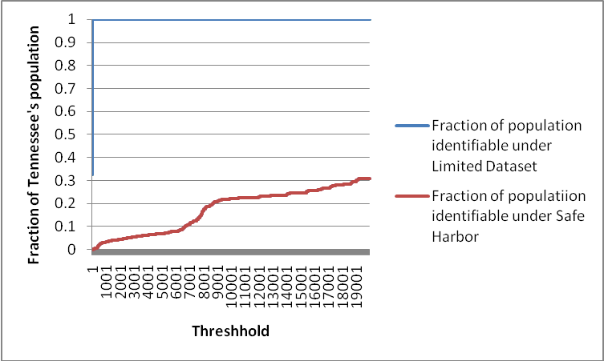
Case Study: Tennessee
Group size = 33
Limited Dataset
{Race, Gender, Date (of Birth), County}
Safe Harbor
{Race, Gender, Year (of Birth), State}

Slide 42
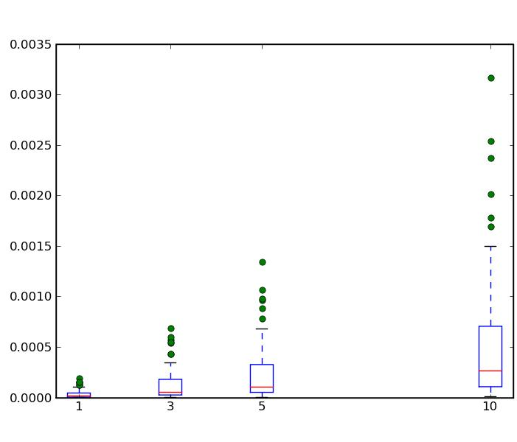
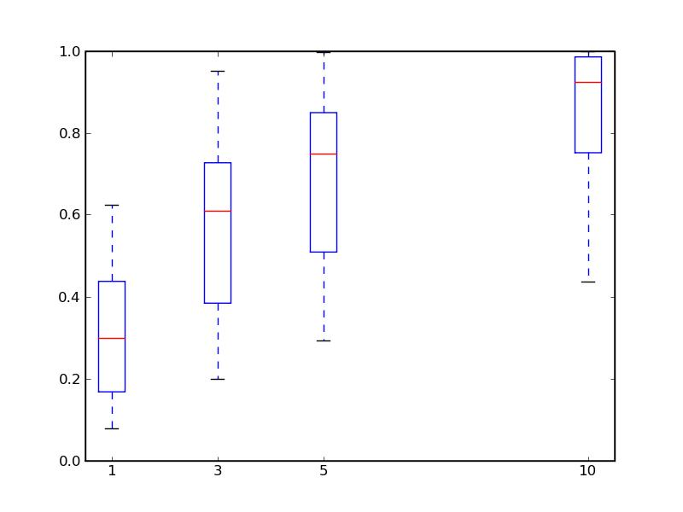
All U.S. States
Safe Harbor
Limited Data set
0.35%
100%
0.30%
80%
0.25%
0.20%
60%
Percent Identifiable
0.15%
40%
0.10%
0.05%
20%
0%
1
3
5
10
0%
1
3
5
10
Group Size
Group Size

Slide 43
Policy Analysis via a Trust Differential
Risk(Limited Dataset)
Risk (Safe Harbor)
Uniques
  Delaware’s risk increases by a factor ~1,000
  Tennessee’s “ “ “ “ ~2,300
  Illinois’s “ “ “ “ “ ~65,000
≤20,000
  Delaware’s risk does not increase
  Tennessee’s risk increases by a factor of ~8
  Illinois’s risk increases by a factor of ~37

Slide 44
…But That was a Worst Case Scenario
How would you use demographics?
Could link to registries
  Birth
  Death
What’s in vogue?
Back to voter registration databases
  Marriage
  Professional (Physicians, Lawyers)

Slide 45
Going to the Source
We polled all U.S. states for what voter information is collected & shared
What fields are shared?
Who has access?
Who can use it?
What’s the cost?

Slide 46
U.S. State Policy
 | IL | MN | TN | WA | WI
WHO??? | Registered Political Committees (ANYONE – In Person) | MN Voters | Anyone | Anyone | Anyone
Format | Disk | Disk | Disk | Disk | Disk
Cost | $500 | $46; “use ONLY for elections, political activities, or law enforcement” | $2500 | $30 | $12,500
Name |  |  |  |  | 
Address |  |  |  |  | 
Election History |  |  |  |  | 
Date of Birth |  |  |  | 
Date of Registration |  |  |  | 
Sex |  |  |  | 
Race |  |  | 
Phone Number |  | 

Slide 47
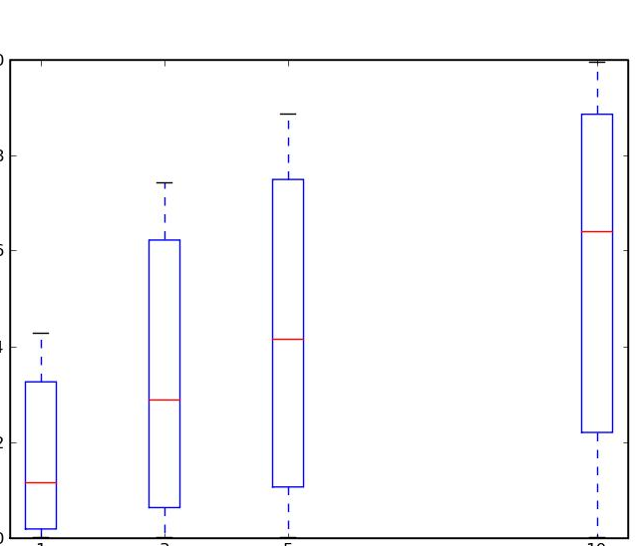
Identifiability Changes!
Limited Data Set
Limited Data Set ←→ Voter Reg.
100%
100%
80%
80%
Percent Identifiable
60%
60%
40%
40%
20%
20%
0%
0%
1
3
5
10
1
3
5
10
Group Size
Group Size

Slide 48
Worst Case vs. Reality
Illinois
Tennessee
Identifiable People
Group Size
Group Size

Slide 49
Cost?
 | Limited Dataset |  | Safe Harbor
State | At Risk | Cost per Re-id | At Risk | Cost per Re-id
VA | 3159764 | $0 | 221 | $0
NY | 2905697 | $0 | 221 | $0
SC | 2231973 | $0 | 1386 | $0
WI | 72 | $174 | 2 | $6,250
WV | 55 | $309 | 1 | $17,000
NH | 10 | $827 | 1 | $8,267

Slide 50
Speaking of HIPAA
(the elephant in the room)
“Covered entity” cannot use or disclose protected health information (PHI)
  data “explicitly” linked to a particular individual, or
  could reasonably be expected to allow individual identification
The Privacy Rule Affords for several data sharing policies
  Limited Data Sets
  De-identified Data
    Safe Harbor
    Expert Determination

Slide 51
HIPAA Expert Determination
(abridged)
Certify via “generally accepted statistical and scientific principles and methods, that the risk is very small that the information could be used, alone or in combination with other reasonably available information, by the anticipated recipient to identify the subject of the information.”

Slide 52
Towards an Expert Model
So far, we’ve looked at on populations (e.g., U.S. state).
Let’s shift focus to specific samples
  Compute re-id risk post-Safe Harbor
  Compute re-id risk post-Alternative (e.g., more age, less ethnic)
K. Benitez, G. Loukides, and B. Malin. Beyond Safe Harbor: automatic discovery of health information de-identification policy alternatives. Proceedings of the ACM International Health Informatics Symposium. 2010: to appear.

Slide 53

Demographic Analysis
Software is ready for download!
  VDART: Vanderbilt Demographic Analysis of Risk Toolkit
  http://code.google.com/p/vdart/

Slide 54
A Couple of Parting Thoughts
The application of technology must be considered within the systems and operational processes they will be applied
One person’s vulnerability is another person’s armor (variation in risks)
It is possible to inject privacy into health information systems – but it must be done early (see “privacy by design)!
Sometimes theory needs to be balanced with practicality

Slide 55
Acknowledgements
Collaborators
Funders
Vanderbilt
  Kathleen Benitez
  Grigorios Loukides
  Dan Masys
  John Paulett
  Dan Roden
Northwestern: David Liebovitz
UIUC: Carl Gunter
Additional Discussion:
  Philippe Golle (PARC)
  Latanya Sweeney (CMU)
NLM @ NIH
  R01 LM009989
  R01 LM010207
NHGRI @ NIH
  U01 HG004603 (eMERGE network)
NSF
  CNS-0964063
  CCF-0424422 (TRUST)

Slide 56
Questions?
b.malin@vanderbilt.edu
Health Information Privacy Laboratory
http://www.hiplab.org/

