Slide 1
Multi-Area Stochastic Unit Commitment for High Wind Penetration in a Transmission Constrained Network
Shmuel Oren
University of California , Berkeley
Joint work with Anthony Papavasiliou
Presented at
DIMACS Workshop on Energy Infrastructure
DIMACS Center, Rutgers University
February 20-22, 2013

Slide 2
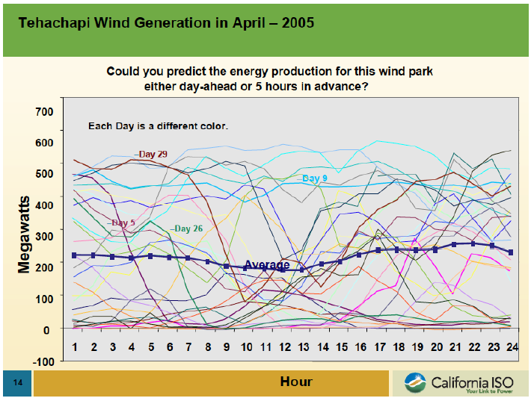
Uncertainty

Slide 3
Negative Correlation with Load
8000
250
7000
200
load
6000
150
load (MW)
wind power output (MW)
5000
100
4000
50
wind power
0
24
48
72
96
120
144
168
3000
hour

Slide 5
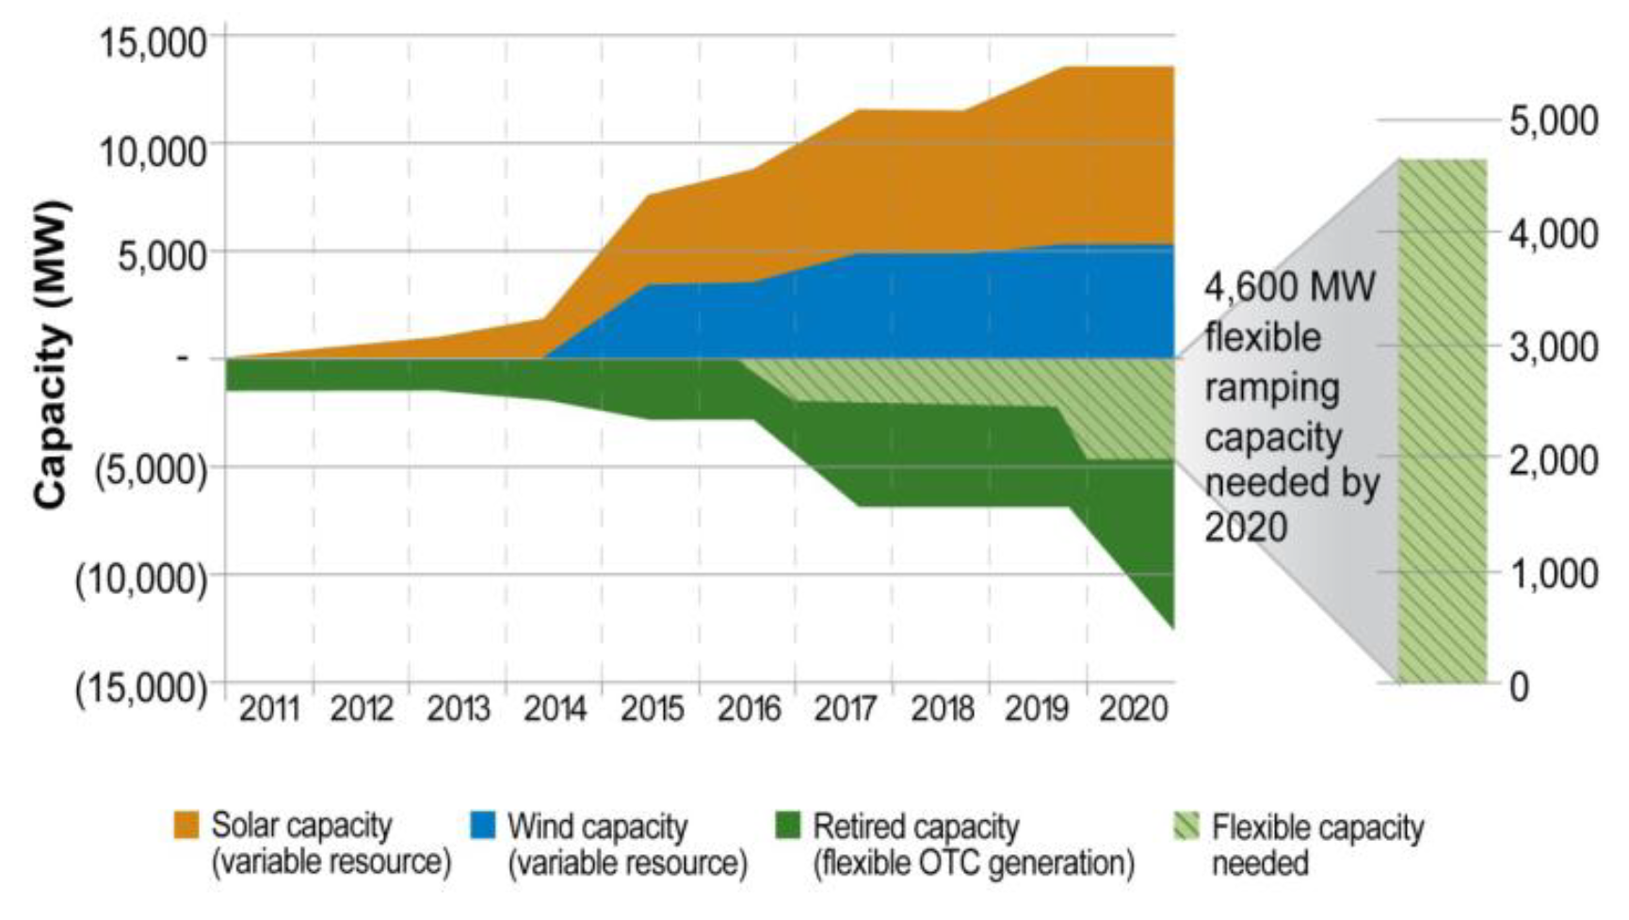
Conventional Solution
Source: CAISO

Slide 6
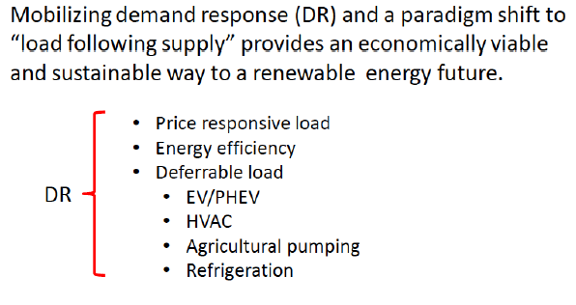
The DR Alternative to Expanding Flexible Thermal Generation

Slide 7
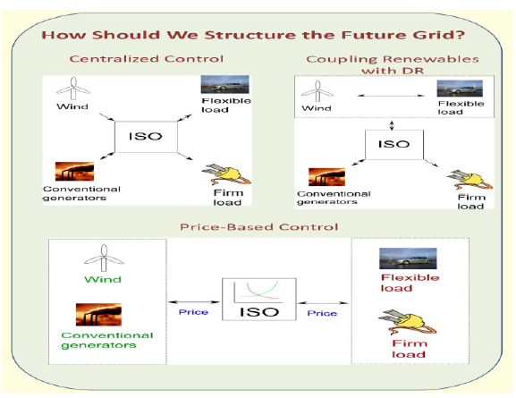
Alternative DR Paradigms

Slide 8
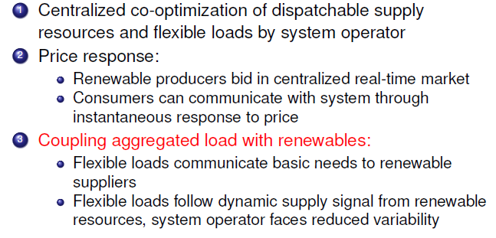
Alternative Approaches to DR Mobilization

Slide 9
Evaluation Methodology
Comparison requires explicit accounting for uncertainty for consistent determination of locational reserves.
Stochastic unit commitment optimization accounts for uncertainty by considering a limited number of probabilistic wind and contingency scenarios, committing slow reserves early with fast reserves and demand response adjusted after uncertainties are revealed.
Economic and reliability outcomes are calculated using Monte Carlo simulation with large number of probabilistic scenarios and contingencies

Slide 10
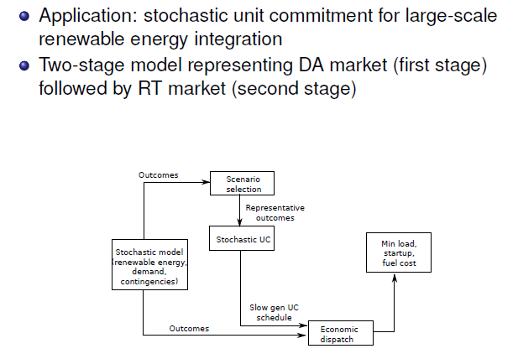
Model Structure

Slide 11
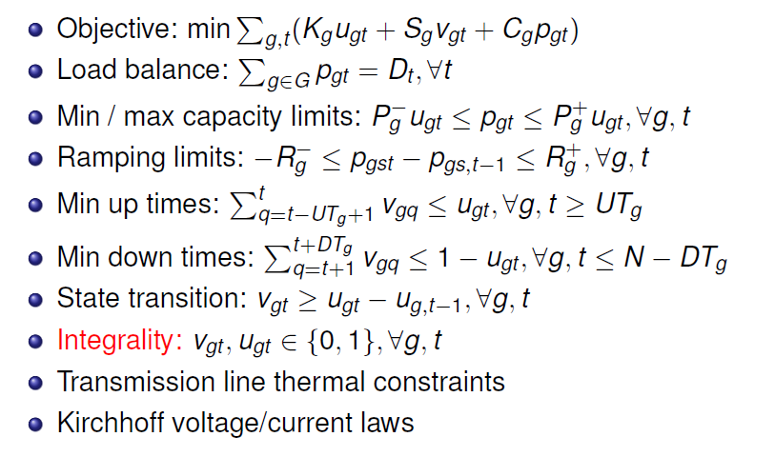
Unit Commitment

Slide 12
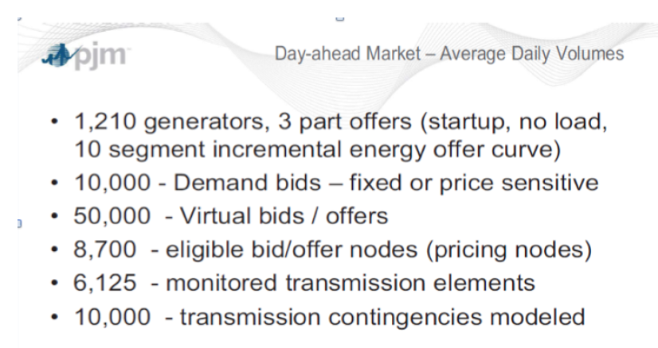
The Real Thing

Slide 13
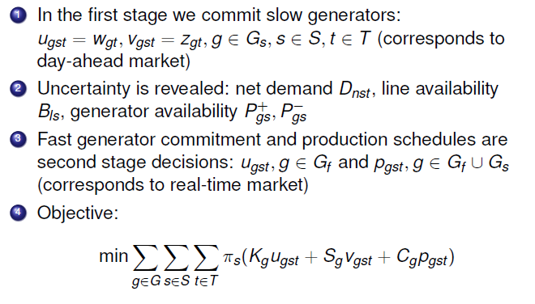
Two Stage Stochastic Unit Commitment

Slide 14
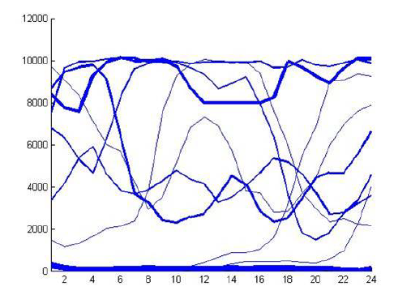
Scenario Selection

Slide 15
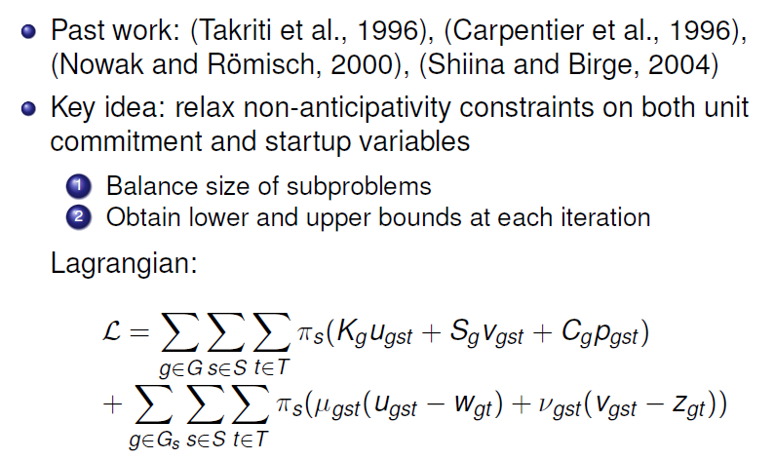
Decomposition

Slide 16
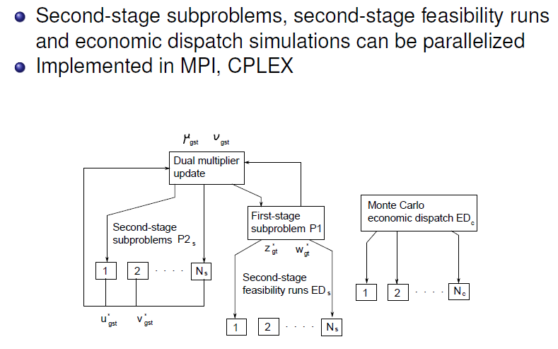
Parallelization

Slide 17
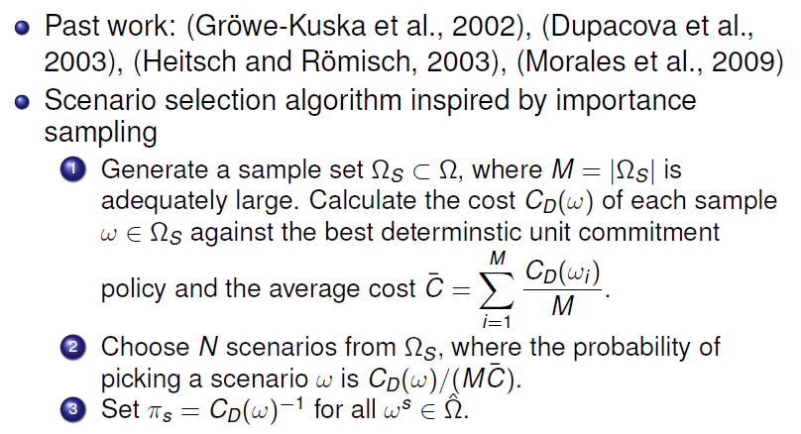
Scenario Selection

Slide 18
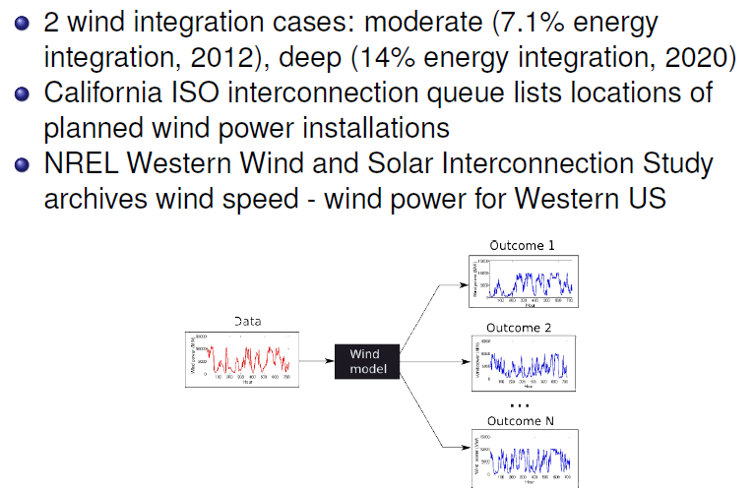
Wind Modeling and Data Sources

Slide 19
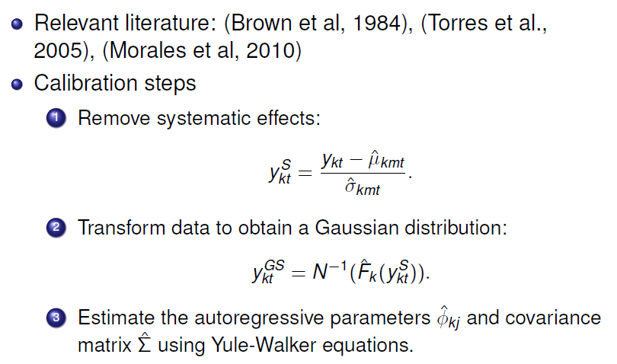
Model Calibration

Slide 20
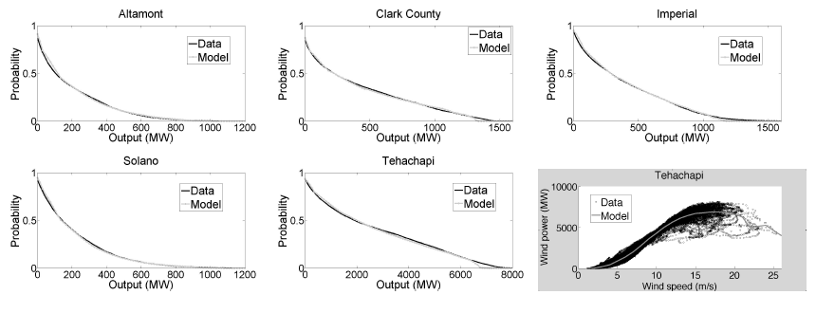
Data Fit

Slide 21
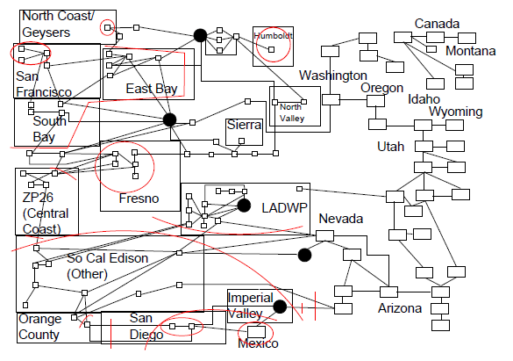
WECC Case Study

Slide 22
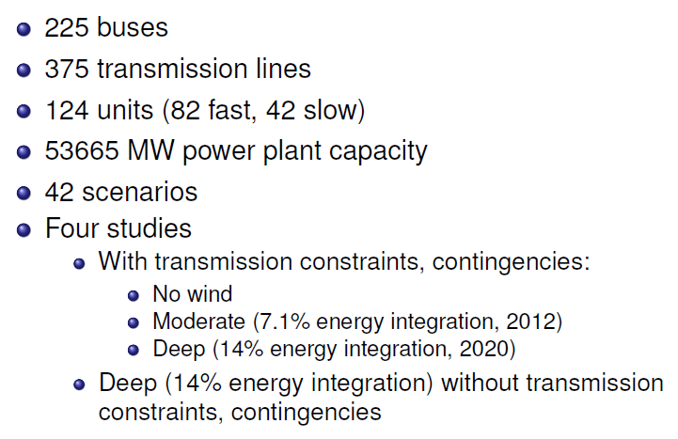
Case Study Summary

Slide 23
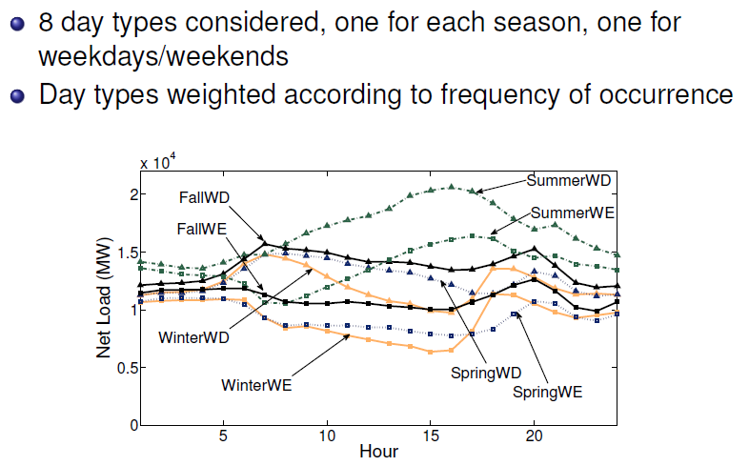
Day Types

Slide 24
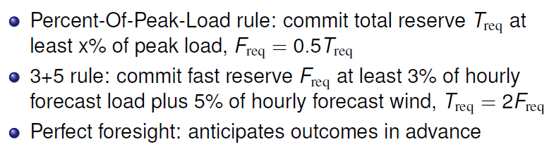
Competing Reserve Rules

Slide 25
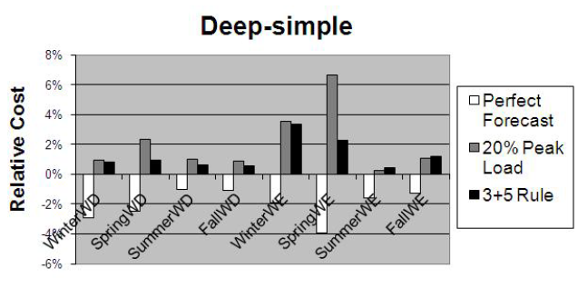
Reserve Policy Comparison
Deep Integration, No Transmission, No Contingencies

Slide 26
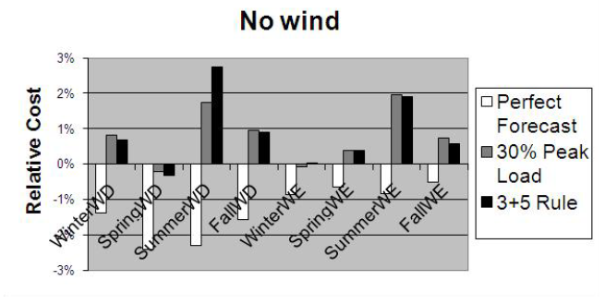
Reserve Policy Comparison
No Wind

Slide 27
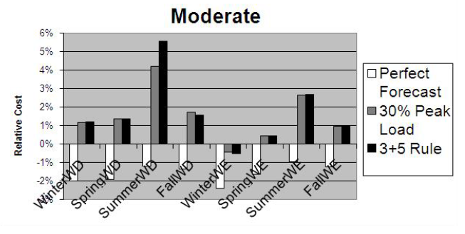
Reserve Policy Comparison
Moderate Integration

Slide 28
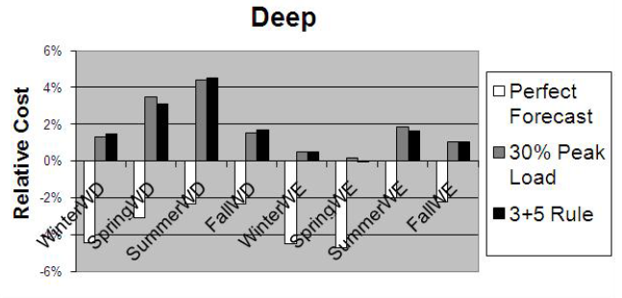
Reserve Policy Comparison
Deep Integration

Slide 29
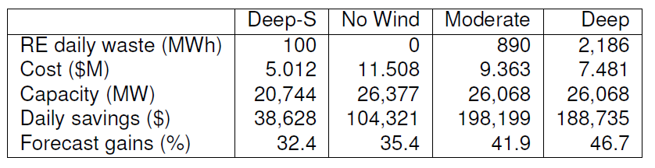
Summary

Slide 30
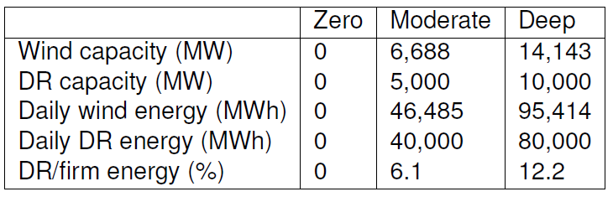
Demand Response Study

Slide 31
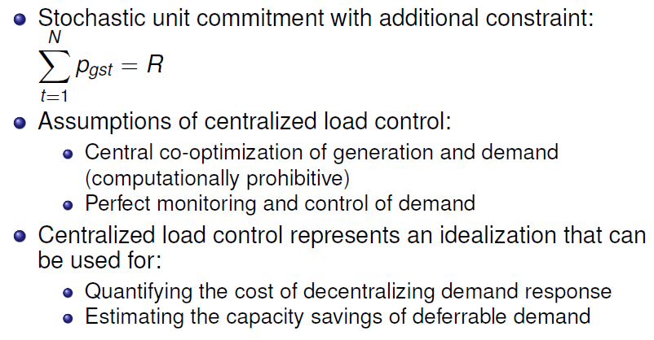
Centralized Load Dispatch

Slide 32
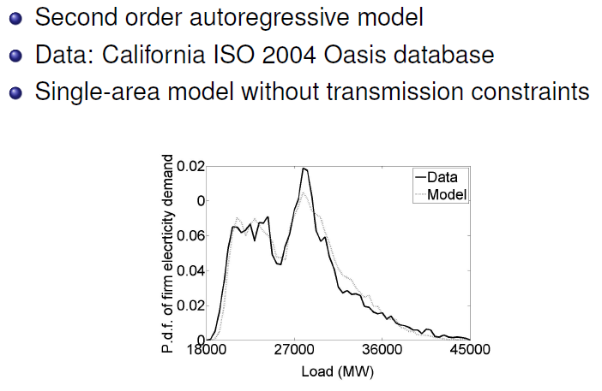
Firm Demand Uncertainty

Slide 33
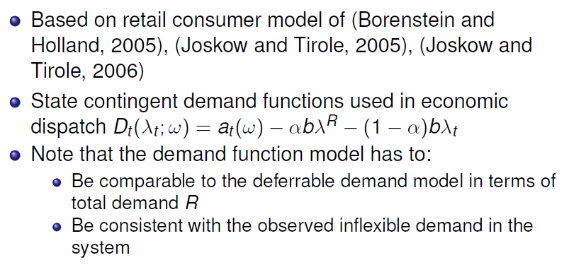
Market Based: Demand Side Bidding

Slide 34
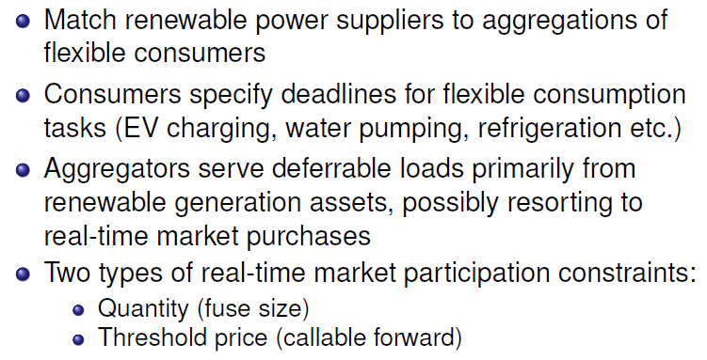
Implementation of Coupling

Slide 35
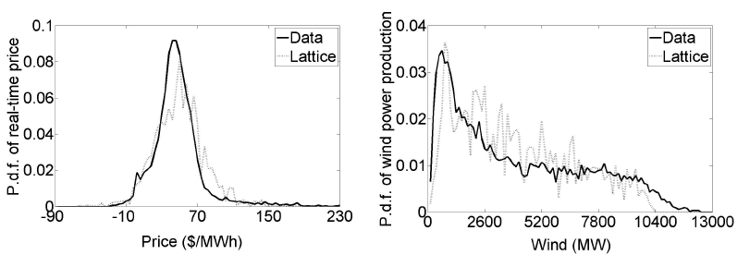

Price and Wind Data For Coupling Model

Slide 36
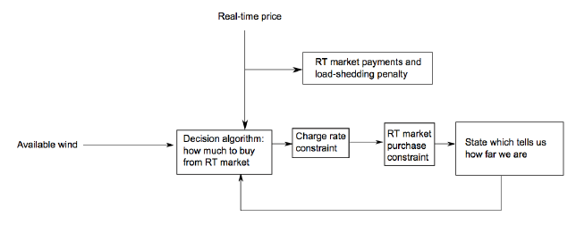
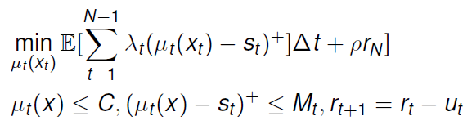
Coupling Model (Smart Charging)

Slide 37
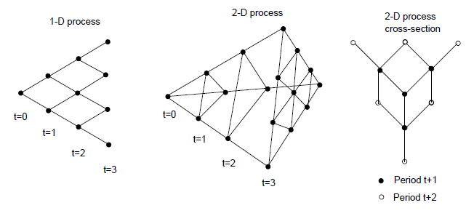
Dynamic Programming With Recombinant Lattices

Slide 38
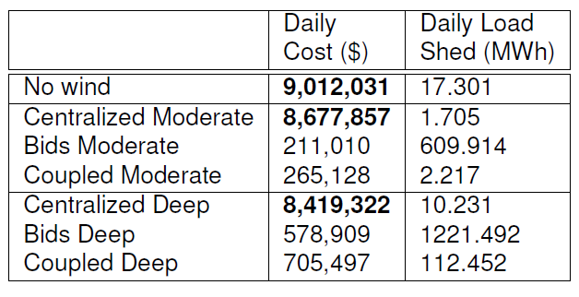
Demand Response Results

Slide 39
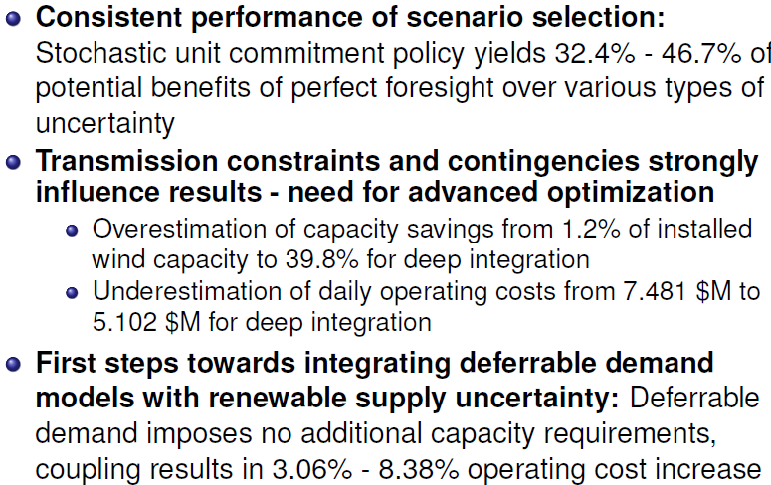
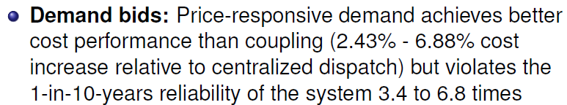
Conclusions

Slide 40
References
Papavasiliou Anthony, Shmuel Oren and Richard O’Neill, “Reserve Requirements for Wind Power Integration: A Scenario-Based Stochastic Programming Framework”, IEEE Transactions on Power System, Vol 26, No4 (2011), pp. 2197-2206
Papavasiliou A. and S. S. Oren, ”Integrating Renewable Energy Contracts and Wholesale Dynamic Pricing to Serve Aggregate Flexible Loads” Invited Panel Paper, Proceeding of the IEEE PES GM, Detroit, Michigan, July 24-28, 2011.
Papavasiliou A. and S. S. Oren “Integration of Contracted Renewable Energy and Spot Market Supply to Serve Flexible Loads”, Proceedings of the 18th World Congress of the International Federation of Automatic Control, August 28 – September 2, 2011, Milano, Italy.
Papavasiliou A.and S. S. Oren, “Stochastic Modeling of Multi-area Wind Power Production “, Proceedings of PMAPS 2012, Istanbul Turkey, June 10-14, 2012.
Oren S. S., Invited Panel Paper ” Renewable Energy Integration and the Impact of Carbon Regulation on the Electric Grid “, Proceeding of the IEEE PES GM, San Diego CA, July 22-26, 2012.
Papavasiliou A., S. S. Oren, ” A Stochastic Unit Commitment Model for Integrating Renewable Supply and Demand Response” Invited Panel Paper, Proceeding of the IEEE PES GM, San Diego, CA, July 24-28, 2012.
Papavasiliou A., S. S. Oren, “Large-Scale Integration of Deferrable Demand and Renewable Energy Sources in Power Systems”, Accepted for publication in a special issue of the IEEE PES Transaction.
Papavasiliou A., S. S. Oren, “Multi-Area Stochastic Unit Commitment for High Wind Penetration in a Transmission Constrained Network”, Accepted for publication in Journal of Operations Research.
Papavasiliou Anthony, Shmuel Oren, Barry Rountree “Applying High Performance Computing to Multi-Area Stochastic Unit Commitment for Renewable Energy Integration”, Submitted to Mathematical Programming (February 2013)

Slide 41
Questions?

