Slide 1
Exact Computation of Coalescent Likelihood under the Infinite Sites Model
Yufeng Wu
University of Connecticut
DIMACS Workshop on Algorithmics in Human Population-Genomics, 2009

Slide 2
Coalescent Likelihood
D: a set of binary sequences.
Coalescent genealogy: history with coalescent and mutation events.
Coalescent likelihood P(D): probability of observing D on coalescent model given mutation rate θ
Assume no recombination.
Infinite many sites model of mutations.
4
1
2
5
3
00000
00010
00010
00010
01100
10000
10001
Coalescent
Mutation

Slide 3
Computing Coalescent Likelihood
Computation of P(D): classic population genetics problem. Statistical (inexact) approaches:
Importance sampling (IS): Griffiths and Tavare (1994), Stephens and Donnelly (2000), Hobolth, Uyenoyama and Wiuf (2008).
MCMC: Kuhner,Yamato and Felsenstein (1995).
Genetree: IS-based, widely used but (sometimes large) variance still exists.
How feasible of computing exact P(D)?
Considered to be difficult for even medium-sized data (Song, Lyngso and Hein, 2006).
This talk: exact computation of P(D) is feasible for data significantly larger than previously believed.
A simple algorithmic trick: dynamic programming
Notes:
Approximation: e.g. PAC likelihood (Li and Stephens, 2003
Solve the so-called Ethier-Griffiths recursions.

Slide 4
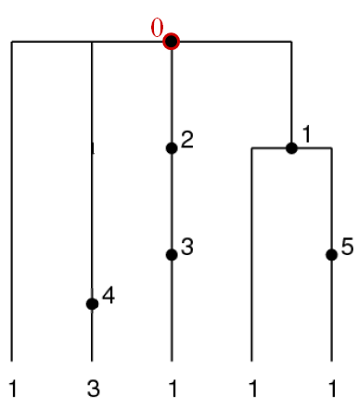
Ethier-Griffiths Recursion
Build a perfect phylogeny for D.
Ancestral configuration (AC): pairs of sequence multiplicity and list of mutations for each sequence type at some time
Transition probability between ACs: depends on AC and θ.
Genealogy: path of ACs (from present to root)
P(D): sum of probability of all paths.
EG: faster summation, backwards in time.
(1, 0), (1, 0), (1, 3 2 0), (1, 1 0), (1, 5 1 0)
(1, 0), (1, 4 0), (1, 3 2 0), (1, 1 0), (1, 5 1 0)
(1, 0), (2, 4 0), (1, 3 2 0), (1, 1 0), (1, 5 1 0)
(1, 0), (3, 4 0), (1, 3 2 0), (1, 1 0), (1, 5 1 0)
(3, 4 0)
Notes:
Approximation: e.g. PAC likelihood (Li and Stephens, 2003

Slide 5
Computing Exact Likelihood
Key idea: forward instead of backwards
Create all possible ACs reachable from the current AC (start from root). Update probability.
Intuition of AC: growing coverage of the phylogeny, starting from root
Start from root AC
b₂
b₁
Possible events at root: three branching (b₁, b₂, b₃), three mutations (m₁, m₂, m₄).
Branching: cover new branch
Covered branch can mutate
Mutated branches < covered branches (unless all branches are covered)
Each event: a new AC
m₂
Notes:
Approximation: e.g. PAC likelihood (Li and Stephens, 2003
Solve the so-called Ethier-Griffiths recursions.

Slide 6
Why Forward?
Coalescent
Mutation
Bottleneck: memory
Layer of ACs: ACs with k mutation or branching events from root AC, k= 1,2,3…
Key: only the current layer needs to be kept. Memory efficient.
A single forward pass is enough to compute P(D).
Notes:
Approximation: e.g. PAC likelihood (Li and Stephens, 2003
Solve the so-called Ethier-Griffiths recursions.

Slide 7
Results on Simulated Data
Use Hudson’s program ms: 20, 30 , 40 and 50 haplotypes with θ = 1, 3 and 5. Each settings: 100 datasets. How many allow exact computation of P(D) within reasonable amount of time?
% of feasible data
Ave. run time (sec.) for feasible data
Number of haplotypes
Number of haplotypes
Notes:
Approximation: e.g. PAC likelihood (Li and Stephens, 2003
Solve the so-called Ethier-Griffiths recursions.

Slide 8
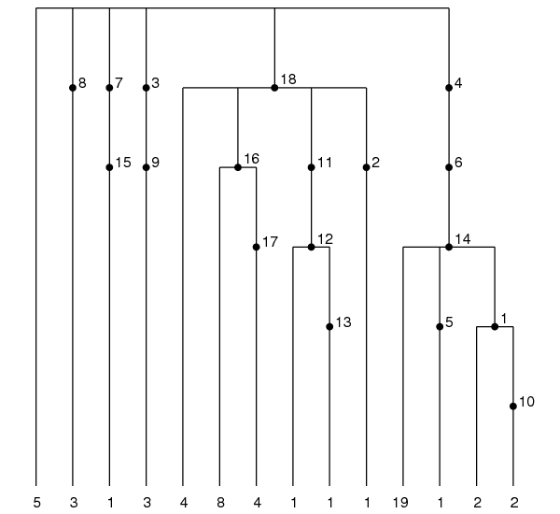
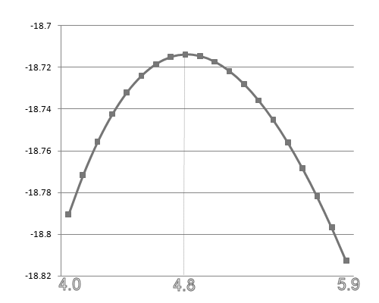
Results on a Mitochondrial Data
Mitochondrial data from Ward, et al. (1991). Previously analyzed by Griffiths and Tavare (1994) and others.
55 sequences and 18 polymorphic sites.
Believed to fit the infinite sites model.
MLE of θ: 4.8 Griffiths and Tavare (1994)
Is 4.8 really the MLE?
Notes:
Approximation: e.g. PAC likelihood (Li and Stephens, 2003
Solve the so-called Ethier-Griffiths recursions.

Slide 9
Conclusion
IS seems to work well for the Mitochondrial data
However, IS can still have large variance for some data.
Thus, exact computation may help when data is not very large and/or relatively low mutation rate.
Can also help to evaluate different statistical methods.
Paper: in proceedings of ISBRA 2009.
Research supported by National Science Foundation.
Notes:
Approximation: e.g. PAC likelihood (Li and Stephens, 2003
Solve the so-called Ethier-Griffiths recursions.

