Slide 1
Population genetic analysis of shotgun sequence data
Rasmus Nielsen
Departments of Integrative Biology and Statistics
UC-Berkeley

Slide 2
Price of Sequencing
1990: 1 dollar per base.
2000: 0.01 dollars per base.
2009: 0.000001 dollar per base.

Slide 3
Outline
Genome wide analyses using comparative data and Sanger sequenced population genetic data.
Analysis of selection in the human genome using genome-wide shotgun sequencing data.

Slide 4
Selection
Positive Selection

Slide 5
Nonsynonymous/synonymous rate ratio: d_{N}/d_{S} = ω
d_{N}/d_{S} < 1: Negative selection
d_{N}/d_{S} = 1: Neutrality (no selection)
d_{N}/d_{S} > 1: Positive selection

Slide 6
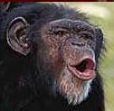

Ancestor
5-6 mill years
Question: which genes/categories of genes have been targeted by positive selection (have adapted) in the evolutionary history of humans and chimpanzees?
Data: directly sequenced data for 13k genes (Celera genomics).

Slide 7
Biological process | Number of genes | p-value
Immunity and defense | 417 | 0.0000
T-cell mediated immunity | 82 | 0.0000
Chemosensory perception | 45 | 0.0000
Biological process unclassified | 3069 | 0.0000
Olfaction | 28 | 0.0004
Gametogenesis | 51 | 0.0005
Natural killer cell mediated immunity | 30 | 0.0018
Spermatogenesis and motility | 20 | 0.0037
Inhibition of apoptosis | 40 | 0.0047
Interferon-mediated immunity | 23 | 0.0080
Sensory perception | 133 | 0.0160
B-cell- and antibody-mediated immunity | 57 | 0.0298

Slide 8
dN/dS in human/chimp divergence
Tissue of max. expression
Number of genes
P-value
Testis
247
0.0002
Thyroid
66
0.0287
Thymus
82
0.0599
Prostate
76
0.0902
Fetal liver
114
0.1668
Salivary gland
195
0.1696
Fetal brain
201
0.912
Ovary
133
0.9295
Whole Brain
83
0.965
Cerebellum
93
0.9903
Spinal cord
14
1

Slide 9
Limitations
Comparisons between species cannot detect ongoing or recent selection.
Cannot detect selection on segregating deleterious mutations.
Requires multiple selected mutations.
So population genetic data is needed!

Slide 10
Data
Directly sequenced polymorphism data from 20 European-Americans, 19 African-Americans and one chimpanzee from 9,316 protein coding genes.
We take demography into account by directly estimating parameters of the demographic model from the data.

Slide 11
Demographic model
European-Americans
African-Americans
migration
Admixture
Population growth
Bottleneck

Slide 12
Estimation
Sampling probabilities from the 2D frequency spectrum
,
Number of SNPs with pattern j in the 2D frequency spectrum
SNPs within a gene are correlated. But estimator is consistent. The estimate has the same properties as a real likelihood estimator except that it converges slightly slower because of the correlation (Nielsen and Wiuf 2005;Wiuf 2006).

Slide 13
African-Americans

Slide 14
European-Americans
Godness-of-fit: p = 0.6

Slide 15
Symbol | G2D | Max. express. | Annotation
EFCAB4B | 33.17 | NA | Calcuium binding protein that interacts with ATN1, which is involved in inherited Ataxias
ZNF473 (Zfp-100) | 32.09 | bone marrow | has KRAB and Zinc-finger domains, involved in transcription-related histone pre-mRNA processing and cell-cycle regulation
SP110 | 29.70 | blood | nuclear hormone receptor, Hepatic venoocclusive disease with immunodeficiency; Mycobacterium tuberculosis; hepatitis C
C11orf16 | 25.46 | NA | None
OCEL1 | 20.30 | liver | occludin-domain containing protein
C17orf64 | 19.32 | testis | None
INPP1 | 18.60 | testis | inositol phosphate-1-phosphatase, linkage to bipolar disorder & colorectal cancer loci
GSG2 | 18.01 | NA | germ-cell-associated 2 (haspin), phosphorylation of histone H3
MYCBPAP | 17.79 | testis | c-myc binding protein associated protein, involved in spermatogenesis
RBM23 | 17.42 | blood | coactivator of steroid hormone receptors and alternative splicing by U2AF65
OSBPL6 | 16.01 | brain | intracellular lipid receptors presumably involved in brain sterol metabolism, association with coronary artery disease
ADIPOR2 | 15.93 | adrenal gland | adiponectin receptor 2; linked to type 2 diabetes, body mass and metabolic rate
ALDH3B1 | 15.59 | NA | aldehyde dehydrogenase; association with schizophrenia
GIMAP7 | 15.39 | blood | GTPases of the immunity-associated protein family
TCEAL2 | 15.17 | brain | transcription elongation factor A (SII)-like 2

Slide 16
Genetic disorders
Genes with a OMIM morbidity association are significantly associated with selection (p=0.0057).
Genes associated with Mendelian disorders are significantly associated with negative selection (p = 0.037).
Genes associated with complex disorders are significantly associated with positive selection (p = 0.0041).

Slide 17
Begun and Aquadro (1992)
D. melanogaster

Slide 18
Linkage reduces the effect of selection
Positive selection reduce variability at linked sites.

Slide 19
Selective Sweeps
New advantageous mutation

Slide 20
Selective Sweeps
Escape by recombination

Slide 21
Linkage reduces the effect of selection
Positive selection reduce variability at linked sites.
Negative selection on deleterious alleles reduces effective population size in linked sites (background selection).

Slide 22
Humans
Hellmann et al. (2003)

Slide 23
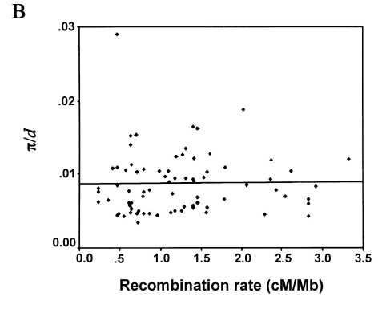
Humans
Hellmann et al. (2003)

Slide 24

Data
Directly sequenced regions contain too little variability in low recombination regions.
SNP data (e.g., HapMap) has strong ascertainment bias.
Must turn to genome-wide shotgun sequencing data.

Slide 25
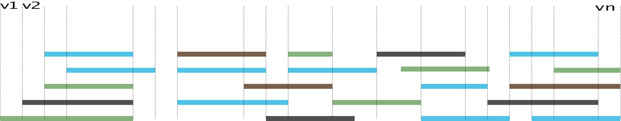
Tiled population genetic data
Shotgun Sanger sequencing, 454 pyrosequencing, Solexa sequencing.
Missing data problem
Identity of haplotype unknown
High error rates

Slide 26
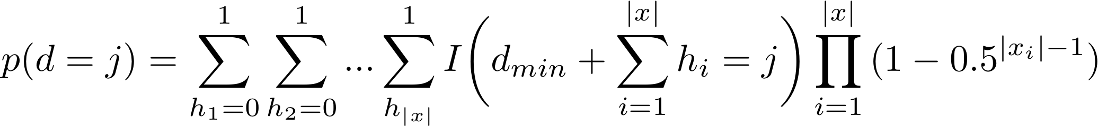
Shotgun sequencing data
Divide the alignment into k segments. Sequences in one segment form a set, x, of equivalence classes, x₁, x₂,…, each equivalence class consisting of sequences sampled from the same individual.

Slide 27
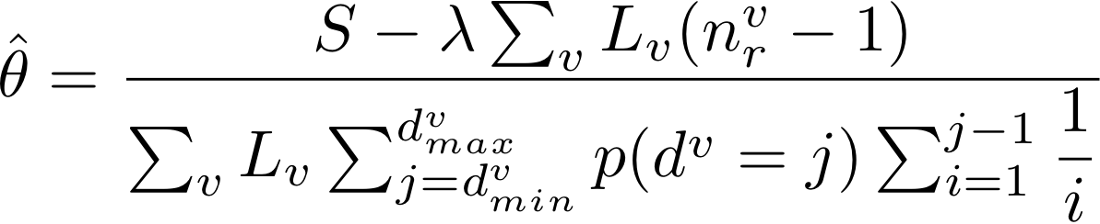
Estimators can easily be derived
θ: population genetic parameter measuring variability
S: the number of variable positions in the sample

Slide 28
Data
Most reads (~70%) originate from one Caucasian individual, but there are also reads from 3 other Caucasians, 1 Hispanic, 1 Asian and 1 African American.
Estimates of θ for 100kb windows sliding by 20kb across the human genome.
Estimates of the local recombination rate were obtained from Myers et al. (2004).
Chimpanzee-human divergence was calculated from the whole genome alignments of ptr2 to hg17.

Slide 29
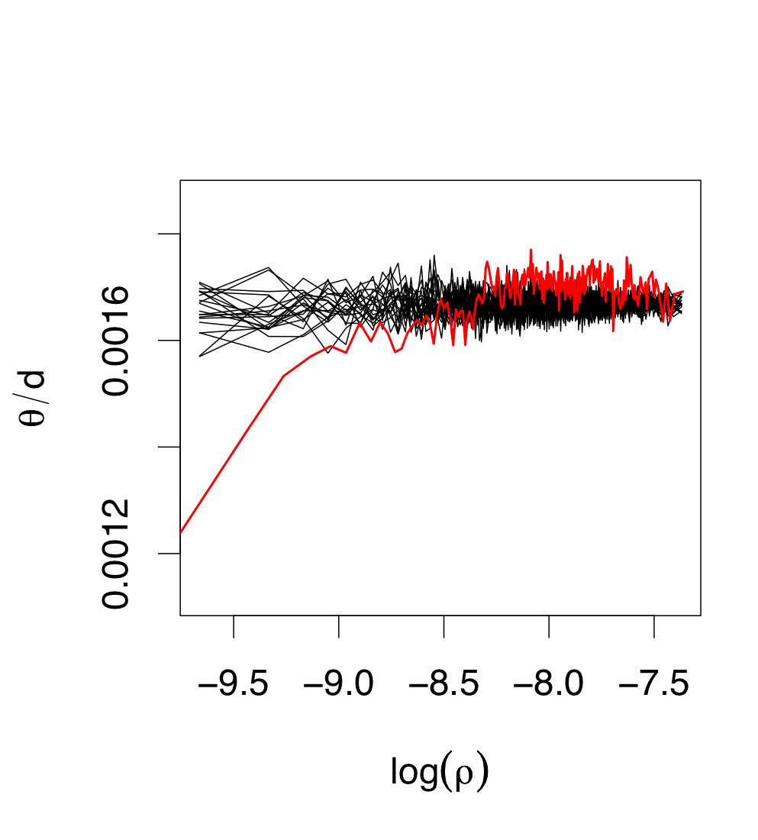
Neutral simulations
Data

Slide 30
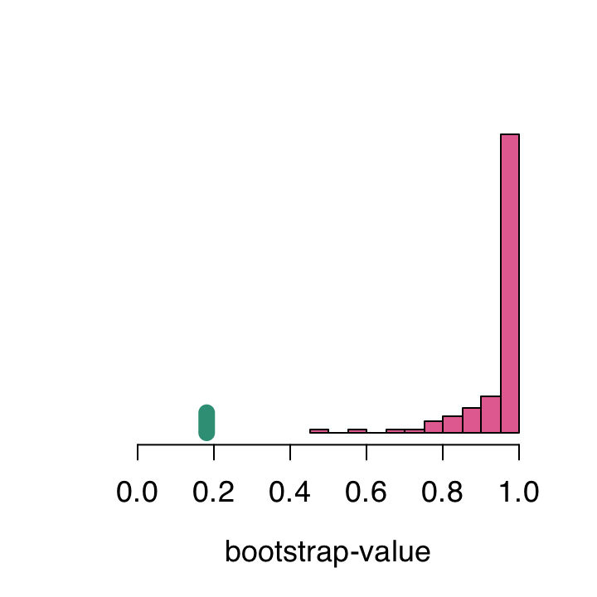
Goodness-of-fit to background selection model vs. selective sweep model.
Real data

Slide 31
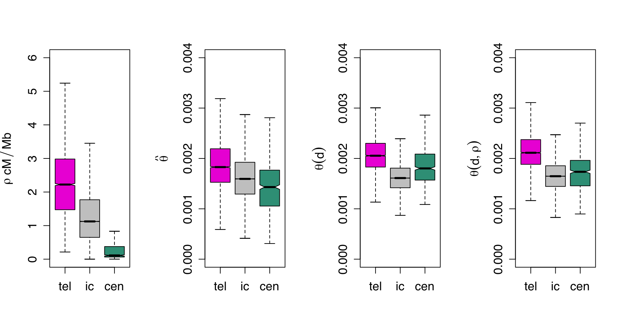
Telomers and centromers
recombination
rate
θ
Scaled divergence
Predicted θ given d & recombination
θ
d
θ_{pred}

Slide 32
Williamson et al. (2007)

Slide 33
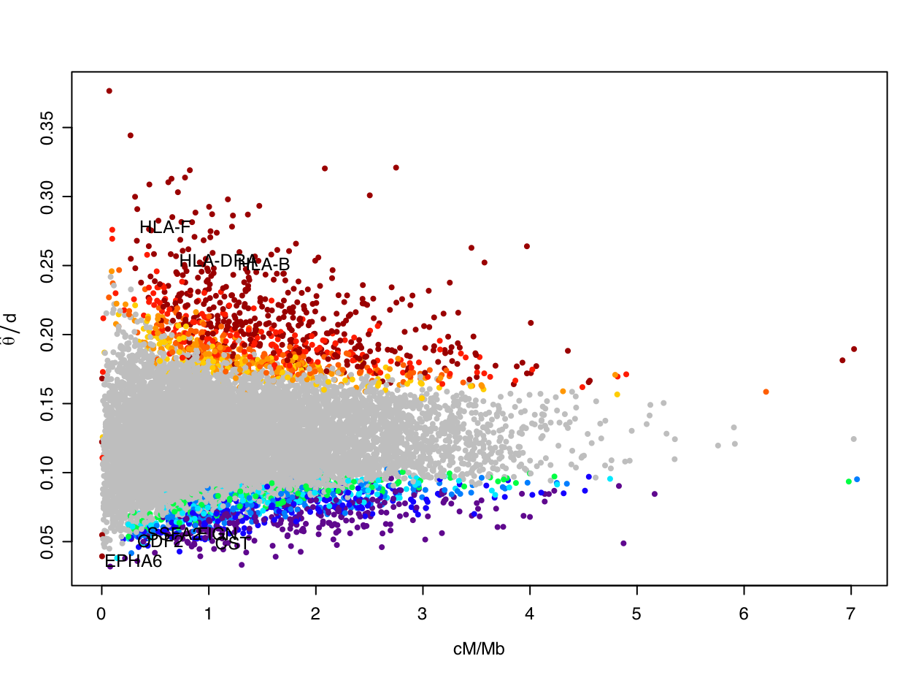
Outliers

Slide 34
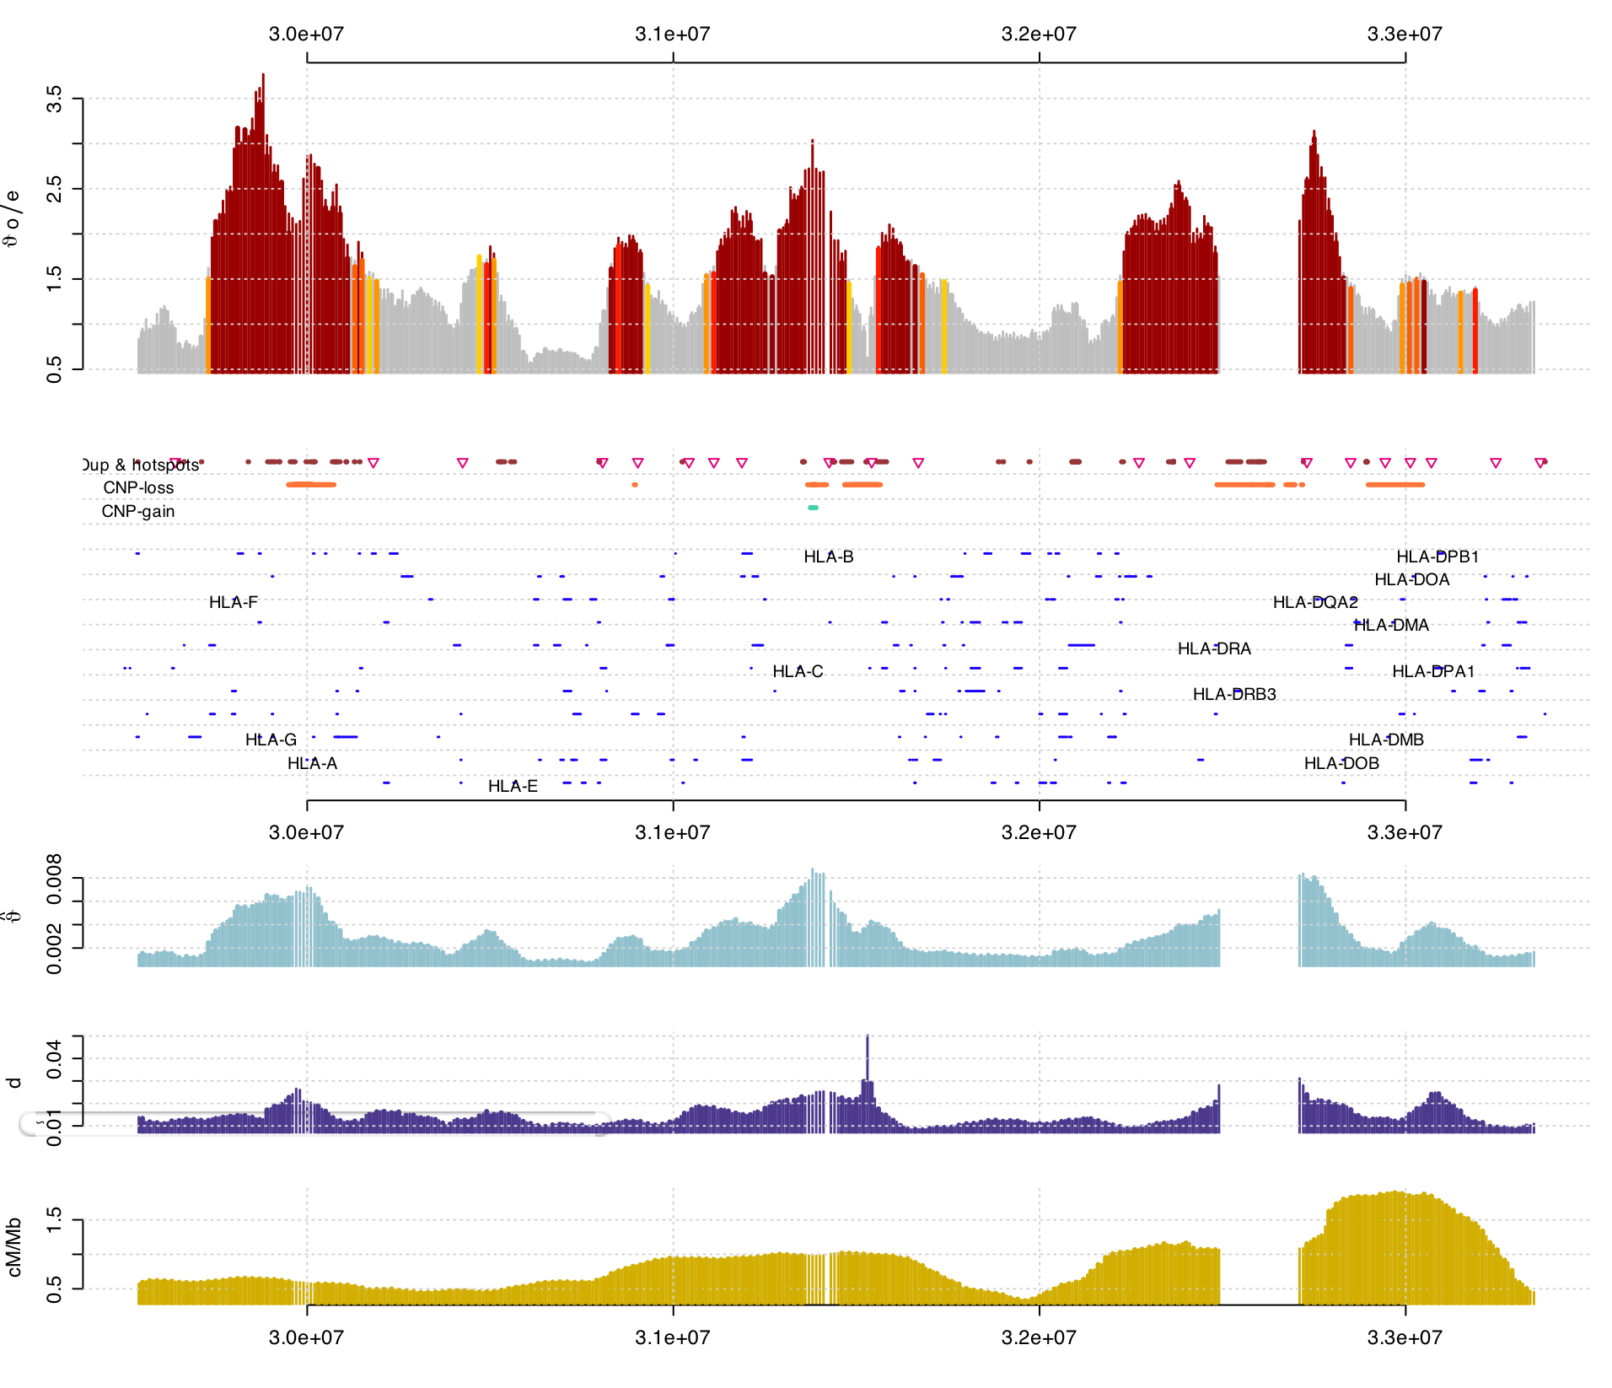
HLA-region on chromosome 6
Known Genes

Slide 35
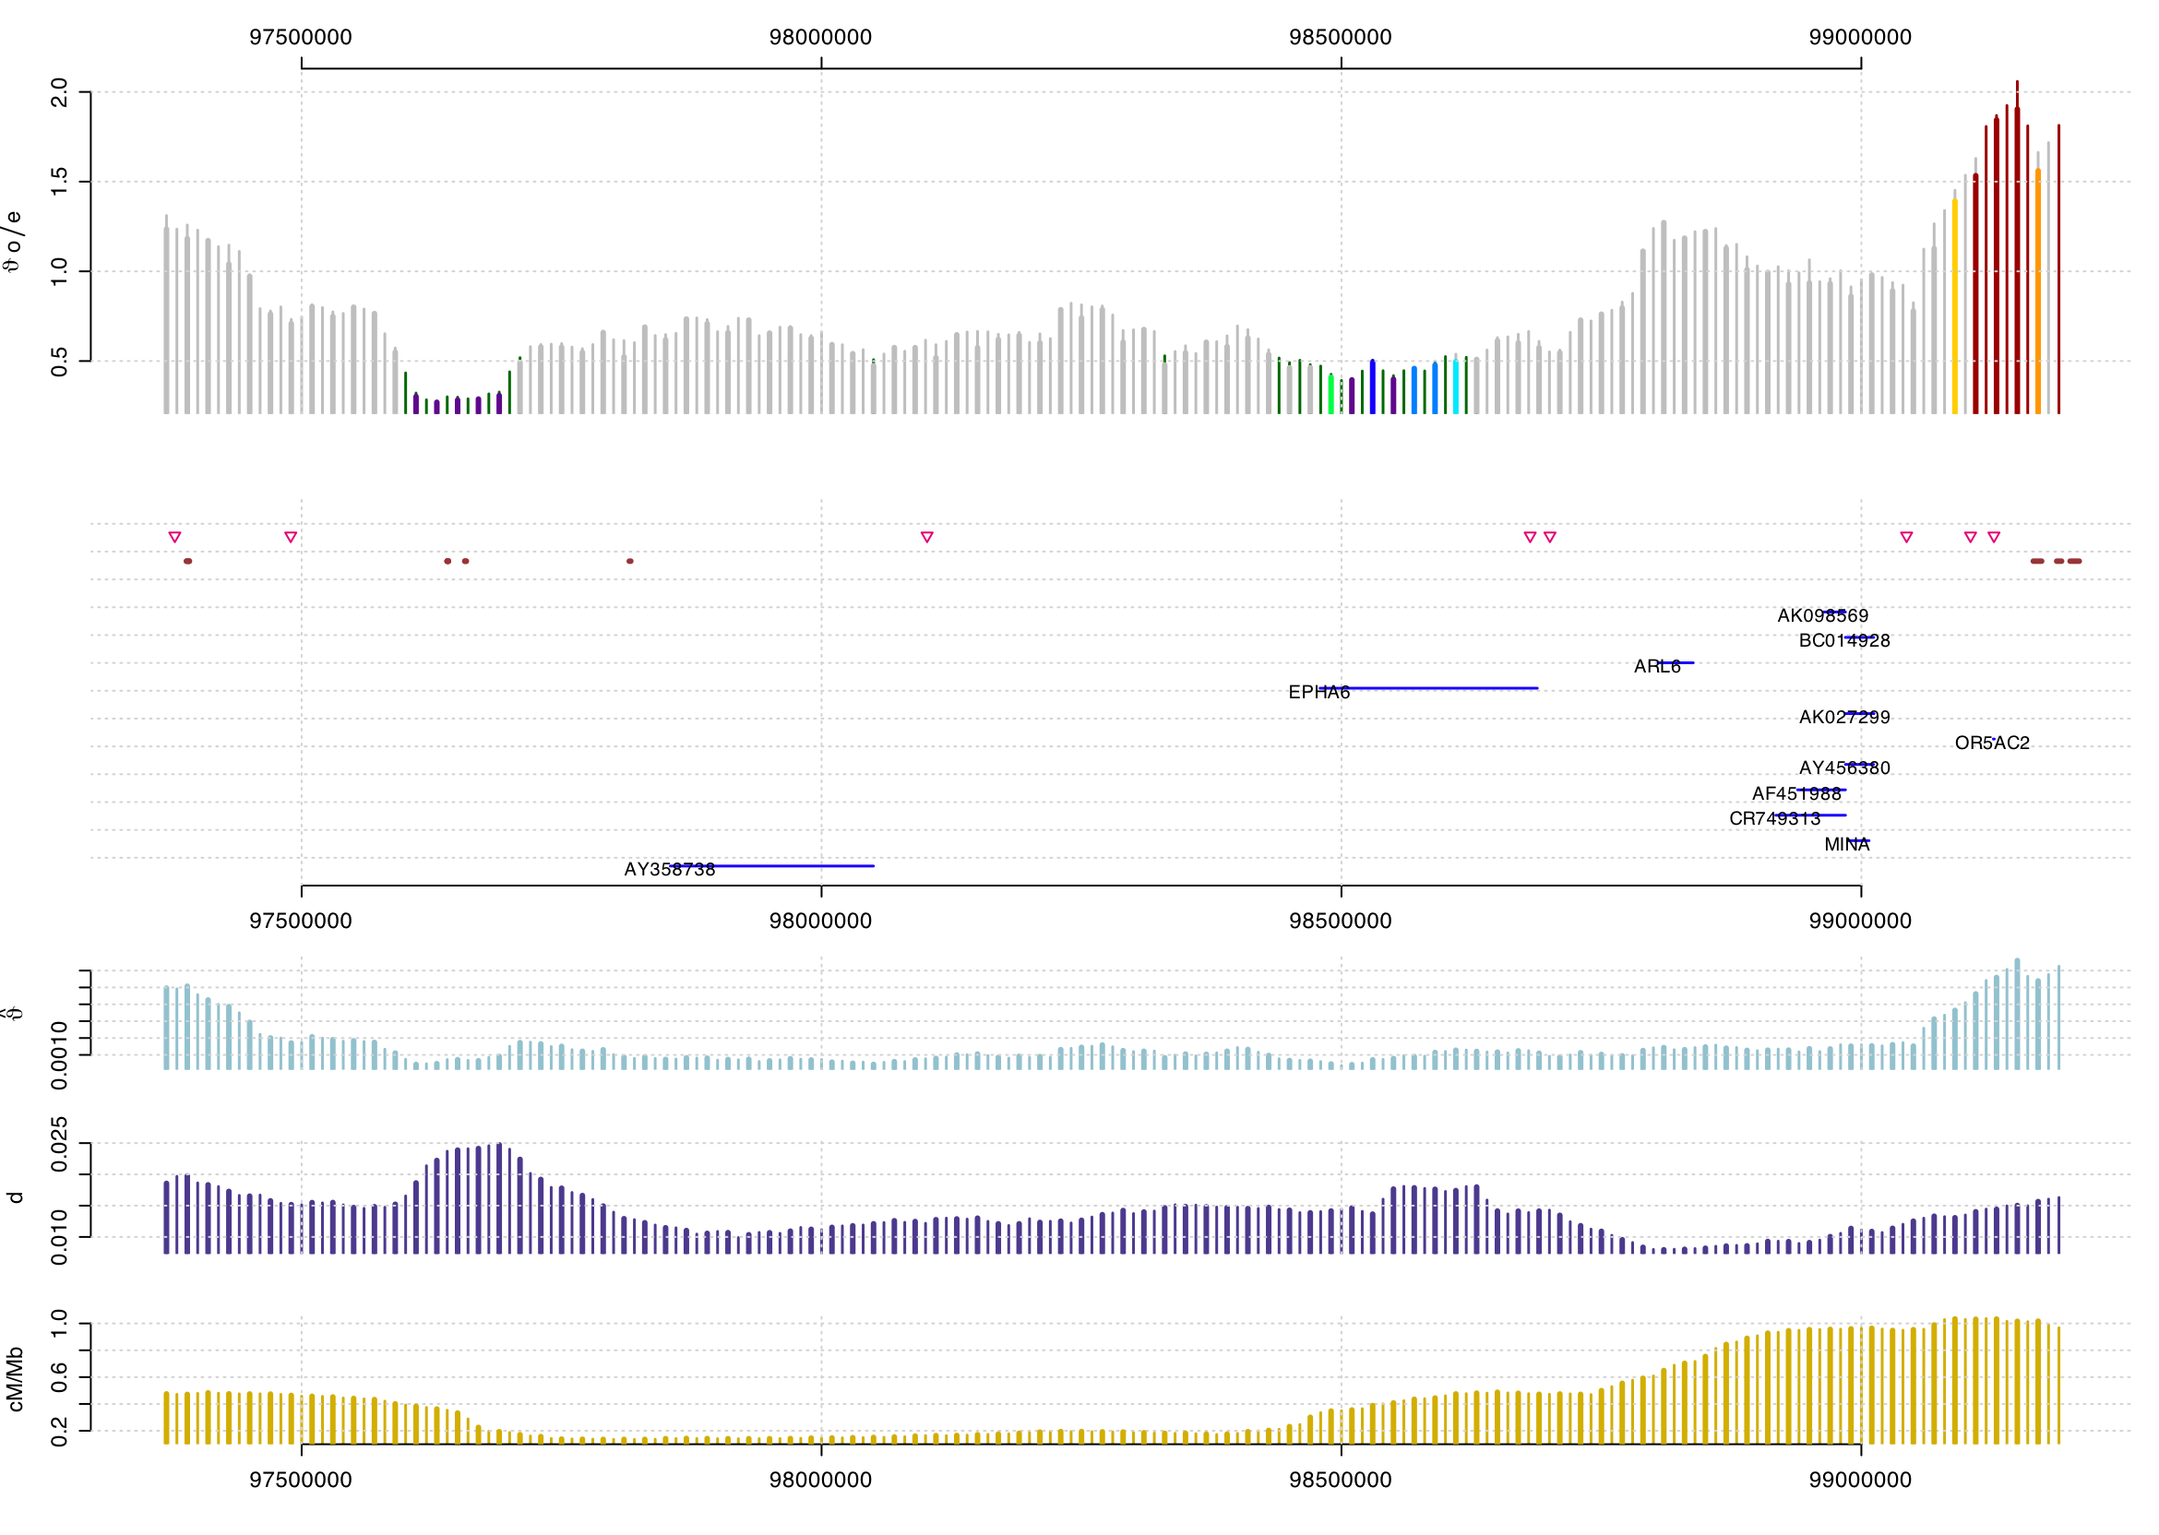
Lowest significant θ around EPHA6 on chromosome 3
This ephrin receptor is expressed in brain & testis.

Slide 36
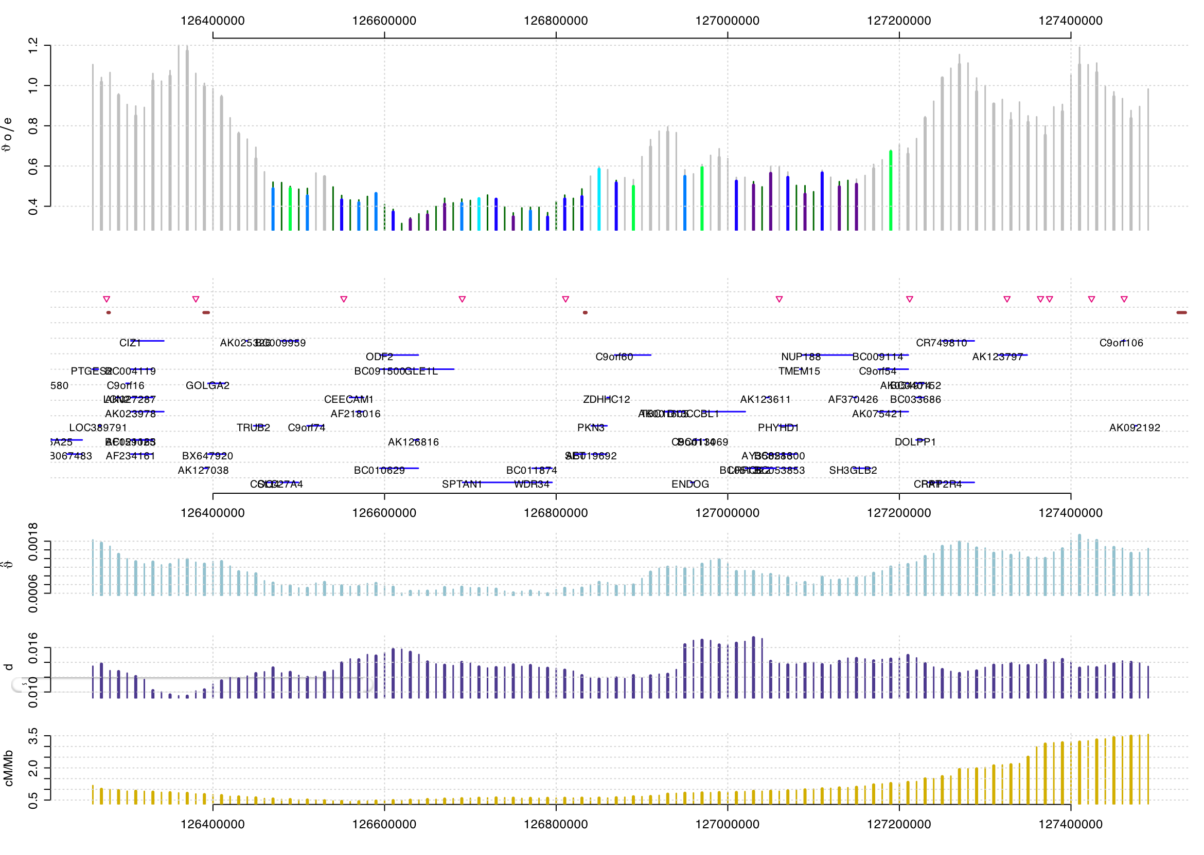
ODF2 on chromosome 9 (outer dense fibre of sperm tail)

Slide 37
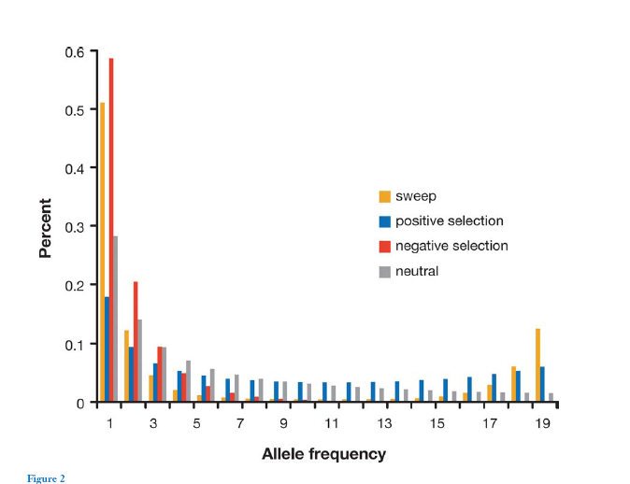
Allele frequencies

Slide 38
Allele frequencies
Calculate the genotype probability for each individual for each SNP, accounting for errors and sequencing depth.
Based on the genotype calls for each individual site, calculate the probabilities of each possible site frequency pattern at each site, p(x₀), p(x₁),…, p(x_{2n}).
Estimate the genomic site frequency pattern based on these probabilities.

Slide 39
Data
Venter’s genome. Sanger sequencing.
Watson’s genome. 454 pyro-sequencing.
Huang Yan’s genome. Solexa sequencing.
From the first two genomes, we don’t have reads – only SNP calls, coverage and information regarding error rates. We then need to sum over the missing information.

Slide 40
Power

Slide 43
Tiled population genetic data
Can be used for valid population genetic inferences – even at low coverage.
Must take read depths and errors into account.
The currently available data suggests that humans in fact have reduced variability and a skewed frequency spectrum in regions of low recombination – even when accounting for possible correlations between mutations rates and recombination rates.

Slide 44
Acknowledgments
Ines Hellmann (Berkeley)
Andrew G. Clark, Carlos Bustamante and other collaborators at Cornell.
Jun Wang and other collaborators at BGI.
Francisco de la Vega and other present and past staff at Celera/Applied Biosystems.

