Slide 1
Making Sense of Unstructured Data
Dan Roth
Department of Computer Science
University of Illinois at Urbana-Champaign
October 2014
Paul Kantor’s Fusion Fest Workshop

Slide 2
Data Science: Making Sense of (Unstructured) Data
Most of the data today is unstructured
  Text, Images, Sensory Data
  It’s not only BIG, it’s COMPLEX & Heterogeneous
Challenge: How to understand what the data says? How to deal with the huge amount of unstructured data as if it was organized in a database with a known schema.
  Organize, access, analyze and synthesize unstructured data.
Develop the theories, algorithms, and tools to enable transforming raw data into useful and understandable information & integrating it with existing resources
[data → meaning] transformation.
TODAY: Why is it hard – What we can do….how Paul helped us

Slide 3
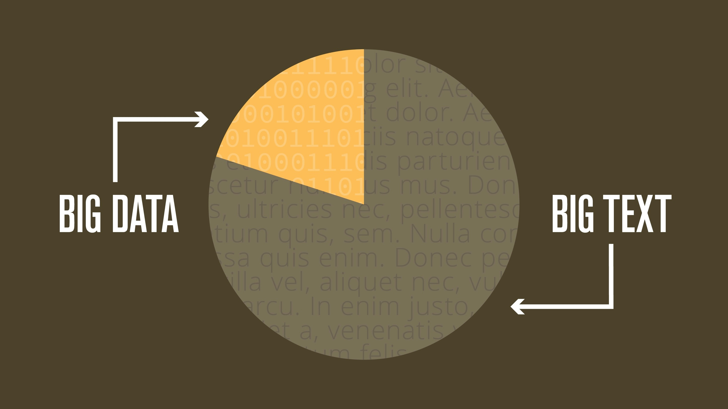
Notes:
How big is this text really? Of all of the information in corporations, 80% is unstructured text.

Slide 4




More than a million rules, requiring companies and their boards to understand what their employees are doing and with whom they are communicating.
Dodd-Frank Act
Amended Federal
Rules of Evidence
Amended Federal Rules of Civil Procedure
Sarbanes
Oxley
Notes:
Thanks to the Dodd-Frank Act and other regulations, there are now more than a million rules, requiring companies and their boards to understand what their employees are doing and with whom they are communicating.
The fortune 500 alone spends [click] $2.5 billion on meeting compliance regulations and I haven’t even mentioned the [click] 10 Billion in annual legal discovery.
These are not discretionary spends……..

Slide 5

WORLD TEXT
90% of the world’s text has been created in the last 2 years, and there will be a 50-fold increase by 2020.
2012
2014
2020
Notes:
And it is getting much more difficult to understand all of this text.
90% [click] of the world’s data has been created in the last 2 years, and there will be a [click] 50-fold increase by 2020.
The compounding effect of regulatory obligations and data is making it impossible for humans to keep up. We need machines to assist.
This is the where the NexLP Story Engine comes in.

Slide 6

Notes:
Just like Big Data is beyond numbers, Story Engine is beyond Keyword Search.

Slide 7
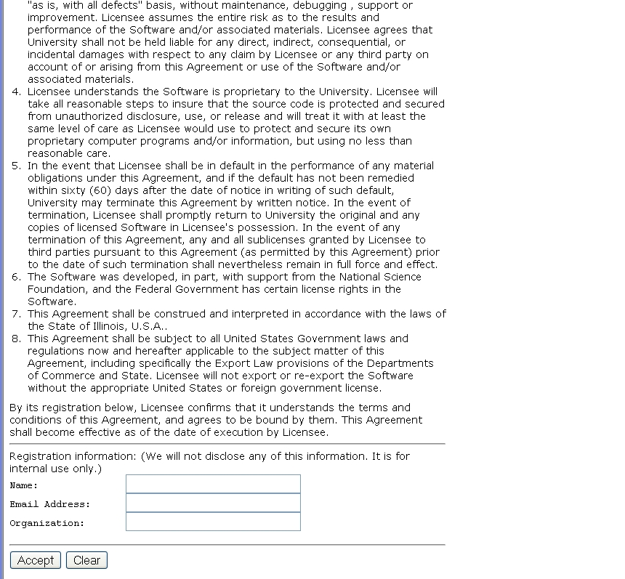
A view on Extracting Meaning from Unstructured Text
Large Scale Data→ Meaning Transformation Massive & Deep
Given:
A long contract that you need to ACCEPT
Determine:
Does it satisfy the 3 conditions that you really
care about?
(and distinguish from other candidates)
Does it say that they’ll give
my email address away?
ACCEPT?
Notes:
This is a collection of different problems of ambiguity resolution - from text correction –
Sorry, it was too tempting to use this one…
Word sense disambiguation, part of speech tagging to a decision that involves a decision across sentence
All these are essentially the same classification problem – and with progress in learning theory and NLP
We have pretty reliable solutions to these today.
Here are a few more problems of this kind.

Slide 8
Why is it difficult?
Meaning
Variability
Ambiguity
Language

Slide 9

Variability in Natural Language Expressions
Determine if Jim Carpenter works for the government
Jim Carpenter works for the U.S. Government.
The American government employed Jim Carpenter.
Jim Carpenter was fired by the US Government.
Jim Carpenter worked in a number of important positions. …. As a press liaison for the IRS, he made contacts in the white house.
Russian interior minister Yevgeny Topolov met yesterday with his US counterpart, Jim Carpenter.
Former US Secretary of Defense Jim Carpenter spoke today…
Standard techniques cannot deal with the variability of expressing meaning
nor with the
ambiguity of interpretation
  Needs:
  Relations, Entities and Semantic Classes, NOT keywords
  Bring knowledge from external resources
  Integrate over large collections of text and DBs
  Identify, disambiguate and track entities, events, etc.
Notes:
9

Slide 10






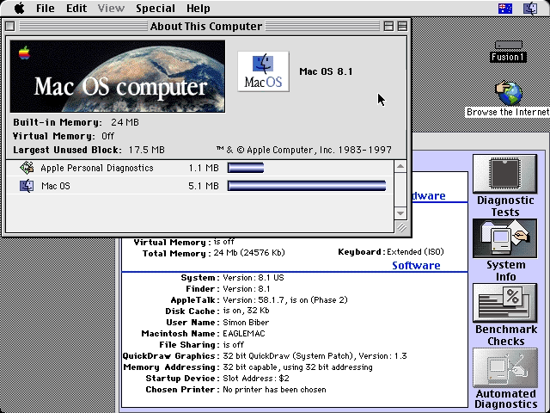
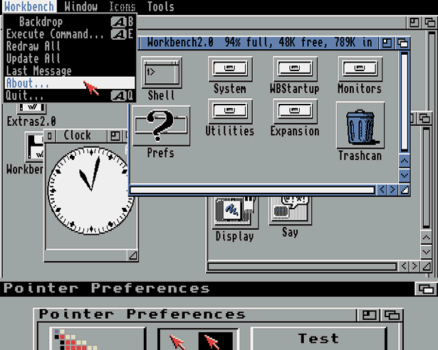
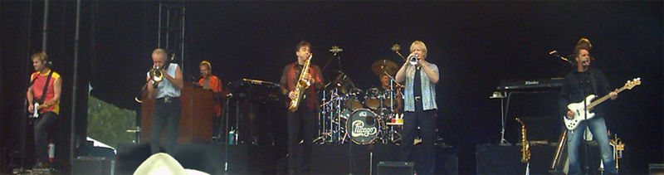
Ambiguity
It’s a version of Chicago – the standard classic Macintosh menu font, with that distinctive thick diagonal in the ”N”.
Chicago was used by default for Mac menus through MacOS 7.6, and OS 8 was released mid-1997..
Chicago VIII was one of the early 70s-era Chicago albums to catch my
ear, along with Chicago II.

Slide 11






Wikification: The Reference Problem
Cycles of Knowledge: Grounding for/using Knowledge
Blumenthal (D) is a candidate for the U.S. Senate seat now held by Christopher Dodd (D), and he has held a commanding lead in the race since he entered it. But the Times report has the potential to fundamentally reshape the contest in the Nutmeg State.
Blumenthal (D) is a candidate for the U.S. Senate seat now held by Christopher Dodd (D), and he has held a commanding lead in the race since he entered it. But the Times report has the potential to fundamentally reshape the contest in the Nutmeg State.
Notes:
Let’s start with what is wikification
Read wiki titles slower

Slide 12
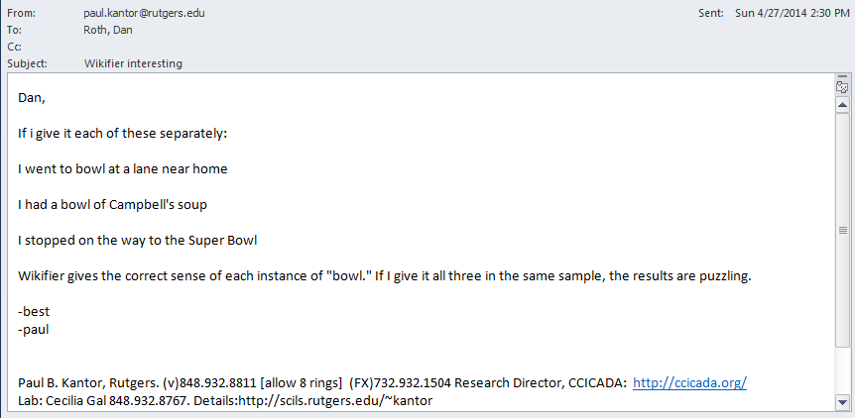
Paul’s Quality Assurance

Slide 13
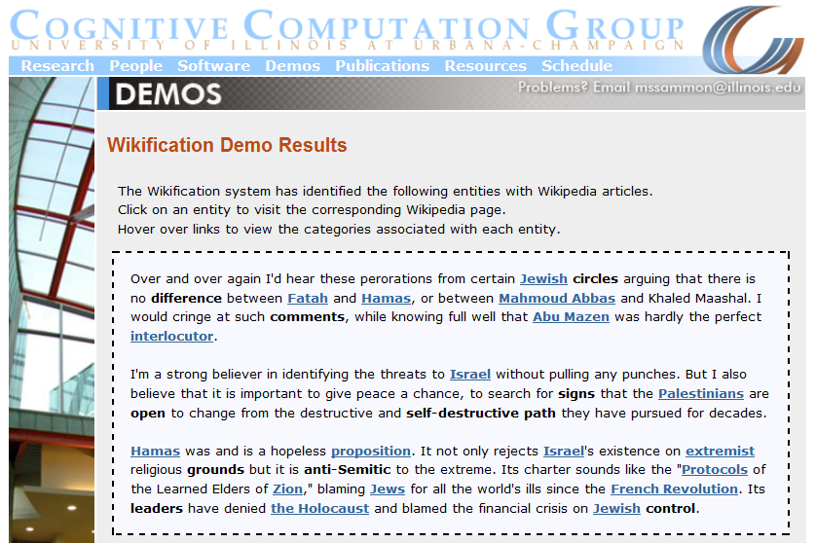
Wikifikation: Demo Screen Shot (Demo)
Training a global model that identifies concepts in text , disambiguates & grounds them in Wikipedia is very involved and relies on the correctness of the (partial) link structure in Wikipedia, but – relying on annotation from Wikipedia
http://en.wikipedia.org/wiki/Mahmoud_Abbas
http://en.wikipedia.org/wiki/Mahmoud_Abbas

Slide 14
Challenges
Blumenthal (D) is a candidate for the U.S. Senate seat now held by Christopher Dodd (D), and he has held a commanding lead in the race since he entered it. But the Times report has the potential to fundamentally reshape the contest in the Nutmeg State.
State-of-the-art systems (Ratinov et al. 2011) can achieve the above with local and global statistical features
  Reaches bottleneck around 70%~ 85% F1 on non-wiki datasets
  Check out our demo at: http://cogcomp.cs.illinois.edu/demos
  What is missing?
Notes:
Quite impressive, bottleneck: adding more sophisticated contextual features does not help much
We do not want to level off here

Slide 15
Relational Inference
Mubarak,
the wife of deposed Egyptian President Hosni Mubarak,…

Slide 16
Relational Inference
Mubarak, the wife of deposed Egyptian President Hosni Mubarak, …
Egyptian President
Hosni Mubarak
, the of deposed , …
Mubarak
wife
What are we missing with Bag of Words (BOW) models?
  Who is Mubarak?
Textual relations provide another dimension of text understanding
Can be used to constrain interactions between concepts
  (Mubarak, wife, Hosni Mubarak)
Has impact in several steps in the Wikification process:
  From candidate selection to ranking and global decision
Notes:
Main contribution here
We will show that by identifying

Slide 17
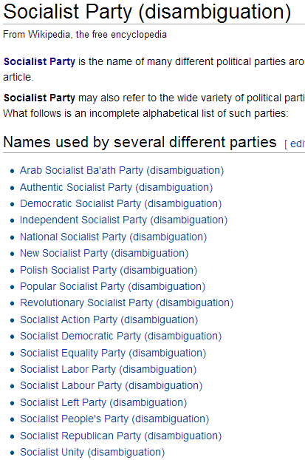

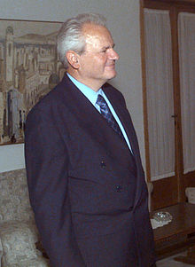
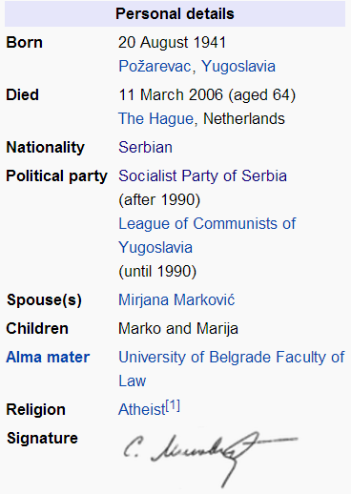
Knowledge in Relational Inference
apposition
Coreference
possessive
...ousted long time Yugoslav President Slobodan Milošević in October. The Croatian parliament... Mr. Milošević's Socialist Party
What concepts can “Socialist Party” refer to?
  Wikipedia link statistics is uninformative
Notes:
There are quite some relations in this short sentence
Overall it is sparse but important in text understanding, as error propagates in structured inference
We do not actually care about relation types too much, as the relation will be constrained by our knowledge

Slide 18
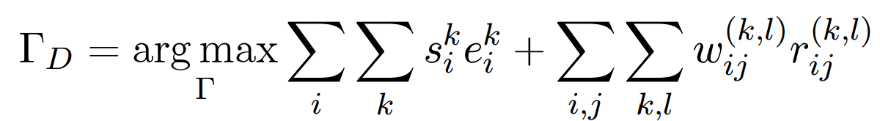
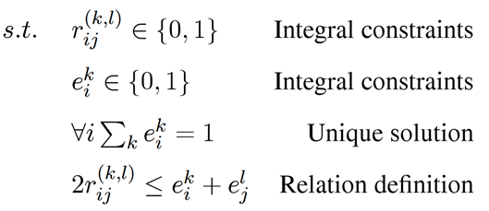
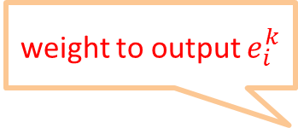
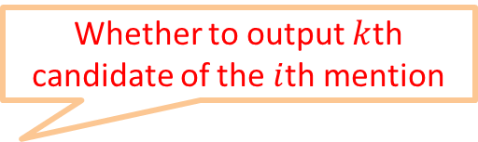
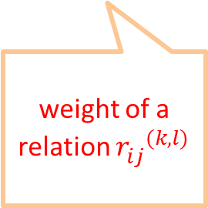
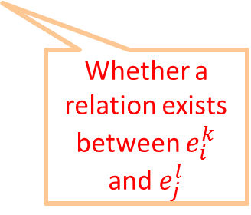
Formulation
Having some knowledge, and knowing how to use it to support decisions, facilitates the acquisition of additional knowledge.
  Goal: Promote concepts that are coherent with textual relations
Formulate as an Integer Linear Program (ILP):
If no relation exists, collapses to the non-structured decision
weight to output $e_{i}^{k}$
Whether to output $k$th candidate of the $i$th mention
weight of a relation ${r_{ij}^{}}^{(k,l)}$
Whether a relation exists between $e_{i}^{k}$ and $e_{j}^{l}$
Notes:
Formalize intuition, weights induced from data, small constraints
Objective function collapse to the original output when there is no relation, so our model is negatives-proof
True-negatives and false-negatives will not negatively impact performance of baseline

Slide 19
Application
Coreference Resolution:
  Using Wikipedia to bridge between raw texts and existing structured knowledge
  Inject knowledge into coreference decisions
Entity Linking
  Top DEFT system in TAC KBP Entity Linking Task
  Wikifier + Non-trivial cross-document clustering
    Best Latent Left-Linking approach
Profiling

Slide 20
Wikification Performance Result [EMNLP’13]
How to use it to get more knowledge?
How to represent it so that it’s useful?
Thank you!
Notes:
And we show that by incorporating these relational inference into the disambiguation framework, our system achieves significant improvements over the previous methods

