Slide 1
El Avión con Fusion
Douglas W. Oard
iSchool and UMIACS
University of Maryland, College Park

Slide 6
The iSchool Vision
Information
People
Technology

Slide 7
US Federal R&D Funds to Universities

Slide 8
Library School Closures (post-1945)
Top-100 US Universities
Other US Universities
1962: Carnegie Institute (39)
1978: Oregon (90)
1985: Minnesota (20)
1986: Sothern California (32)
1986: Case Western (53)
1988: Vanderbilt (36)
1990: Chicago (8)
1992: Columbia (7)
1994: Berkeley (2)
1948: William and Mary
1952: NJ College for Women
1983: SUNY Genesco
1984: Mississippi
1985: Ball State
1993: Brigham Young
1994: Northern Illinois
2005: Clark Atlanta
(2010 Shanghai Jiao Tong Academic Ranking of US Universities)

Slide 9
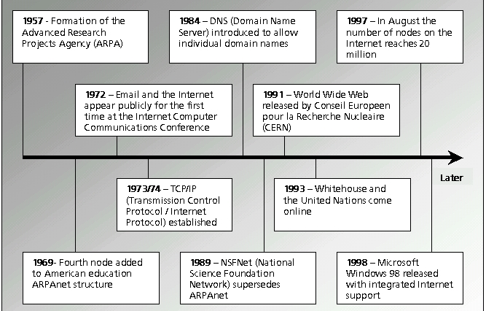
Internet Adoption Changes the Dynamic

Slide 10
US LIS Programs in Top-100 Universities
US LIS Program in an iSchool
Other US LIS Programs
UCLA (11)
Washington (14)
Wisconsin-Madison (15)
Michigan (18)
Illinois (19)
Maryland (28)
Texas (29)
UNC Chapel Hill (30)
Rutgers (37)
Pittsburgh (38)
Indiana (50)
Florida State (70)
Tennessee (70)
Kentucky (90)
Arizona (45)
Hawaii (55)
Iowa (55)
Alabama (70)
Louisiana State (70)
SUNY Buffalo (90)
Missouri-Columbia (90)
South Carolina (90)
South Florida (90)

Slide 11
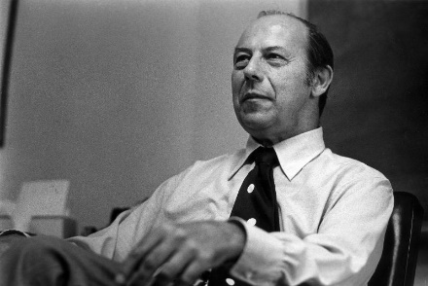
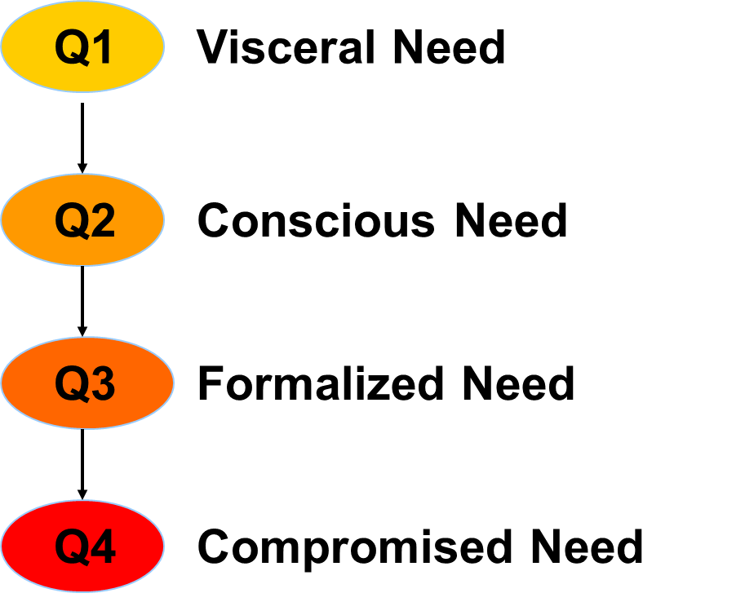

Slide 12
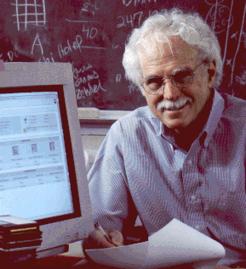

Slide 14
