Slide 1
Paired Experiments and Interleaving for Retrieval Evaluation
Thorsten Joachims, Madhu Kurup, Filip Radlinski
Department of Computer Science
Department of Information Science
Cornell University
Notes:
Big Data often comes from human behavior and decisions
Understanding data means understanding human preferences

Slide 2
Decide between two Ranking Functions
Distribution P(u,q)
of users u, queries q

(tj,”SVM”)

Retrieval Function 1 f₁(u,q) → r₁
Retrieval Function 2 f₂(u,q) → r₂
Which one is better?
1. Kernel Machines http://svm.first.gmd.de/
2. SVM-Light Support Vector Machine http://svmlight.joachims.org/
3. School of Veterinary Medicine at UPenn http://www.vet.upenn.edu/
4. An Introduction to Support Vector Machines http://www.support-vector.net/
5. Service Master Company
http://www.servicemaster.com/
⁞
1. School of Veterinary Medicine at UPenn http://www.vet.upenn.edu/
2. Service Master Company
http://www.servicemaster.com/
3. Support Vector Machine http://jbolivar.freeservers.com/
4. Archives of SUPPORT-VECTOR-MACHINES http://www.jiscmail.ac.uk/lists/SUPPORT...
5. SVM-Light Support Vector Machine http://ais.gmd.de/~thorsten/svm light/
⁞
U(tj,”SVM”,r₁)
U(tj,”SVM”,r₂)
Notes:
Scenario:
Off-the-shelf IR system installed on company intranet
scientific paper search
any other search that does not have big bucks

Slide 3
Measuring Utility
Name | Description | Aggre-gation | Hypothesized Change with Decreased Quality
Abandonment Rate | % of queries with no click | N/A | Increase
Reformulation Rate | % of queries that are followed by reformulation | N/A | Increase
Queries per Session | Session = no interruption of more than 30 minutes | Mean | Increase
Clicks per Query | Number of clicks | Mean | Decrease
Click@1 | % of queries with clicks at position 1 | N/A | Decrease
Max Reciprocal Rank* | 1/rank for highest click | Mean | Decrease
Mean Reciprocal Rank* | Mean of 1/rank for all clicks | Mean | Decrease
Time to First Click* | Seconds before first click | Median | Increase
Time to Last Click* | Seconds before final click | Median | Decrease
(*) only queries with at least one click count

Slide 4
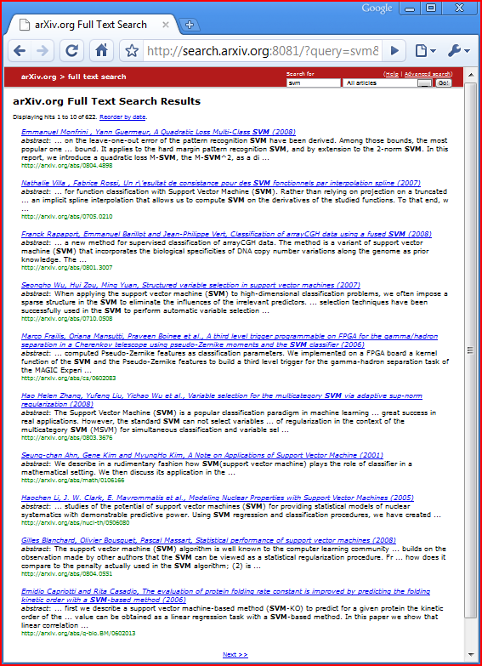
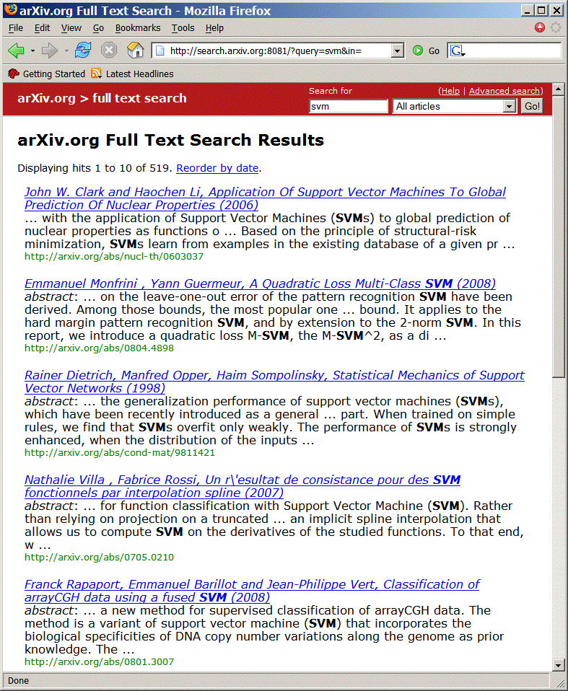
ArXiv.org: User Study
User Study in ArXiv.org
Natural user and query population
User in natural context, not lab
Live and operational search engine
Ground truth by construction
Orig Â Swap2 Â Swap4
Orig: Hand-tuned fielded
Swap2: Orig with 2 pairs swapped
Swap4: Orig with 4 pairs swapped
Orig Â Flat Â Rand
Orig: Hand-tuned fielded
Flat: No field weights
Rand : Top 10 of Flat shuffled
[Radlinski et al., 2008]

Slide 5
ArXiv.org: Experiment Setup
Experiment Setup
Phase I: 36 days
Users randomly receive ranking from Orig, Flat, Rand
Phase II: 30 days
Users randomly receive ranking from Orig, Swap2, Swap4
User are permanently assigned to one experimental condition based on IP address and browser.
Basic Statistics
~700 queries per day / ~300 distinct users per day
Quality Control and Data Cleaning
Test run for 32 days
Heuristics to identify bots and spammers
All evaluation code was written twice and cross-validated

Slide 6
Arxiv.org: Results
Conclusions
None of the absolute metrics reflects expected order.
Most differences not significant after one month of data.
Analogous results for Yahoo! Search with much more data.
[Radlinski et al., 2008]
Notes:
Mention:
Data Cleaning
Two months worth of data (700 queries / 300 users per day)

Slide 7
Yahoo! Search: Results
Retrieval Functions
4 variants of production retrieval function
Data
10M – 70M queries for each retrieval function
Expert relevance judgments
Results
Still not always significant even after more than 10M queries per function
Only Click@1 consistent with DCG@5.
[Chapelle et al., 2012]

Slide 8
Decide between two Ranking Functions
Distribution P(u,q)
of users u, queries q

(tj,”SVM”)

What would Paul do?
Take results from two retrieval functions and mix them → blind paired comparison.
Fedex them to the users.
Users assess relevance of papers. Retrieval system with more relevant papers wins.
KANTOR, P. 1988. National, language-specific evaluation sites for retrieval systems and interfaces. Proceedings of the International Conference on Computer-Assisted Information Retrieval (RIAO). 139–147.
Retrieval Function 1 f₁(u,q) → r₁
Retrieval Function 2 f₂(u,q) → r₂
Which one is better?
1. Kernel Machines http://svm.first.gmd.de/
2. SVM-Light Support Vector Machine http://svmlight.joachims.org/
3. School of Veterinary Medicine at UPenn http://www.vet.upenn.edu/
4. An Introduction to Support Vector Machines http://www.support-vector.net/
5. Service Master Company
http://www.servicemaster.com/
⁞
1. School of Veterinary Medicine at UPenn http://www.vet.upenn.edu/
2. Service Master Company
http://www.servicemaster.com/
3. Support Vector Machine http://jbolivar.freeservers.com/
4. Archives of SUPPORT-VECTOR-MACHINES http://www.jiscmail.ac.uk/lists/SUPPORT...
5. SVM-Light Support Vector Machine http://ais.gmd.de/~thorsten/svm light/
⁞
U(tj,”SVM”,r₁)
U(tj,”SVM”,r₂)
Notes:
Scenario:
Off-the-shelf IR system installed on company intranet
scientific paper search
any other search that does not have big bucks

Slide 9
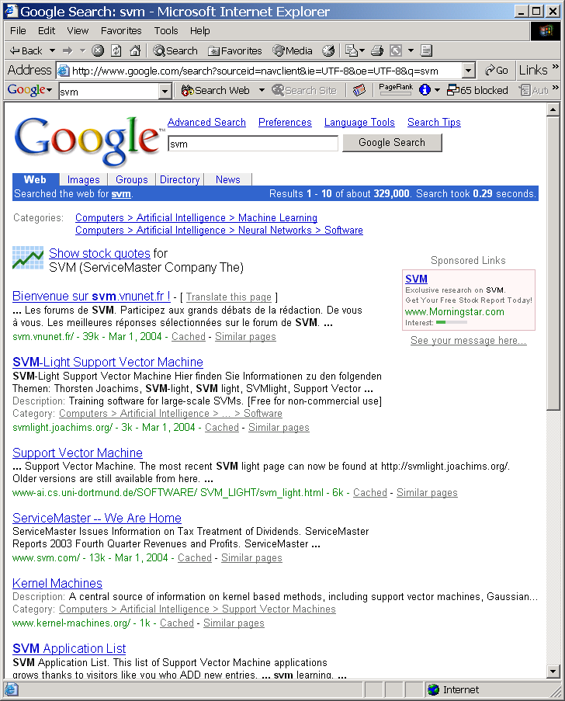
Economic Models of Decision Making
Rational Choice
Alternatives Y
Utility function U(y)
Decision y*=argmax_{y2Y}{U(y)}
Bounded Rationality
Time constraints
Computation constraints
Approximate U(y)
Behavioral Economics
Framing
Fairness
Loss aversion
Handling uncertainty
Click
Notes:
If only I could get 1 (noisy) bit of knowledge out of every user interaction.

Slide 10
A Model of how Users Click in Search
Model of clicking:
Users explore ranking to position k
Users click on most relevant (looking) links in top k
Users stop clicking when time budget up or other action more promising (e.g. reformulation)
Empirically supported by [Granka et al., 2004]
Click
$$\underset{y∈Top k}{argmax}{U(y)}$$

Slide 11
Balanced Interleaving
(u=tj, q=“svm”)
f₁(u,q) → r₁
f₂(u,q) → r₂
1. Kernel Machines http://svm.first.gmd.de/
2. Support Vector Machine http://jbolivar.freeservers.com/
3. An Introduction to Support Vector Machines http://www.support-vector.net/
4. Archives of SUPPORT-VECTOR-MACHINES ... http://www.jiscmail.ac.uk/lists/SUPPORT...
5. SVM-Light Support Vector Machine http://ais.gmd.de/~thorsten/svm light/
1. Kernel Machines http://svm.first.gmd.de/
2. SVM-Light Support Vector Machine http://ais.gmd.de/~thorsten/svm light/
3. Support Vector Machine and Kernel ... References http://svm.research.bell-labs.com/SVMrefs.html
4. Lucent Technologies: SVM demo applet http://svm.research.bell-labs.com/SVT/SVMsvt.html
5. Royal Holloway Support Vector Machine http://svm.dcs.rhbnc.ac.uk
Interleaving(r₁,r₂)
1. Kernel Machines 1 http://svm.first.gmd.de/
2. Support Vector Machine 2 http://jbolivar.freeservers.com/
3. SVM-Light Support Vector Machine 2 http://ais.gmd.de/~thorsten/svm light/
4. An Introduction to Support Vector Machines 3 http://www.support-vector.net/
5. Support Vector Machine and Kernel ... References 3 http://svm.research.bell-labs.com/SVMrefs.html
6. Archives of SUPPORT-VECTOR-MACHINES ... 4 http://www.jiscmail.ac.uk/lists/SUPPORT...
7. Lucent Technologies: SVM demo applet 4 http://svm.research.bell-labs.com/SVT/SVMsvt.html
Model of User: Better retrieval functions is more likely to get more clicks.
Invariant: For all k, top k of balanced interleaving is union of top k₁ of r₁ and top k₂ of r₂ with k₁=k₂ ± 1.
Interpretation: (r₁ Â r₂) ↔ clicks(topk(r₁)) > clicks(topk(r₂)) → see also [Radlinski, Craswell, 2012] [Hofmann, 2012]
[Joachims, 2001] [Radlinski et al., 2008]
Notes:
You might want to skip this slide.
This is the evaluation method. Get the ranking for the learned retrieval function and for the standard retrieval function (e.g. Google).
Combine both rankings into one combined ranking in a “fair and unbiased” way. This means, that at each position in the combined ranking the number of links from “learned” equals the number of links from “google” plus/minus 1. So, if user have no preference for a ranking function, with 50/50 chance they will click on links from either ranking function.
We then evaluate, if the users click on links from one ranking function significantly more often. In the example, the lowest click in the combined ranking is 7. Due to the “fair” merging, the user has seen the top 4 from both rankings. Tracing back where the clicked on links came from, 3 links were in the top 4 from “Learned”, but only one in the top 4 from “google”. So, “learned” wins on this query.
Note that this is a blind test. Users do not know which retrieval function the link came from. In particular, we use the same abstract generator.

Slide 12
Balanced Interleaving: a Problem
r₁
r₂
Example:
Two rankings r₁ and r₂ that are identical up to one insertion (X)
“Random user” clicks uniformly on results in interleaved ranking
“X” → r₂ wins
“A” → r₁ wins
“B” → r₁ wins
“C” → r₁ wins
“D” → r₁ wins
→ biased
A
B
C
D
⁞
X
A
B
C
⁞
X ¹
A ¹
B ²
C ³
D ⁴
⁞

Slide 13
Team-Game Interleaving
(u=tj,q=“svm”)
f₁(u,q) → r₁
f₂(u,q) → r₂
1. Kernel Machines http://svm.first.gmd.de/
2. Support Vector Machine http://jbolivar.freeservers.com/
3. An Introduction to Support Vector Machines http://www.support-vector.net/
4. Archives of SUPPORT-VECTOR-MACHINES ... http://www.jiscmail.ac.uk/lists/SUPPORT...
5. SVM-Light Support Vector Machine http://ais.gmd.de/~thorsten/svm light/
NEXT PICK
1. Kernel Machines http://svm.first.gmd.de/
2. SVM-Light Support Vector Machine http://ais.gmd.de/~thorsten/svm light/
3. Support Vector Machine and Kernel ... References http://svm.research.bell-labs.com/SVMrefs.html
4. Lucent Technologies: SVM demo applet http://svm.research.bell-labs.com/SVT/SVMsvt.html
5. Royal Holloway Support Vector Machine http://svm.dcs.rhbnc.ac.uk
Interleaving(r₁,r₂)
1. Kernel Machines T2 http://svm.first.gmd.de/
2. Support Vector Machine T1 http://jbolivar.freeservers.com/
3. SVM-Light Support Vector Machine T2 http://ais.gmd.de/~thorsten/svm light/
4. An Introduction to Support Vector Machines T1 http://www.support-vector.net/
5. Support Vector Machine and Kernel ... References T2 http://svm.research.bell-labs.com/SVMrefs.html
6. Archives of SUPPORT-VECTOR-MACHINES ... T1 http://www.jiscmail.ac.uk/lists/SUPPORT...
7. Lucent Technologies: SVM demo applet T2 http://svm.research.bell-labs.com/SVT/SVMsvt.html
Invariant: For all k, in expectation same number of team members in top k from each team.
Interpretation: (r₁ Â r₂) ↔ clicks(T₁) > clicks(T₂)
Notes:
You might want to skip this slide.
This is the evaluation method. Get the ranking for the learned retrieval function and for the standard retrieval function (e.g. Google).
Combine both rankings into one combined ranking in a “fair and unbiased” way. This means, that at each position in the combined ranking the number of links from “learned” equals the number of links from “google” plus/minus 1. So, if user have no preference for a ranking function, with 50/50 chance they will click on links from either ranking function.
We then evaluate, if the users click on links from one ranking function significantly more often. In the example, the lowest click in the combined ranking is 7. Due to the “fair” merging, the user has seen the top 4 from both rankings. Tracing back where the clicked on links came from, 3 links were in the top 4 from “Learned”, but only one in the top 4 from “google”. So, “learned” wins on this query.
Note that this is a blind test. Users do not know which retrieval function the link came from. In particular, we use the same abstract generator.

Slide 14
Arxiv.org: Interleaving Experiment
Experiment Setup
Phase I: 36 days
Balanced Interleaving of (Orig,Flat) (Flat,Rand) (Orig,Rand)
Phase II: 30 days
Balanced Interleaving of (Orig,Swap2) (Swap2,Swap4) (Orig,Swap4)
Quality Control and Data Cleaning
Same as for absolute metrics

Slide 15
Arxiv.org: Interleaving Results
% wins Orig
% wins Rand
Conclusions
All interleaving experiments reflect the expected order.
All differences are significant after one month of data.
Same results also for alternative data-preprocessing.
Percent Wins

Slide 16
Team-Game Interleaving: Results
Paired Comparison Tests:
Summary and Conclusions
All interleaving experiments reflect the expected order.
Same results also for larger scale experiment on Yahoo and Bing
Most differences are significant after one month of data.
Percent Wins

Slide 17
Yahoo and Bing: Interleaving Results
Yahoo Web Search [Chapelle et al., 2012]
Four retrieval functions (i.e. 6 paired comparisons)
Balanced Interleaving
→ All paired comparisons consistent with ordering by NDCG.
Bing Web Search [Radlinski & Craswell, 2010]
Five retrieval function pairs
Team-Game Interleaving
→ Consistent with ordering by NDGC when NDCG significant.

Slide 18
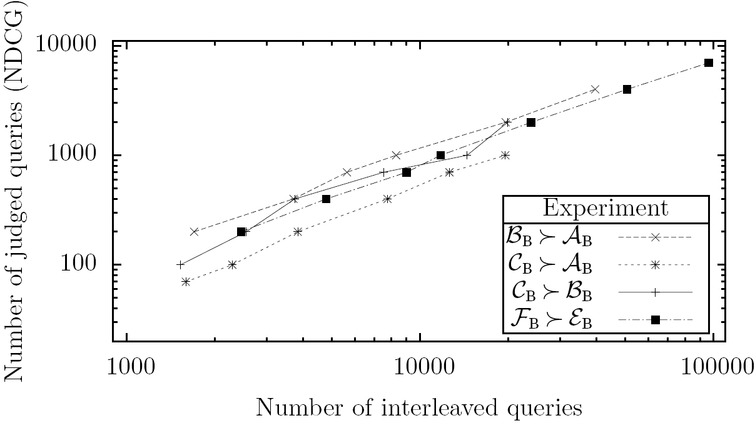
Efficiency: Interleaving vs. Explicit
Bing Web Search
4 retrieval function pairs
~12k manually judged queries
~200k interleaved queries
Experiment
p = probability that NDCG is correct on subsample of size y
x = number of queries needed to reach same p-value with interleaving
➔ Ten interleaved queries are equivalent to one manually judged query.
[Radlinski & Craswell, 2010]

Slide 19
Conclusion
Pick Paul’s brain frequently
Pick Paul’s brain early
Library dust is not harmful

