Slide 1
Marrying Neuro-cognitive Methods and Information Science
http://www.ischool.utexas.edu
http://bit.ly/ix_lab
Jacek Gwizdka
Information eXperience (IX) Lab, Co-director
School of Information, University of Texas at Austin
fusionfest2014@gwizdka.com
http://www.gwizdka.com
Fusion Fest ’2014
October 11, 2014
@jaceksg

Slide 2
Connection to Paul Kantor
Department of Library and Information Science (2005-12)
University of Toronto
Department of Industrial Engineering (1996-2004)

Slide 3
Neuro-cognitive Methods & Info Science: A Promising Marriage?
Improve IR systems’ understanding of user information intent and needs
Obtaining more information from and about users
self-reports are subjectively biased
explicit relevance feedback - users are typically not willing to do this
implicit relevance feedback
inferring user intent and needs from click throughs, dwell time etc.
some success, but some “signals” ambiguous (e.g., dwell time)
need to find other, complementary sources of information
implicit feedback more generally (not only relevance)
detecting user’s cognitive states (cognitive load, daydreaming, …)
Take advantage of neuro-cognitive methods and tools to learn more about information searchers
What cognitive functions are engaged during human-information interaction?
How do users acquire information and learn while searching?
How do they read documents?
What are cognitive demands of different search systems and tasks?

Slide 4
Understanding Information Searchers
Recent work on understanding how searchers read and process text documents at different levels of relevance
Relevant News Story (R)
+
Irrelevant Story (I)
+
Topical Story (T)
t

Slide 5
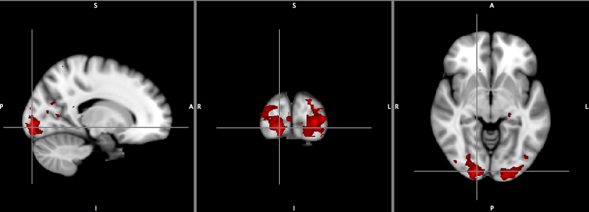
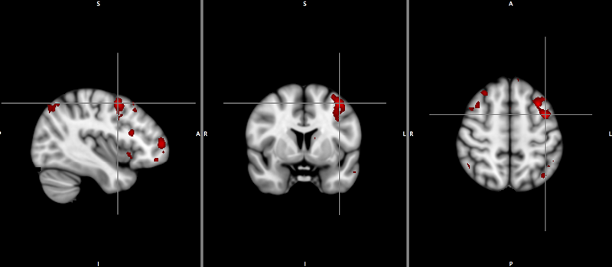
Brain Activations and Text Relevance
Significant difference in activation between answering questions vs. finding words
Left/right Occipital lobe/pole
Significant differences in activation between finding answers to relevant, topical vs. irrelevant documents
Left Frontal lobe (Middle Frontal Gyrus)
R-I > R-T > T-I

Slide 6
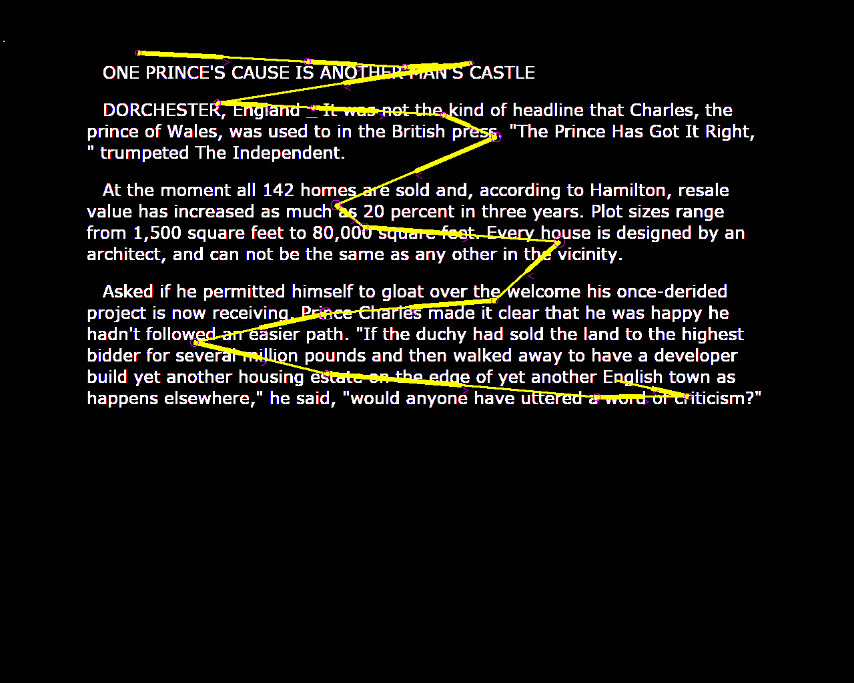
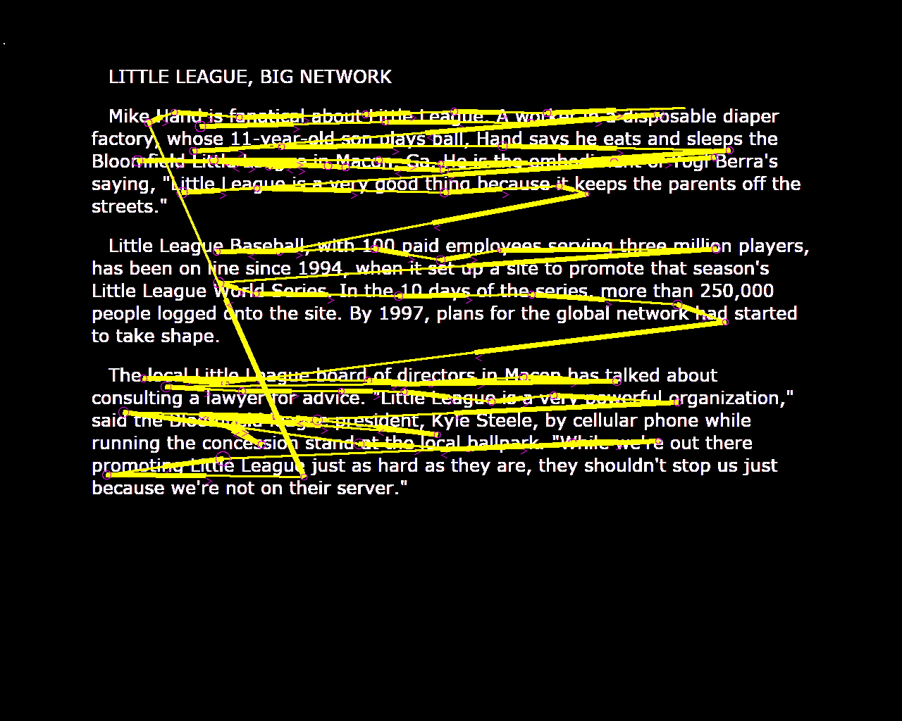
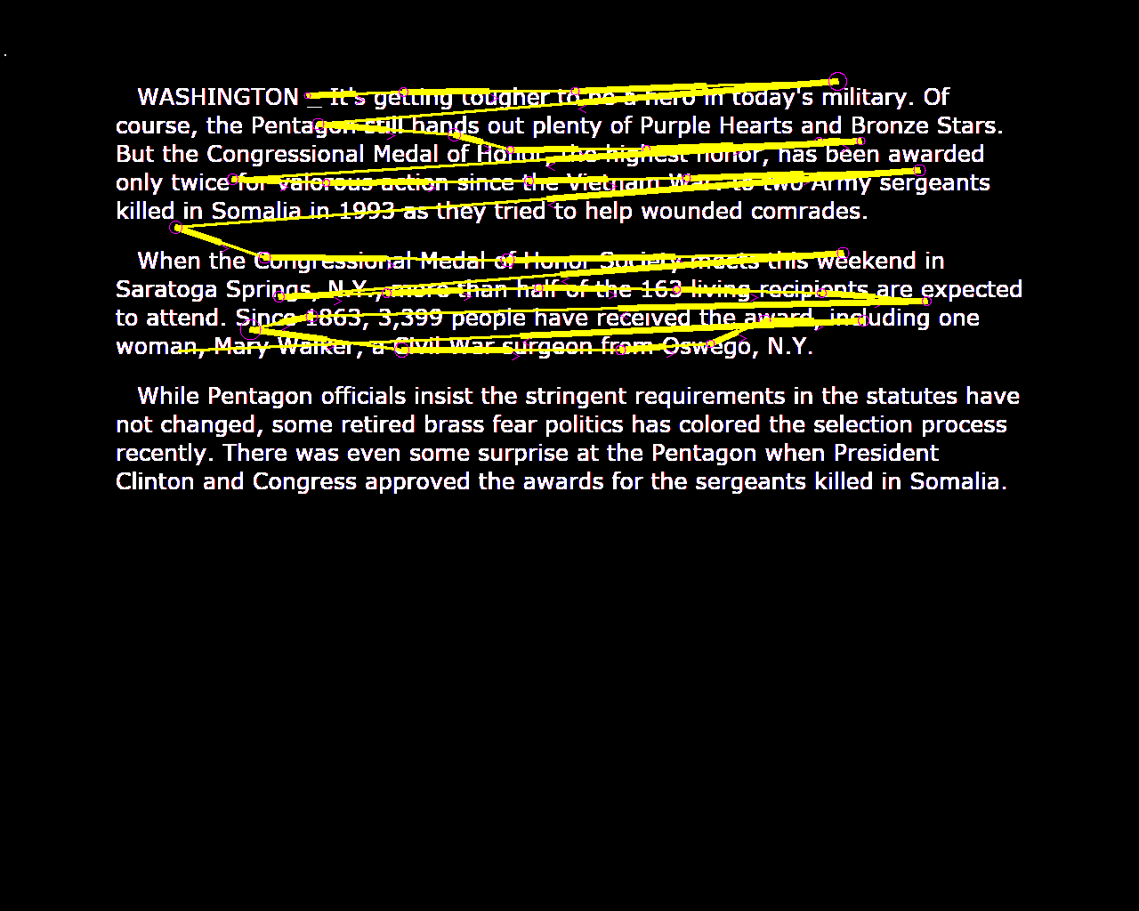
Eye-Movement and Text Relevance
1. Irrelevant doc
2. Topical doc
3. Relevant doc
Text relevance affects:
How the text is read
Cognitive load
Eye-movement → relevance
reading patterns, eye-movement measures, pupil dilation: 65%-74% classification accuracy of predicting binary relevance

Slide 7
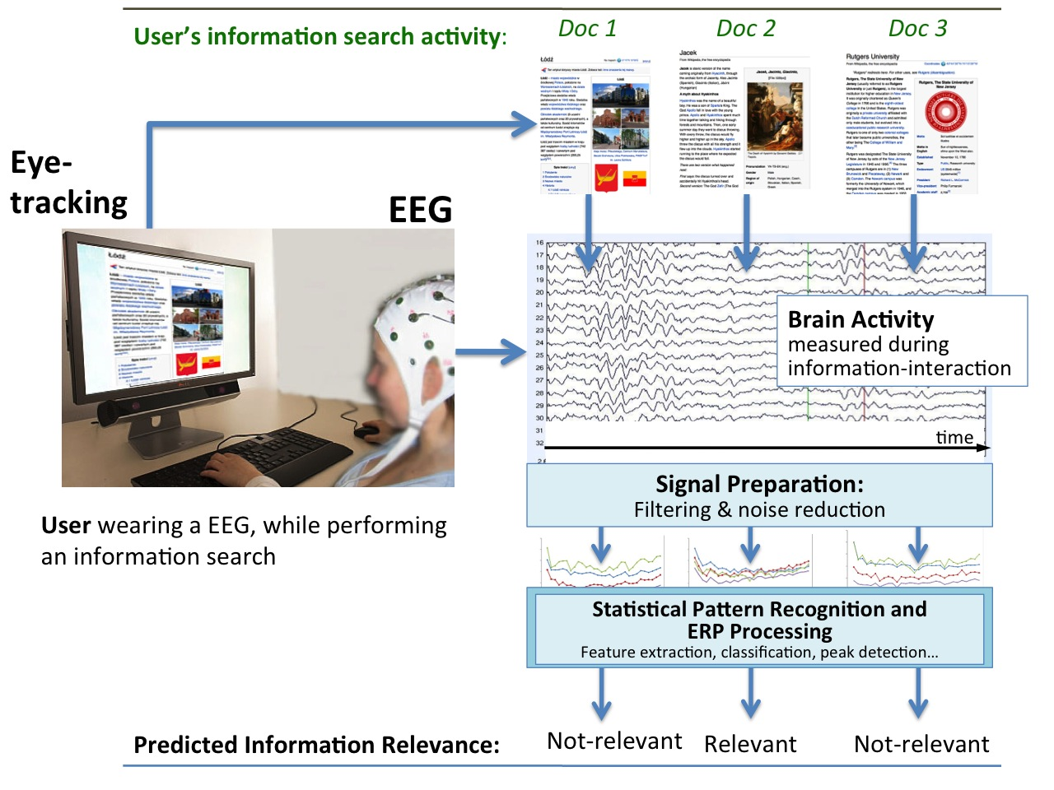
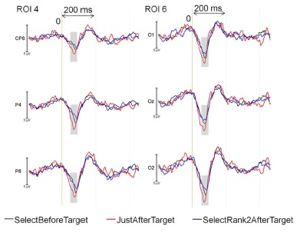
EEG / Eye-Movement and Relevance
EEG and Eye-tracking to infer relevant words
Hypothesis: we can distinguish when a person is reading relevant vs. irrelevant paragraphs/words by combining EEG and eye-tracking data
EFRPs – Eye-fixation related potentials → word relevance
(Frey et al. 2013)

Slide 8
So What?
At an applied level:
eye-tracking / EEG → a possibility of inferring relevance in real-time
At a theoretical level:
mapping neuro-cognitive signals on information science phenomena → improve our information science models and theories
for example, a better understanding of how texts of different relevance are processed and of cognitive effort involved in relevance judgments
When we marry the methods we make progress – theoretical and applied → leading to the design of better search engines
Neuro-Cognitive Methods
Information Science
fMRI, Eye-tracking, EEG…
Neuro-Information Science

Slide 9
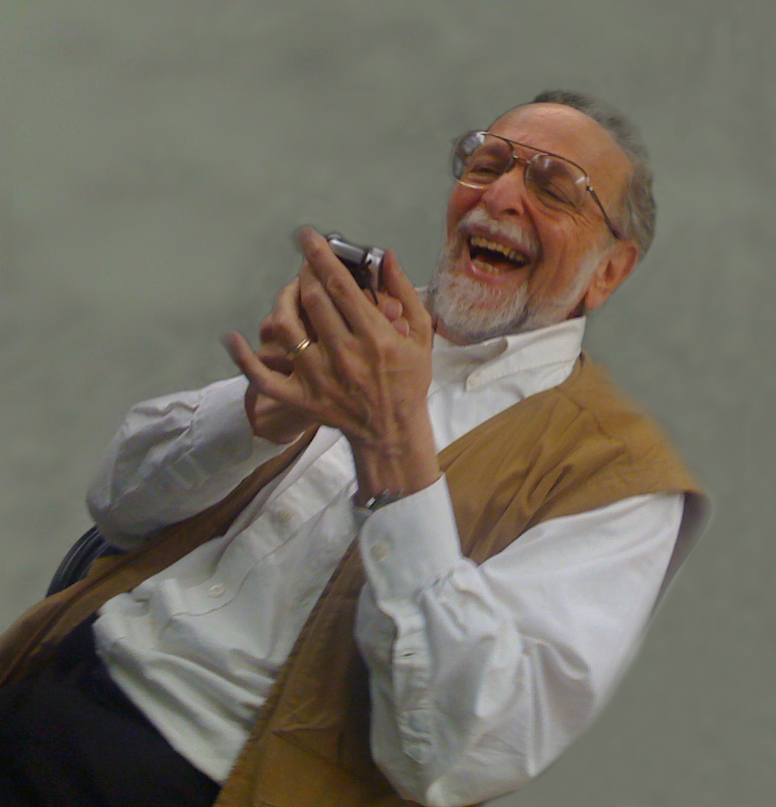
and …

Slide 10
Thank You
Questions?
Acknowledgements
Funding: IMLS National Leadership Research CAREER Award
Google Faculty Award, Lockheed Martin Corp, Rutgers University (fMRI)
Collaboration: Prof. Paul Kantor (fMRI)
Prof. Steve Hanson and Dr. Catherine Hanson (fMRI - RUBIC at Rutgers University)
Prof. Bradley D. Hatfield, Joe Dien, Rodolphe J. Gentili (U Maryland) (EEG)
Michael Cole (PhD candidate at Rutgers) (fMRI, eye-tracking)
More info & contact: jgwizdka@acm.org www.gwizdka.com
www.neuroinfoscience.org

Slide 11
Bonus Slides

Slide 12
Experimental Design
Mixed-design: 2 blocks (types of tasks, balanced)
WS – word search: find target word in a short news story – press yes/no
IS – information search: find information that answers given question– press yes/no
21 trials – a question and 3 documents: Relevant (R), Topical (T), Irrelevant (I)
Order of trials randomized
To minimize memory load, the question was repeated before each stimulus
21 x
WS
30s 6s 6s 6s 20s max 6s
WS task instruc-tions
+
target: word
+
xmx ssms nsns snsns jsdjsd djdjd djdj dkke ekek
kdkddk dkdkdk dkdkdkd
kkdkd d d dd d djdj djdjdj rjrjr rjr jweje ejejej ejej
kekekek ekeke wej e eej eje j
+
21 x
IS
+
+
+
+
+
+
30s 6s 8s 6s 20s max 6s 4s 6s 20smax 6s 4s 6s 20smax
IS task instruc-tions
+
target: infoQ
xmx ssms nsns snsns jsdjsd ke ekek dkdkdkkd
kdkddk dkdkdk dkdkdkd
kkdkd d rjr jweje ejejej ejej
kekekek ekeke wee ejej fjfjf fjfjfjfjf fjfjrjr rreje j
target: infoQ
xmx ssms nsns snsns jsdjsd djdjd djdj dkke ekek dkdkdkkd
kdkddk dkdkdk dkdkdkd
kkdkd d d dd d djdj djdjdj rjrjr rjjweje ejejej ejej
kek ekeke wej e ejej eje j
target: infoQ
xmx ssms nsns snsns jsdjsd ke ekek dkdkdkk
kdkddk dkdkdkdkdkdkd
kkdkd d rjr jweje ejeje
ekeke wej e ejej fjfjf fjfjfjfjf fjfjrjr rreje j

