Slide 1
Working Outside One’s Domain of Understanding
Ophir Frieder
Department of Computer Science
Georgetown University
&
Department of BioStatistics, BioInformatics, & BioMathematics
Georgetown University Medical Center
ophir@ir.cs.georgetown.edu

Slide 2
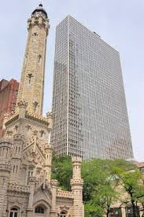
Once upon a time… decades ago
Courtesy of en.wikipedia.org
Desiring to visit Chicago, and not understanding the domain nor the conference
O. Frieder and H. T. Siegelmann., "On the Allocation of Documents in Information Retrieval Systems," ACM Fourteenth Conference on Research and Development in Information Retrieval (SIGIR), Chicago, Illinois, October 1991.
Courtesy of atproperties.com

Slide 3
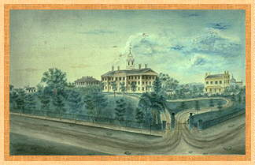
And a few years later…
P. Kantor, W. A. Woods, H.D., Moser, & O. Frieder, “An Experimental Evaluation of Task Scheduling on Reconfigurable Multicomputer Architectures,” Seventh Conference on Parallel and Distributed Computing Systems, Las Vegas, Nevada, October 6 - 8, 1994.
Best Paper Award
W. A. Woods, H.D. Moser, O. Frieder, and P. Kantor, "A Case for Reconfigurable Parallel Architectures for Information Retrieval," Third Conference on Information and Knowledge Management, Gaithersburg, Maryland, November 1994.
Watercolor of Rutgers College by T. Sanford Doolittle, ca. 1850's.

Slide 4
From within the vast I do not know
Diagnosing complicated urinary tract infections
Detecting health-related outbreaks
Eliminating malaria
Courtesy of Icaid.com

Slide 5
Diagnosing Complicated Urinary Tract Infections
“Urinary tract infections are the second most common type of infection in the body, accounting for about 8.1 million visits to health care providers each year” – 2007 NIH study
Patient specific data vs. guidelines driven treatment
(age, sex, geographical location, occupation, symptoms , prior prescription use)
Patient group | Num Patients | susceptibility
 |  | Nitro | Nitro + algorithm
all patients | 2233 | 75.3% | 76.7% (p < 0.01)
patients w/ prior culture | 823 | 72.4% | 75.3% (p < 0.01)
H. Alphs-Jackson, J. Cashy, O. Frieder, and A. Schaeffer, “Data Mining Derived Treatment Algorithms from
the Electronic Medical Record Improve Theoretical Empirical Therapy for Outpatient Urinary Tract Infections,”
The Journal of Urology, vol. 186, December 2011.

Slide 6
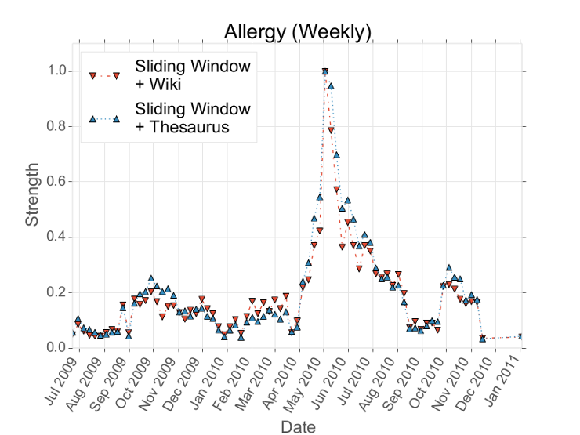
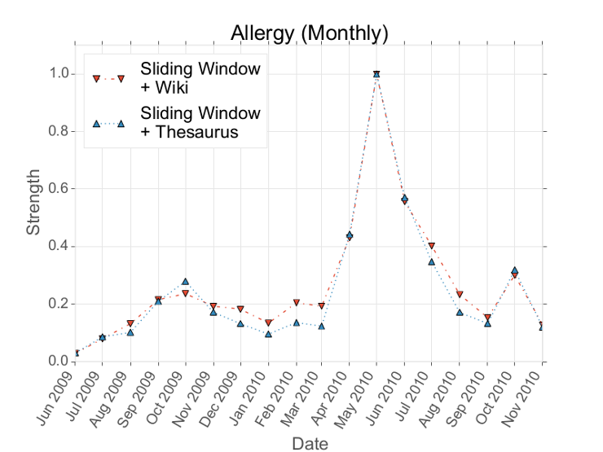
Detecting Health-Related Outbreaks
Global health surveillance is human intensive & delayed
Monitor real-time common media
Hypothesis generation vs. validation
Joint effort with Twitter & Harvard University
Yates, J. Parker, N. Goharian, and O. Frieder, “A Framework for Public Health Surveillance,”
9th Language Resources and Evaluation Conference (LREC-2014), Reykjavik, Iceland, May 2014.

Slide 7
Staging Malaria Elimination How can we optimize the pathway to elimination?
Malaria: Maps & Models
Malaria theory & micro-simulation modeling framework
Large, well-curated databases
Geostatistical models
Strategy & Implementation
Spatial targeting
Stratification
Regional coordination
Supported by: “Strategic Planning Tools for Staging Malaria Elimination”, Bill and Melinda Gates Foundation, Lead PI: David Smith, Oxford University, Sept 2014 – August 2019.
(Subcontract to Georgetown Univ. – PI: Frieder)

Slide 8
Paul!
And many many many more to come !!
Courtesy of November2013calendar.org

