Slide 1
Bayesian Network Meta-Analysis for Unordered Categorical Outcomes with Incomplete Data
Christopher H Schmid
Brown University
Christopher_schmid@brown.edu
Rutgers University
16 May 2013
New Brunswick, NJ

Slide 2
Outline
Meta-Analysis
Indirect Comparisons
Network Meta-Analysis
Problem
Multinomial Model
Incomplete Data
Software

Slide 3
Meta-Analysis
Quantitative analysis of data from systematic review
Compare effectiveness or safety
Estimate effect size and uncertainty (treatment effect, association, test accuracy) by statistical methods
Combine “under-powered” studies to give more definitive conclusion
Explore heterogeneity / explain discrepancies
Identify research gaps and need for future studies
Notes:
3
3

Slide 4
Types of Data to Combine
Dichotomous (events, e.g. deaths)‏
Measures (odds ratios, correlations)‏
Continuous data (mmHg, pain scores)‏
Effect size
Survival curves
Diagnostic test (sensitivity, specificity)‏
Individual patient data

Slide 5
Hierarchical Meta-Analysis Model
Y_{i} observed treatment effect (e.g. odds ratio)
θ_{i} unknown true treatment effect from i^{th} study
First level describes variability of Y_{i} given θ_{i}
Within-study variance often assumed known
But could use common variance estimate if studies are small
DuMouchel suggests variance of form k* s_{i}²
Notes:
8

Slide 6
Hierarchical Meta-Analysis Model
Second level describes variability of study-level parameters θ_{i}
in terms of population level parameters: θ and τ²
Equal Effects θ_{i} = θ (τ² = 0)
Notes:
9

Slide 7
Bayesian Hierarchical Model
Placing priors on hyperparameters (θ, τ²) makes Bayesian model
Usually noninformative normal prior on θ
Noninformative inverse gamma or uniform prior on τ²
Inferences sensitive to prior on τ²
Notes:
9

Slide 8
Indirect Comparisons of Multiple Treatments
Trial
1 A B
2 A B
3 B C
4 B C
5 A C
6 A C
7 A B C
Want to compare A vs. B
Direct evidence from trials 1, 2 and 7
Indirect evidence from trials 3, 4, 5, 6 and 7
Combining all “A” arms and comparing with all “B” arms destroys randomization
Use indirect evidence of A vs. C and B vs. C comparisons as additional evidence to preserve randomization and within-study comparison

Slide 9
Indirect comparison
A
B
C
C

Slide 10
Indirect comparison
A
B
A
B
C
C
C

Slide 11
Indirect comparison
A
B
A
B
C
C
C
A – B = (A – C) – (B – C)

Slide 12
Indirect comparison
?
A
B
-10
-8
C

Slide 13
Indirect comparison
-10-(-8) = -2
A
B
-10
-8
C

Slide 14
Consistency
-2
A
B
-1.9
-10
-8
C

Slide 15
Inconsistency
-2
A
B
+5
-10
-8
C

Slide 16
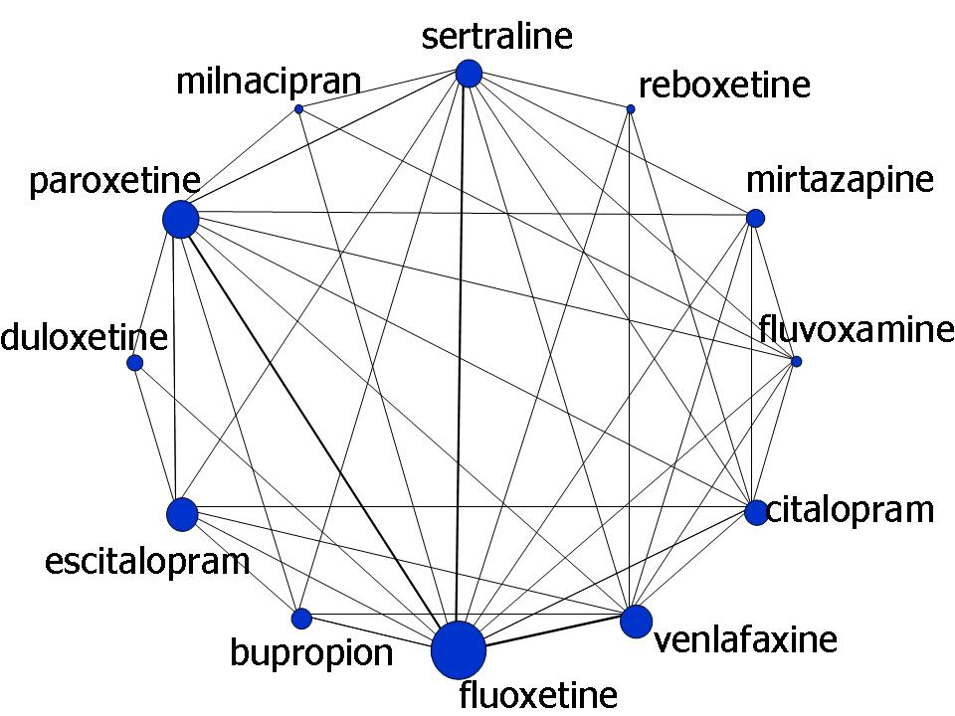
Network of 12 Antidepressants
paroxetine
reboxetine
duloxetine
mirtazapine
escitalopram
fluvoxamine
milnacipran
citalopram
sertraline
venlafaxine
bupropion
fluoxetine
milnacipran
paroxetine
sertraline
?
duloxetine
bupropion
escitalopram
fluvoxamine
milnacipran
19 meta-analyses of pairwise comparisons published
Notes:
The main drawback is that meta-analysis focuses on comparing only two alternatives at the time leading to a plethora of analyses to interpret with no quantitatively rigorous methods for integrating them.
16

Slide 17
Network Meta-Analysis
(Multiple Treatments Meta-Analysis, Mixed Treatment Comparisons)
Combine direct + indirect estimates of multiple treatment effects
Internally consistent set of estimates that respects randomization
Estimate effect of each intervention relative to every other whether or not there is direct comparison in studies
Calculate probability that each treatment is most effective
Compared to conventional pair-wise meta-analysis:
  Greater precision in summary estimates
  Ranking of treatments according to effectiveness
17
Notes:
17

Slide 18
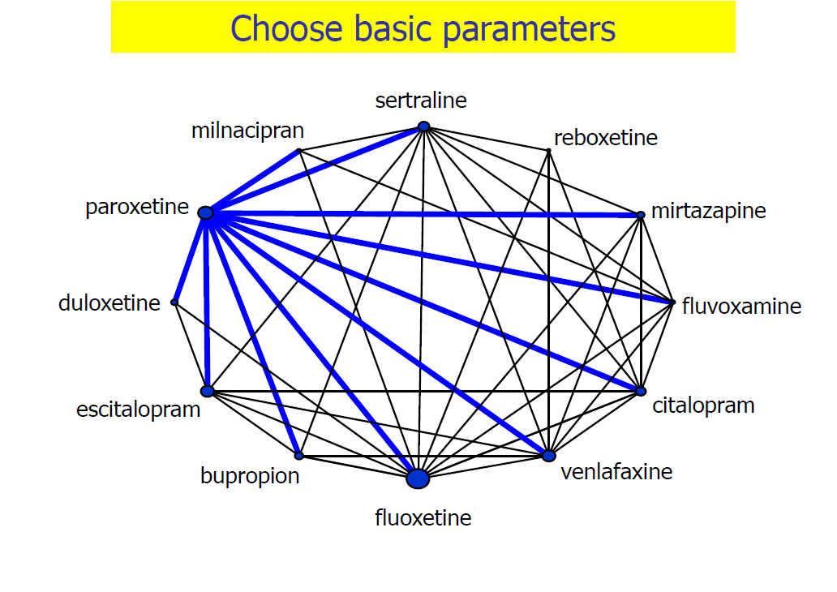

Slide 19
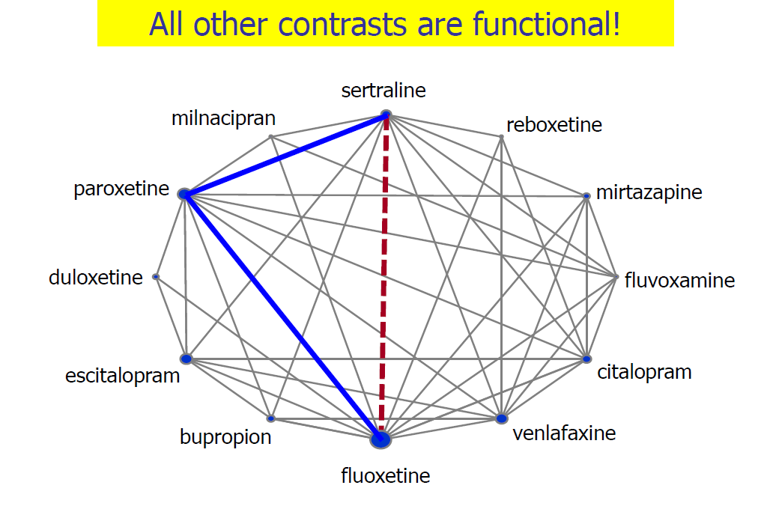

Slide 20
Single Contrast
Distributions of observations
Distribution of random effects
C
A

Slide 21
Closed Loop of Contrasts
Distributions of observations
Distribution of random effects
C
A
B
Functional parameter μ^{BC} expressed in terms of basic parameters μ^{AB} and μ^{AC}

Slide 22
Closed Loop of Contrasts
Distributions of observations
Distribution of random effects
C
Three-arm study
A
B

Slide 23
Measuring Inconsistency
Suppose we have AB, AC, BC direct evidence
Indirect estimate
Measure of inconsistency:
Approximate test (normal distribution):
with variance
23
Notes:
23

Slide 24
Basic Assumptions
Transitivity (Similarity)
Trials involving treatments needed to make indirect comparisons are comparable so that it makes sense to combine them
Needed for valid indirect comparison estimates
Consistency
Direct and indirect estimates give same answer
Needed for valid mixed treatment comparison estimates

Slide 25
Five Interpretations of Transitivity
Salanti (2012)
Treatment C is similar when it appears in AC and BC trials
‘Missing’ treatment in each trial is missing at random
There are no differences between observed and unobserved relative effects of AC and BC beyond what can be explained by heterogeneity
The two sets of trials AC and BC do not differ with respect to the distribution of effect modifiers
Participants included in the network could in principle be randomized to any of the three treatments A, B, C.

Slide 26
Inconsistency vs. Heterogeneity
Heterogeneity occurs within treatment comparisons
  Type of interaction (treatment effects vary by study characteristics)
Inconsistency occurs across treatment comparisons
  Interaction with study design (e.g. 3-arm vs. 2-arm) or within loops
  Consistency can be checked by model extensions when direct and indirect evidence is available

Slide 27
Multinomial Network Example
Population: Patients with cardiovascular disease
Treatments: High and Low statins, usual care or placebo
Outcomes:
  Fatal coronary heart disease (CHD)
  Fatal stroke
  Other fatal cardiovascular disease (CVD)
  Death from all other causes
  Non-fatal myocardial infarction (MI)
  Non-fatal stroke
  No event
Design: RCTs
Notes:
27

Slide 28
Multinomial Network
4 studies
High Dose Statins
Low Dose Statins
9 studies
4 studies
Control

Slide 29
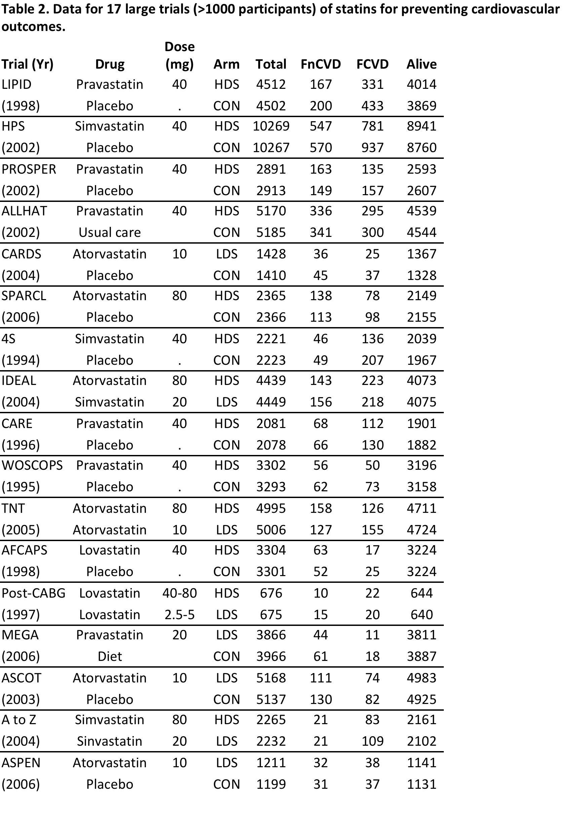
Subset of Example
3 treatments
3 outcomes

Slide 30
Multinomial Model
For each treatment arm in each study, outcome counts follow multinomial distributions
Studies k = 1, 2, …, I,
Treatments j = 0, 2, …, J-1
Outcomes m = 0, 2, …, M-1

Slide 31
Baseline Category Logits Model
Multinomial probabilities are re-expressed relative to reference
k study
m outcome
j treatment
Model as function of study effect and treatment effect
Treatment effects are set of basic parameters representing random effects for tx j relative to tx 0 in study k for outcome m
Study effects may apply to different “base” tx in each study
Random treatment effects centered around fixed “d’s”

Slide 32
Random Effects Model
Combine across outcomes:
so that

Slide 33
Random Effects Model for Tx Effects
with
d_{jm} is average treatment effect for outcome m and treatment j relative to reference treatment 0
Σ_{ij} is covariance matrix between treatments i and j among different outcome categories

Slide 34
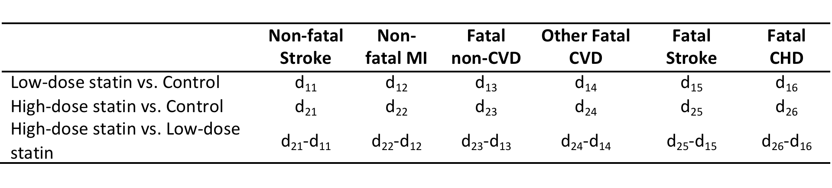
Baseline Category Logit Model

Slide 35
General Variance

Slide 36
Homogeneous Variance
Covariance between arms that share treatment
Covariance between arms that do not share treatment

Slide 37
Incomplete Treatments
Usual assumption that treatments ordered so that lowest numbered is base treatment b(k) in study k
for b < j; j = 1, …, J; m = 1, …, M
are fixed effects

Slide 38
Incomplete Treatments
Collecting treatments together

Slide 39
Prior Distributions
Noninformative normal priors for means
d_{j} = (d_{j1}, d_{j2}, …, d_{jM-1}) ~ N_{M-1}(0,10⁶ x I_{M-1})
Implies that event probabilities in no event reference group are centered at 0.5 with standard deviation of 2 on logit scale
This implies that event probabilities lie between 0.02 and 0.98 with probability 0.95, sufficiently broad to encompass all reasonable results

Slide 40
Noninformative Inverse Wishart Priors
Σ~ InvWish(R,ν)
R is the scale factor, ν is the degrees of freedom
Minimum value of ν is rank of covariance matrix
R may be interpreted as an estimate of the covariance matrix
Choosing R as the identity matrix implies that the prior standard deviations and variances are each one on the log scale
  A 95% CI is then approximately log OR +/- 2 which corresponds to a range for the OR of about [1/7, 7]

Slide 41
Noninformative Inverse Wishart Priors
As R→0, posterior approaches likelihood
Implies very small prior covariance matrix and runs into same problems as inverse gamma prior with small parameters
  Too much weight is placed on small variances and so prior is not really noninformative
  Study effects are shrunk toward their mean
Could instead choose R with reasonable diagonal elements that match reasonable standard deviation
Still assumes independence
  One degree of freedom parameter which implies same amount of prior information about all variance parameters

Slide 42
Variance Structure
Factor covariance matrix
Σ= SRS
where S is diagonal matrix of standard deviations
R is correlation matrix
Then factor Σ as
f(Σ) = f(Σ)f(R|Σ)‏
More information about standard deviations and correlations
Lu and Ades (2009) have implemented this for MTM

Slide 43
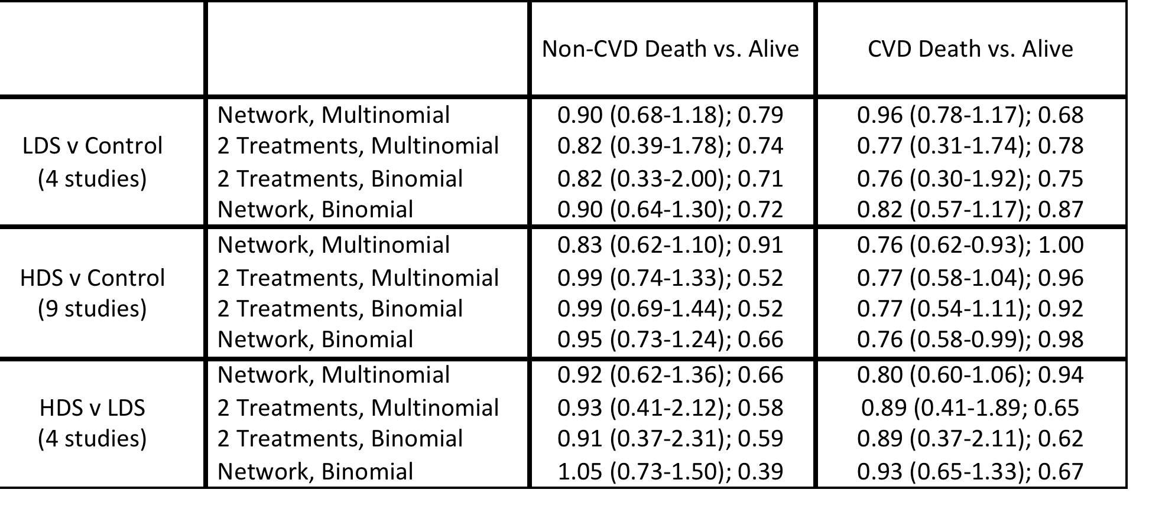
Example

Slide 44
Rank Plot

Slide 45
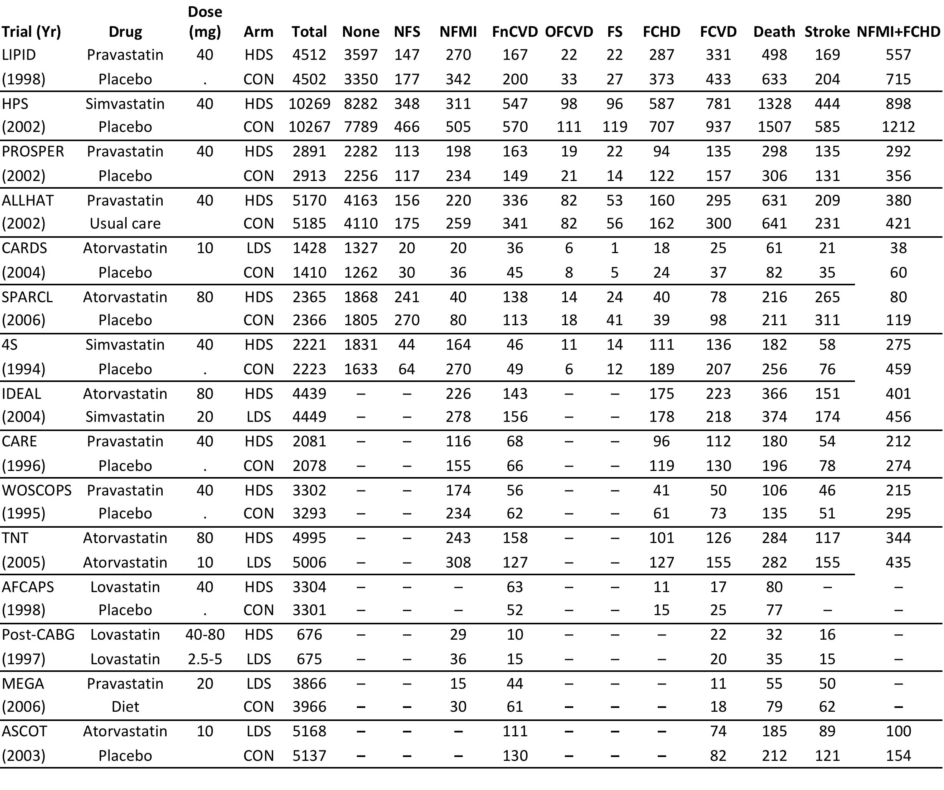
Data

Slide 46
Data Setup
Each study has 7 possible outcomes and 3 possible treatments
Not all treatments carried out in each study
Not all outcomes observed in each study
Incomplete data with partial information from summary categories
Can use available information to impute missing values
Can build this into Bayesian algorithm

Slide 47
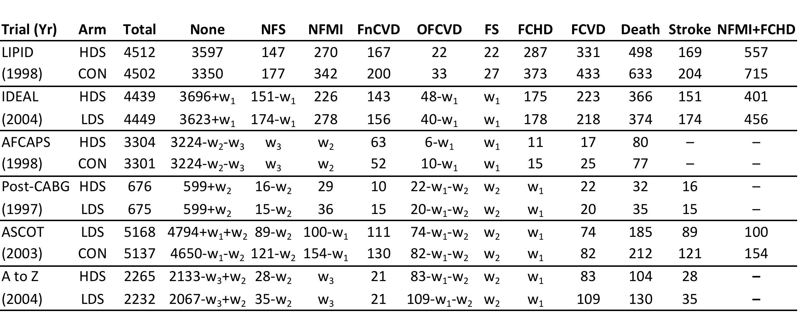
Six Patterns of Missing Outcome Data

Slide 48
Missing Data Parameters
Treat missing cell values as unknown parameters
Need to account for partial sums known (e.g. all deaths, all FCVD, all stroke)
May be able to treat sum of two categories as single category
Can use multiple imputation to fill in missing data and then perform complete data analysis
Can incorporate uncertainty of missing cells into probability model

Slide 49
Imputations for Missing Data via MCMC
EM gives us ‘‘plug-in’’ expected values for whatever we are treating as missing data
MCMC gives us a sample of ‘‘plug-in’’ values --- or multiple imputations
  MCMC allows averaging over uncertainty in model’s other random quantities when making inferences about any particular random quantity (either missing data point or parameter)‏
Bottom line: really no distinction between missing data point and parameter

Slide 50
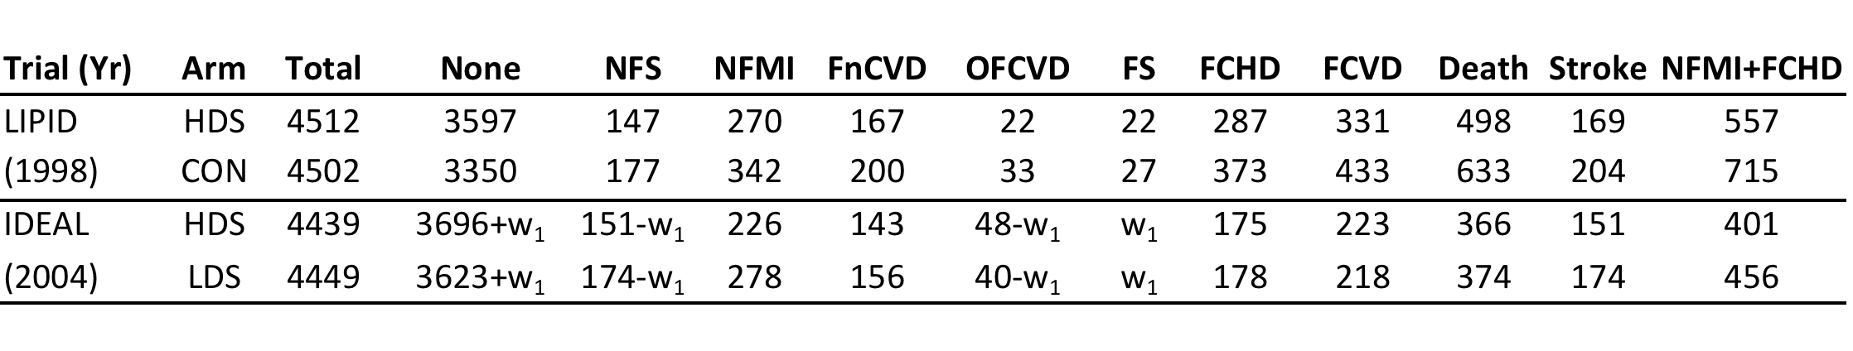
Example of Imputation
Imputing FS in IDEAL trial:
Bounded by 48 (total of FS + OFCVD)
Ratio of FS/(FS+OFCVD) between 0.14 and 0.69 with median about 0.5
Logical choice is Bin (48, p) where p is probability of FS as fraction of all strokes
Choose beta prior on p that fits data range, say beta(6,6)

Slide 51
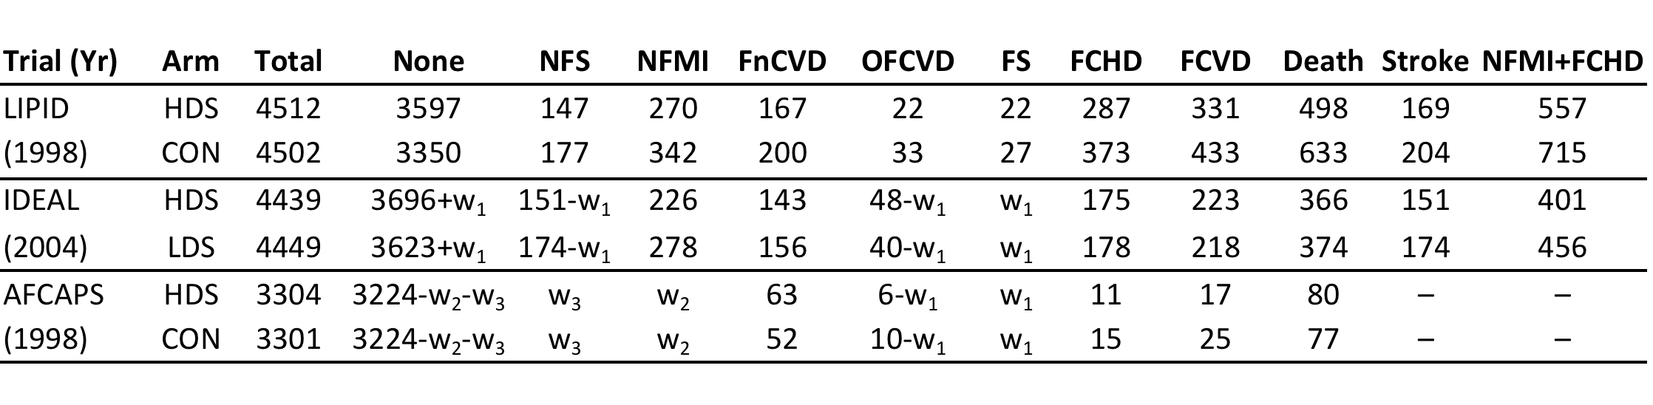
Example of Imputation
For AFCAPS trial, need to impute three cells
Possible competing bounds
May be difficult!

Slide 52
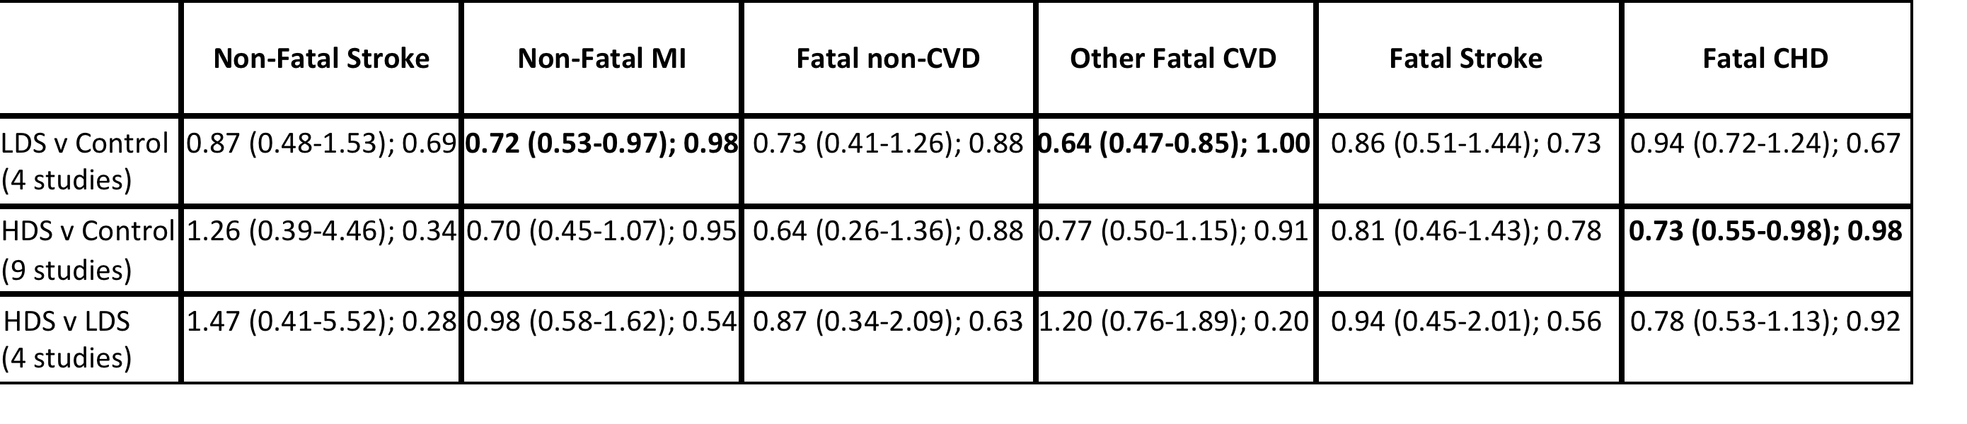
Example

Slide 53
Open Meta-Analyst Software
Coded in R calling JAGS (open source BUGS)
Inputs include data frame, model, missing data patterns, location of outcomes, trial, tx, MCMC convergence instructions
R code builds JAGS data, initial value and program files
Complete flexibility for display using R computational and graphical commands
R output returned to Python for rendering

Slide 54
Summary of Multiple Treatments MA
Network models can incorporate categorical outcomes
Simultaneous analysis of treatments and categories increases precision of estimation and promotes comparisons
Applicable to many clinical and non-clinical problems
Bayesian approach provides model flexibility and can accommodate missing data and prior information
Software will soon be available that will enable fitting of these models without need to be Bugs programmer

