Slide 1
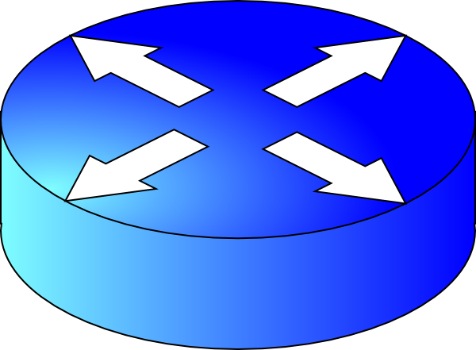
Game Theoretic and Economic Perspectives on Interdomain Routing
Michael Schapira
Yale University and UC Berkeley

Slide 2
Interdomain Routing
Establish routes between Autonomous Systems (ASes).
Handled by the Border Gateway Protocol (BGP).
UUNET
AT&T
Comcast
Qwest

Slide 3
Interdomain Routing is Hard!
Not shortest path routing!
Routing policies…
Always choose shortest paths.
Load-balance my outgoing traffic.
UUNET
AT&T
Comcast
Qwest
Avoid routes through AT&T if possible.
My link to UUNET is for only for backup.

Slide 4
BGP
Routes to every destination AS are computed independently.
Each node (AS) has preferences over all (simple) routes between itself and the destination.
Import
routes from neighbours
Choose “best” neighbour
Export (or not) to neighbours
Notes:
4

Slide 5
BGP (DISAGREE [Griffin-Shepherd-Wilfong])
Prefer routes through 2
Prefer routes through 1
1
2
1, my route
is 2d
1, I’m available
2, I’m available
d
Notes:
5

Slide 6
Two Important Desiderata
BGP safety
Guaranteeing convergence to a stable routing state.
Compliant behaviour.
Guaranteeing that nodes (ASes) adhere to the protocol.

Slide 7
Game Theory and Economics Help
Obvious reason: Interdomain routing is about the interaction of self-interested economic entities.
Not-so-obvious reason: Extensive research on dynamics in game-theoretic and economic environments.
Notes:
7

Slide 8
BGP Safety

Slide 9
BGP Instability (DISAGREE [Griffin-Shepherd-Wilfong])
Prefer routes through 2
Prefer routes through 1
BGP might oscillate forever between
1d, 2d
and
12d, 21d
1
2
2, my route
is 1d.
1, my route
is 2d.
1, 2, I’m available.
d

Slide 10
A Stable State Might Not Exist
Example: BAD-GADGET [Griffin-Shepherd-Wilfong 99]
31d
3d
312d
12d
1d
123d
3
1
d
23d
2d
231d
2
Notes:
10

Slide 11
Designing Safe Networks
Sufficient conditions for BGP safety?
No Dispute Wheel [Griffin-Shepherd-Wilfong]
So, why is the Internet (relatively) stable?
Best answer to date: the Gao-Rexford conditions.
The Internet is formed by economic forces.
ASes sign long-term contracts that determine who provides connectivity to whom.

Slide 12
Gao-Rexford Framework
Neighboring pairs of ASes have:
a customer-provider relationship (One node is purchasing connectivity from the other node.)
a peering relationship (Nodes carry each other’s transit traffic for free, often to shortcut a longer route.)
peer
providers
peer
customers

Slide 13
Designing Safe Networks
Necessary conditions?
Thm [Sami-S-Zohar]: If two stable states (or more) exist in a network then BGP is not safe on that network.
Conjectured by Griffin and Wilfong.

Slide 14
Games
Column
Player
movie
opera
2,1
0,0
movie
Row
Player
opera
0,0
1,2

Slide 15
Pure Nash Equilibria and Best-Replies
Column
Player
movie
opera
2,1
0,0
movie
Row
Player
opera
0,0
1,2

Slide 16
Best Reply Dynamics
Column
Player
movie
opera
2,1
0,0
movie
Row
Player
opera
0,0
1,2

Slide 17
But…
Column
Player
movie
opera
2,1
0,0
movie
Row
Player
opera
0,0
1,2

Slide 18
Looks Familiar?
Interdomain routing with BGP is a game!
ASes = players.
stable states = pure Nash equilibria
BGP = best-reply dynamics
Thm [Jaggard-S-Wright]: If two pure Nash equilibria (or more) exist in a game then best-reply dynamics can potentially oscillate.

Slide 19
Insights for Protocol Analysis
sometimes it helps to abstract away from BGP
… and get rid of “noise”.
e.g., update messages!
Insight (informal): Every “BGP-like” protocol will have the same behaviour.
R-BGP [Kushman-Kandula-Katabi-Maggs], NS-BGP [Wang-S-Rexford] , …

Slide 20
Actually…
This helps with identifying sufficient conditions for BGP safety too.
dominance-solvable games…
This is also a key ingredient in recent progress on the computational complexity of BGP convergence. [Fabrikant-Papadimitriou]

Slide 21
Incentives and Security

Slide 22
Do ASes Always Adhere to the Protocol?
BGP was designed to guarantee connectivity between largely trusted and obedient parties.
In today’s commercial Internet ASes are owned by self-interested, often competing, entities.
might not follow the “prescribed behaviour”.

Slide 23
Strategic ASes
Prefer routes through 2
Prefer routes through 1
1
2
2, my route
is 2d.
I’m not telling 1 anything!
1, I’m available
2, I’m available
d
Notes:
23

Slide 24
Undesirable Phenomena [Levin-S-Zohar]
m1d
m12d
12d
1d
m1d
m12d
12d
1d
m
1
m
1
d
d
2
2md
2d
2
2md
2d
with BGP

Slide 25
How Can We Fix This?
Economic Mechanism Design: “the reverse-engineering approach to game-theory”.
Goal: Incentivize players to follow the prescribed behaviour.

Slide 26
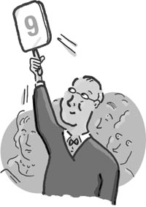
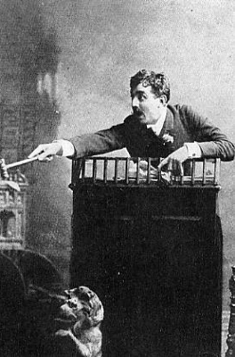
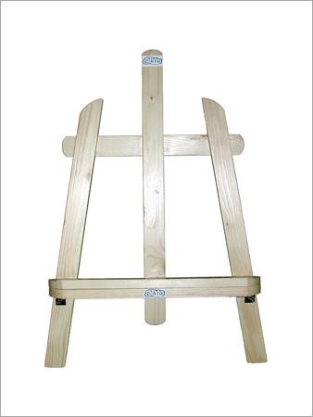
2nd-Price Auctions
155$
120$

Slide 27
What does this have to do with BGP?
The mechanism design approach to interdomain routing [Feigenbaum-Papadimitriou-Sami-Shenker]
Approach 1: Incentivize ASes to adhere to BGP via VCG payments. [Feigenbaum-Papadimitriou-Sami-Shenker, Feigenbaum-Sami-Shenker, Feigenbaum-Karger-Mirrokni-Sami, Feigenbaum-Ramachandran-S, Hall-Nikolova-Papadimitriou]
Approach 2: Restrict ASes’ routing policies to achieve BGP incentive-compatibility without money. [Feigenbaum-Ramachandran-S, Feigenbaum-S-Shenker]

Slide 28
New Approach: Combining Security and Incentives [Levin-S-Zohar]
m1d
m12d
12d
1d
m
1
m is able to announce a non-existent route and get away with it.
d
2md
2d
2

Slide 29
Making BGP Incentive-Compatible
We define the following property:
Route verification means that an AS can verify that a route announced by a neighbouring AS is available.
Route verification can be achieved via security tools (S-BGP etc.).

Slide 30
Does this solve the problem?
Many forms of non-BGP-compliant behaviours still possible:
Data-plane-control-plane mismatch.
Reporting inconsistent information.
…

Slide 31
Yet…
Thm [Levin-S-Zohar]: Security enhancements of BGP are incentive-compatible (and even collusion-proof).
The connections between security and incetives in interdomain routing are further explored in [Goldberg-Halevi-Jaggard-Ramachandran-Wright]

Slide 32
To Conclude
Game theory and economics can be useful in addressing fundamental networking concerns.
Not just in interdomain routing!

Slide 33
Thank You

