Slide 1
Orleans: Cloud Programming for Everyone
Sergey Bykov, Alan Geller, Gabriel Kliot, James Larus, Ravi Pandya, Jorgen Thelin
eXtreme Computing Group, Microsoft Research
DIMACS
Workshop on Systems and Networking Advances in Cloud Computing 12/8/2011

Slide 2
Cloud Programming Must Become Simpler
Complex
Software
OOP
GUI
MVC
Server Applications
Java
.NET
Web
JSP
ASP.NET
Ruby on Rails
Cloud
Orleans

Slide 3
Orleans = Programming Model + Distributed Runtime
Applications
Simplified programming model
Transparent scalability
Adaptive performance management
Orleans
.NET + Azure

Slide 4
Grains
Shopping Cart Grain
Product Grain
Behavior
State
Behavior
State
NumAvailable()
Buy(…)
AddReview(…)
Name | “Canon EOS T3i”
SKU | B004J3V90Y
Quantity | 12345
Price | $800
Buy(…)
Checkout(…)
Total Price | $1300
Products
Customer
Buy(…)
Product Grain
Behavior
State
Customer Grain
Behavior
State
NumAvailable()
Buy(…)
AddReview(…)
Name | “Sony TC412”
SKU | X0322D12
Quantity | 315
Price | $500

Slide 5
Asynchronous Communication and Promises
Buy(…)
Reply
Closure can execute
Schedule closure
Promise

Slide 6
Simplified Error Handling
Grain A
Grain B
Grain C
Behavior
State
Behavior
State
Behavior
State
Success closure
Error closure

Slide 7
Single Threaded Execution Model
Grain A
Message Queue
Behavior
State
Execution Queue

Slide 8
Activations
State Reconciliation
NumAvailable()
Buy(…)
Quantity | 1231
Name | “Canon EOS T3i”
SKU | B004J3V90Y
NumAvailable()
Buy(…)
Quantity | 1231
Name | “Canon EOS T3i”
SKU | B004J3V90Y
Store A0
Branch A1
Branch A2
NumAvailable()
Buy(…)
Quantity | 1231
Name | “Canon EOS T3i”
SKU | B004J3V90Y
Merge

Slide 9
What could go wrong?
Failure
C
D
Inconsistency
A
B
D’
Interleaving
E

Slide 10
Lightweight Transactions
D’
C
D
A
B’
A’’
B
A’
D’
E
B”

Slide 11
Adaptive Runtime
Silo
Silo

Slide 12
Applications and Grain Size
Chirper
Simplified Twitter-like system
User, Address book, Chirp
Messaging intensive
PageRank
Large sparse matrices (billions x billions)
Horton
Distributed graph database
Data intensive
Compute
intensive
Processor
Graph partition

Slide 13
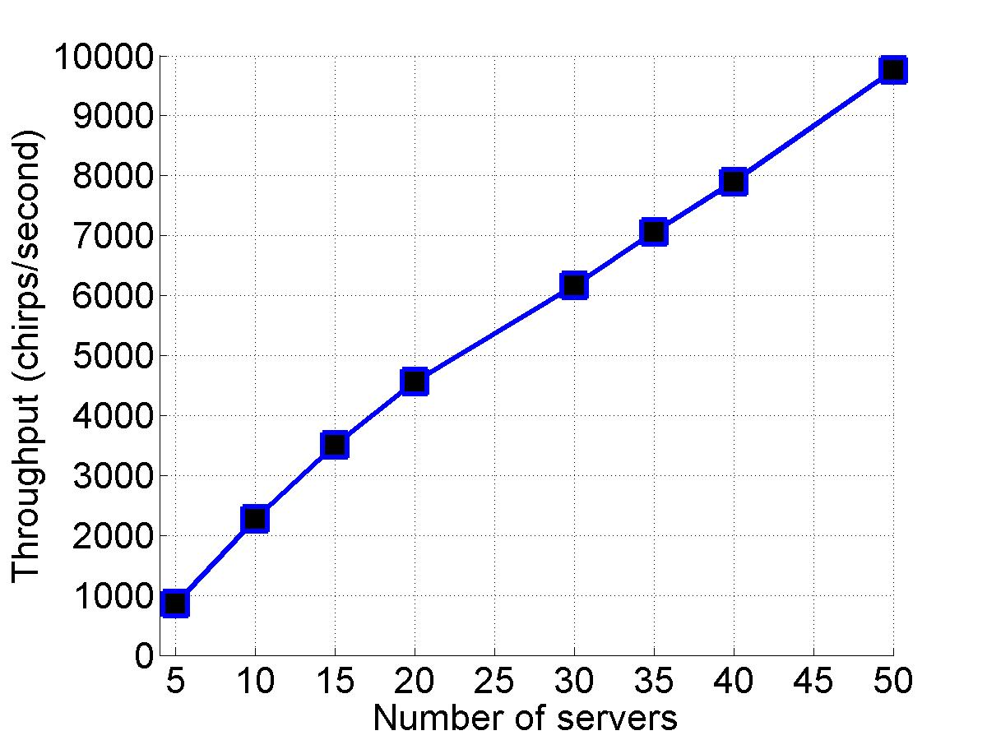
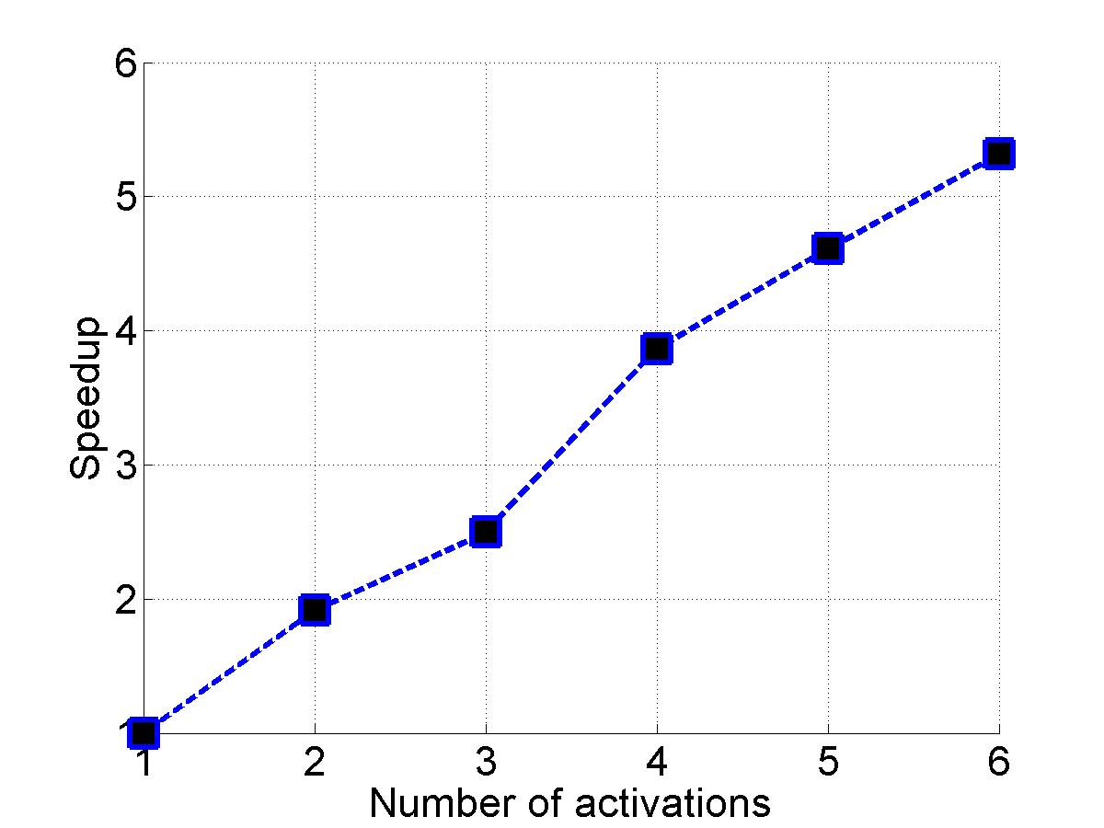
Evaluation
Heavy Subscriber
Total Chirper Throughput
200 lines of code
Near linear scalability

Slide 14
Related Work
Actor models
Erlang
E
Thorn
Distributed objects
Emerald
EJB
CORBA
Transactions
Futures/Promises
[Liskov et al]
Conflict resolution
CRDTs [Marc Shapiro]
Concurrent revisions [Burckhardt & Leijen]

Slide 15
Conclusion
Orleans = programming model + distributed runtime
Simplified programming model
Transparent scalability
Adaptive performance tuning
Make cloud programming
accessible to everyone!

