Slide 1
The Social, Behavioral, and Economic (SBE) Perspective in Secure and Trustworthy Cyberspace (SaTC)
Heng Xu
SaTC Program Director
Directorate for Social, Behavioral and Economic Sciences
Aug 17, 2014

Slide 2
Agenda
What is SBE?
The SBE Perspective of SaTC Program
SaTC EAGERs Enabling New Collaborations Between Computer and Social Scientists
Research on Privacy in Today's Networked World

Slide 3
NATIONAL SCIENCE FOUNDATION
National Science
Board
Office of the Director
Offices
International & Integrative Activities
Legislative & Public Affairs
General Counsel
Diversity & Inclusion
Office of Inspector General
Social, Behavioral, & Economic Sciences
Computer &
Info. Science
& Engineering
Mathematical & Physical Sciences
Engineering
Geosciences
Education & Human Resources
Budget,
Finance &
Award Management
Information & Resource Management
Biological Sciences

Slide 4
NSF SBE OVERVIEW
Directorate for Social,
Behavioral & Economic Sciences
Dr. Joanne Tornow, Acting Assistant Director
SBE Office of Multidisciplinary Activities (SMA)
Division of Behavioral and Cognitive Sciences (BCS)
Division of Social and Economic Sciences (SES)
National Center for Science and Engineering Statistics
Notes:
SBE OFFICE OF MULTIDISCIPLINARY ACTIVITIES (SMA):
Coordinating SBE’s participation in NSF-wide and crosscutting activities, including:
Interdisciplinary Behavioral and Social Science Research (IBSS)
SBE Postdoctoral Research Fellows (SPRF)
SBE Research Experiences for Undergraduate Sites (SBE REU Sites)
Science of Learning Centers (SLC)
Science of Science and Innovation Policy (SciSIP)

Slide 5
BCS STANDING PROGRAMS
Archaeology and Archaeometry
Cognitive Neuroscience
Cultural Anthropology
Developmental and Learning Sciences
Documenting Endangered Languages
Geography and Spatial Sciences
Linguistics
Perception, Action, and Cognition
Biological Anthropology
Social Psychology
Notes:
BCS supports research to develop and advance scientific knowledge about humans spanning areas of inquiry including brain and behavior, language and culture, origins and evolution, and geography and the environment.

Slide 6
SES STANDING PROGRAMS
Decision, Risk and Management Sciences
Economics
Ethics Education in Science and Engineering
Science of Organizations
Law and Social Sciences
Methodology, Measurement and Statistics
Political Science
Science, Technology and Society
Sociology
Notes:
SES Seeks to enhance our understanding of human, social and organizational behavior by building social science infrastructure and by developing social disciplinary and interdisciplinary research projects that advance knowledge in the social and economic sciences.

Slide 7
NATIONAL CENTER FOR SCIENCE AND ENGINEERING STATISTICS (NCSES)
Nation’s primary source of data and analysis on the science and engineering enterprise
Designs, supports and directs about 11 periodic surveys, other data collections and research projects
30 publications yearly
Congressionally-mandated publications:
Science and Engineering Indicators
Women, Minorities and Persons with Disabilities in Science and Engineering

Slide 8
The SBE / SaTC Perspective
SBE / SaTC seeks to fund cutting edge SBE research proposals that
Have the potential to enhance the trustworthiness and security of cyberspace AND
contribute to theory or methodology of basic SBE sciences
Proposers are encouraged to include SBE science and collaborate with SBE scientists as needed

Slide 9
The SBE / SaTC Perspective
SBE primary proposals should NOT simply apply SBE research and methods to cybersecurity.
Research from the SBE perspective uses the domain of cybersecurity to explore, develop, or "push the boundaries" of SBE science.
Make theoretical or methodological contributions to the SBE sciences
Seek generalizable theories
Proposals will be reviewed by SBE scientists

Slide 10
The SBE / SaTC Perspective
Proposals that APPLY rather than contribute to the SBE sciences may fit into the TWC perspective or with the SBE perspective as secondary.
E.g. as human factors research

Slide 11
Example SBE / SaTC Topics
The value of cybersecurity insurance
Methods to incentivize or nudge end-users to improve their cybersecurity compliance
Socio-technical solutions to reduce risk exposure of end-users
Game theoretic and microeconomic modeling and experimentation to identify incentive mechanisms for enhancing security and privacy
Behavioral economic analyses of privacy decision making
Motivators of insider threat and incentive countermeasures
Methods for detecting deception and cybercrime prevention
The impact of trust and institutional design on cybersecurity decisions
Social network methods of detecting malware propagation
Incentive structures for cybersecurity in firms and other organizations
Incentive, communication, and profitability mechanisms of attackers

Slide 12
Dear Colleague Letter (DCL): SaTC EAGERs Enabling New Collaborations Between Computer and Social Scientists

Slide 13
SaTC New Collaboration EAGERs
New Collaboration:
Proposals should clarify how the proposed NEW collaboration between computer and social scientists will take place
Budget: around $200,000
Stay tuned for future opportunities

Slide 14
1359632: Consumer Response to Security Incidences and Data Breach Notification
PIs: Rahul Telang (applied economics), Artur Dubrawski (machine learning & data mining), CMU
Analyze a large financial dataset regarding customer transactions and details on security incidence
Examine degree of user behavior changes due to an adverse security event or breach notification
Highlight the cost and benefits of existing policies & provide guidelines on more effective regulations
Budget: $199,908 for two years
Notes:
whether a customer encountered adverse security incidence or fraud, received a breach notification, and etc

Slide 15
1359601: Exploring Spear-Phishing: a Socio-Technical Experimental Framework
PIs: Oded Nov (behavioral research), Nasir Memon (computer security), Polytechnic Institute of NYU
Examine the effect of Big Five personality traits on users’ responses to spear-phishing attacks
Send simulated spear-phishing messages to people on their actual email accts at 4 organizations (2 universities and 2 companies)
Develop novel types of cyber defenses that are tailored to users’ idiosyncratic characteristics
Budget: $203,648 for two years

Slide 16
Dear Colleague Letter (DCL): Research on Privacy in Today's Networked World

Slide 17
Law: Privacy = “Right to be left alone”(Warren and Brandeis 1890).
Warren, S.D., and Brandeis, D.L. (1890) "The Right to Privacy," Harvard Law Review (4:5), pp 193-220.

Slide 18
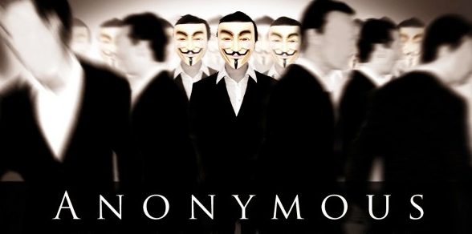
Computer Science
Privacy: Several definitions have evolved over the last decade including k-Anonymity, L-diversity, T-closeness, M-invariance, differential privacy, private information retrieval…

Slide 19
Social Psychology, HCI and Information Systems:
Frequent linkage of privacy and control

Slide 20
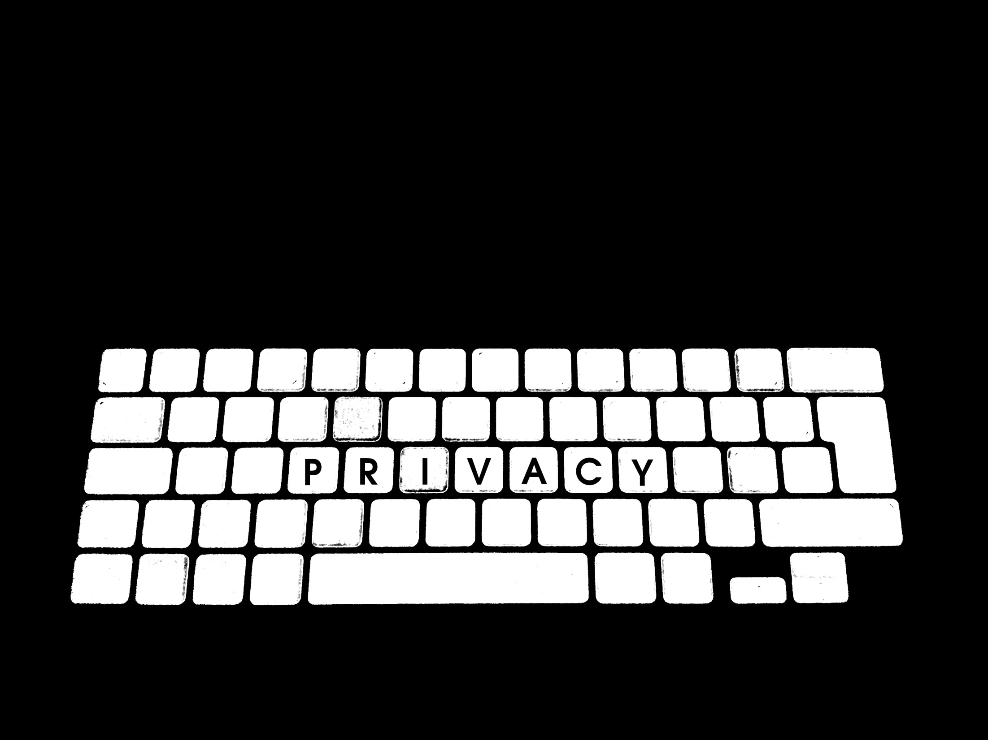
What is Privacy?
Privacy scholars “do not agree...on what privacy is or on whether privacy is a behavior, attitude, process, goal, phenomenal state, or what” (Margulis 1977, p.17)
“The notion of privacy is fraught with multiple meanings, interpretations, and value judgments” (NAC 2007).
Privacy "is in disarray and nobody can articulate what it means" (Solove 2006, p. 477)
Margulis, S.T. (1977) "Conceptions of Privacy - Current Status and Next Steps," Journal of Social Issues (33:3), pp 5-21.
Solove, D.J. (2006) "A Taxonomy of Privacy," University of Pennsylvania Law Review (154:3), pp 477-560.

Slide 21
NSF Privacy Research Portfolio
Formulation of privacy in terms of access to information
Formulation of privacy as a social-psychological construct
Privacy policy formulation, specification, enforcement, analysis
Algorithmic foundations for privacy and tools
Economics of privacy
Usability aspects of privacy
Privacy - Security - Usability trade-offs
Privacy preserving solutions for data integration, mining, querying
Privacy preserving solutions for cloud computing

Slide 22
NSF Privacy Research Portfolio
In August 2013 and in February 2014, the White House Office of Science and Technology Policy (OSTP) issued two Requests For Information (RFI) on privacy research activities pursued by the agencies
NSF: Approximately $25M per year is invested in privacy research activities
Approximately 35% of the FY13 SaTC program is in whole or large part related to privacy
ranging from $100K/2 years to $10M/5 years
http://www.nitrd.gov/Pubs/Report_on_Privacy_Research_within_NITRD.pdf
Notes:
http://www.nitrd.gov/Pubs/Report_on_Privacy_Research_within_NITRD.pdf

Slide 23
Privacy Related Awards
CISE:
The general goal is to ensure that data can be shared and utilized but does not reveal personally identifiable information (PII).
SBE:
Privacy should be a social-psychological construct.
Address privacy by seeking means of protecting PII.

Slide 24
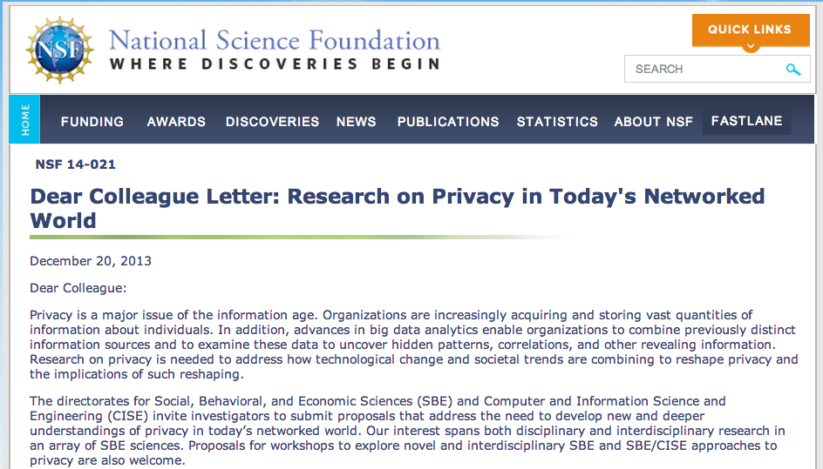
Dear Colleague Letter: Research on Privacy in Today's Networked World
Encourages social, behavioral & economic aspects of privacy research.
Proposals should be submitted through existing programs including:
SBE Interdisciplinary Behavioral and Social Science (IBSS) Research program
Secure and Trustworthy Cyberspace (SaTC) program
Standing SBE programs
Science, Technology & Society
Economics
Sociology
Notes:
http://www.nsf.gov/pubs/2014/nsf14021/nsf14021.jsp?org=NSF
Our initial data gathering activity for responding to the August 2013 RFI yielded interesting observations regarding the somewhat narrow range of topics that had been addressed by NSF-supported privacy related research to date. On Dec 20, 2013, NSF published a Privacy DCL to encourage research in technical and social aspects of privacy, particularly in the social, behavioral and economic sciences (http://www.nsf.gov/pubs/2014/nsf14021/nsf14021.jsp).

Slide 25
Research on Privacy in Today's Networked World
Social and psychological functions privacy performs
Relationship between technical and psychological conceptualizations of privacy
Privacy DCL
(NSF 14-021)
Psychological or social consequences of privacy violations
Factors encouraging attention or inattention to privacy
Institutional adaptations to and utilization or avoidance of privacy-invading technologies
Understanding the contextual nature of privacy or privacy violations
Examining privacy issues and impacts across different levels of analysis with different technologies

Slide 26
QUESTIONS?
Email: hxu@nsf.gov
Phone: (703) 292-8643
Division of Social and Economic Sciences
Directorate for Social, Behavioral and Economic Sciences

