Slide 1
Getting There: Example of Successfully Obtaining SaTC CAREER Award
Dr. Oleg Komogortsev
Associate Professor
Department of Computer Science
Texas State University

Slide 2
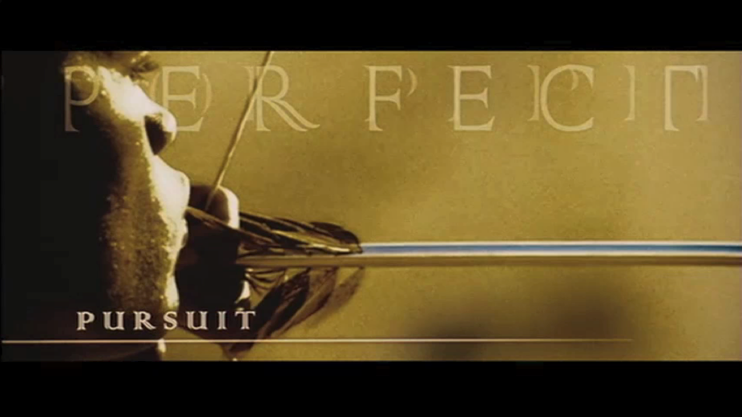
Technological Example
< Video clip from Minority Report (2002) omitted>

Slide 3
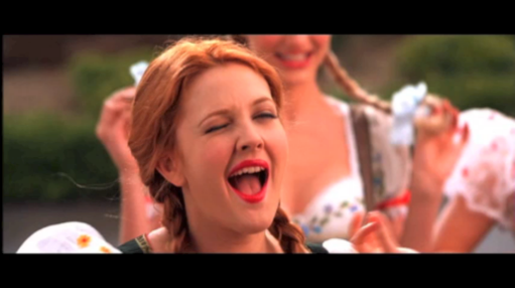
Motivation cont’d
Biometrics: provide easier and more secure access control than traditional passwords
Challenges: spoofing
< Video clip from Charlie’s Angels (2000) omitted>
Notes:
Biometrics fights fraud by preserving the identity of the user “what you are” not “what you have”
However biometric itself is susceptible to fraud, i.e., spoofing.

Slide 4
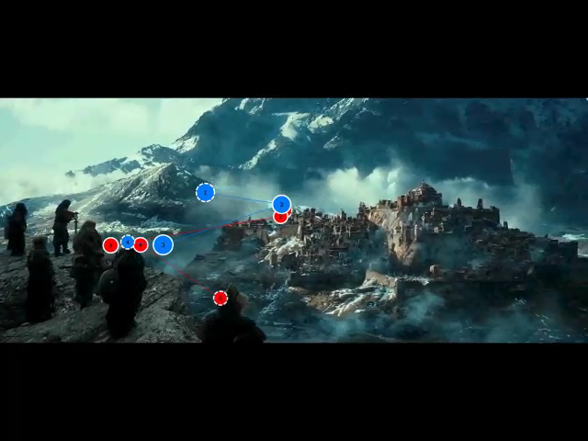
Ocular Biometrics Idea

Slide 5
Ocular Biometrics Idea cont’d

Slide 6
Broader Impact
More accurate than iris
Spoof resistant

Slide 7
Broader Impact cont’d
Scientific
  Detection of physiological and psychological states
  Metrics and tools to study how different we are
Societal impacts
  UDAI project in India that affects 1.2B people

Slide 8
The Beginning
Antagonist
Agonist

Slide 9
First Attempt: Research Ideas
Create more accurate Oculomotor Plan model
Explore novel Human Computer Interaction techniques
Identifying a person based on the internal structure of human eye

Slide 10
First Attempt: Challenges
Getting preliminary results

Slide 11
First Attempt: Finding an Appropriate Program
Contacting Program Directors
  E-mails
  Personal meetings
Advice
  Be persistent
  Get feedback, no matter how hard it is.

Slide 12
First Attempt: Getting Help
Ask for successful proposals
Ask people to review and provide feedback

Slide 13
First Attempt: Official Review
Too many aims
  Each of the goal has to be defended against domain-specific criticism
Broader impact is unclear
  The proposal should be easily defendable by the community from the broader impact standpoint
Insufficient preliminary results
Biometrics component is interesting!

Slide 14
Second Attempt: Challenge of Going Forward
Publishing preliminary results
Convincing biometrics community that eye movement-driven biometrics makes sense

Slide 15
Second Attempt: Plan
Talk to NSF program director
Concentrate on one area – biometrics
Use language and concepts that would be understood by the reviewers in the community
Provide coherent structure
Outline clear goals and outcomes
Notes:
Given document by Carl Landwehr “The National Biometrics Challenge” written by the National Science and Technology Council. The document provided the information to highlight the important challenges in the area, provide terminology and the structure to the proposal.

Slide 16
Second Attempt: Official Review
Unclear how ocular biometrics is better than existing methods, such as iris scan
How proposal meets goals of SaTC program?

Slide 17
Third Attempt: Plan
Clearly explain advantages of Ocular Biometrics
“provide the basis for designing, building, and operating a cyberinfrastructure with improved resistance and resilience to attack… ”.
Extra step
  Co-organizing eye movement biometrics competition
  contributing to a NIST liveness standard
  contributing to larger project such as UDAI

Slide 18
Third Attempt: Result
Award!

Slide 19
Summary
Idea that will result in significant broader impacts
Scope of work manageable and defendable
Submission to the correct program
Clear structure, goals, and outcomes
Start working early

Slide 20

Thank you
NSF
SaTC program

