Slide 1
National Science Foundation Directorate for Computer & Information Science & Engineering (CISE) Trustworthy Computing and Transition to Practice Secure and Trustworthy Cyberspace (SaTC) Presented by Jeremy Epstein, Program Officer

Slide 2
SaTC Goals and Perspectives
Goal: To protect cyber-systems (including host machines, the internet and other cyber-infrastructure) from malicious behaviour, while preserving privacy and promoting usability
SaTC emphasizes different approaches and research communities by introducing perspectives
Trustworthy Computing (TWC)
Social, Behavioral & Economic (SBE)
Transition to Practice (TTP)
Cybersecurity Education (EDU)

Slide 3
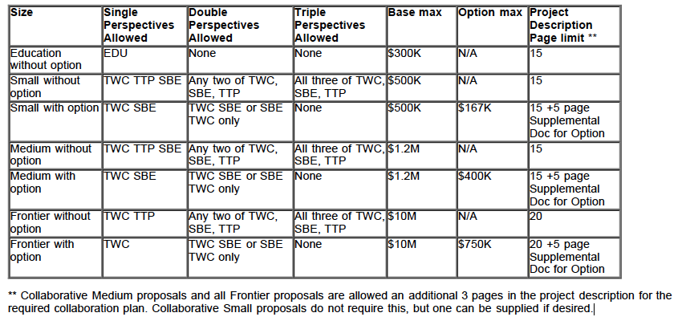
SaTC Combinations

Slide 4
Trustworthy Computing Systems Perspective

Slide 5
Trustworthy Computing Systems Perspective
Roughly corresponds to former Trustworthy Computing Program
Supports designing, building or operating cyber-infrastructure that resists malicious attackers
Includes security, privacy and accountability concerns
Supports approaches from theoretical to experimental to human-centric
Theories, models, algorithms, methods, architectures, languages, tools, systems and evaluation frameworks
Studies of tradeoffs among security, privacy, usability
Methods to assess, reason about and predict system trustworthiness
Methods to increase attacker cost, enable tailored security environments

Slide 6
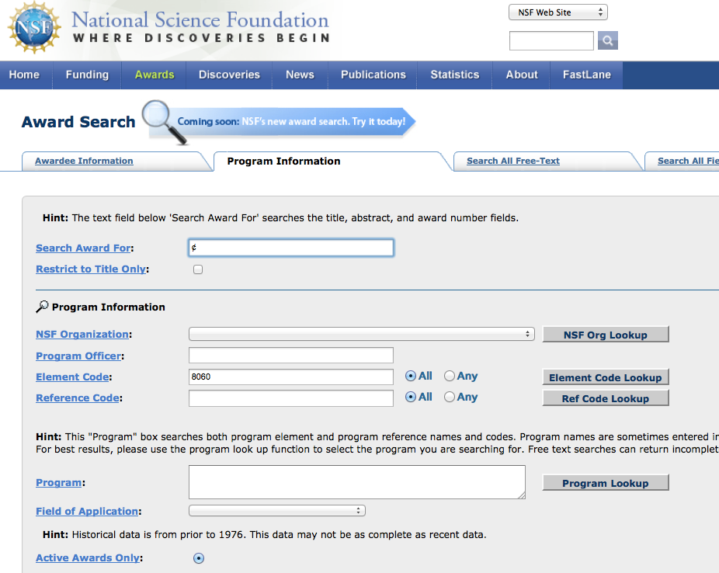
Does my area fit?
Look on www.nsf.gov/awardsearch for what we’ve funded already!

Slide 7
FY12 TWC Actual Funding Areas (83 proposals / 56 projects total)
Medical device security
Browser security
Anonymity
Mobile device security & privacy
Cloud security
Hardware security
Smart grid security
Data privacy
Network security (BGP, IDS)
Software security
Cybereconomics
Censorship evasion
Security data collection & analysis
Social network security
Biometrics
Security usability

Slide 8
National Strategy Areas Where We’d Like To See More Proposals
Underrepresented
Moving Target
Tailored Trustworthy Spaces
Science of Security
Well represented in
Designed-In Security
Cybereconomics

Slide 9
Common Mistakes in TWC
Lack of a clear threat model – a solution without knowing the problem you’re trying to solve!
Insufficient comparison to other research
In some areas, insufficient comparison to commercial products

Slide 10
Transition To Practice Option and Perspective

Slide 11
Transition Option vs. Perspective
Transition Perspective
Transition Option

Slide 12
Transition Perspective
Take existing research, extend it, and focus on transitioning to practice
Commercial
State, local, Federal government
Release as open source
“Applied research, development, prototyping, testing, and experimental deployment”

Slide 13
TTP Perspective Requirements
The expected impact on the deployed environment described in the proposal.
The extent to which the value of the proposed cybersecurity research and development is described in the context of a needed capability required by science and engineering, and potential impact across a broader segment of the NSF community.
The feasibility, utility, and interoperability of the capability in its proposed operational role.
A project plan that addresses in its goals and milestones the demonstration and evaluation of a working system in the target environment.
Tangible metrics described to evaluate the success of the capabilities developed, and the steps necessary to take the system from prototype status to production use.

Slide 14
Transition Option
Transition option is an optional supplemental part to small, medium, and Frontier proposals going into TWC and/or SBE perspectives
Description of phase activities in supplementary documents – NOT IN THE BASE DOCUMENT
Transition option
Will NOT factor into the primary proposal review
Will NOT factor into ranking of proposal in the review panel

Slide 15
TTP Option Requirements
The expected impact on the deployed environment described in the proposal supplemental document.
The extent to which the value of the proposed cybersecurity research and development is described in the context of a needed capability required by science and engineering, and potential impact across a broader segment of the NSF community.
The feasibility, utility, and interoperability of the capability in its proposed operational role.
An option project plan that addresses in its goals and milestones the demonstration and evaluation of a working system in the target environment.
Tangible metrics described to evaluate the success of the capabilities developed, and the steps necessary to take the system from prototype status to production use.
The appropriateness of the budget for the option. The supplemental document should explain how the additional budget will be used to execute the option.

Slide 16
Which One to Use?
If existing research results to be transitioned, then use TTP perspective
If new research which you plan to transition, then use TTP option
May not include both in the same proposal!
Common mistakes for option:
Option must include separate document describing the option activities, and must not be described in the base proposal
Budget for option must not be included in the proposal budget
Word “Option” must be in the proposal title

Slide 17
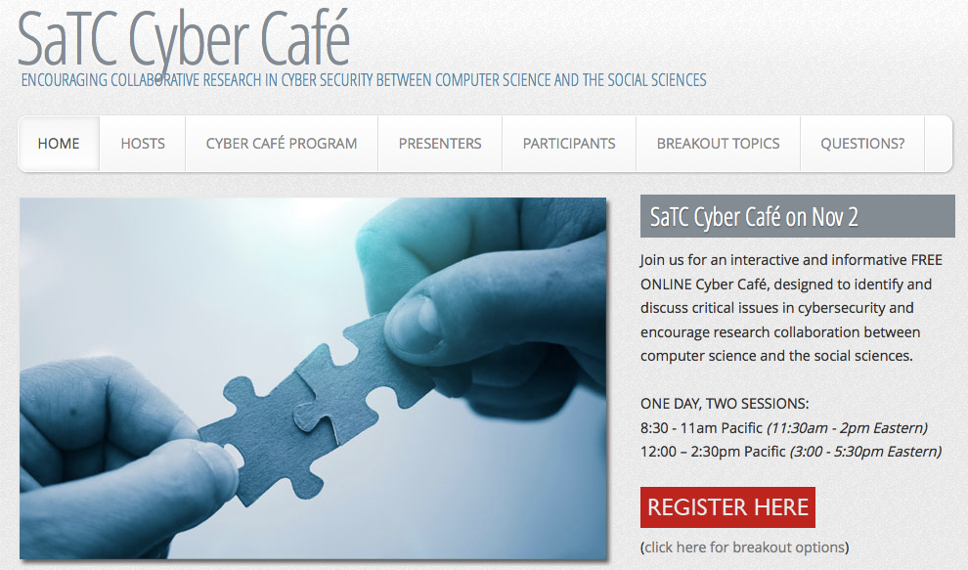
Advertisement!
http://www.satc-cybercafe.net/

Slide 18
National Science Foundation Directorate for Computer & Information Science & Engineering (CISE) Trustworthy Computing and Transition to Practice Secure and Trustworthy Cyberspace (SaTC) Presented by Jeremy Epstein, Program Officer

