Slide 1



Some of My Work: Accountability & Privacy
Rebecca Wright
Rutgers University
www.cs.rutgers.edu/~rebecca.wright
NSF/DIMACS Workshop for Aspiring PIs in Secure and Trustworthy Cyberspace
October 15, 2012

Slide 2

My Research Approach
Take a foundational approach to secure and trustworthy cyberspace:
  what is the boundary of possibility and impossibility?
  are there fundamental tradeoffs (e.g., between security and efficiency? communication and computation? privacy and usability?)
Insights gained lead to more informed choices and better system design.
Thinking about users, uses, and usability is critical.
  Includes recognizing that different parties have different goals and values.
Notes:
Important to know your own research style: what are your strengths and experiences, what do you find interesting and rewarding?

Slide 3
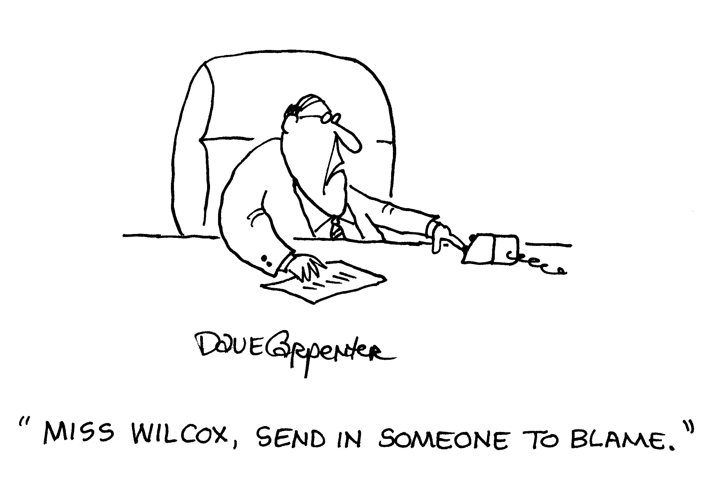
Example 1: Accountability
Both in the real world and in Internet systems, people often express a desire for “accountability”.
Not completely clear what people mean, but often about ensuring consequences for people who break the rules.
May or may not require identification and tracking of everyone at all times. (Without definitions, we can’t tell!)
We are exploring this as a useful paradigm shift from approaches based only on prevention [FJW11, FHJWW11].

Slide 4
How the Project Developed
People keep saying: “In order to provide accountability, we need to be able to keep track of who is doing what.”
I kept saying: “Really?... How could we know whether or not this is true?”
This project was formed out of the desire to be able to find a definitive answer.

Slide 5
Need for Accountability
Weitzner et al., CACM 2008:
This hide-it-or-lose-it perspective … on privacy, copyright, and surveillance is increasingly inadequate. … As an alternative, accountability must become a primary means through which society addresses appropriate use.
Lampson, CACM 2009:
Misplaced emphasis on prevention (“security based on locks”) rather than accountability (“security based on deterrence”) has resulted in unusable security technology that people do not understand and often work around.

Slide 6
Some Prior CS Work
Applications of Lampson’s definition
    Accountable Internet Protocol [Andersen et al., 2008]
    Social-web applications [MIT DIG]
Cryptographic applications in which participants remain anonymous unless they break the rules
    Electronic cash
    Anonymous group messaging [Corrigan-Gibbs & Ford, 2010]
Identity plays a major role, even in most systems with some anonymity.

Slide 7
Limitations of Prior Approaches
Reliance on identification (or at least persistent identities) of those held accountable
Reliance on an authority to hold an entity accountable
Need for the authority to take an explicit action in order to hold an entity accountable

Slide 8
Research Agenda
Formalize accountability and related concepts
  Clarify interrelated (and often conflated) notions
  Provide framework for formal analysis
Use these ideas to study accountability and identity requirements in systems
  Tradeoffs and impossibility results
  To what extent is identity required?

Slide 9
Toy Example: Car Dealership Lot
Policy: people shouldn’t be able to drive cars off the lot without paying for them first.
Mediated, identifiable accountability:
  a customer can show ID and sign paperwork to drive the car around the lot. If she leaves in the car without payment, a judge can punish her based on the presented evidence.
Prevention:
  an electronic shut-off device stops cars from driving through the exit. Can only be disabled by the manager, who does this upon payment.
Automatic, anonymous accountability:
  an electronic explosive device blows up cars and their passengers if they drive through the exit. Can only be disabled by the manager, who does this upon payment.

Slide 10
Our Formulation [FJW11]
Working Definition: An entity is accountable with respect to policy P if, whenever the entity violates P, then it could be punished.
  We separate accountability from identifiability, so accountability doesn’t assume identifiability in the first place.
  Broadens Lampson’s definition (to allow automatic punishment).

Slide 11
Formalizing this Approach: Automatic Punishment
T
Violation e
Vickrey (second-price) auctions are an example. No mediator or identification needed!
The violation is automatically punished if the violator’s utility is lower in the outcomes extending the violating trace Te than in the outcomes extending T but not Te.

Slide 12
Formalizing this Approach: Mediated Punishment
Violation
Subtrace
Punishing event
Punishing event must be caused by the fact of the violation
Compare utility of outcomes after punishing event with utility of outcomes extending the subtrace
  Remove events up to punishment that are caused by the violation
  Depending on view of causality, specializes to automatic punishment

Slide 13
Research Goal: Explicate Relationship Between Accountability and Related Properties
Identification
Authorization
Accountability
Compensation
Detection
Closed
Systems
Punishment
Example research question: in open systems with mediated punishment, are anonymity and accountability compatible?

Slide 14

Example 2: Privacy
Means different things to different people, to different cultures, and in different contexts.
Appropriate uses of data:
  What is appropriate?
  Who gets to decide?
  What if different stakeholders disagree?
Simple approaches to “anonymization” don’t work in today’s world where many data sources are readily available.
There are some good definitions for some specific notions of privacy.

Slide 15
Our Results: Secure Multiparty Computation
[WY04,YW05]: privacy-preserving construction of Bayesian networks from vertically partitioned data.
[YZW05]: privacy-preserving frequency mining in the fully distributed model (enables naïve Bayes classification, decision trees, and association rule mining).
[JW05, JPW06, JPUW10]: privacy-preserving clustering: k-means clustering for arbitrarily partitioned data and a divide-and-merge clustering algorithm for horizontally partitioned data.
[SKW08]: privacy-preserving reinforcement learning, partitioned by observation or by time.
[IMSW07, IMSW09]: private multiparty sampling and approximation of vector combinations.
[RKWF05, RKW08]: an experimental platform for privacy-preserving data analysis, improved performance of Lindell-Pinkas privacy-preserving natural logarithms
[JW06, JW08b]: Private policy enforcement for inference control policies on aggregate database queries.
[JW08]: Privacy-preserving imputation of missing data.
[YZW07, SW09]: Privacy-preserving model and attribute selection.

Slide 16
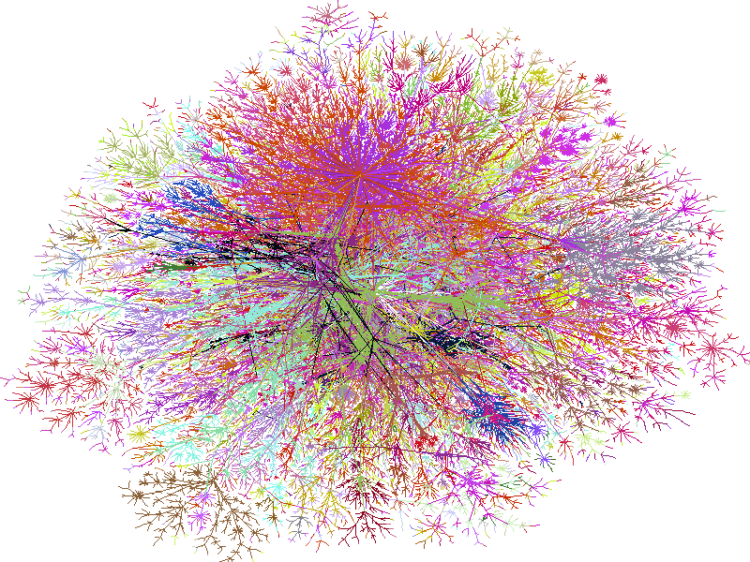
Our Results: Differential Privacy
Efficient and accurate decision tree construction [JPW09].
Pan-private streaming algorithms [MMNW11].
Compact graph representation and generation [MW09, MW12].
Differentially private learning and information theory [M12].

Slide 17
Research Agenda Over Time
Note shift from secure multiparty computation to differential privacy over time.
This was driven by my growing understanding when working on SMC of its limitations in providing data privacy in many important usage scenarios, and my recognition that differential privacy addresses those limitations.
I think both have a place and still work actively on both.

Slide 18
Acknowledgments
Collaborators on this work:
  Joan Feigenbaum, James Hendler, Yuval Ishai, Geetha Jagannathan, Aaron Jaggard, Onur Kardes, Shigenobu Kobayashi, Tal Malkin, Darakhshan Mir, S. Muthukrishnan, Aleksander Nikolov, Krishnan Pillaipakkamnatt, Rafail Ryger, Martin Strauss, Daryl Umano, Daniel Weitzner, Zhiqiang Yang, and Sheng Zhong.
Grant support:
  National Science Foundation awards 0331584, 0822269, 1018557, and 1018445.
  Department of Homeland Security award 2009-ST-061-CCI002.

