Slide 1
Some Experiences with the
NSF CT, TC, and SaTC Programs
Michael Reiter
reiter@cs.unc.edu
Lawrence M. Slifkin Distinguished Professor
Department of Computer Science
University of North Carolina at Chapel Hill

Slide 2
My History of CT/TC/SaTC Funding
Program | Title | Size | Role | Awarded
CT | Security Through Interaction Modeling | “Center” | PI | 2004
CT | Cross-Layer Large-Scale Efficient Analysis of Network Activities to Secure the Internet | “Large” | Co-PI | 2008
TC | Trustworthy Virtual Cloud Computing | “Large” | Co-PI | 2009
TC | Server-side Verification of Client Behavior in Distributed Apps | “Small” | PI | 2011
SaTC | Crowdsourcing Security | “Medium” (small) | Co-PI | 2012

Slide 3
Security Through Interaction Modeling (STIM)
A “center-scale” project funded in the CyberTrust program (2004)
Team consisted of ten faculty members at Carnegie Mellon University
Technical focus:
  modeling interactions (social networks?) …
  at various levels (network, application, human) …
  to develop methods for detection of attacks and defense
Developed in a very bottom-up fashion

Slide 4
Security Through Interaction Modeling (STIM)
We had achieved a lot (technically) in the first 18 mos
What we achieved was consistent with our proposal
Our first site visit was not smooth at all, however
The visit team felt that our research agenda was too focused on research advances and not transition
  Not enough Bright Shiny Objects (BSOs)!
Bottom line: NSF defends its programs to congress; goes doubly for “center-scale” projects
Lesson: Large projects need BSOs that PMs can advertise to the (wo)man-on-the-street

Slide 5
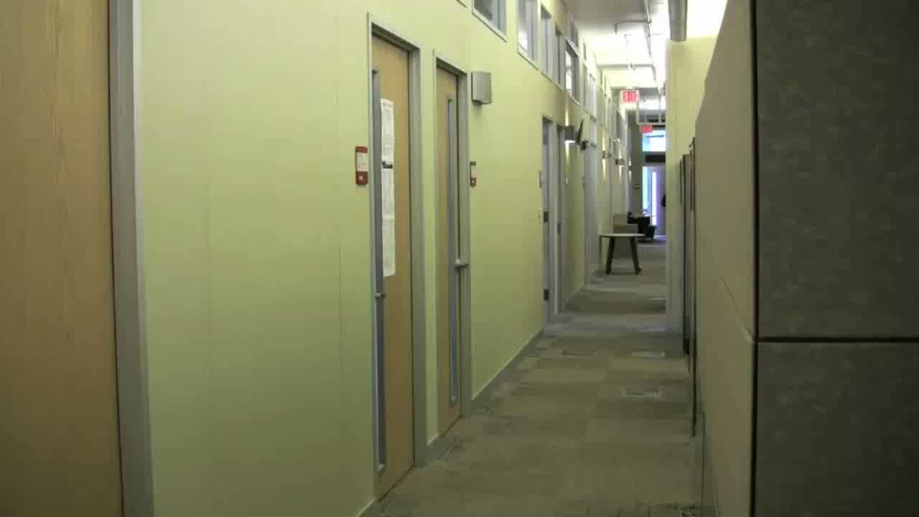
Example STIM BSO: The Grey System

Slide 6
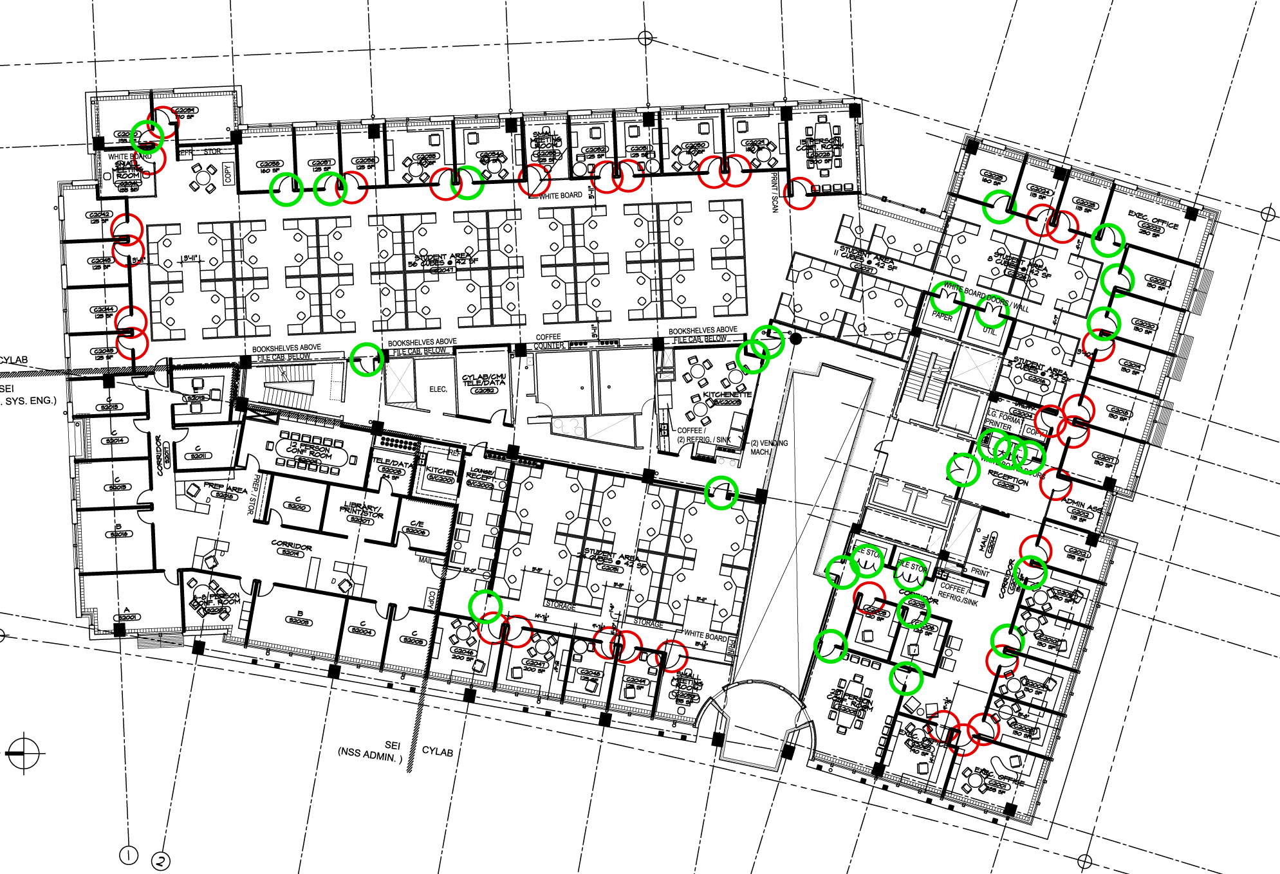
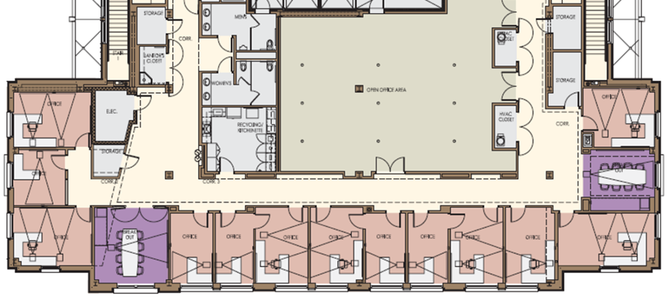
Example STIM BSO: The Grey System
Two deployments for physical access control
  CMU’s Collaborative Innovation Center
  UNC’s Fred Brooks Building

Slide 7
Security Through Interaction Modeling (STIM)
Second challenge was turnover
Over the course of the grant …
  … three faculty members (including me) moved to other universities
  … one faculty member left academia permanently
  … one faculty member went on leave for a startup
  … one faculty member went on leave to go to NSF
  … two faculty members were promoted into administration
Lesson: Leadership in a large project is important to navigate disruptions

Slide 8
Virtual Cloud Computing
A “large” project funded in the TC program (2009)
  Lead institution: NC State
  Other institutions: UNC, Duke, NC A&T
Technical focus: Virtualization and cloud security
My group’s focus
  Initially: primitives for trusted software platforms (TPMs, Flicker, …)
  More recently, timing channel attacks and defenses in cloud environments

Slide 9

The Emergence of Clouds
One of the most dominant trends in the computing landscape today is “clouds”
Company A
Company B

Slide 10
The Emergence of Clouds
One of the most dominant trends in the computing landscape today is “clouds”
Company A
Company B
Amazon, Rackspace, …

Slide 11

The Dangers of Clouds
Cloud computing introduces important new challenges to isolation tasks
Company A
Company B

Slide 12
Cross-VM Side-Channels
We have developed the first high fidelity cross-VM side-channel attack
  Can extract cryptographic keys from victim VMs
  Come to the talk tomorrow!
We are also developing new cloud architectures to convincingly defend against cross-VM side channels
In the meantime, physical isolation is still best for highly secure tasks

Slide 13

Detecting Unwanted Co-Residency
[w/ Zhang, Juels, Oprea; 2011]
Using “side channels” to detect co-residency of unauthorized VMs on cloud platforms
  Without help of the platform operator!

