Slide 1

My SaTC Funded Research,
How I got There and Future
Daniela Oliveira
Bowdoin College

Slide 2
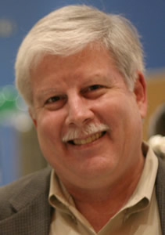
How did I get here?
NSF CAREER award letter
Sol Greenspan
A beaming
Daniela

Slide 3
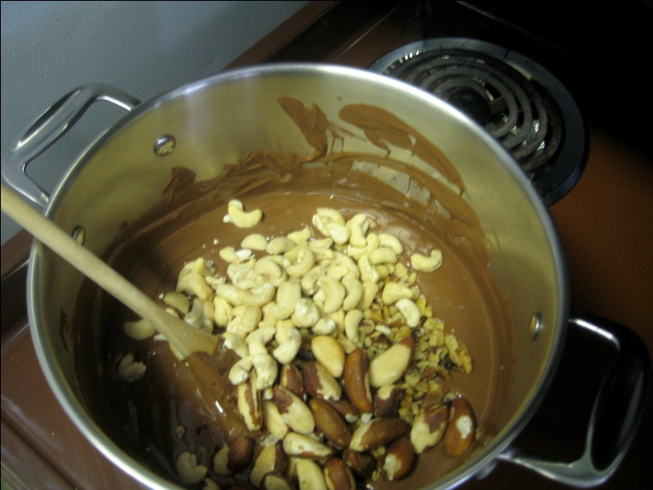
A Research Idea
An idea is nothing more nor less than a new combination of old elements
James Webb Young (1886-1973)
From Latin:
Cogito: to think, shake together
Intelligo: to select among

Slide 4
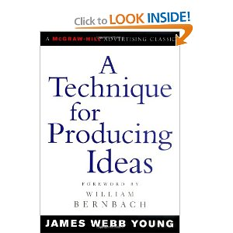
1. Gather raw materials
  Specific and general
2. Work over these materials in your mind
  Try to establish relationships
3. Incubating stage
  Do something that stimulates your emotions
4. The unexpected birth of the idea
5. Submit your idea to criticism

Slide 5
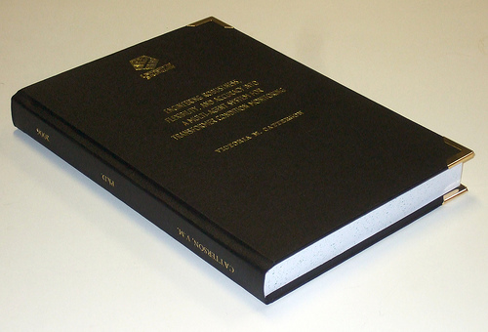


My Research Idea
Research papers
Part of dissertation
FBI strategy to bring down mob
Protected kernel against rootkits
OS communicated with VM: adhoc manner

Slide 6
Traditional VM Usage Model
Guest App
Guest App
Guest OS
Security solutions
VM
Host OS
HW
HW

Slide 7


Traditional Model Cost: the Semantic Gap
Application
System calls
Files
Memory areas
Semantic Gap
Processes
OS
I/O devices
Memory
Security Solution
Instructions
VM
CPU
Registers

Slide 8
Introspection to Bridge the Semantic Gap
Goal: extract meaningful information from OS
Physical memory analysis:
  Detailed knowledge of OS layout and objects
Assumption:
  even if guest OS is compromised we can still report correct results

Slide 9
Introspection to Bridge the Semantic Gap
Attacker can change OS layout and data structures:
  Three views can be provided [Baram et al.]:
Why not leverage guest OS?
External, bogus: for introspection tool
Internal, bogus: for guest OS
Real: known only to the attacker

Slide 10
A New Model
Virtualization-aware OS + VM
Security solutions
Guest OS
Collaboration
Security solutions
VM
HW
Host OS
HW

Slide 11
Collaboration for Introspection
Easier to obtain semantic information:
  No need to reverse engineer from low level data structures
Allows for stronger, fine grained security solutions
No less secure than the traditional model

Slide 12

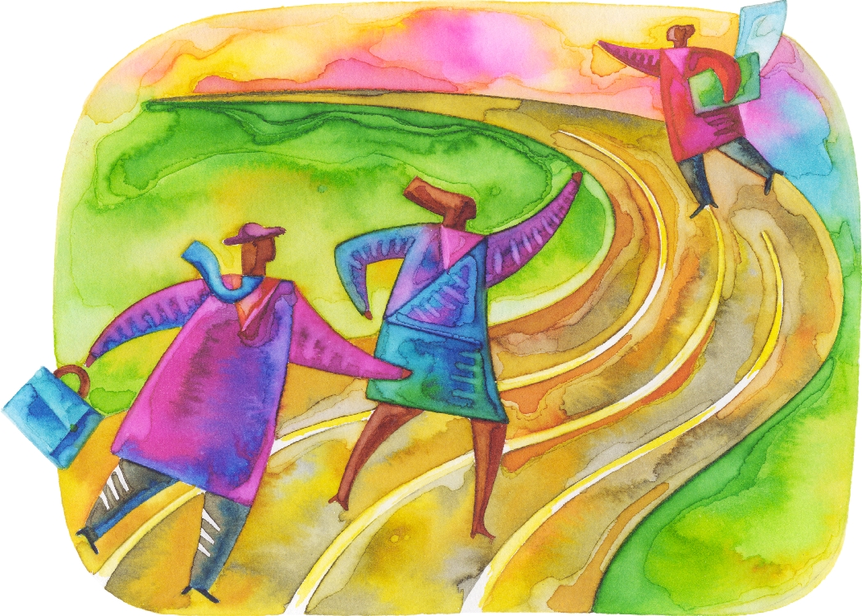

Slide 13
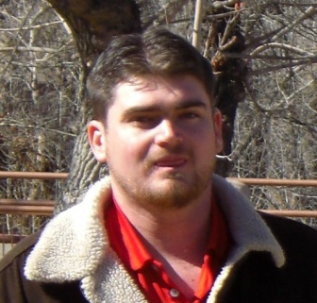
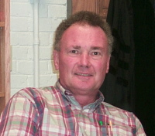
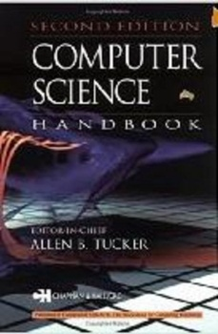
New Projects from Old Ones
Allen Tucker (Emeritus/Bowdoin) invites me to write a book chapter on Security for new edition of his book (November/2011)
I invite Jed Crandall (CS/UNM) as co-author

Slide 14
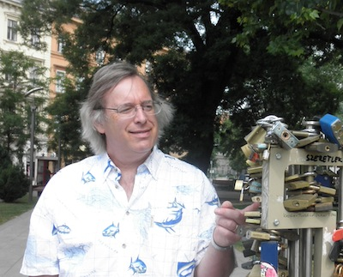

New Projects from Old Ones
Daniela and Jed research about vulnerabilities for book chapter
Daniela came across a 1995 paper from Matt Bishop that discussed how vulnerability studies are imperfect
Hum… Vulnerability studies are ambiguous
because vulnerabilities cross layers of abstraction…
If layers collaborated …

Slide 15
New Projects from Old Ones
Daniela writes a draft section for book chapter and shows Jed an example with buffer overflows

Slide 16
New Projects from Old Ones
Jed also researches and ties vulnerabilities to his information flow interests
Fenton 1973 thesis
Vulnerabilities are an information flow problem. As
information flows it is interpreted differently…

Slide 17
New Projects from Old Ones
Jed also writes a draft and explains his idea using TOCTTOU

Slide 18
New Projects from Old Ones
Maybe it is both! Vulnerabilities are fractures in interpretation as information flows across abstraction boundaries. Let’s write an NSPW paper together? (March/2012)

Slide 19
Results so Far
Paper accepted at NSPW 2012 (April)
Warm reception motivates follow-up paper with students: work in progress
NSPW selects our paper for ACSAC NSPW Experience (December)
Future: a grant together?

Slide 20
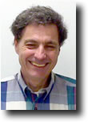
Final Thoughts
Networking is crucial:
  Old contacts to get new contacts
  Conferences and workshops
  You feel you are not the only one…
“Whenever you have a chance to present/discuss your research, do it”
                Karl Levitt (UC Davis)

Slide 21
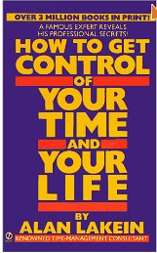
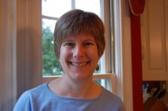
Final Thoughts
Use your time wisely:
  What is the best use of my time now?
Have a hobby or time to open yourself to emotions:
  “gastric juice”
Go to others workshops like this one:
  NSF CAREER grant proposal writing
  CRA career mentoring
Ellen Zegura (GeorgiaTech)

Slide 22
Thank you!

