Slide 1
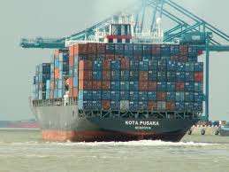
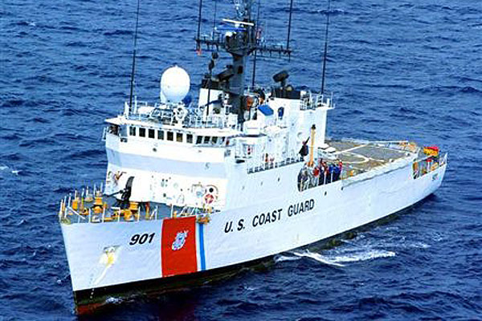
i-Group Learning and i-Detect for Dynamic Anomaly Detection with Applications in Maritime Threat Detection
Fred Roberts
Rutgers University
Credit: commons.wikipedia.org

Slide 2
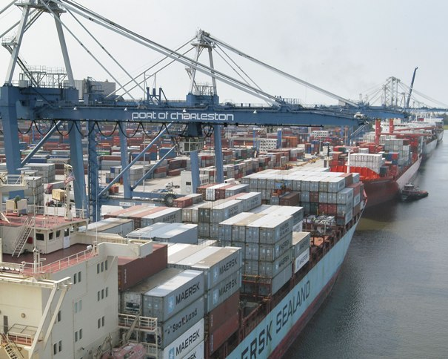
Motivation
Security is of paramount importance to human existence. Accurate and early detection of threat is becoming increasingly crucial to security.
Novel and sophisticated statistical methods/algorithms are needed to take advantage of vast amount of available data.
The maritime transportation system (MTS) is critical to the US and world economy. 95% of world’s goods still travel by sea.
This project concentrates on detection of threats in the MTS.
Credit: http://www.worldslargestship.com
Credit: Admiral Chuck Michel, USCG

Slide 3
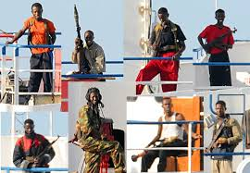
Motivation
Security in the MTS raises many challenges:
The vast ocean space and complex river systems
Long and often un-monitored shorelines
Extremely busy ports, and the sheer volume of goods being transported
Threats are multi-faceted: human/drug trafficking, smuggling, transportation of nuclear materials, illegal fishing.
Hence it is important to have an efficient early detection and risk assessment system for maritime traffic over space and time.
Somali Pirates
Credit: wikipedia.org

Slide 4
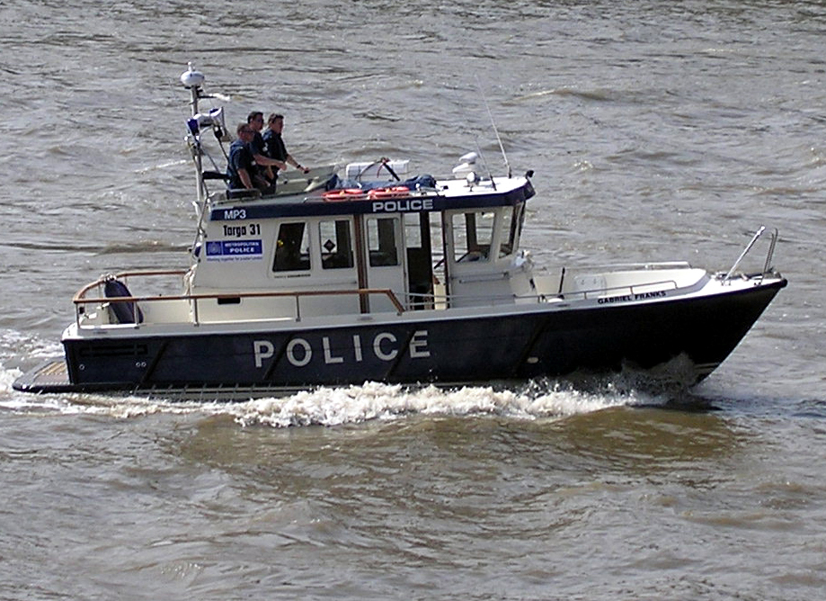
Motivation
Identification of unusual maritime traffic is critical to being able to apprehend law-breakers.
Need fast identification in terms of time and accuracy in terms of location.
With today’s data gathering capability, it is possible to achieve these goals with sophisticated and advanced statistical tools.
Credit: Wikimedia commons

Slide 5
New Tools
We have started to develop two new statistical tools, i-Group (individualized group learning to group similar vessels) and i-Detect (individualized detection to identify vessels deviating from the normal).
Developed, tested, implemented in the context of maritime threat detection
But they are general statistical methods readily applied to other areas (cell phone monitoring, cyber security, anti-money laundering, etc.)
We are consolidating publicly available maritime traffic data sets & geological/geographical/geophysical data sets
Our tools aim to provide:
Early warnings of abnormalities and assessments of risk for vessels being monitored
Ways to trace vessel movements, with emphasis on threat detection

Slide 6
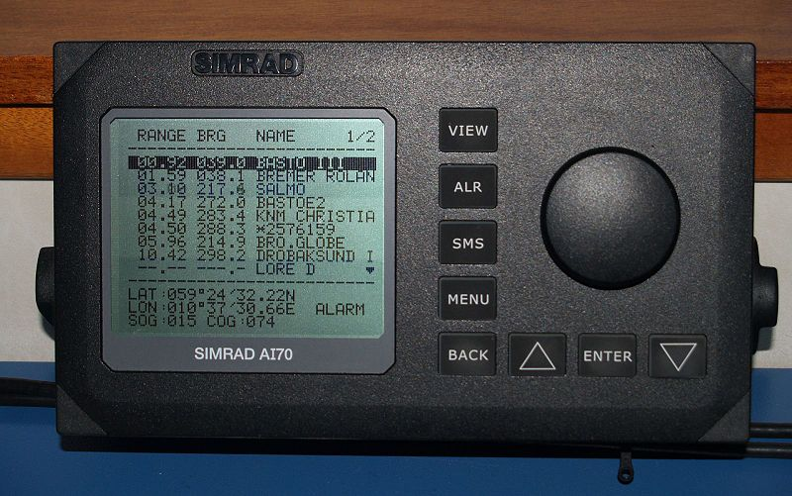
AIS Data
We had discussions with the US Coast Guard Research & Development Center and USCG HQ.
These discussions led us to explore how Automatic Identification System (AIS) data could be used to flag early warning of changed shipping patterns and other anomalous data.
AIS display with list of
nearby vessels
Credit: commons.Wikimedia.org

Slide 7
AIS Data
By international agreement, all ships of at least 300 gross tons and all passenger ships required to automatically transmit data through an Automatic Identification System (AIS).
Dynamic data: Location, course, speed, navigation status (at anchor, under way using engine), rate of turn
Voyage-related information: destination, ETA, etc.
Vessel identifiers: name, VHF call sign, maritime mobile service identity, type of ship, ship dimensions, etc.
AIS system was developed by technical committees under auspices of the International Maritime Organization.
AIS uses Global Positioning Systems (GPS), gyrocompass, other shipboard sensors, and digital VHF radio.
Vessel identifiers are programmed in the device and included in the transmittal.

Slide 8
AIS Data
The global AIS system receives data from approximately 1,000,000 ships.
There are updates for each ship as frequently as every two seconds while in motion and every three minutes while at anchor.
AIS tracks ships automatically by electronically linking data with other ships, AIS base stations, and satellites.
Primary initial function: traffic management, collision avoidance, other safety applications.
Now: many uses.
AIS offers awareness about other vessels operating in the extensive maritime transportation system.

Slide 9
AIS Data
AIS data include:
Maritime Mobile Service Identity – a unique ID number
Navigation status (at anchor, under way using engine(s), not under command)
Rate of turn
Speed over ground
Position accuracy
Longitude and Latitude
Course over ground in degrees
True heading from gyro compass
International Maritime Organization ID
International radio call sign
Type of ship/cargo
Ship dimensions
Type of positioning system
Draught of ship
Destination
ETA

Slide 10
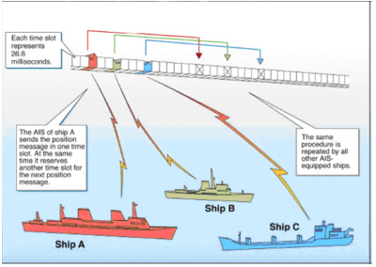
AIS Data
AIS data are collected by the U.S. Coast Guard.
Selected AIS data are made public online.
Massive data: US coast and waterway data accounts for 32 GB of AIS data daily.
Credit: Wikimedia Commons

Slide 11
Data Quality
Data Quality a challenge. E.g., for AIS data:
Transmission problems, forgetting to turn on the AIS transponder
Some data have 50% errors
Could be intentionally inaccurate
A cyber attacker could falsify a vessel’s identity, position, heading, speed, or make it invisible to authorities
The key problem with AIS is that it has no built-in security. No encryption. All information is automatically assumed as being genuine and hence treated as correct.
Dr. Marco Balduzzi of Trend Micro discussing potential scenario for cyber attack on AIS
Credit: Help Net Security

Slide 12
Data Quality
Aside: Danger of Cyber Attacks on AIS
A cyber attacker could falsify a vessel’s identity, position, heading, speed, or make it invisible to authorities.
An attacker could tamper with the data, impersonate port authorities, communicate with the ship or effectively shut down communications between ships and with ports.
Plausible scenarios (CyberKeel 2014):
Modification of all ship details, position, course, cargo, speed, name
Creation of “ghost” vessels at any global location, which would be recognized by receivers as genuine vessels
Trigger a false collision warning alert, resulting in a course adjustment
Send false weather information to a vessel to have them divert around a non-existent storm

Slide 13
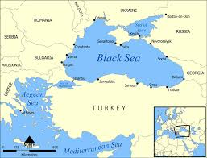
Data Quality
Aside: Danger of Cyber Attacks on AIS
Plausible scenarios (CyberKeel 2014) continued:
Impersonate marine authorities to trick the vessel crew into disabling their AIS transmitter, rendering them invisible to anyone but the attackers themselves
Cause vessels to increase the frequency with which they transmit AIS data, resulting in all vessels and marine authorities being flooded by data. Essentially a “denial-of-service attack”
There were suspected cases of mass-spoofing of AIS in the Black Sea in June 2017, with more than 20 ships affected.
The GPS were giving false locations, some inland and some at airports.
(Source: Fairplay 11-22-17)
Credit: commons.wikimedia.com

Slide 14
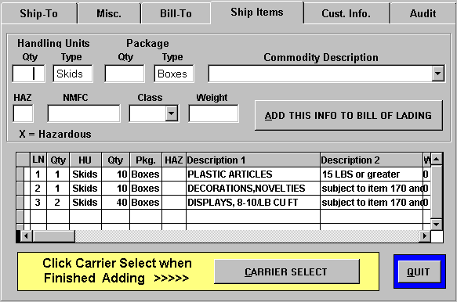
Other Data Sets Complementing AIS
Geological/Geographical/Geospatial information
Example: standard shipping routes between ports, riverways, water depth, port location, designated anchor area, etc.
Such information is available in forms such as nautical charts, e.g., the Electronic Chart Display and Information System (ECDIS)
Other relevant data
Manifest data about cargo in vessels
Vessels‘ participation history in voluntary or required programs, e.g., the Customs-Trade Partnership Against Terrorism (C-TPAT)
Manifest data

Slide 15
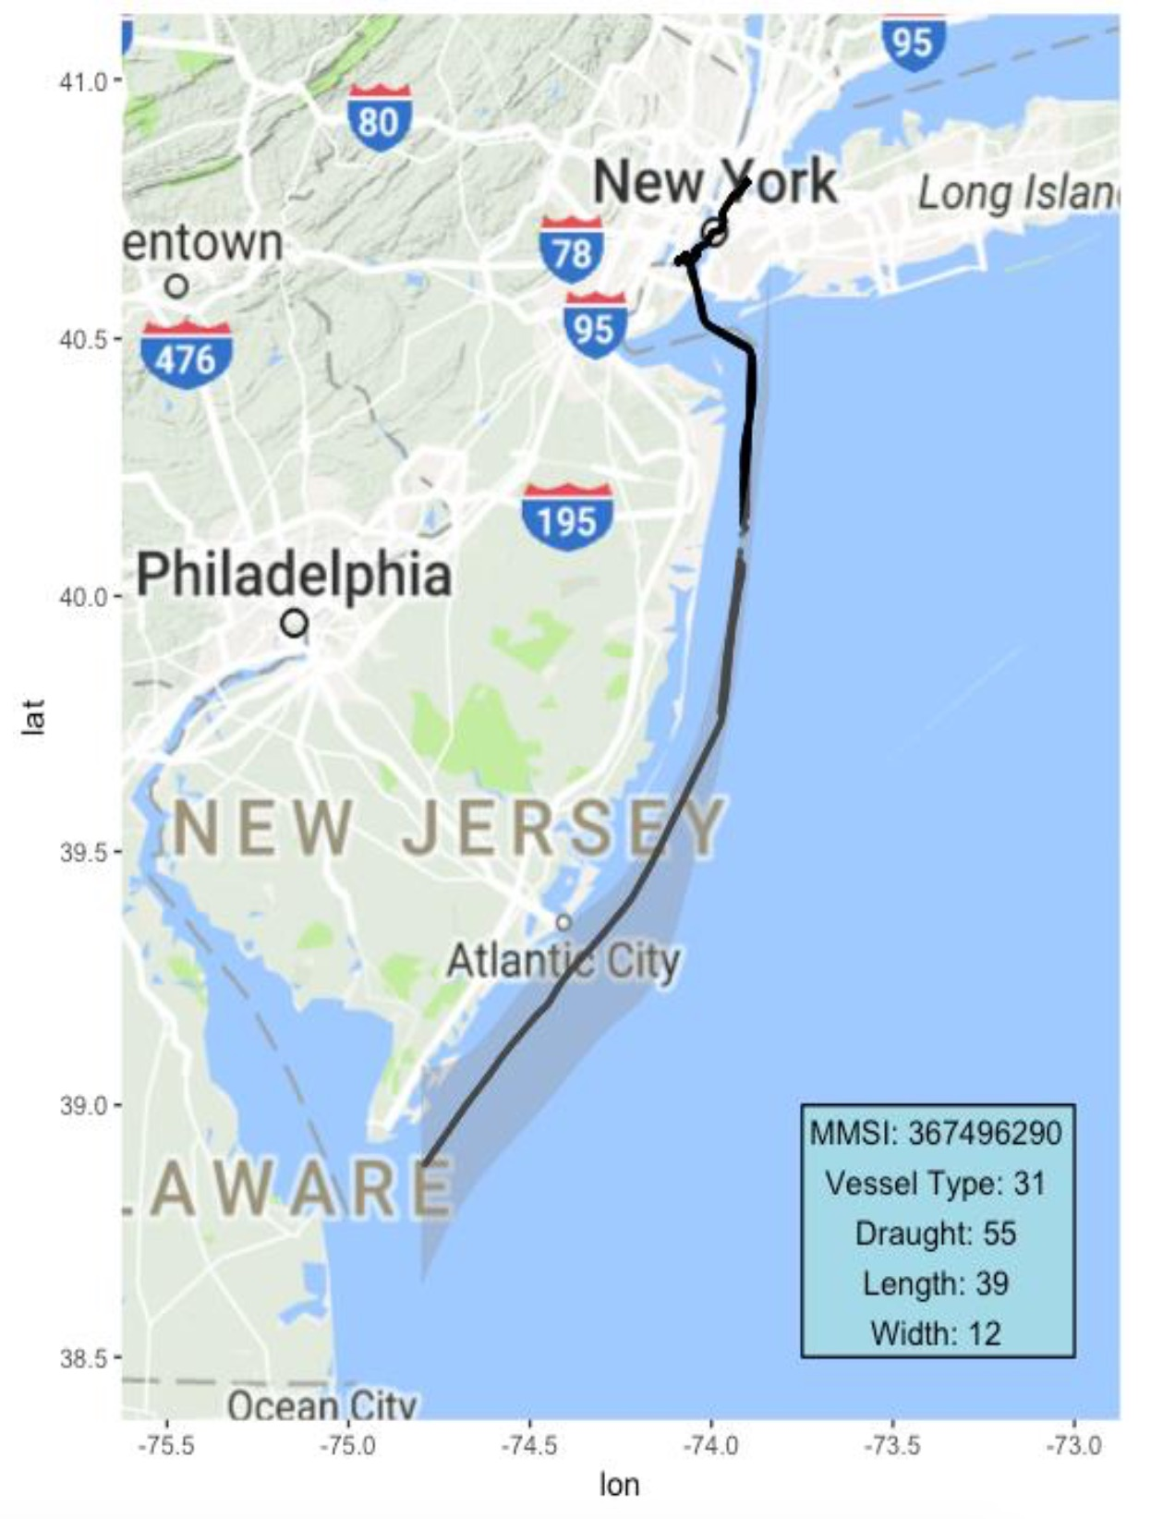
Grouping: Similar Ships
We often try to cluster or group individual entities into subgroups of “similar” entities.
E.g., in personalized medicine and stock price analysis.
Individuals with similar health conditions, stocks of similar companies
This figure shows a partial route of a vessel, obtained from AIS data.
The grey area depicts “normal” routes taken by ”similar” ships.
Obtained from AIS data by our methods of grouping to be defined.
A ship going out of the grey area may indicate a high level of abnormality.

Slide 16
New Tools
What is a good way to group?
With a heterogenous population, conventional methods often cluster/group individual entities into homogeneous subgroups.
Clustering and subgrouping are typically performed a priori.
This has disadvantages:
Forming of subgroups depends on pre-determined number of clusters – a parameter hard to determine.
All analytical outcomes and inferences are identical for all individuals in same subgroup.
In many situations there may not be any clear-cut and well divided subgroup structure in the population.
In these situations, conventional subgroup analysis imposes an artificial grouping structure to the population.
The analysis often leads to large biases and thus invalid inference.

Slide 17
New Tools: i-Group
We have begun to develop a new statistical method, i-Group.
Intended to identify a group of individuals that behave similarly to a target individual.
Enables us to effectively establish baseline (normal) behavior of the target individual.
In terms of a joint distribution of features from “similar” individuals.
In contrast to traditional methods, i-Group focuses on each individual and forms one individualized group for each individual.
By locating individuals that share similar characteristics of the target individual.
This sidesteps the aforementioned difficulties
Forms an i-Group specifically for the target individual
Ignores entities having little in common with the target
Works even if no clear-cut, well divided subgroup structure.

Slide 18
i-Group vs. Clustering
Grouping with a 2-dimensional feature
Clustering is global, i-Group is individualized.

Slide 19
New Tools: i-Group
For maritime traffic monitoring, i-Group is intended to identify a group of vessels that behave similarly to a target individual vessel.
Enables us to effectively establish baseline (normal) behavior of the target vessel.
First, identify key feature groups to be used.
Example below.
Suppose A is a given target vessel.
Let D_{A} be the target’s feature set and D_{k} be the feature set of vessel k.
Let d(.,.) be an appropriate similarity or distance measure between D_{A} and D_{k}.
Look for the i-Group (clique) for A consisting of all vessels k so that
d(D_{A},D_{k}) < T,
where T is a threshold determined by optimizing some criterion.

Slide 20
New Tools: i-Group
In the anomaly application, such a group allows us to establish a baseline behavior for the individualized group with high accuracy and from which to detect anomalies for the target individual.
Customized grouping for a specific individual is not new.
However, our method has a solid theoretical foundation.
Roughly, i-Group methodology is similar to nonparametric estimation in spirit.
Nonparametric estimation can be viewed as a special case of i-Group.
i-Group is different from clustering as it is localized while clustering is a global partition technique.
Preliminary conclusions:
i-Group Learning is robust and effective for handling heterogeneity from diverse sources in big data.
i-Group is parallel in nature and can scale up better for big data than existing competitors.

Slide 21
New Tools: i-Detect
We have also begun to develop an individual detection method i-Detect.
This scores the anomaly (abnormality) of the target individual against the baseline distribution of features obtained from its own i-Group (clique).
The problem is essentially outlier detection.
However, the challenge is that the features under consideration may be complex and of mixed type, and that the features’ importance may not be equal.
A new approach is needed to assess the deviation of an observation from its baseline distribution.
i-Detect aims to do this.

Slide 22
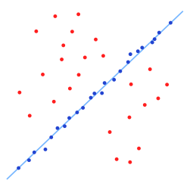
New Tools: i-Detect
i-Detect is based on the idea of “data depth,” extended to complex space, noisy features, and features of unequal importance.
Data depth is a way to measure how deep or central a given point is with respect to an observed multivariate sample or its underlying distribution.
It naturally provides a measure of ”outlyingness”.
Credit: https://en.wikipedia.org/wiki/Random_sample_consensus

Slide 23
Features
We identified the following feature groups by preliminary study and consultation with maritime traffic experts.
Vessel Profile vessel type, dimensions, draught, etc.
Risk Features country of registration, ports visited in the near past, etc.
At-anchor Features AIS indicator, on-land indicator, port indicator, etc.
In-motion Features average speed/acceleration, maximum speed/acceleration, etc.
Functional Voyage Features trajectory of vessel, time series of speed/acceleration, etc.
Dyadic Product Formula Features dyadic parameters of time series of variety of variables.
All these features are divided into two groups:
standard features to be used by i-Group
risk-related features to be used by i-Detect for anomaly detection
In a given application, we will use some of these features.

Slide 24
i-Detect
i-Detect: detect outliers based on a vessel’s own individualized baseline distribution
Many possible outlier detection rules:
1.5 inter-quantile rule: detect outliers based on empirical quantiles
two/three standard deviation rule: detect outliers lying more than two/three s.d. away from the mean
parametric distribution based quantile rule: detect outliers by estimated quantile from a parametric distribution model
multiple hypothesis testing procedures: detect outliers that can reject a corresponding hypothesis testing
data depth: detect outliers that are far away from the data center

Slide 25
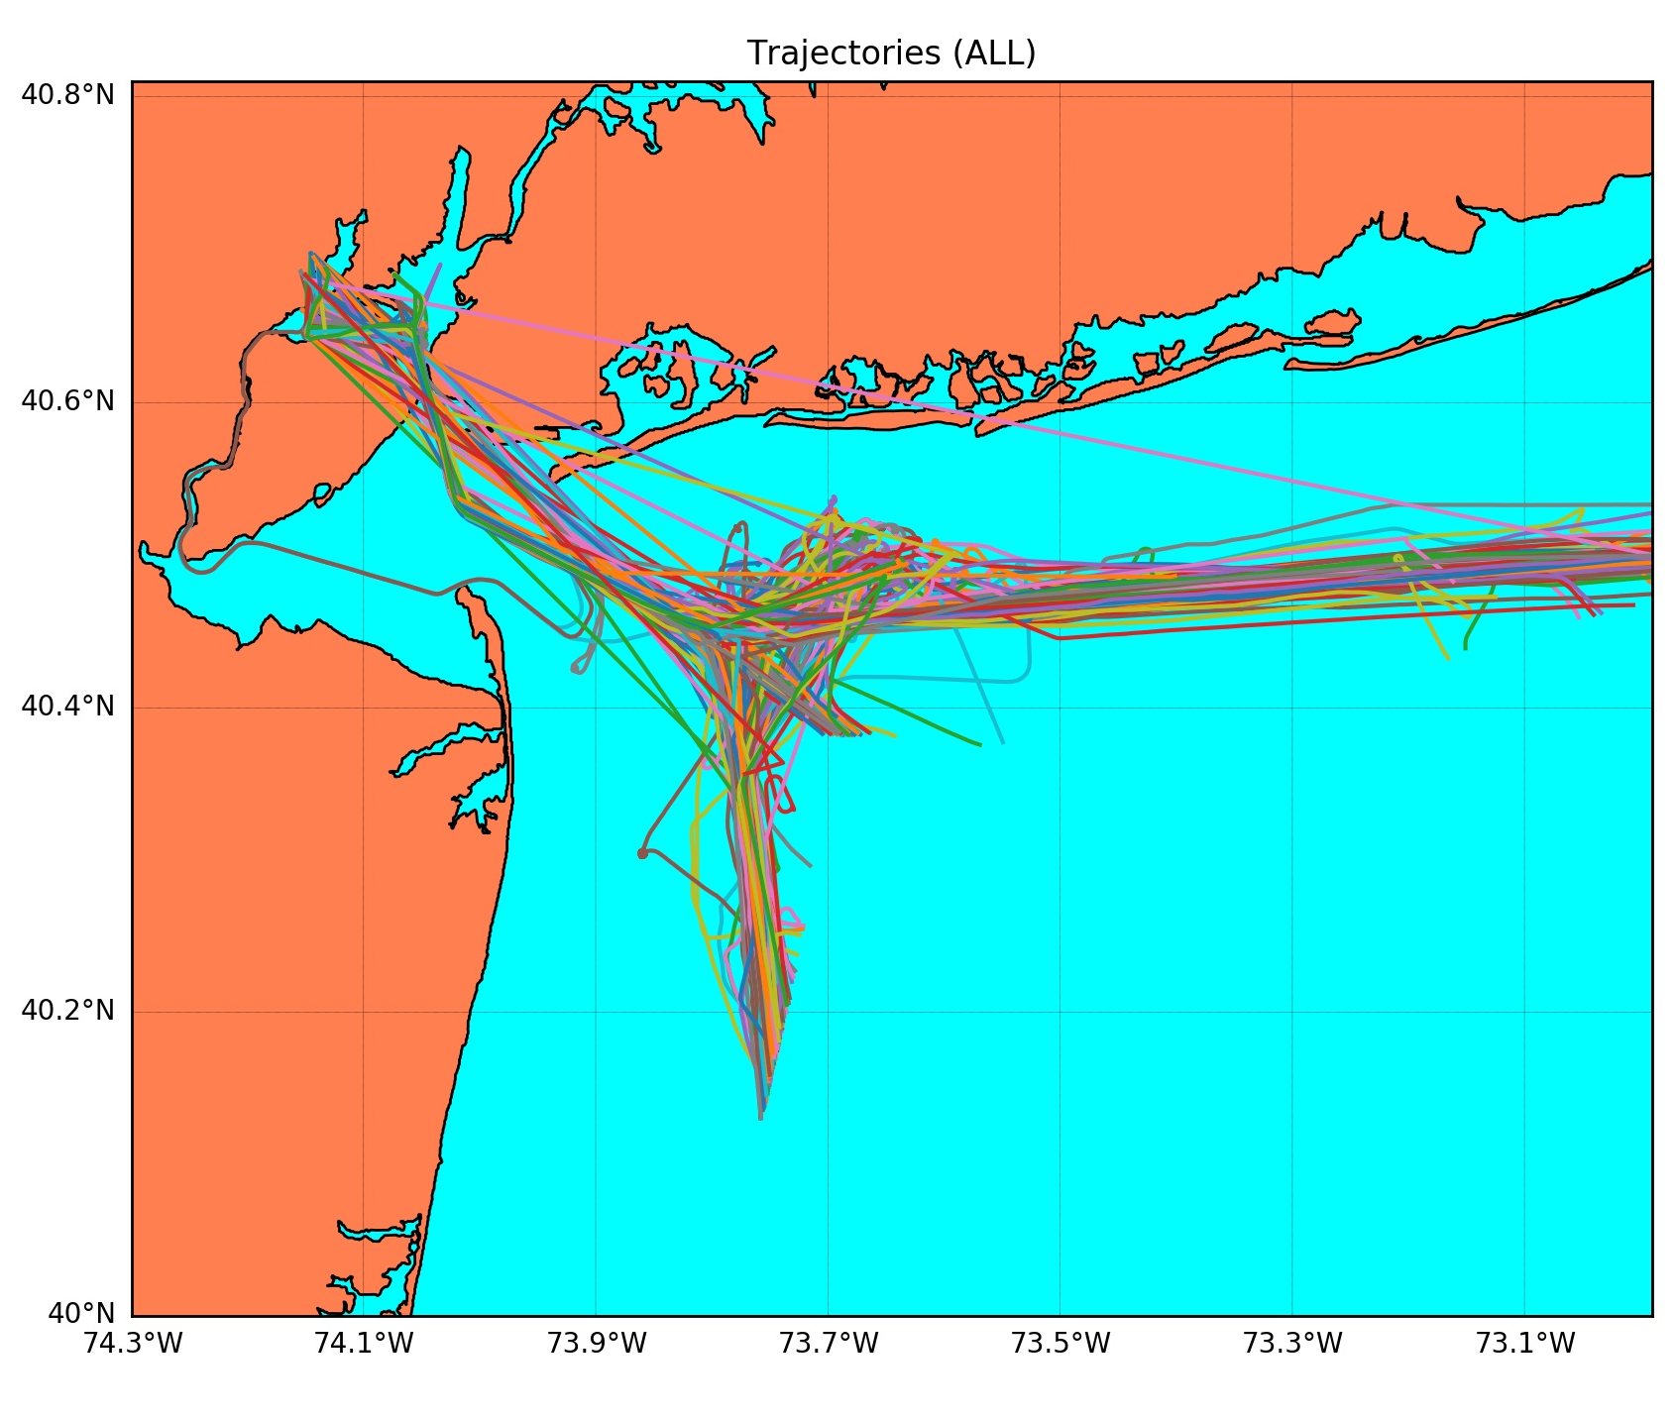
Case Study
We focused on AIS data for 534 vessels/voyages (tankers, cargo vessels) arriving in Port of Newark between July and November 2014
Investigated behaviors starting from crossing the 12 nautical mile US territorial sea (TS) boundary to arrival
The trajectory, a functional feature, was used as the standard feature for i-Group
The trajectory is a time series of GPS locations
Thanks to David Nichols, Esq.,
Captain, USCG, ret. for suggesting
this application.

Slide 26
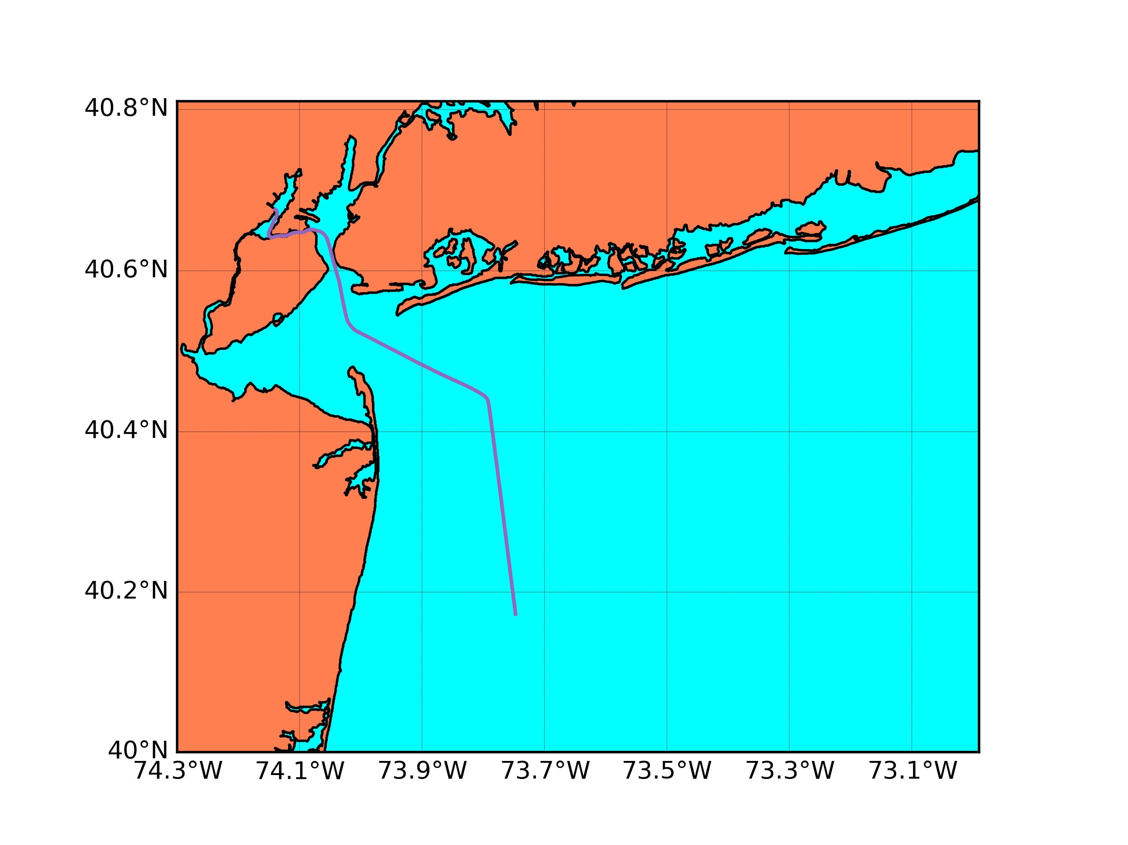
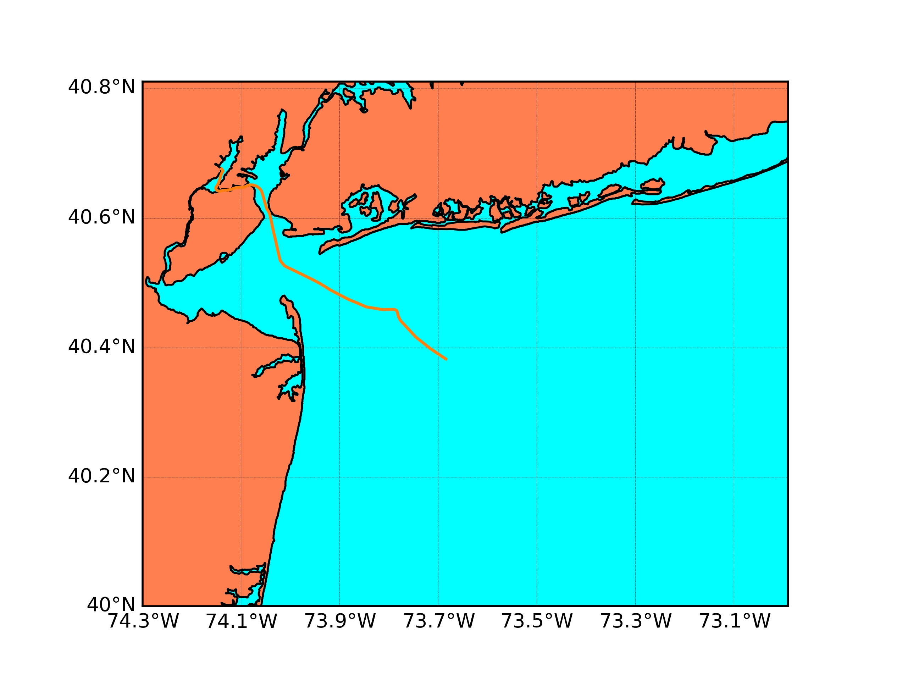
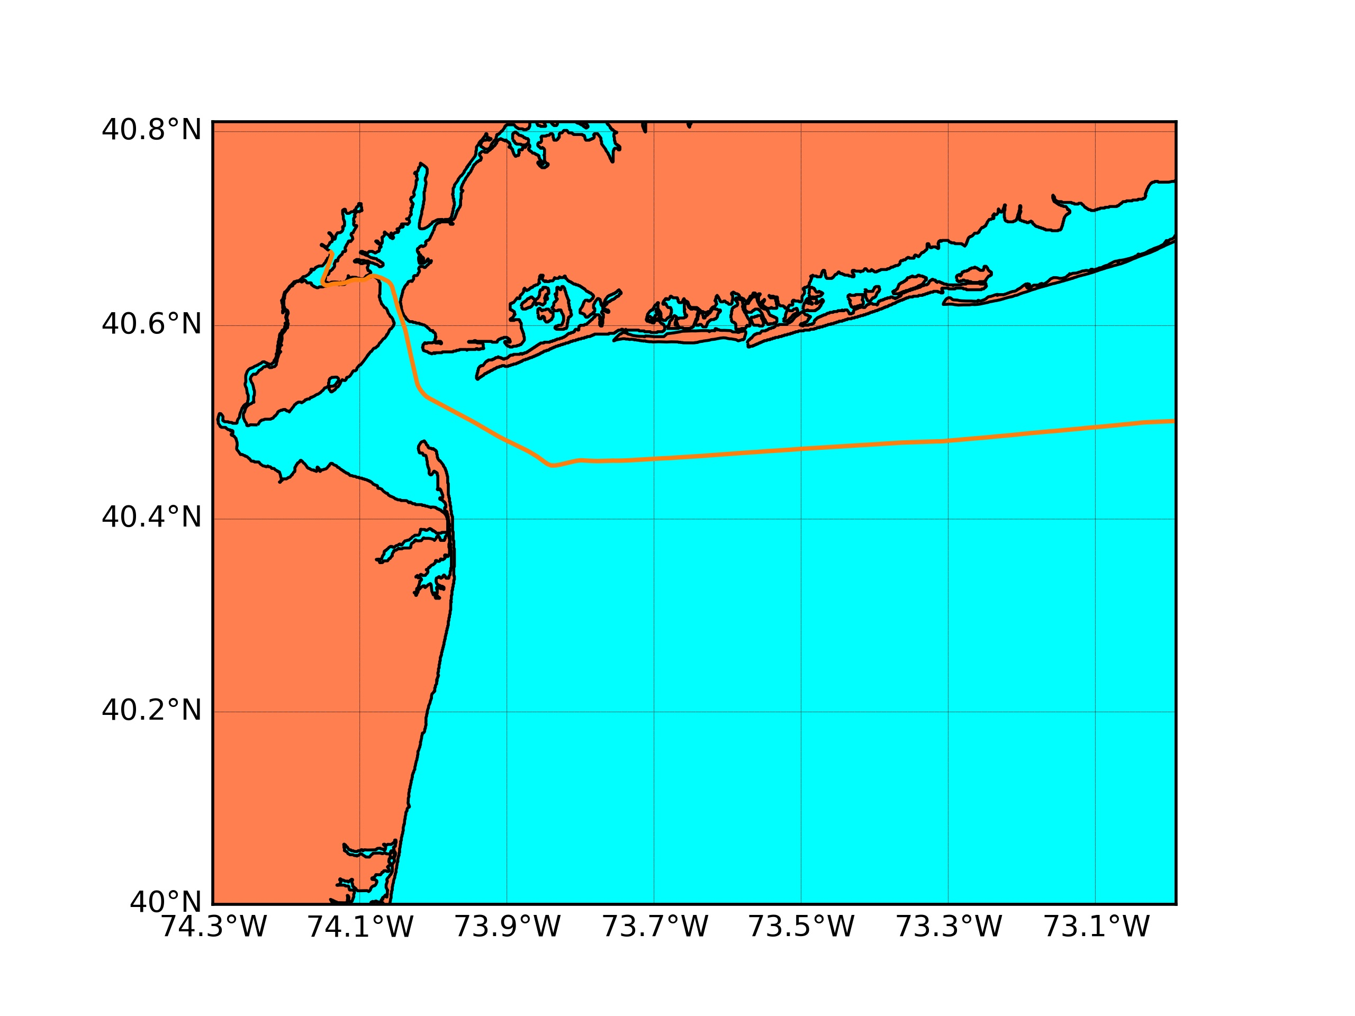
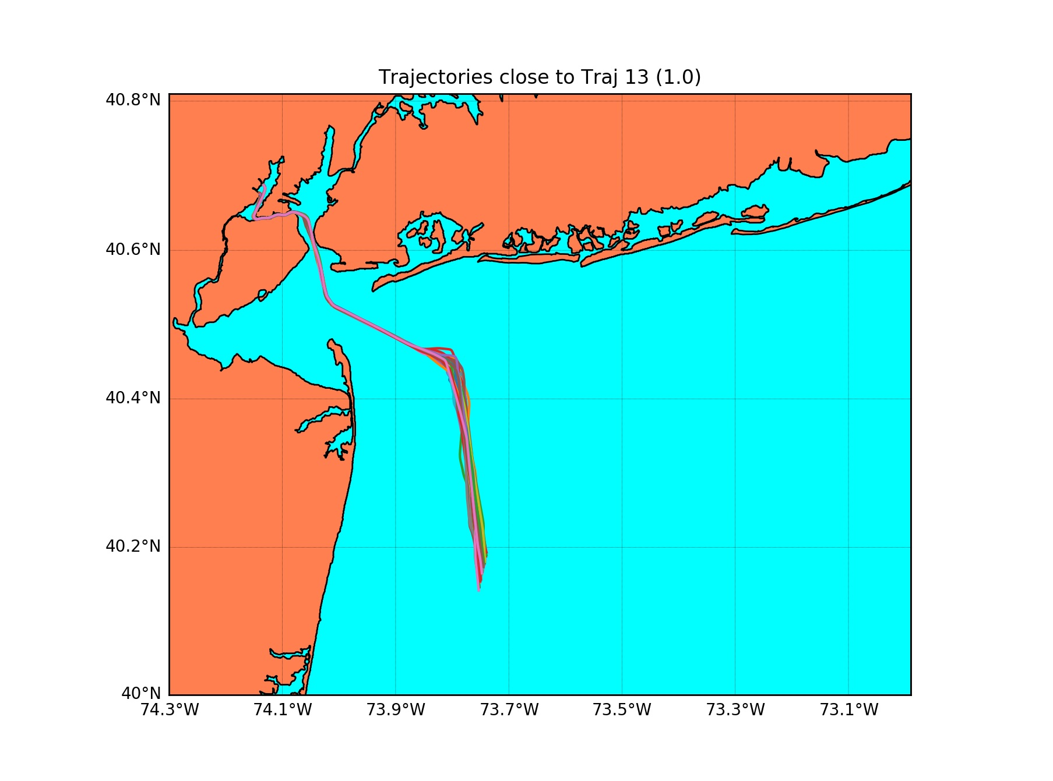
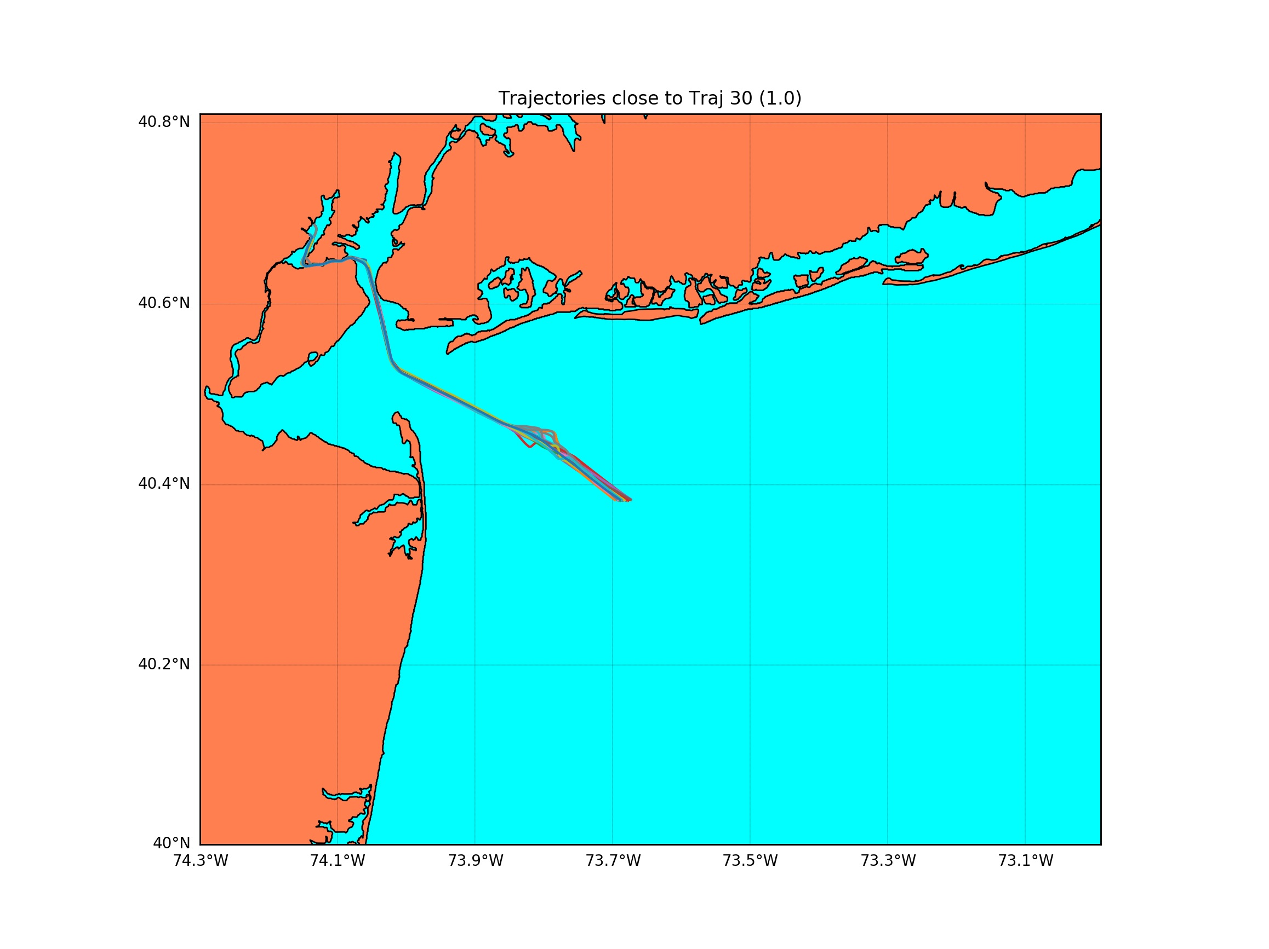
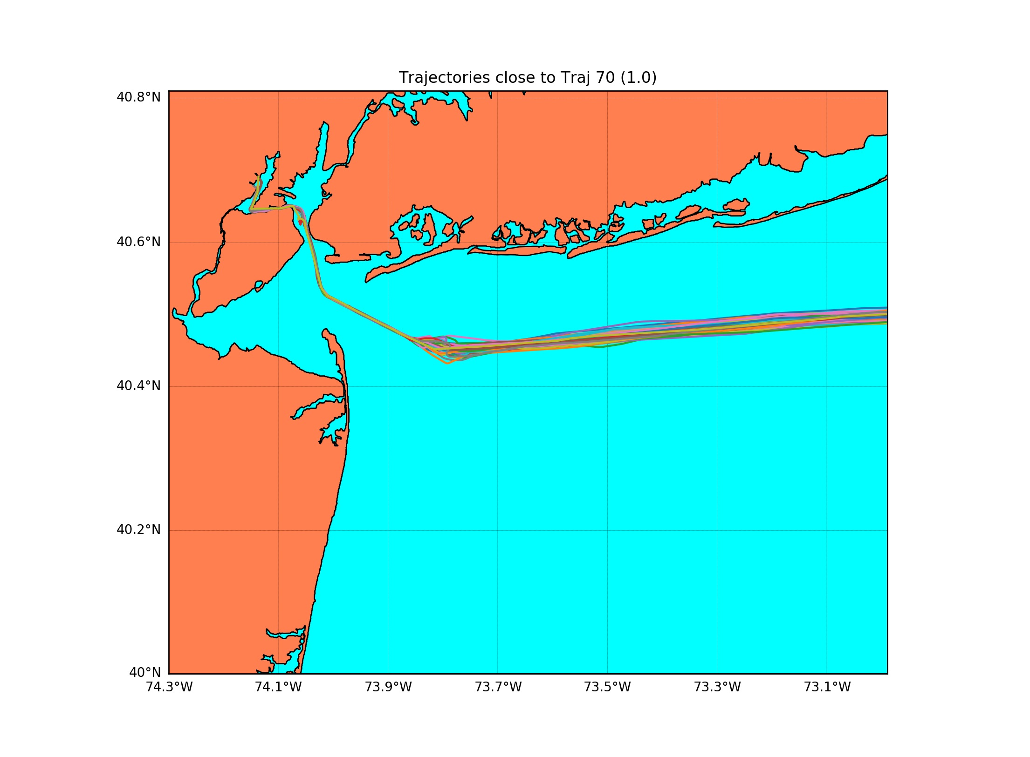
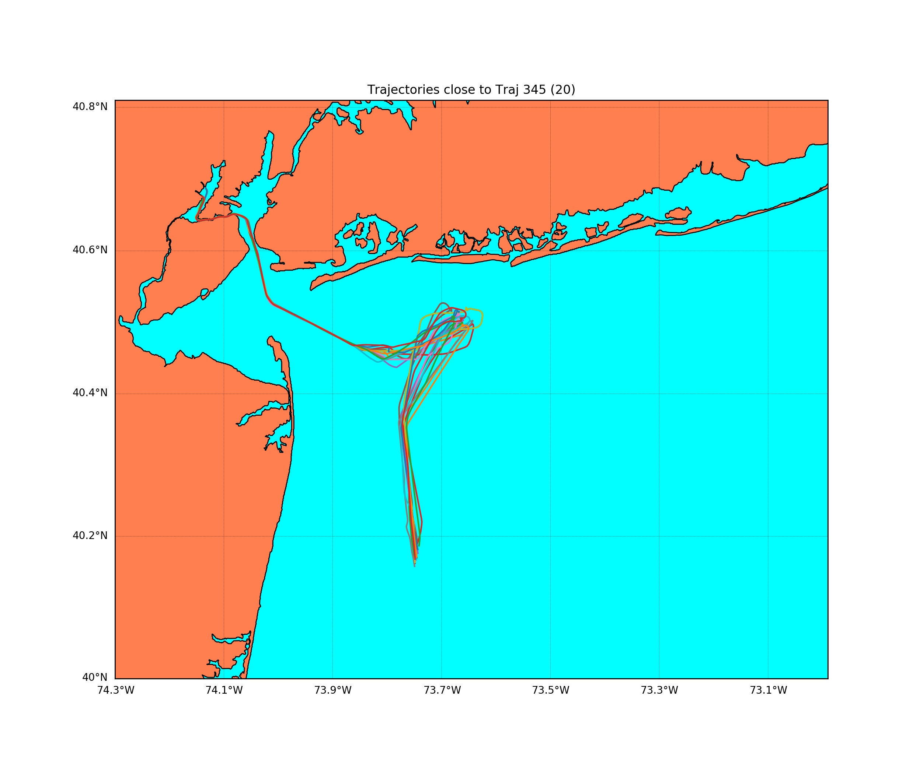
Case Study: i-Group
To define the i-Group, we defined the distance between trajectories to be the dynamic time warping distance (DTW), which finds an optimal match between two time series
The following figures demonstrate the cliques found by i-Group for 4 selected vessels/voyages. (Top is vessel trajectory, bottom is set of trajectories in its i-Group.)

Slide 27
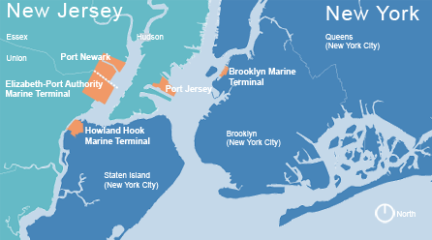
Case Study: i-Detect
Looked for outliers in duration (time spent from TS boundary to port), i.e., vessels that have abnormal time duration (from territorial sea boundary to Port) compared to vessels in their i-Group (vessels with similar trajectory).
Outliers were detected by the two standard deviation rule: Vessels in a clique with time duration at least two s.d. from the group mean.
Credit: Port Authority of
New York & New Jersey

Slide 28
Case Study: i-Detect
95 detected outliers:
(a) 50 vessels had a prior dock before the Port of Newark (left);
(b) 18 vessels were anchored somewhere outside the port for an extremely long time (middle);
(c) the other 27 vessels were traveling too fast/slow compared with their cliques (right)
(One example of each is shown.)

Slide 29
Case Study: i-Detect
Our algorithm can be completed in O(K²T) time, where
K = 534 is number of trajectories
T ~ 200 is average number of time stamps in the DTW algorithms to calculate distance between trajectories.
On a 6-core machine, the algorithm took about 26 minutes to do the grouping and detect the outliers.
With a single thread, one could guess the time might rise to something like 2.5 hours.

Slide 30
Some Research Challenges
Data quality: Part of AIS data is incomplete, unreliable or deliberately misleading
Handling functional data: Treatment of functional data is significantly different from numerical values. Extracting useful features from functional data is generally difficult. (E.g., trajectory is a function.)
Dimension reduction: It is challenging to select from such a large number of features an efficient small subset that could be collected or derived from our data sets

Slide 31
Future Work in Our Research: Partial List
Broaden the feature sets by including more geological information, vessel history, etc.
Extend the current results to a high-dimensional features case
Investigate theoretical properties of i-Group and i-Detect
Develop an individualized feature selection scheme
Develop an online system that enables online-updating of features and online outlier detection

Slide 32
Future Work in Our Research: Partial List
Look at other features or feature combinations for i-Group, e.g.:
Vessel type (tanker, container ship, etc.)
Type of cargo (oil, fertilizer, etc.)
Size of vessel
Anomalous behavior for one type of vessel with one type of cargo or one size of vessel may not be anomalous for another.
E.g., port only has a few docks for really large vessels, so might be long delays to dock
E.g., port gets many petrochemical tankers, so many wait in anchorage for a long time
Consider the effect of last port visited (or last 5 ports)
Consider effect of seasonality
E.g., behavior of tankers delivering heating oil in the Northeast

Slide 33
Research Team
PI Rong Chen Department of Statistics and Biostatistics Rutgers University
Co-PI Minge Xie Department of Statistics and Biostatistics Rutgers University
Co–PI Fred Roberts Department of Mathematics, Director of CCICADA Center, founded as a DHS University Center of Excellence Rutgers University
Consultant David Nichols Retired USCG Captain
Chencheng Cai, Xiaoyun Li, Alexander Liu, Chang Liu
Student Researchers
Work supported by NSF grant DMS-1737857

Slide 34
Questions
For more information:
Fred Roberts
froberts@dimacs.rutgers.edu
CCICADA Center
www.ccicada.org

